Slide 1
Transiting Exoplanet and Variable Star Photometry
with the NKU 14-inch Telescope
David Dodge and Nathan De Lee
Department of Physics, Geology, and Engineering Technology

Slide 2
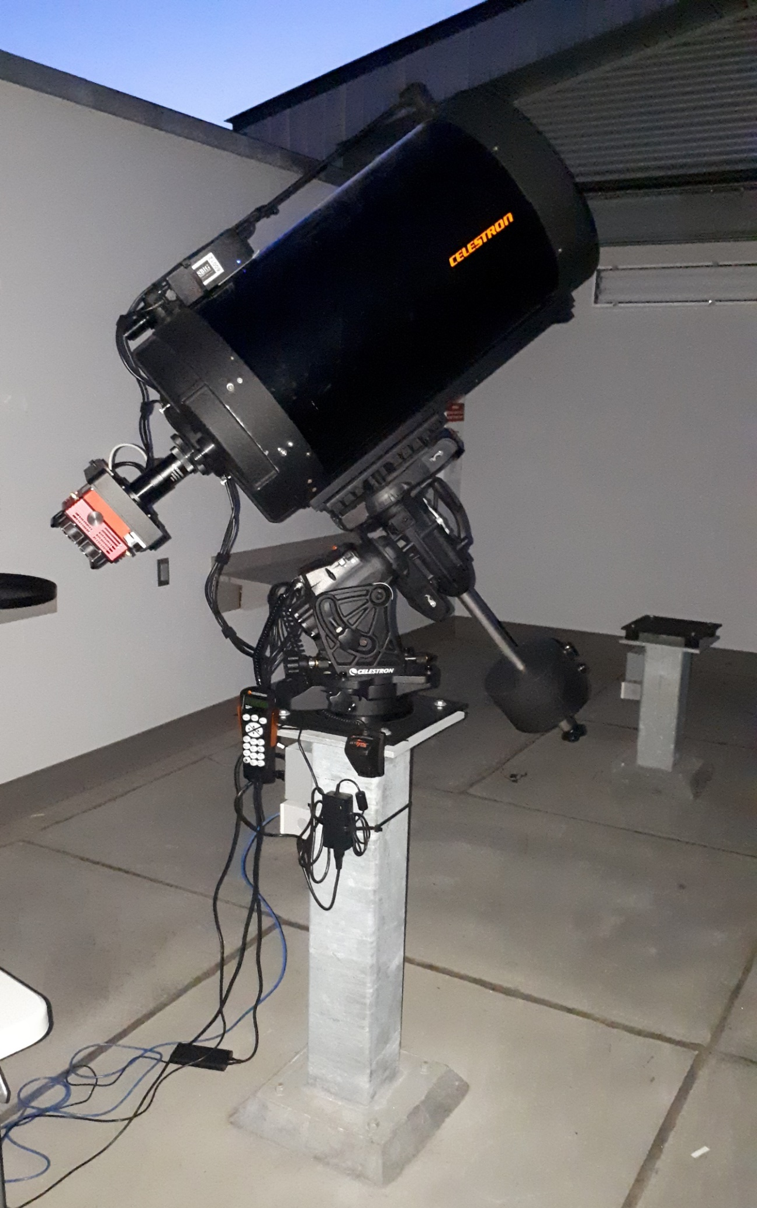
Instrumentation
Hardware
14in (355mm) Schmidt-Cassegrain Optical Tube
German Equatorial Mount
SBIG STT-3200ME CCD with Autoguiding
Johnson Filter Set (U,B,V,Rc,I)
Software
MaxImDL
CPWI
AstroImageJ
Python (Astropy, photutils)
ESO
Notes:
Overview of hardware and software setup

Slide 3
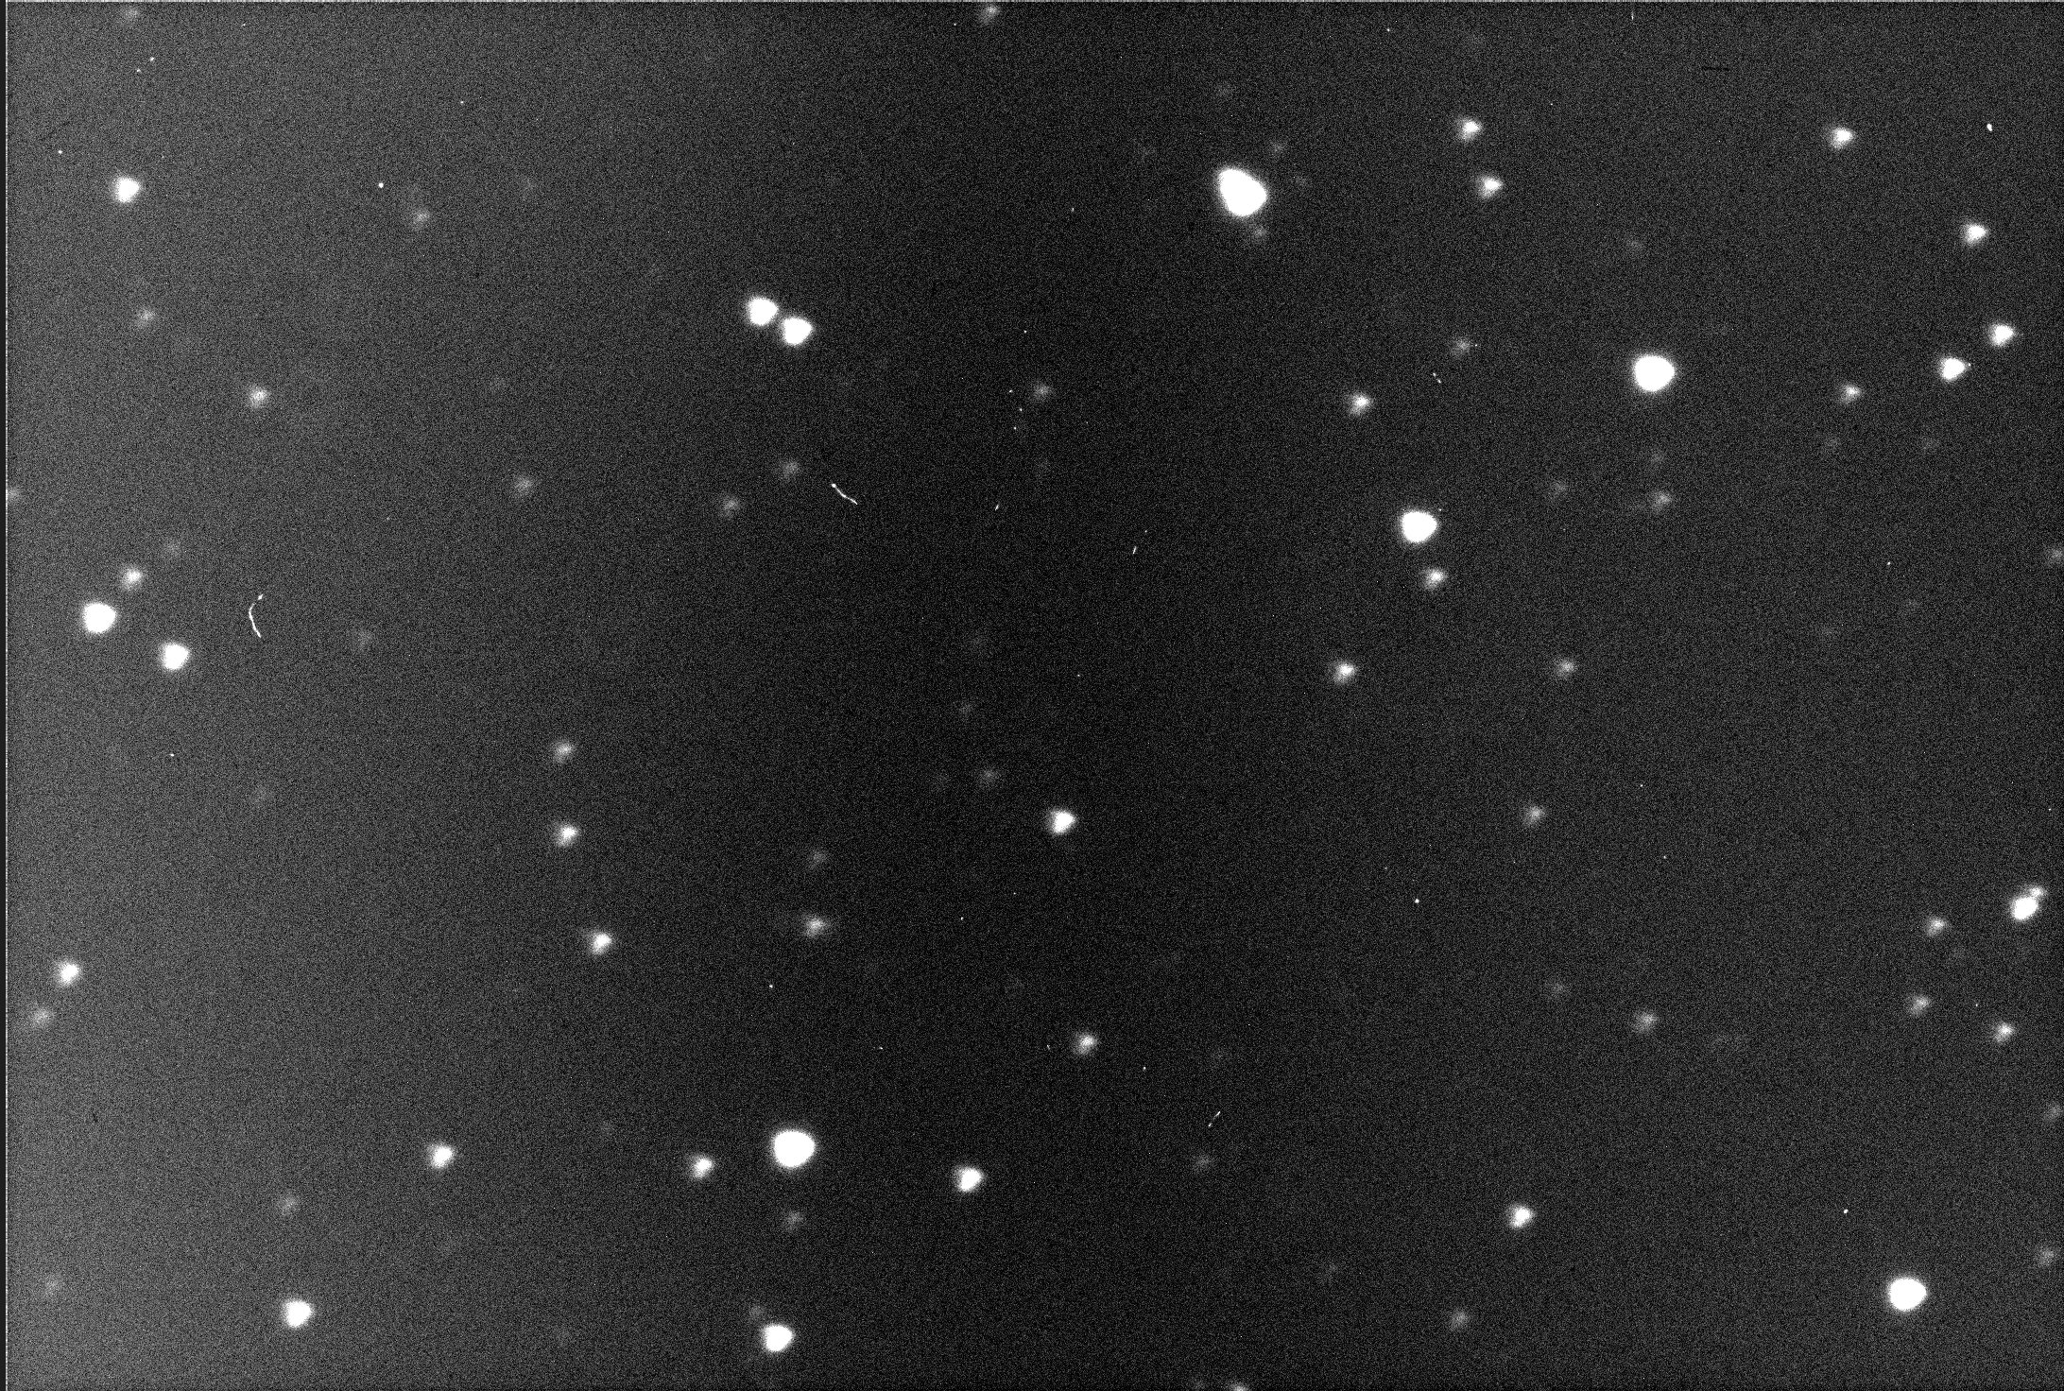
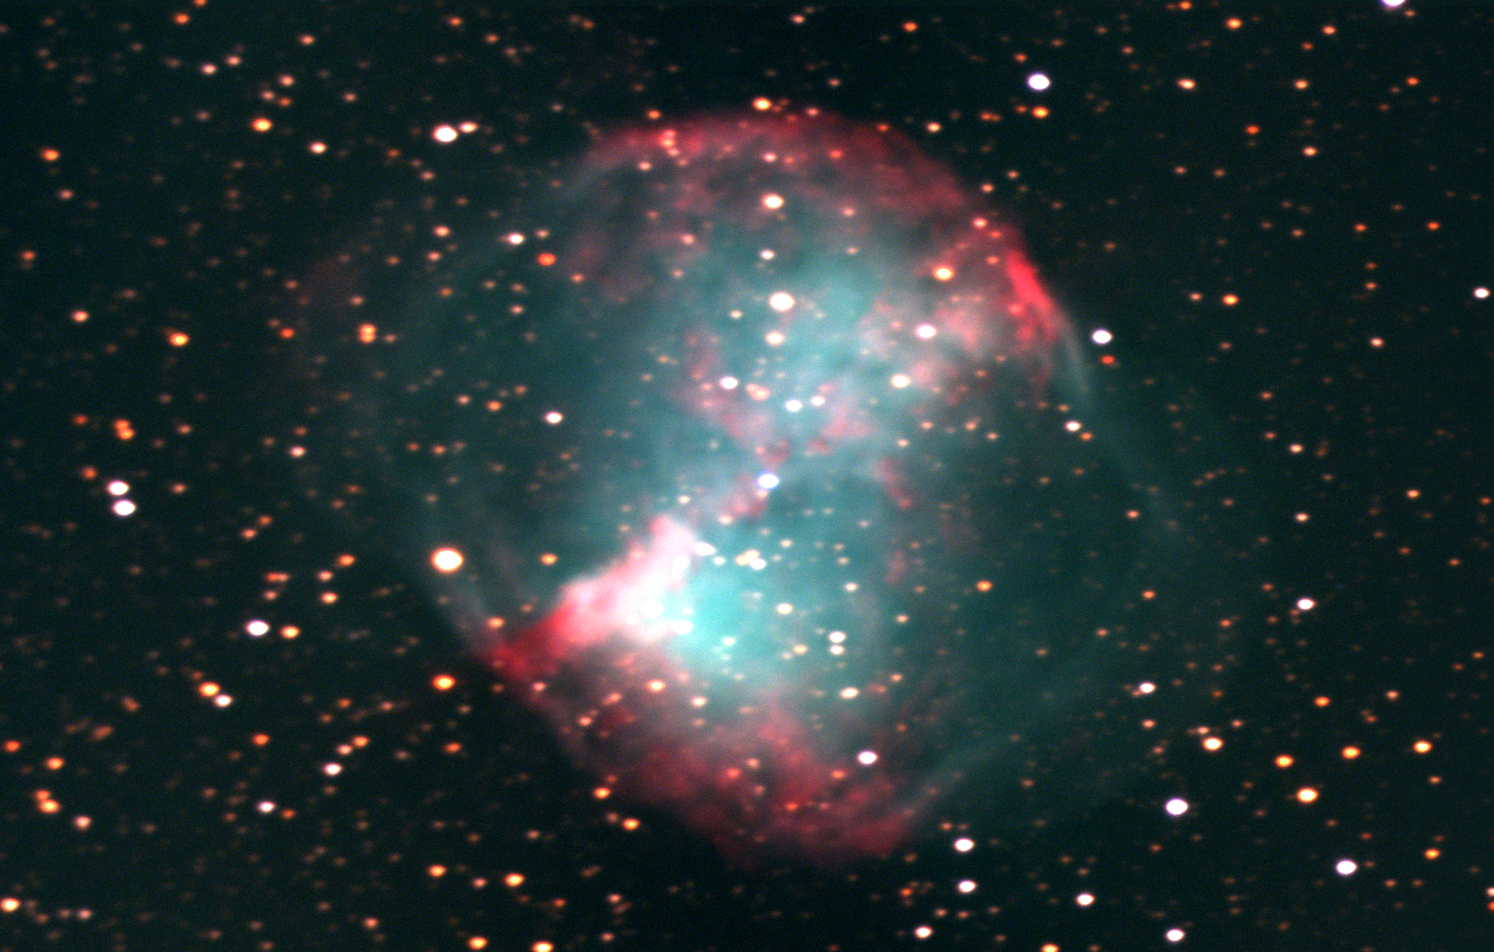
Example Images
ESO
Notes:
Example raw data frame from camera and processed color image of M27 Dumbbell Nebula for comparison

Slide 4
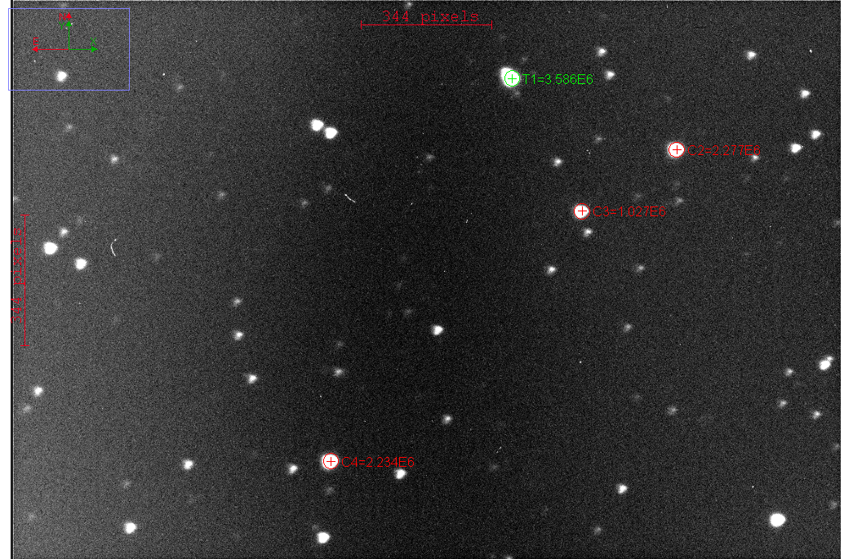
Variable Object Tracking
ESO
Notes:
Overview of method for locating and taking data on an exoplanet transit, HAT-P-20b is shown in the example data frame

Slide 5
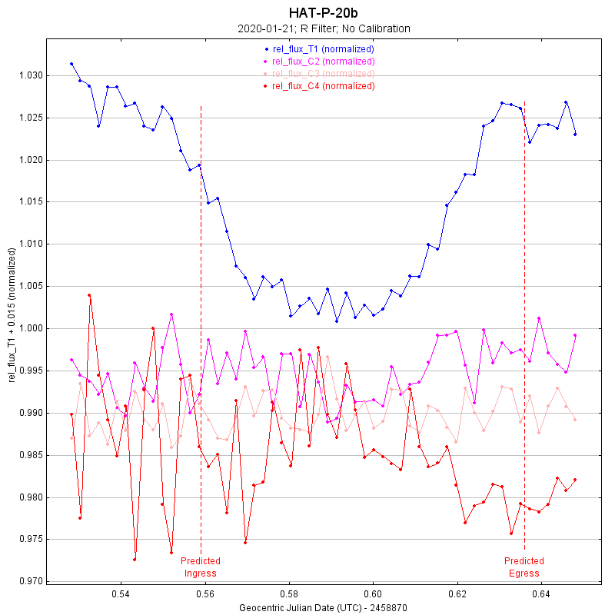
Data Processing of Variable Objects
ESO
Notes:
Quick example of how the graphs are generated from multiple data frames

Slide 6
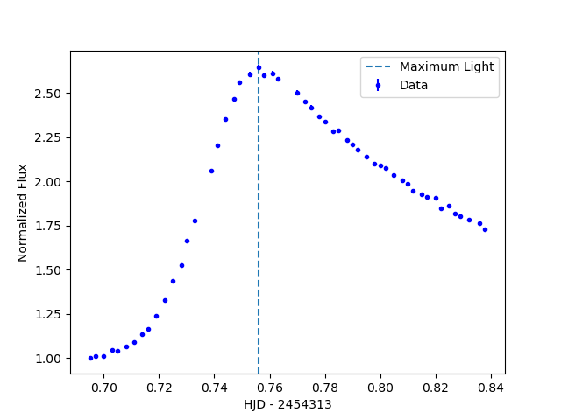
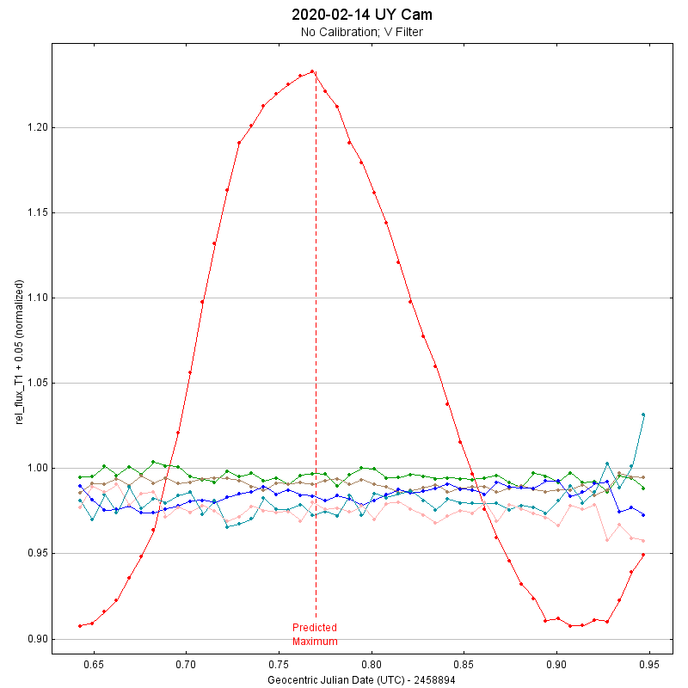
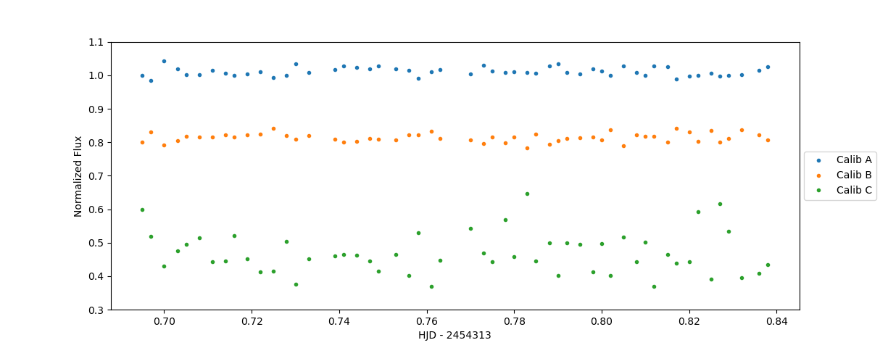
Custom Data Processing Pipeline
Reproducible methods & results
Further understanding of processing techniques
Construct application-specific pipelines
Increase potential for automation
Utilized Python to recreate plot style of AstroImageJ
ESO
Notes:
Outline of reasons for constructing a custom pipeline with Python

Slide 7
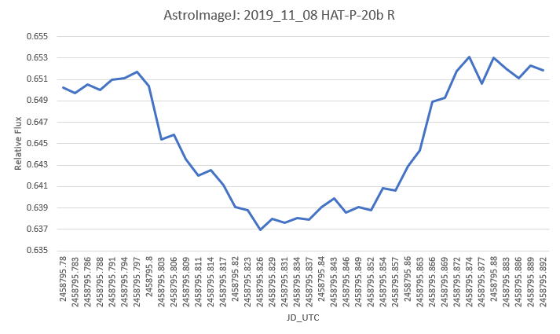
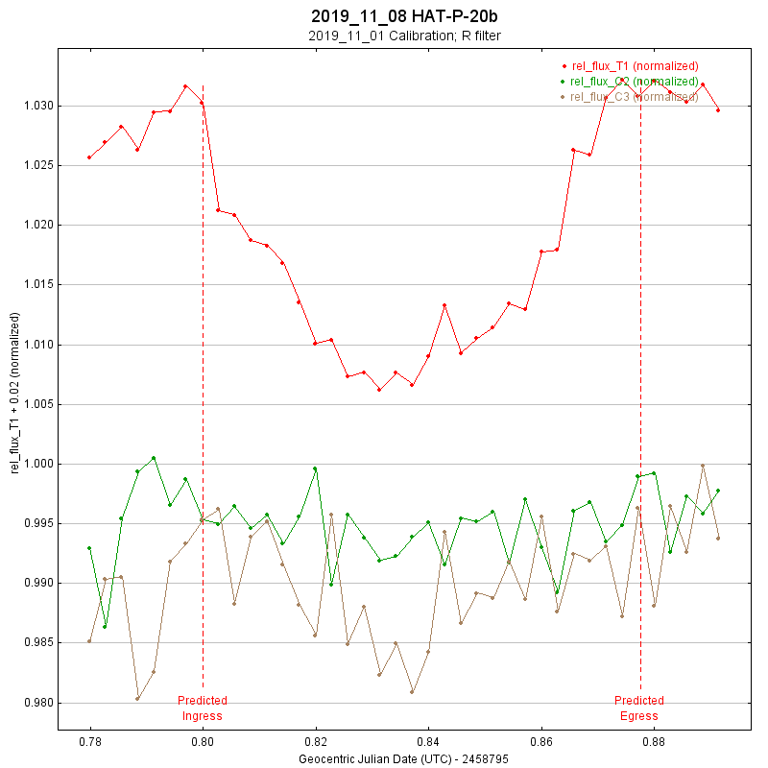
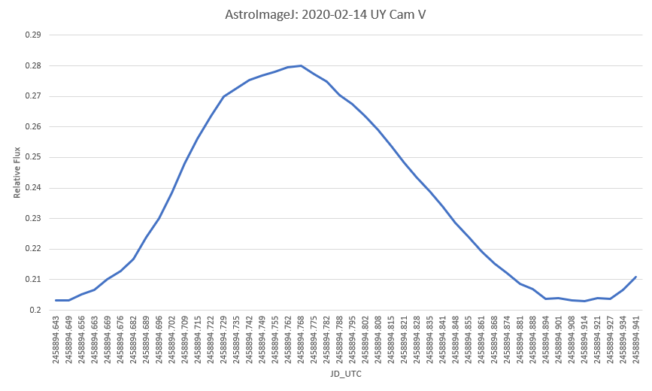
Processing Techniques
Exoplanet Transit
Variable Star
ESO
Notes:
Comparison of AstroImageJ output vs Python script output on 2 variable objects, graphs will be made in Excel to simplify visual comparison

Slide 8
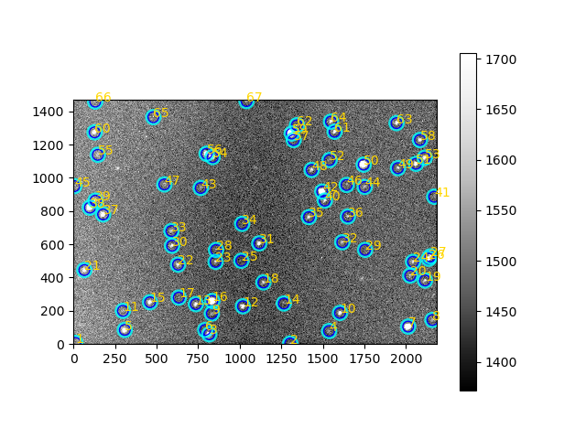
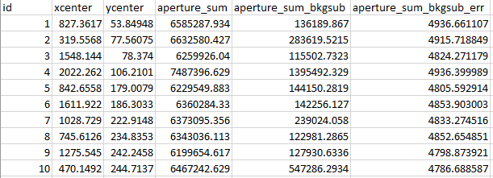
Next Steps
ESO
Notes:
Comparison of AstroImageJ output vs Python script output on 2 variable objects, graphs will be made in Excel to simplify visual comparison

Slide 9
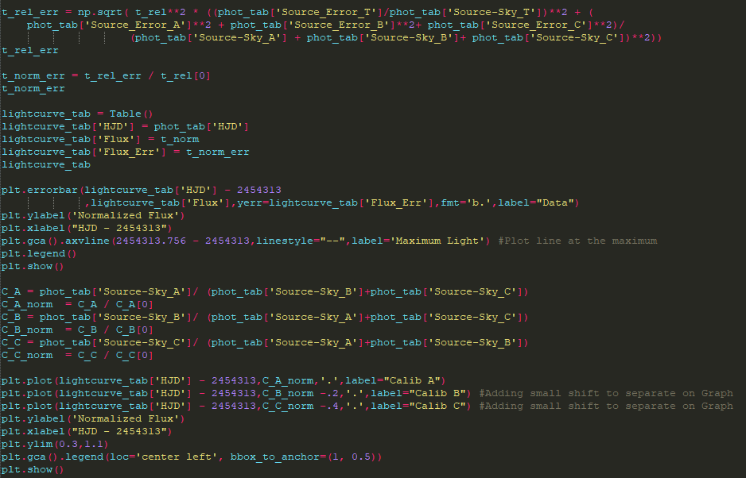
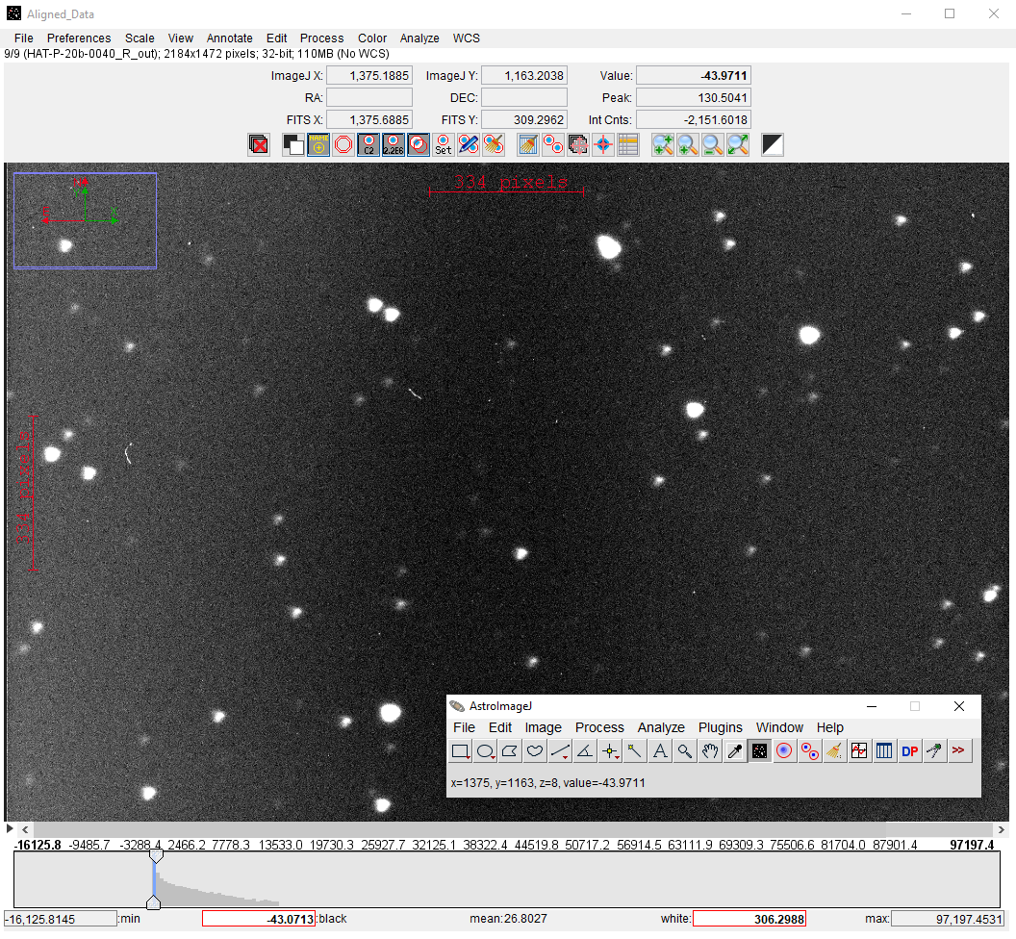
Future Work
Account for all differences between AstroImageJ and Python script results
Integrate Centroiding and image alignment into Python processing technique
Construct fully automated data processing pipeline with Python
ESO
Notes:
Recap of presentation & outline of goals for future work. Excerpt from Python processing script and AstroImageJ window are shown.

Slide 10
References & Acknowledgements
Collins, K. A., Kielkopf, J. F., Stassun, K. G., et al. 2017, AJ, 153, 77
Jensen, E. 2013, Tapir: A web interface for transit/eclipse observability, ascl:1306.007
This material is based upon work supported by the National Science Foundation under Grant No. 1616684
ESO
Notes:
References slide, end of presentation

