Slide 1
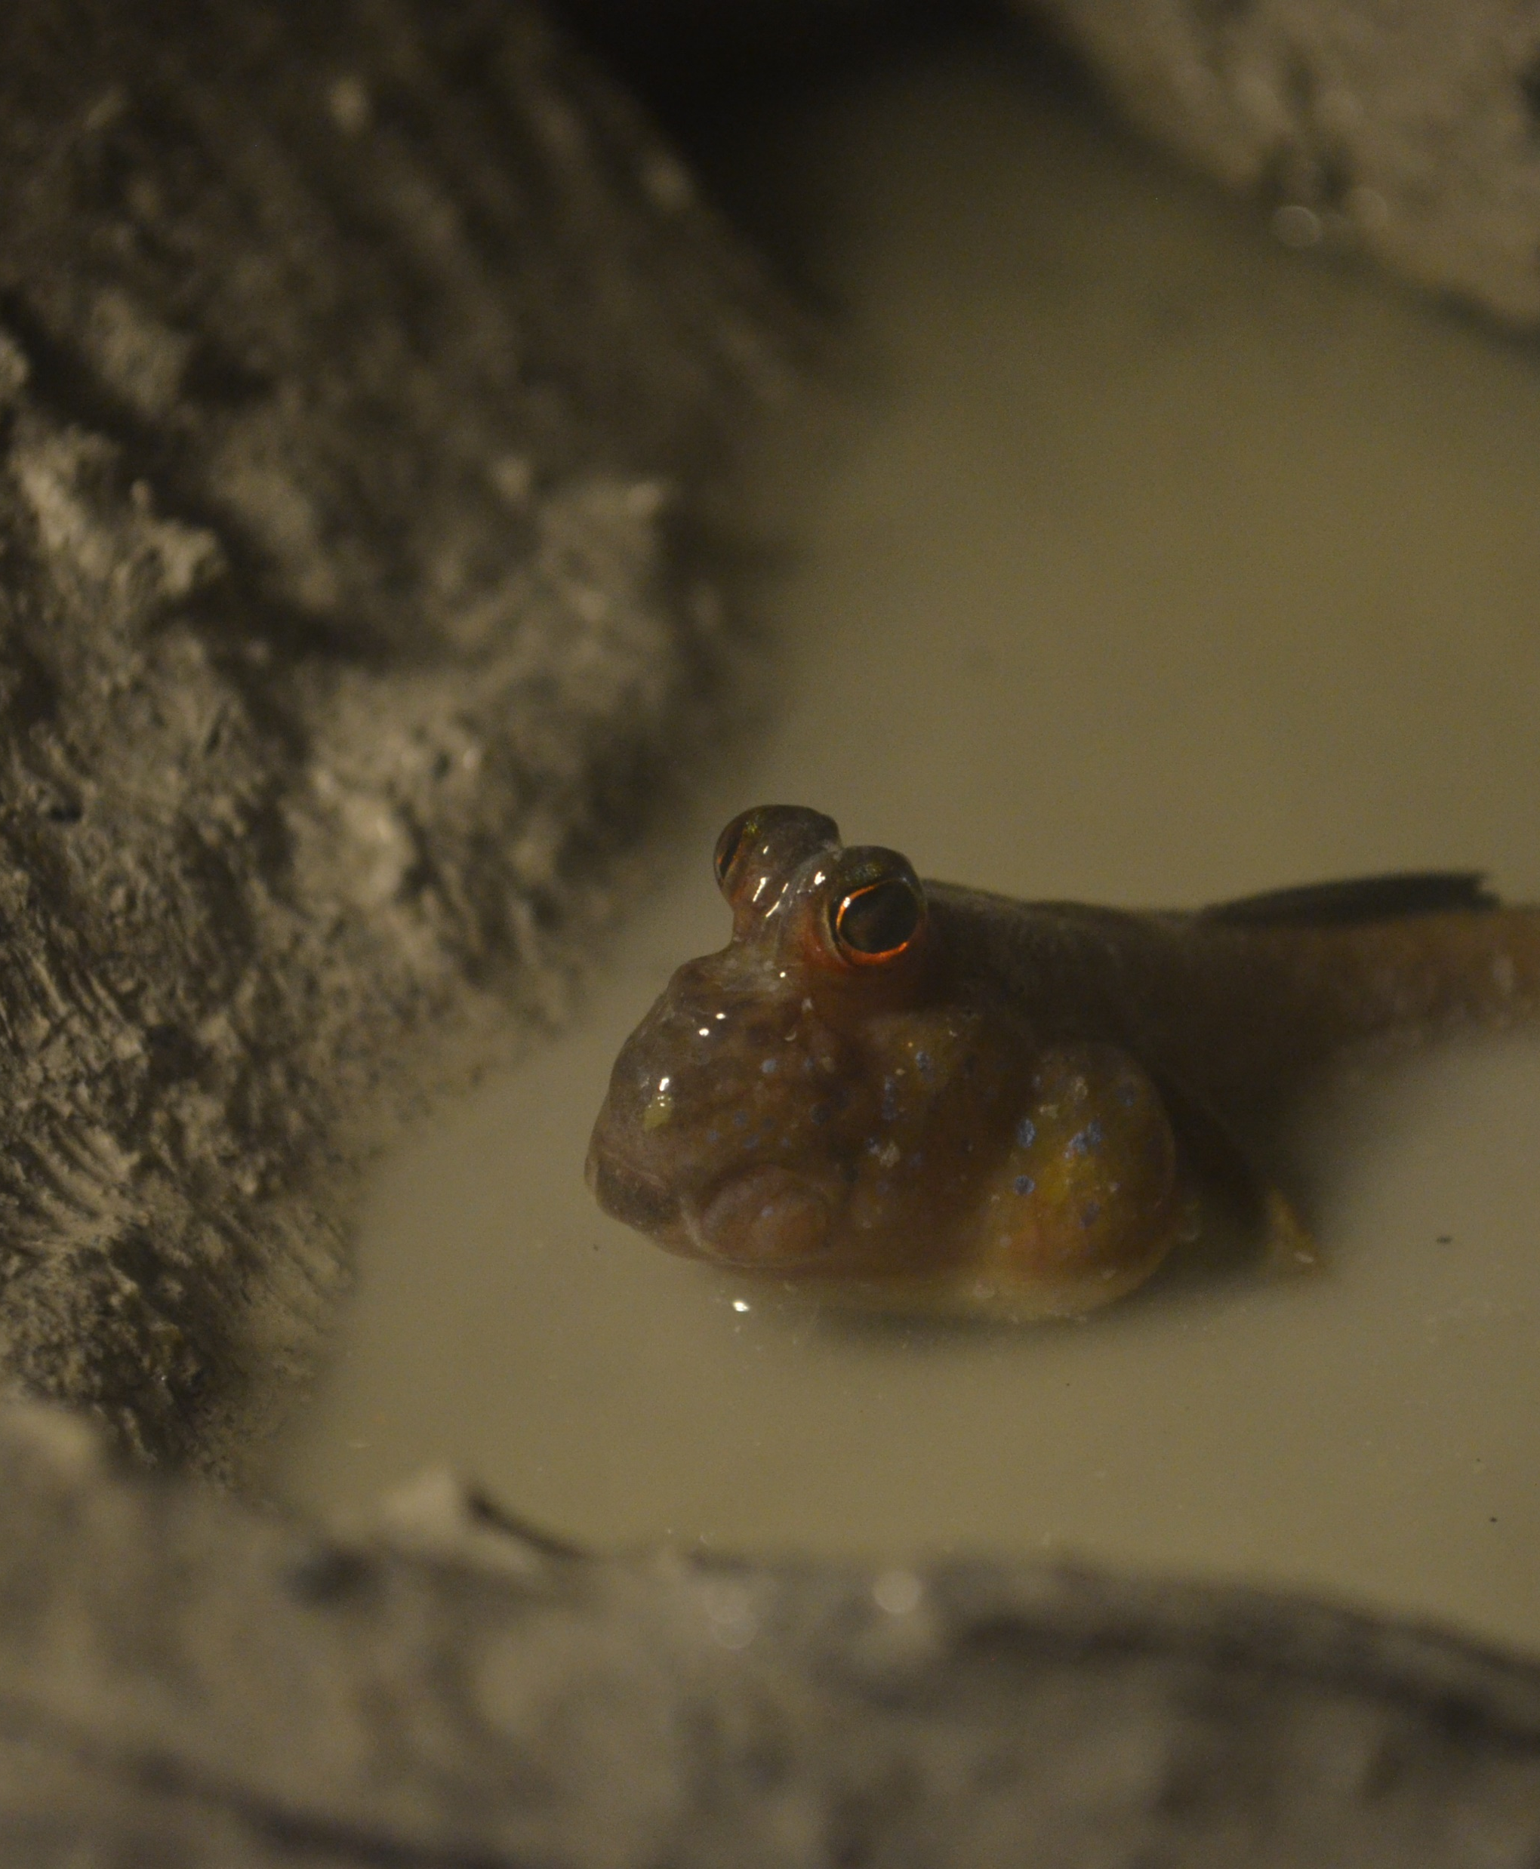
Vibrational communication in the Atlantic mudskipper, Periopthalmus barbarus
Seth Hoffman, Michael E. Smith, Gianluca Polgar
Western Kentucky University

Slide 2
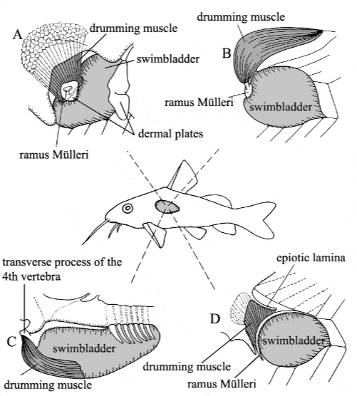
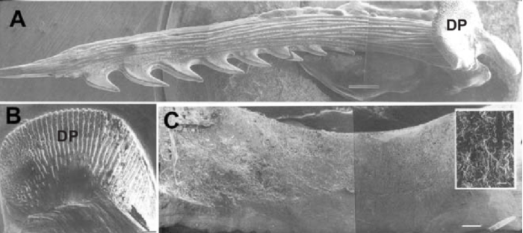
Introduction
Acoustic communication common in many teleost fish species.
Sound production in fishes accomplished in a variety of mechanisms.
Scanning electron micrographs of modified pectoral spine of the channel catfish Ictalurus punctatus used for sound production. (Paramentier & Diogo 2006)
Swim bladder vibrational mechanisms of catfish (Ladich et al. 2006)

Slide 3
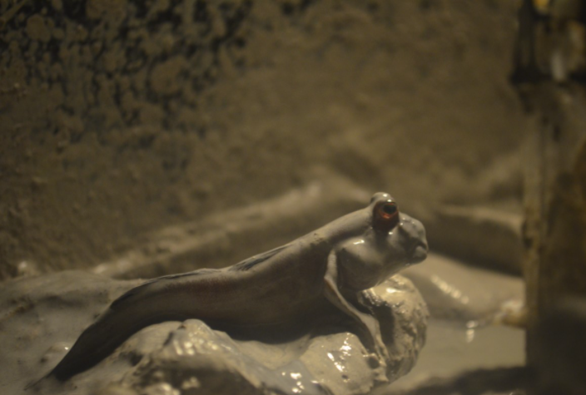
Introduction
Gobiidae family known to use acoustic communication underwater.
The mudskipper Periopthalmodon septemradiatus communicates via vibrations while out of the water (Polgar et al. 2011).
Context and mechanism of vibrational communication of Periopthalmus barbarus is unknown.

Slide 4
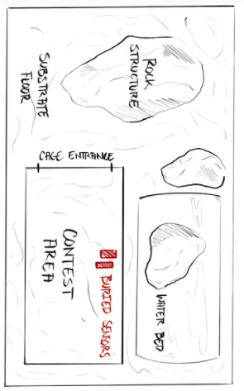
Methods: Experimental Set-up
Over-head layout of experimental tank.
Experimental tank for dyadic contest recordings
Dyadic interactions and contests produce recordable sounds for contextual analysis.

Slide 5
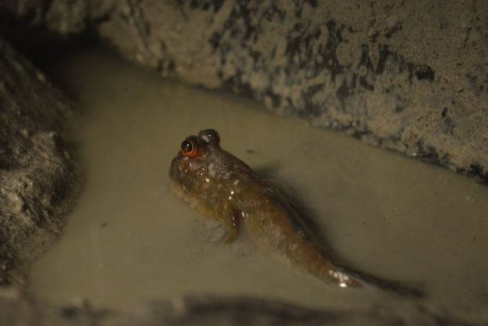
Methods: Data Collection
Total length, standard length, mass, and sex of 11 fish was recorded.
A fish was acclimated in tank for at least 3 days in tank (resident).
Then, another fish was added to the cage within the tank (intruder) and the interaction was video recorded while accelerometers measured vibration in the mud.
Each of the 12 fish was given an opportunity to interact as an intruder and resident.
Both sexes were used (7 males, 5 females) and size varied from 5.9 To 13.0cm. TL.

Slide 6
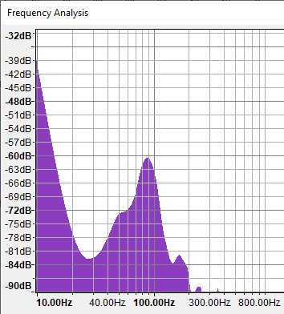
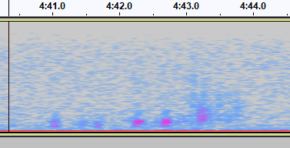
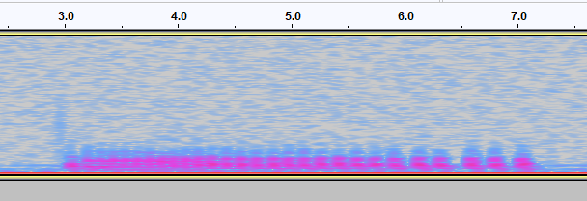
Methods: Bioacoustic analysis
Each recorded call was analyzed and organized into call type, frequency, and behavioral context.
Call signals were exported as .wav files and importing into Audacity.
Peak frequency and duration of each call were recorded.
Three call types were found: grunts, pulse trains, and tones.
Spectrogram of a pulse train
Spectrogram of a grunt
Peak Frequency plot of a grunt.

Slide 7
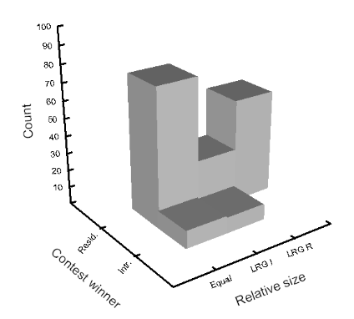
Contest Results: Size and role context
Residents almost always won contests and made a majority of the calls.
Large resident never beaten by intruder.
Intruders only won and made calls at equal or larger size relative to resident.

Slide 8
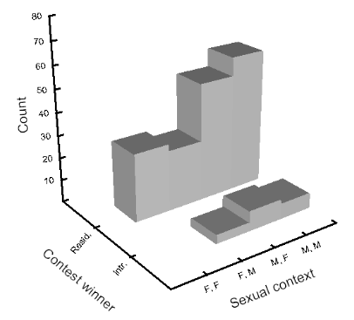
Contest Results: Sex
Winners were of all combinations:
Male/Female, Resident/Intruder
Female Intruders never won against female residents

Slide 9
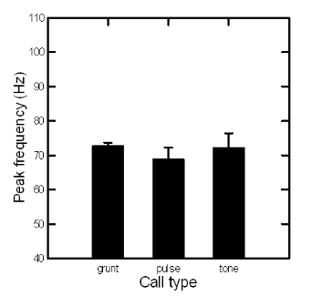
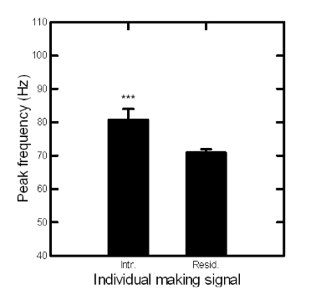
Sound Results
Total calls: 172
Pulses: 24
Grunts: 134
Tones: 14
Resident: 152
Intruder: 20
No statistical difference in frequency between different call types
Intruders produced calls with higher mean peak frequencies than residents

Slide 10
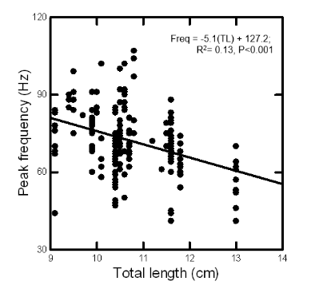
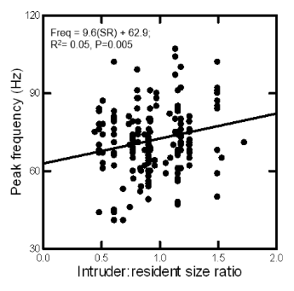
Sound Results
Inverse relationship between fish size and frequency of calls
Significant linear regression relationship between size ratio of the competing fish and the peak frequencies of produced sounds

Slide 11
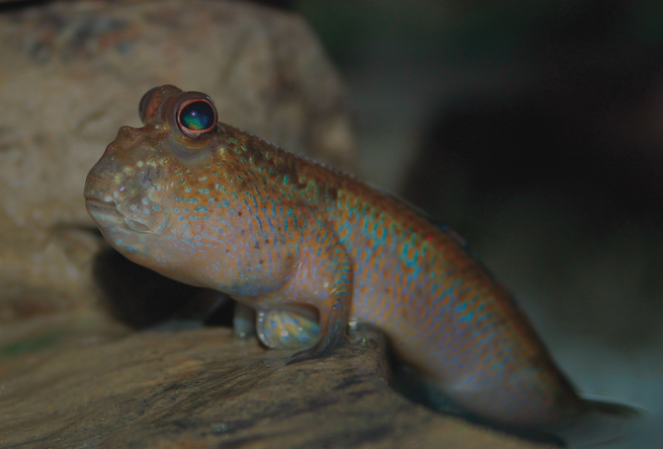
Conclusions
Fish size and sound frequency relationships followed the expected inverse relationship.
It is unclear why the frequency:size ratio relationship is opposite to what would be expected from the size:frequency relationship.
Dyadic contests usually favor the territorial resident of the contest setting. Resident fishes also reliably produce the most calls.
Influences of sex pairing seem to have no indication of contest outcome or sound production.

Slide 12
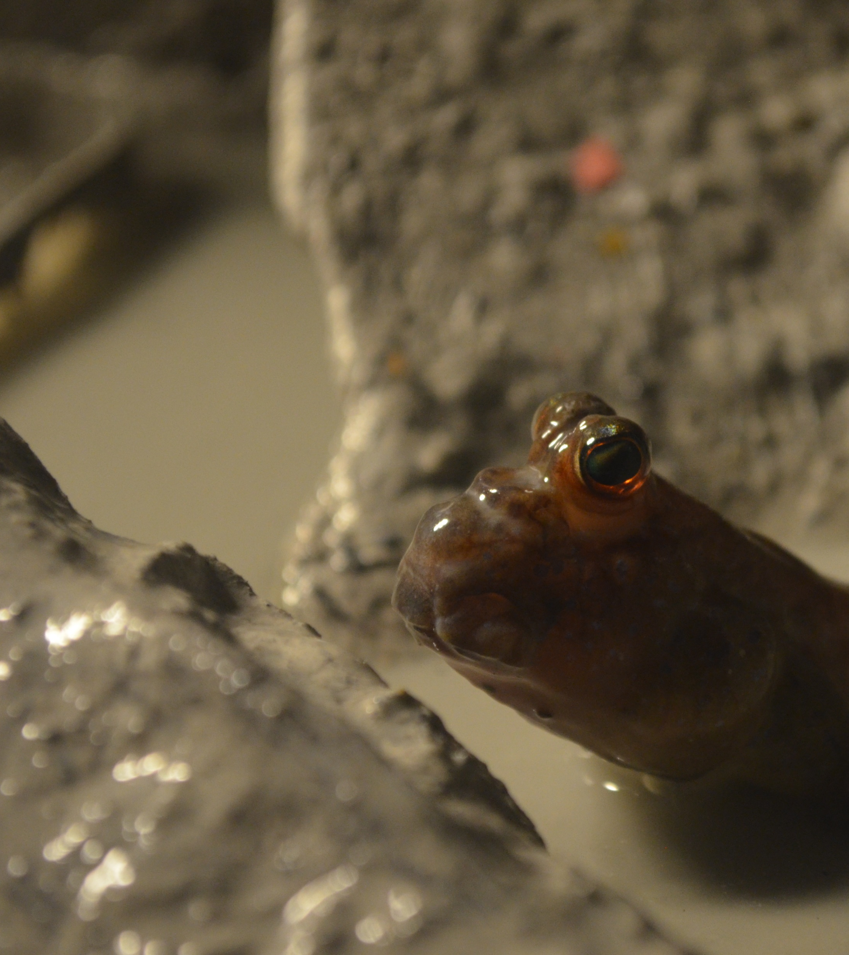
Future Directions
Morphological examination with an emphasis on the sound generating mechanism.
Sound analysis comparing territorial disputes to courtship interactions
Possible differentiation of sound characteristics/production in different sexes.
Supported by WKU FUSE Grant

