Slide 1
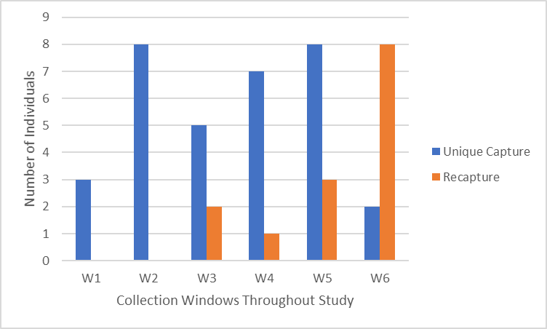
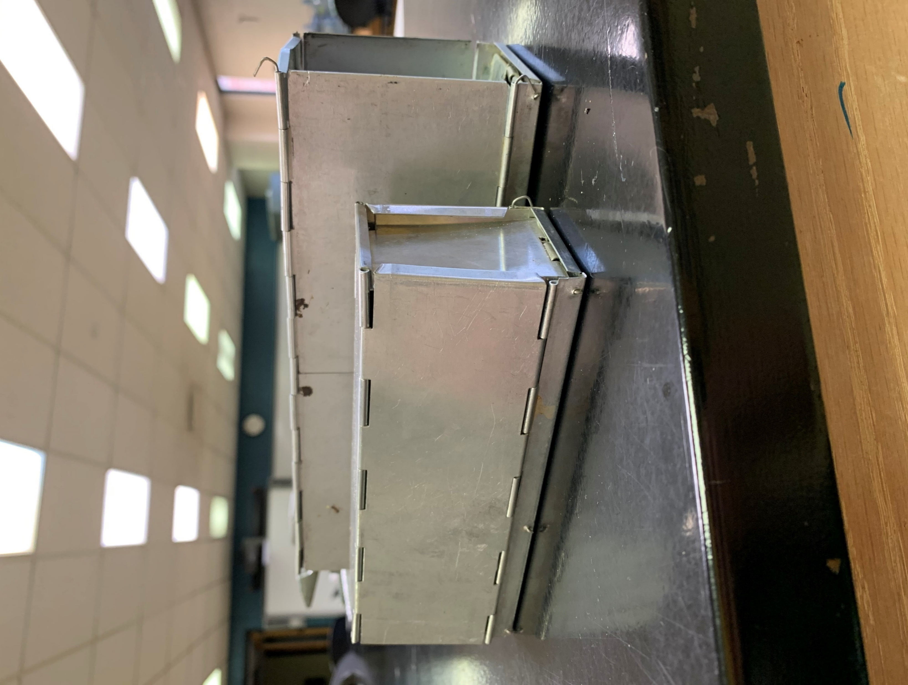
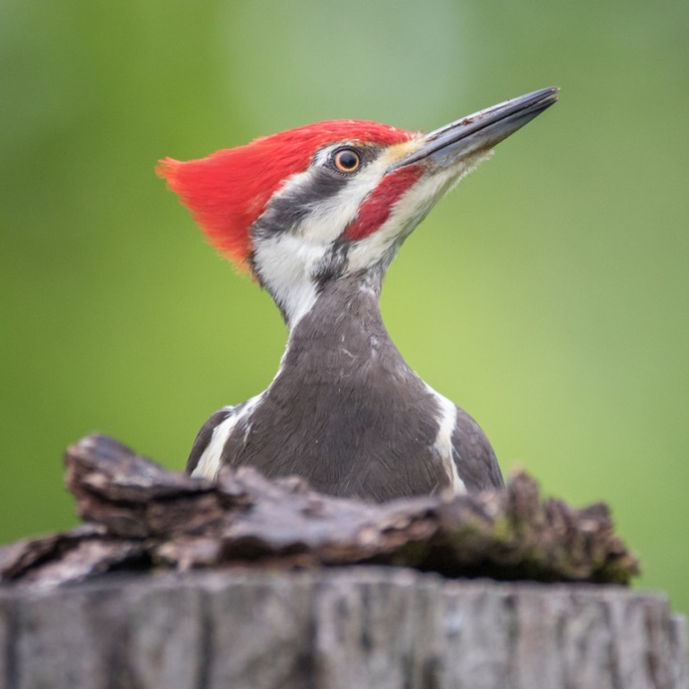
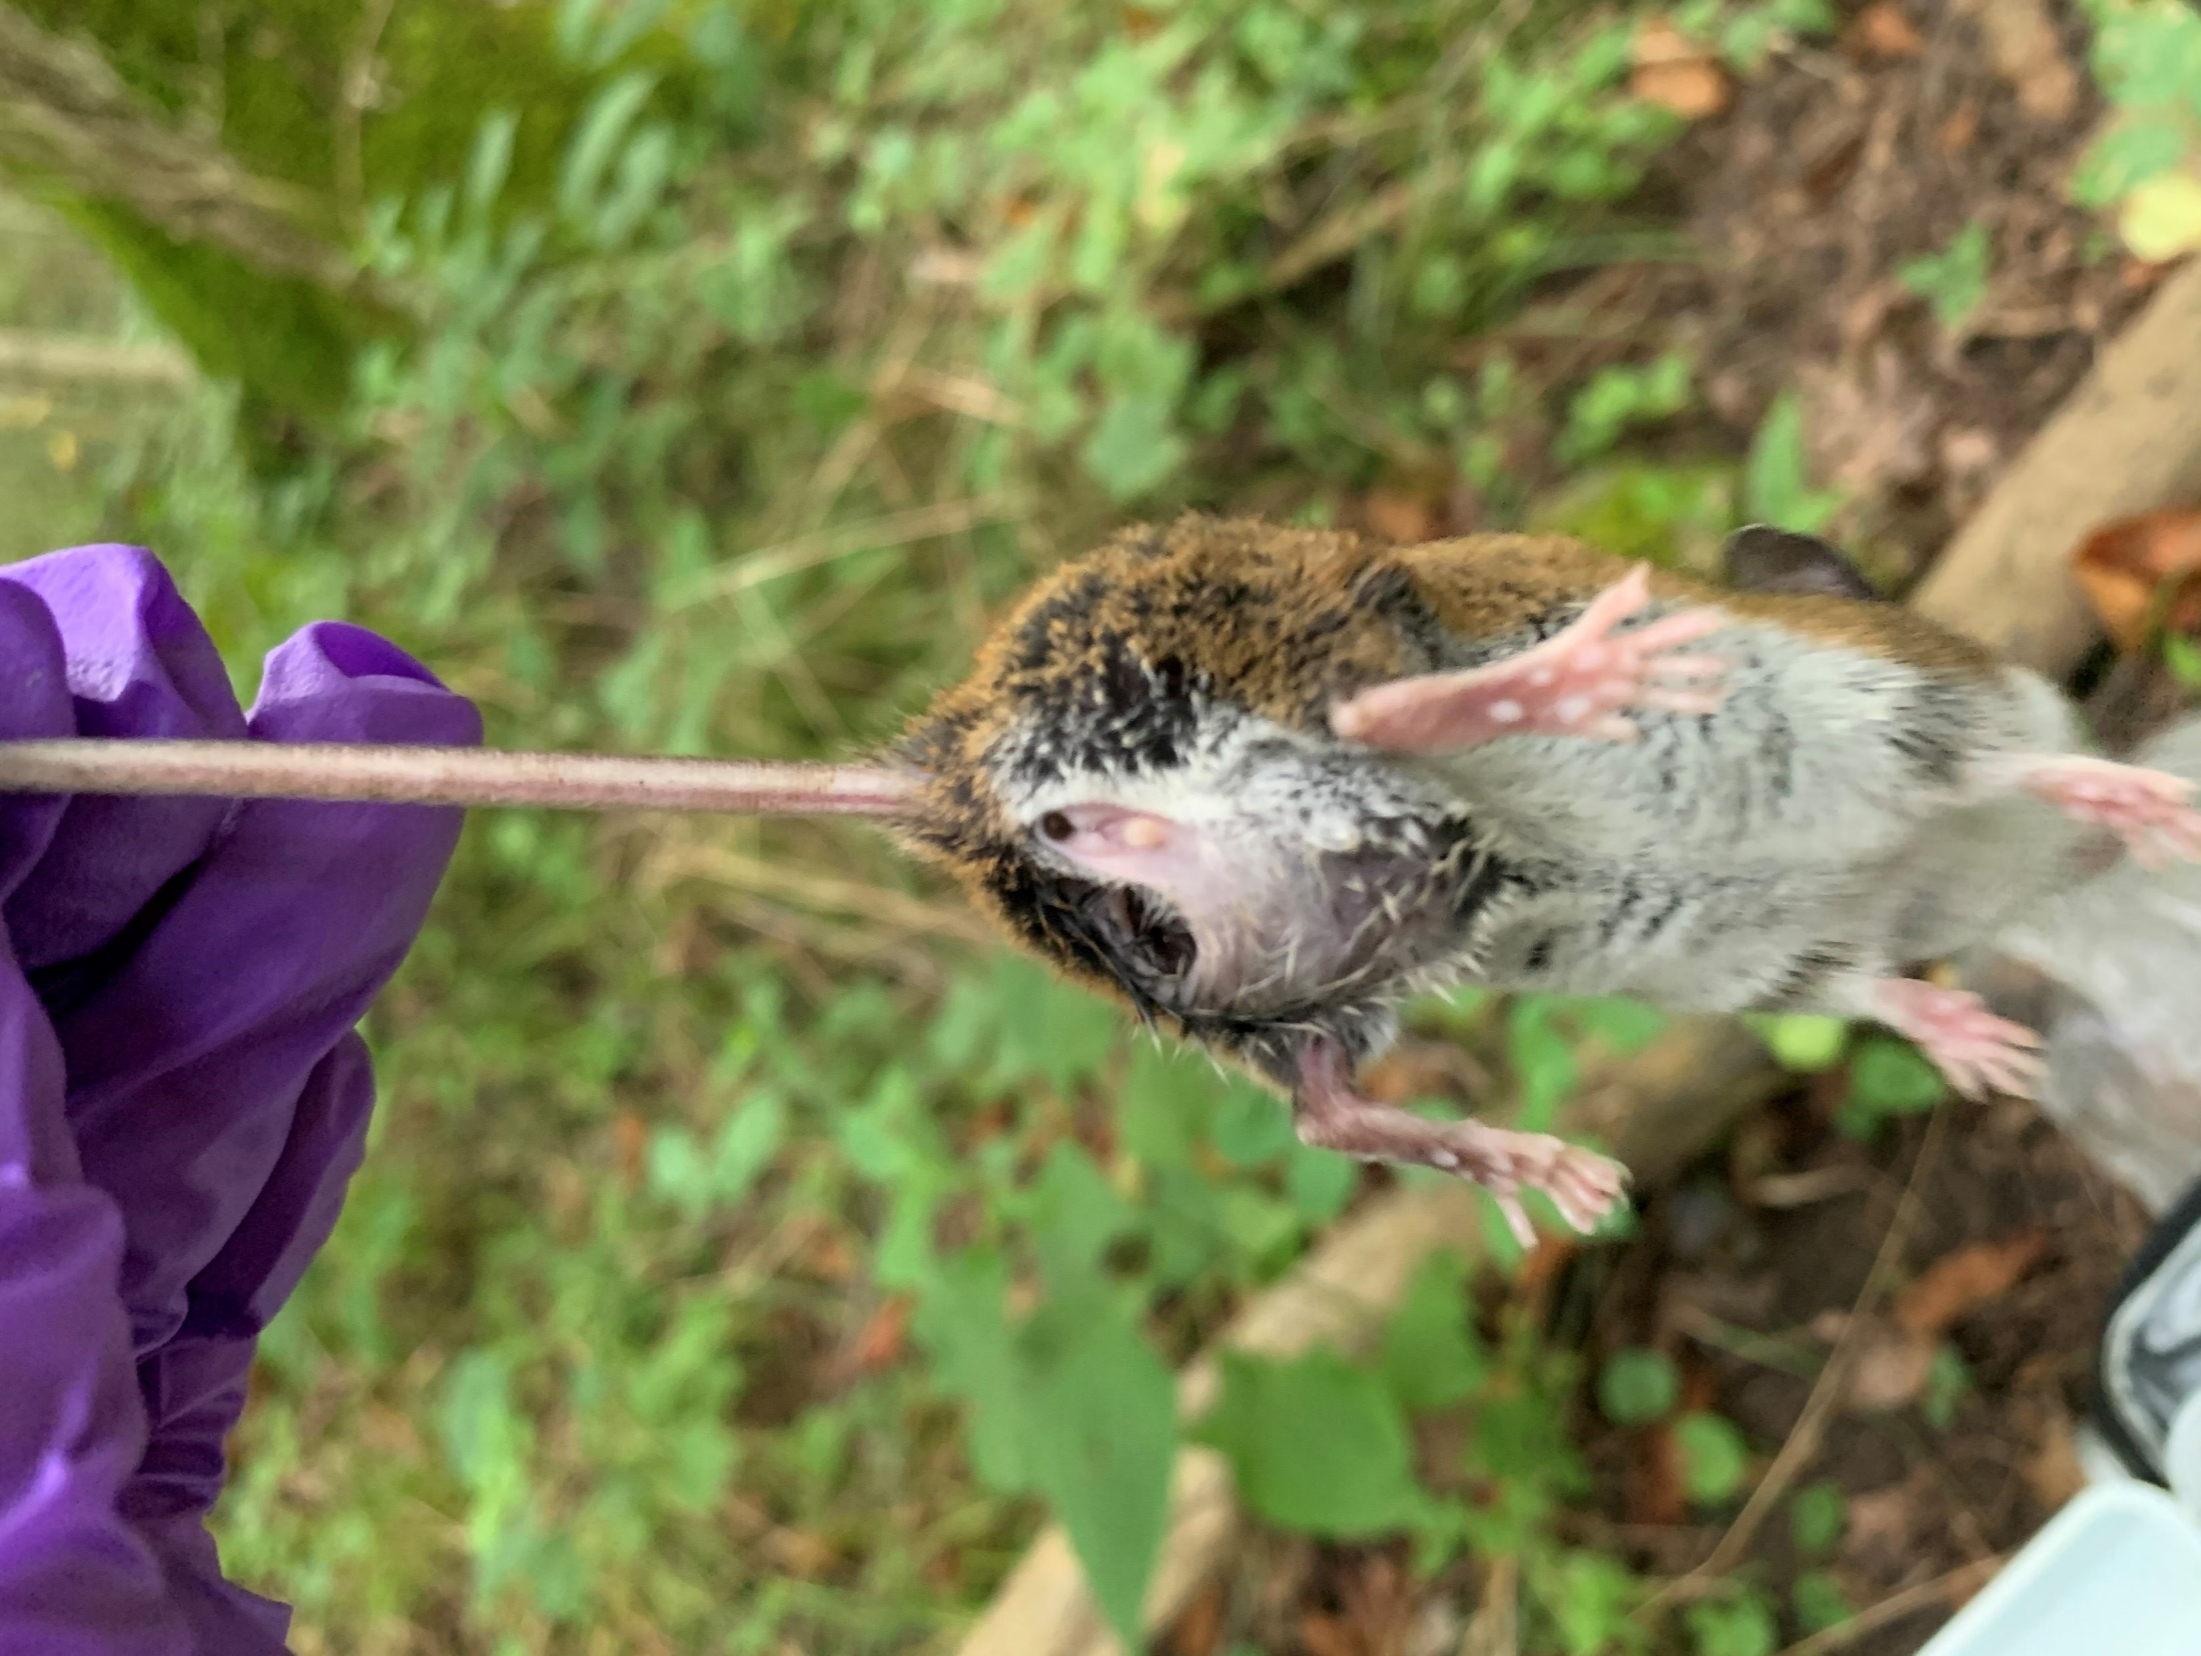
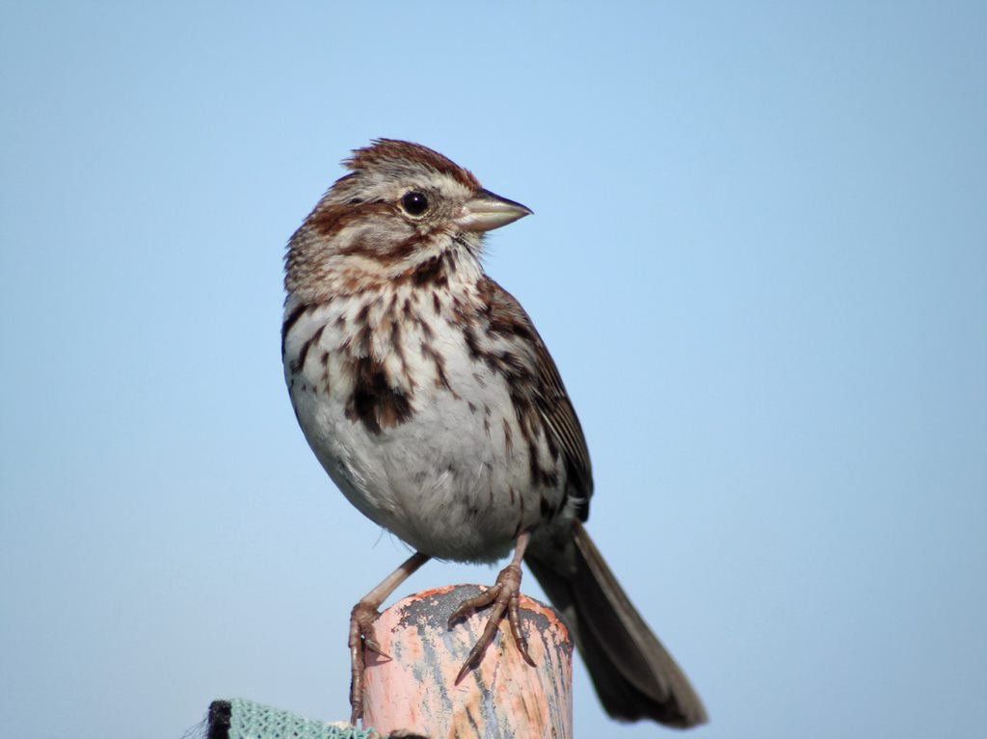
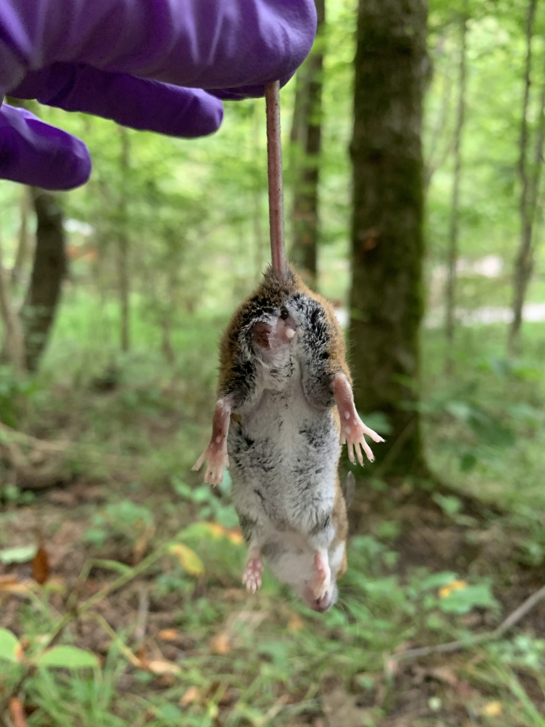
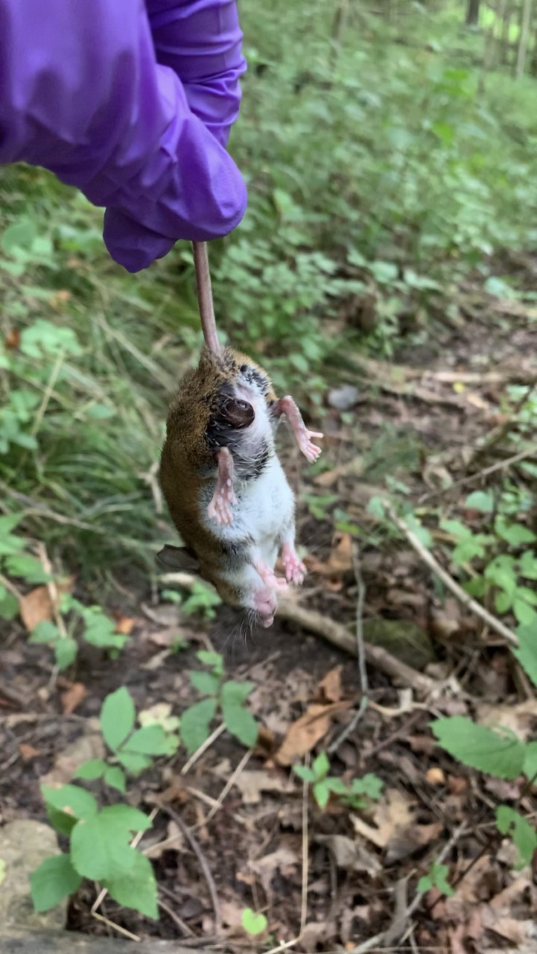
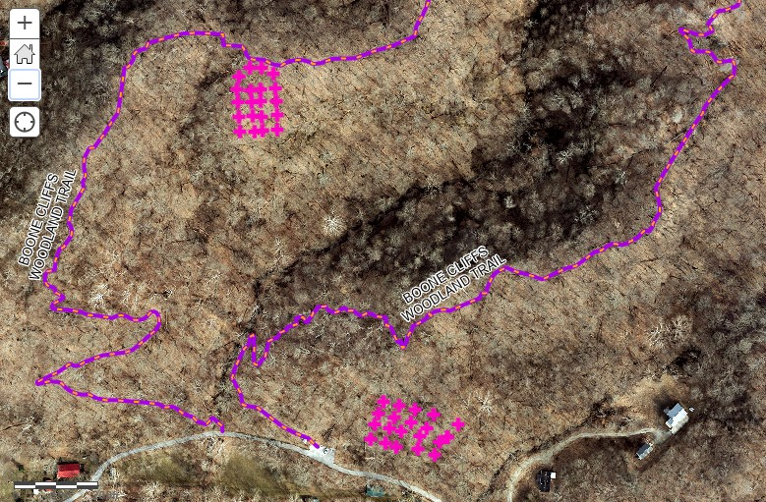
A continuing survey of small mammalian species in the Boone Cliffs State Nature Preserve (Burlington, KY) Joseph A. Pedro and Dr. Zachary S. Taylor Thomas More University, Department of Biological Sciences, Crestview Hills, KY
Introduction
The Boone Cliffs state nature preserve has a rich history with major events spanning from 1975 – 2010 in its lifespan. Recently, strides have been made to prove the ecological value of the Boone Cliffs Nature Preserve, with studies being conducted analyzing everything from moth populations to tree species. However, not much progress has been made in the way of small mammal data. Small mammals are critical to whatever ecosystem they inhabit due to several key factors; such as their consuming of plants, insects, and seeds (Barbour and Davis, 1974). Their role in food webs as primary consumer, by eating producers and serving as a food source for higher levels of the food web like raptors, or their roles in agriculture (Blair, 1940). Overall the role of small mammals cannot be stressed enough, and it is on our part as researchers to collect as much data as possible on these animals so that we may fully understand their role within the Boone Cliffs Nature Preserve.
During the proposed collection windows during the study we expect to see certain species that are believed to have ranges found in the Northern Kentucky area such as P. leucopus the white-footed mouse, P. maniculatus the deer mouse, N. insignis the woodland jumping mouse, B. brevicauda the northern short-tailed shrew, and lastly S. cinereus the masked shrew (Barbour and Davis, 1974).
Results
Analysis
The only species that was trapped over the course of the study was the White Footed Mouse or P. leucopus.
Thirty-three unique individuals were trapped with eleven retrappings.
Due to only finding P. leucopus over the course of the study it was found that Menhinick's Index for Species Richness for the data set was D = 0.18 with the Shannon Index for Species Diversity being H’ = 0.0
The Lincoln Index for estimating population size was found to be 37 at the end of the second year.
The average weight of the mice over the course of the study was found to be 18.2g, the average tail length 71.6mm, and the average ear length 13.4mm
It was also found that twenty-two percent of the mice captured over the duration of the study were found to be hosts to some type of invertebrate larva.
Discussion
Unsurprising given that only P. leucopus was found over the course of the study the small mammal community at the Boone Cliffs Preserve was incredibly homogenous with a Shannon Index for Species Diversity value (H’ = 0.0) the lack of species diversity was also represented in the Menhinick's Index for Species Richness for the data set which was found to be (D = 0.18). With regards to available research, the findings of this study do not line up with previous research in that previous studies found a variety of small mammals such as P. leucopus, along with P. maniculatus the deer mouse, N. insignis the woodland jumping mouse, B. brevicauda the northern short-tailed shrew, and lastly S. cinereus the masked shrew. This discrepancy in findings may be attributed to several different factors, for one the gap in data with regards to small mammal populations in Kentucky, and especially Northern Kentucky is quite severe. Another may be that the other species mentioned besides P. leucopus are not present in the areas surveyed of the Boone Cliffs Preserve. Further research should be considered in the Boone Cliffs Preserve utilizing different capture methods (i.e. varying numbers of traps used and arrangements of said traps) along with surveying different areas of the preserve.
Figure 2. The number of unique captures vs. recaptures of the species P. leucopus per collection window over the course of the study within the Boone Cliffs Preserve in Burlington, KY during the summers of 2019 and 2020
Various stages of growths found on white footed mice specimen over the course of the study.
References
Barbour RW, Davis WH. 1974. Mammals of Kentucky. Lexington, KY: The University Press of Kentucky.
Blair WF. 1940. A Study of Prairie Deer-Mouse Populations in Southern Michigan. American Midland Naturalist 24:273.
Wildlife Management Areas/Public Hunting Areas. Kentucky Department of Fish & Wildlife Wildlife Management Areas/Public Hunting Areas. [accessed 2019].
Figure 1. The two varieties of Sherman live capture traps used over the course of the study (3 x 3.5 x 9" and 2 x 2.5 x 6.5" respectively).
Methods
Before the first collection window a topographic map of the Boone Cliffs Preserve was obtained to find the flattest areas of the preserve, these areas were where the grids used over the course of the study were placed.
Over the course of the study six three-day collection windows were conducted.
The evening of the first day of the window the traps were baited and placed roughly eighteen paces apart, while alternating the two sizes used.
The morning of the second day the traps were rebaited, if an individual was found demographic data listed in Figure 2 was collected and the trap rebaited. The procedure for the evening of the second day was identical to the procedure listed for the morning of the second day.
The morning of the third and final day the traps were collected, with any individuals captured having their demographic data taken.
After the field component of the study was concluded the demographic data collected was used to calculate various values.
Acknowledgements
I would like to thank Kentucky Nature Preserves for permitting me to conduct this study in Boone Cliffs, one of their many nature preserves across the state.
I would also like to thank David Whitehouse at Boone County Parks for agreeing to fund the first year of the study.
Along with Boone County Parks I’d like to thank Mark, Susan, and Pavla at the Boone County Conservation District for agreeing to fund the second year of the study and for giving me a fantastic internship experience.
Finally, I’d like to thank my dad Chip Pedro, throughout the first year and for part of the second I couldn’t have asked for a better field assistant.
Figure 3. A map generated in GIS of the Boone Cliffs Preserve, illustrating where the study grids were located geographically with regards to the rest of the preserve using and ae. Each point illustrated on the map represents one individual trap used in the study.

