Slide 1
Polydimethylsiloxane as a Substrate to Facilitate the use Photocatalysts in the Breakdown of Organic Water Pollutants
Connor Schulte, Lovence Ainembabazi, and Dr. Matthew Nee

Slide 2
Dealing with Organic Water Pollution
Organic pollutants in large bodies of water cannot be removed effectively using treatments like filtration
Photocatalysts address this by breaking down the pollutants, but photocatalysts can be difficult to remove afterward
Attaching the photocatalysts to a large substrate simplifies the removal process
PDMS beds float in water – just like oil
Greenpeace; 2020

Slide 3
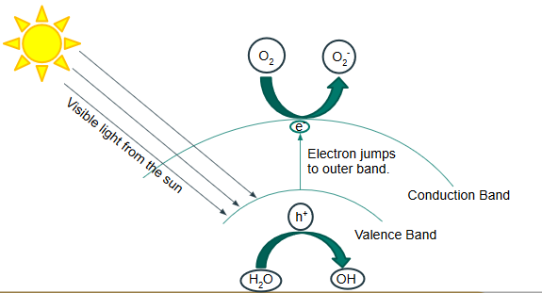
How do Photocatalysts Work?

Slide 4
Polydimethylsiloxane (PDMS) beads as a substrate
Beads:
Are buoyant
Are easy to filter out
Do not significantly affect the activity of the photocatalyst
Can successfully incorporate photocatalyst into their structure
Ainembabazi, L. MA Thesis, Western Kentucky University, Bowling Green, KY, 2019.

Slide 5
Methods
Mix
PDMS
DI water
N-heptane
Sorbitan monooleate
Add crosslinker, then heat-cure at 80 degrees Celcius
Emulsify

Slide 6
Characterized by:
Scanning Electron Microscopy (SEM) to observe the surface morphology
Brunauer-Emmet-Teller isotherms (BET) to determine the surface-area-to-volume ratio
Energy-Dispersive X-ray Spectroscopy (EDS) and Raman Spectroscopy to verify that the photocatalysts have been incorporated, and that their structure has not changed
UV-vis Spectroscopy with methylene blue to measure photocatalytic ability

Slide 7
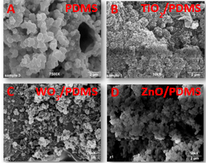
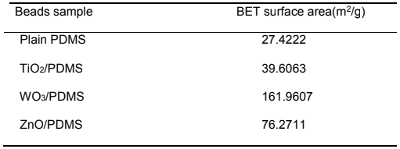
SEM and BET data
Ainembabazi, L. MA Thesis, Western Kentucky University, Bowling Green, KY, 2019.

Slide 8
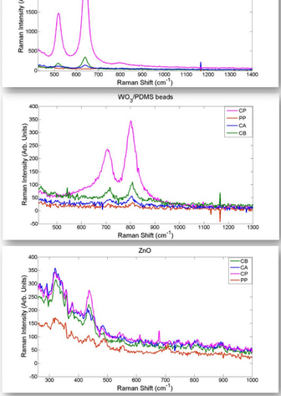
Raman data
CP = Photocatalyst powder
CB = photocatalyst/PDMS beads
CA = photocatalyst beads after 3hr degradation trials
PP = Plain PDMS beads
Peaks are in the same locations for photocatalyst powder, and photocatalyst/PDMS beads

Slide 9
UV-vis Setup
Xe-arc lamp
Peristaltic pump
Cuvette

Slide 10
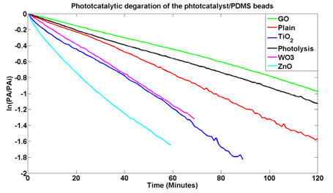
UV-vis data
Degradation of methylene blue follows $1^{st}$ order kinetics, so ln[MB] vs time is linear.

Slide 11
Conclusions:
Beads at high surface-are-to-volume ratios
Incorporation of photocatalysts was successful
Photocatalyst/PDMS beads degraded methylene blue faster than PDMs alone or photolysis
Future Work:
While this project has shown promising results, it is not currently scalable due to the prohibitive cost of the triethoxysilane cross-linker. Future work will be done to find a more cost-effective polymer substrate.

Slide 12
Acknowledgements
This work has been supported by a grant through the Kentucky Water Resources Research Institute, a US Geological Society 104-b program, grant 3200000437-19-282. Additional support has been provided by the WKU Department of Chemistry.
Additionally, this work would not have been possible without the help of the following people:
Lovence Ainembabazi
Dr. Matthew Nee
Dr. John Andersland

