Slide 1
Will an emerging monsoonal weather pattern affect agricultural practices in Kentucky?
Cynthia Rice¹, Buddhi Gyawali¹, and Jeremy Sandifer¹
¹Division of Environmental Studies, College of Agriculture, Community, and the Sciences, Kentucky States University, Frankfort, KY 40601
Kentucky Academy of Science - 2020

Slide 2
Introduction

Slide 3
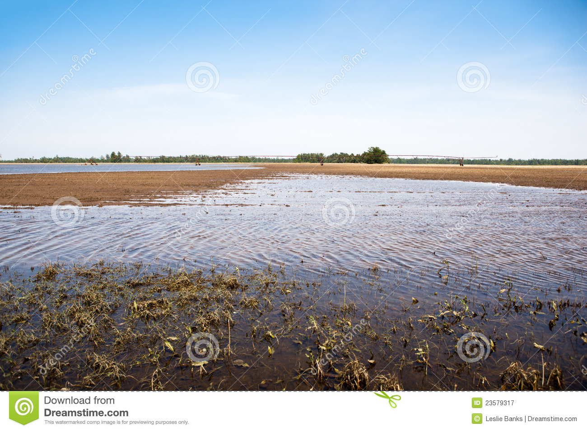
Farmer observations
Earlier planting season and later/longer harvest season
After early warm-up, polar vortexes sometimes occur, resulting in tree blossom loss and plant loss
Heavier rain events in spring result in muddy fields/flooding, delaying planting, reducing production and/or resulting in crop loss
Hotter summers requiring more water/irrigation for cooling/drought relief
Agricultural production may be one season or several years depending on plant life cycle (annual plants vs. perennial plants such as trees– decisions need to be formulated now for long-term solutions)
https://www.dreamstime.com/royalty-free-stock-photography-flooded-farmland-image23579317

Slide 4
Hypothesis

Slide 5
Farmer observations
Is this a new norm (from 4 season to monsoonal type weather)?

Slide 6
Objectives/Research Questions

Slide 7
Objectives
Examine weather pattern from 1960s to 2020s
Examine contributing factors of weather as opposed to climate
Determine trends
Anticipate changes to traditional agriculture
Research Questions
Is Kentucky still a 4-season weather pattern?
Is Kentucky a monsoonal weather pattern?
Is monsoonal weather pattern an anomaly?

Slide 8
Methodology

Slide 9
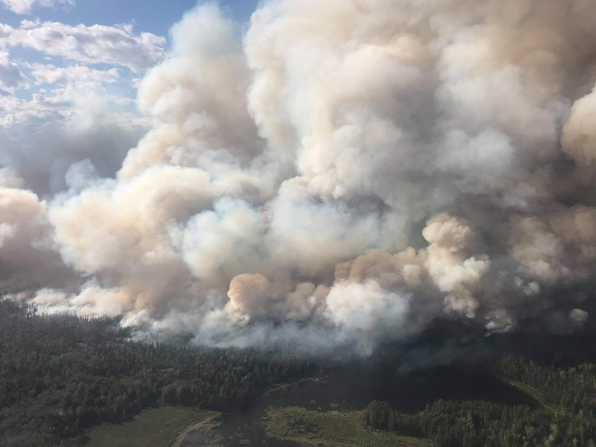
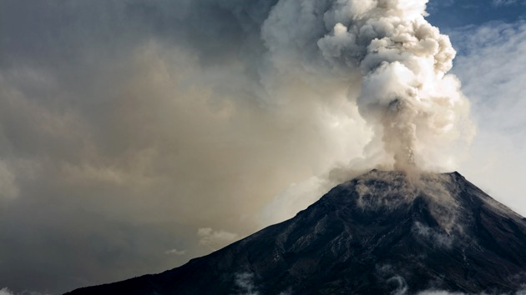
What factors affect weather
Environmental
Volcanoes
Man-made issues
Wildfire
Hurricane/Tropical Storm
Cloud cover
Solar
Temperature
Precipitation
Anomaly
Event amount
Event frequency
What factors affect climate
Trending weather (decade or decades)
Environmental reaction (desertification movement west to east over long time span)
https://www.drydennow.com/images/stories/news/2020/August/red%20lake%20fire%20sol%20mamakwa.jpg
https://www.connectradio.fm/wp-content/uploads/2020/01/iStock_012020_volcanoalaskafile.jpeg

Slide 10
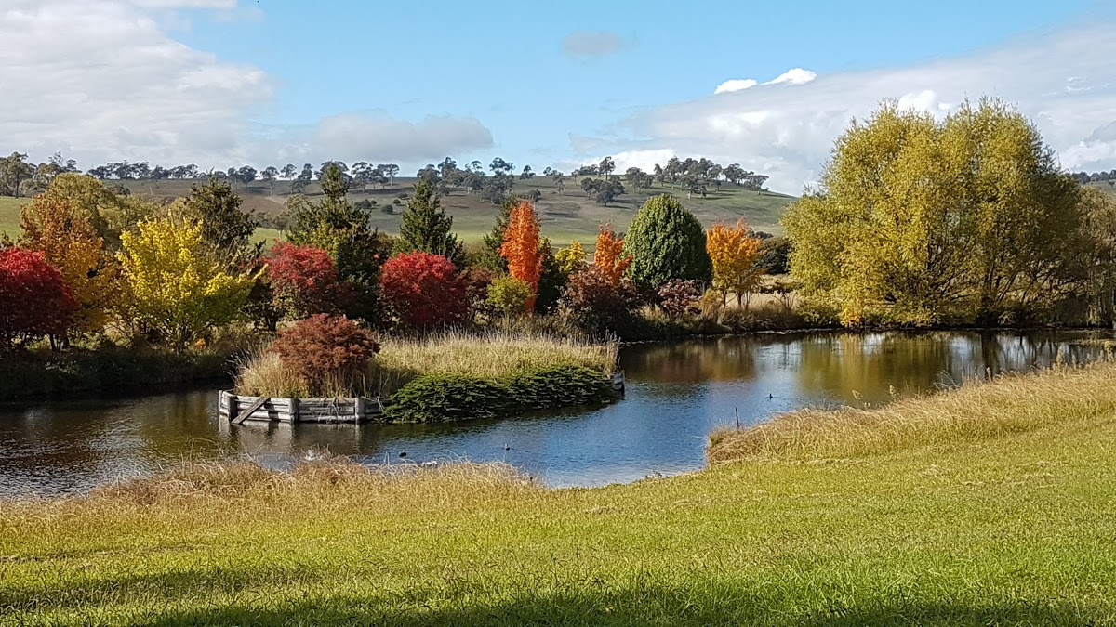
Rationale
Kentucky may be in the process of changing its historical weather patterns
Kentucky has a temperate climate and, usually, a high level of humidity
Each of the seasons lasted three months in the past
Now, fall and spring appear to be one or two months, while summer appears to be five months (May - September)
Fall corresponds to October and November, while winter appears to last from December to February
Spring begins in March/ends with May, with occasional polar vortex bringing a freeze after plants are coming out of dormancy
https://lh3.googleusercontent.com/p/AF1QipN1-tB39DDpWEbvH8kLHoe5zHIsxo2m21FEY9Hk=s1600-w1200

Slide 11
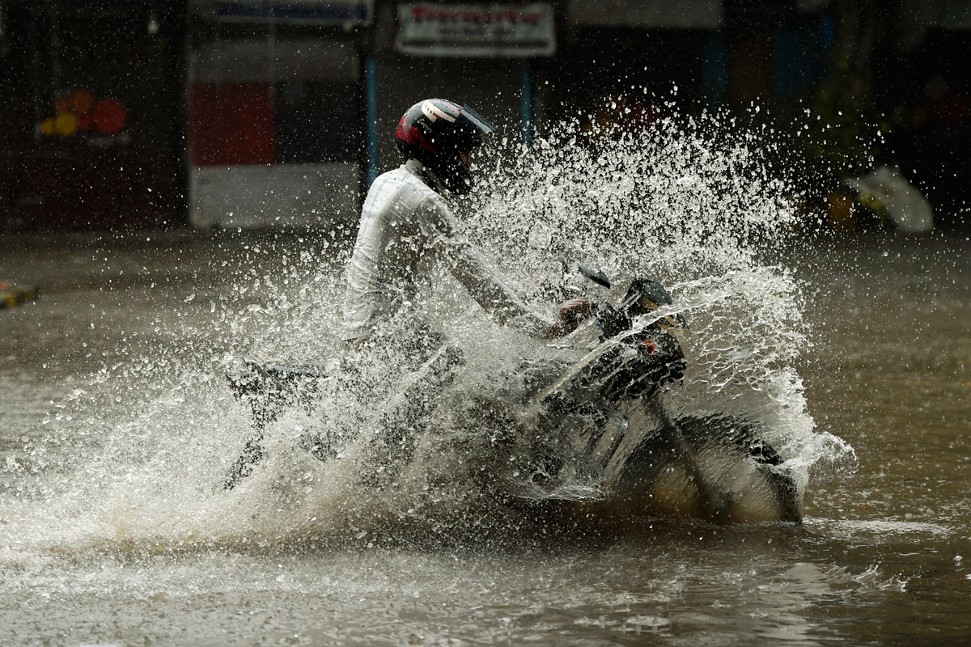
Rationale (contd.)
Kentucky appears to be moving from four-season weather pattern to a monsoonal weather pattern
Longer planting season– beginning/end of plant life cycle underlines changing weather patterns
Changing weather pattern, slow absorption of water– snow/ice of winter changing to rain, heavier flow than soil can absorb, results in run-off
Detrimental to farms, carrying topsoil and fertility away from farms
Heaver rains leave land wet longer; historical planting times may be delayed; longer summers with heat dry out land, leaving arid condition hampering traditional Kentucky agricultural production
Farmers need to adapt and mitigate effects of weather for sustainable farm production
https://www.aljazeera.com/mritems/Images/2016/8/12/85354b3bd01a4de7bd9fd65d175b232d_8.jpg

Slide 12
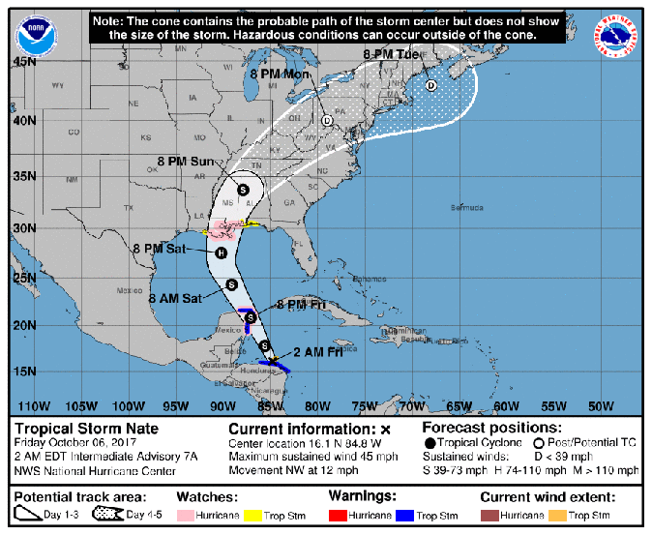
Many factors when dealing with weather and climate
Weather is short term
Climate is an aggregate trend of weather and environmental effects
Oscillations– fluctuating ocean temperatures or atmospheric circulation combine in different ways with different effects
There are no independent factors; they are interrelated
Environmental considerations include man-made events, cloud cover from volcanic eruptions, wildfires, tropical storms/hurricanes, reducing effects of solar energy radiation
There are many phases (oscillations being one type) which have different lengths from seasonal in a year to various yearly to decadal or longer periods of time
http://cdn.images.express.co.uk/img/dynamic/153/590x/secondary/Hurricane-Nate-NOAA-path-update-1087478.png
Notes:
Think body collision with roller blades, skateboard, bicycle, motorcycle, car, tractor trailer, train – from small impacts to much larger and longer impacts

Slide 13
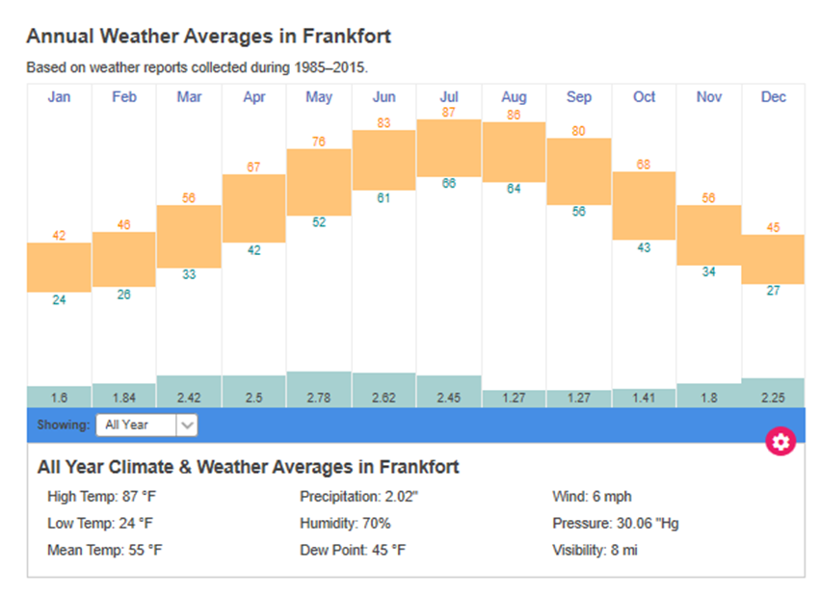
Presentation of data can affect perception
https://www.usclimatedata.com/climate/frankfort/kentucky/united-states/usky0919
https://www.timeanddate.com/weather/usa/frankfort/climate
Looking at data– statewide earlier data is less defined over many years (later data more in-depth) so inconsistent comparisons (same data different visual representation)
Notes:
Think fruit in the 1960s, citrus 1980s, oranges 2000s, Valencia 2020s

Slide 14
What is the information actually saying?
Information can be misleading (Rankings in comparison to average temperature over a season is ambiguous as a relational indicator and not a specific temperature or range)
Data can be interpreted different ways, but data relevant to the question is not always easy to find– IF AVAILABLE

Slide 15
Discussion

Slide 16
Air & Water (ocean) pattern affecting North America
Arctic Oscillation (AO) is a climate index of the state of the atmospheric circulation over the Arctic.
El Niño-Southern Oscillation (ENSO) is a naturally occurring phenomenon that involves fluctuating ocean temperatures in the equatorial Pacific
The Pacific/North American teleconnection pattern (PNA) is one of the most recognized, influential climate patterns in the Northern Hemisphere mid-latitudes beyond the tropics
Pacific Decadal Oscillation (PDO) is a pattern of Pacific climate variability similar to ENSO in character, but it varies over a much longer time scale. The PDO can remain in the same phase for 20 to 30 years, while ENSO cycles typically only last 6 to 18 months

Slide 17
Arctic Oscillation(AO)
https://climate.ncsu.edu/climate/patterns/nao
Positive phase- below average geopotential heights (negative geopotential height anomalies)
Negative phase- opposite is true. Negative phase, the polar low-pressure system (polar vortex) over the Arctic is weaker [weaker upper-level winds (the westerlies)]
Weaker westerlies- cold, Arctic air pushes farther south into the U.S., storm track also remains farther south.
AO is positive- opposite is true: polar circulation is stronger, forces cold air and storms to remain farther north. Arctic Oscillation often shares phase with the North Atlantic Oscillation (NAO), and its phases directly correlate with the phases of the NAO concerning implications on weather across the U.S.

Slide 18
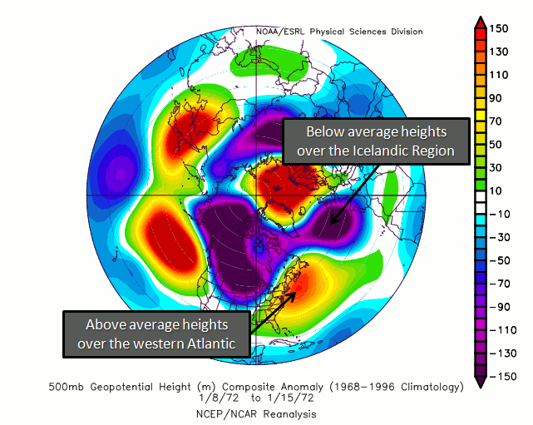
North Atlantic Oscillation (Positive NAO)
A stronger Icelandic low and Azores high translates into lower-than-average 500mb heights near Iceland, and above-average heights near the Azores Islands. In turn, above-normal temperatures are seen over the eastern U.S. as the stronger westerlies transport colder air away from North America.
https://climate.ncsu.edu/climate/patterns/nao

Slide 19
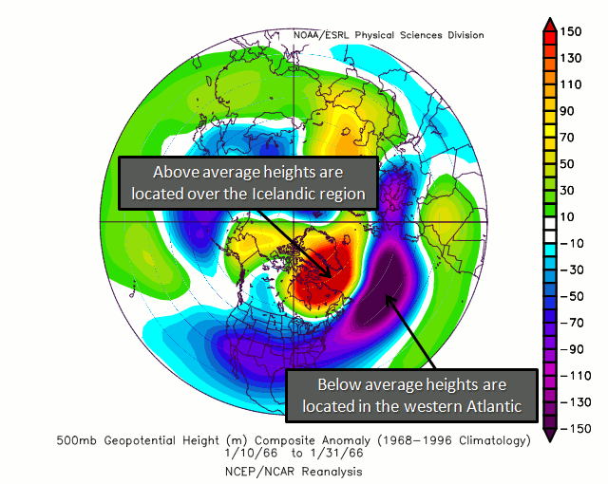
North Atlantic Oscillation (Negative NAO)
When the Icelandic low and Azores high are weaker, above-average 500mb heights are located near Iceland, and below-average heights near the Azores Islands. This results in a phenomenon referred to as high latitude blocking, which allows cold air to drain from Alaska and Canada into the U.S. and become entrenched, resulting in cold air outbreaks and below-normal temperatures.
https://climate.ncsu.edu/climate/patterns/nao

Slide 20
El Niño (Warm Phase)
Typical El Niño Effects: December through February
Typical El Niño Effects: June through August
Research conducted at the SCO indicates more storms and increased winter precipitation for the southeast during El Niño events. In contrast, decreased summer rainfall occurs during El Niño events, partly due to a decrease in the number of tropical cyclones that develop in the North Atlantic Basin.
https://climate.ncsu.edu/climate/patterns/enso

Slide 21
La Niña (Cool Phase)
Typical La Niña Effects: December through February
Typical La Niña Effects: June through August
Climatic conditions in North Carolina during La Niña: Conditions tend to be opposite those seen during El Niño events, including an increase in the number of tropical cyclones that develop in the North Atlantic Ocean. The State Climate Office has also studied the relationship between severe weather, such as tornadoes, and El Niño/La Niña. In North Carolina, it appears that there are more tornadoes during La Niña events. (North Carolina and Kentucky both South East.
https://climate.ncsu.edu/climate/patterns/enso

Slide 22
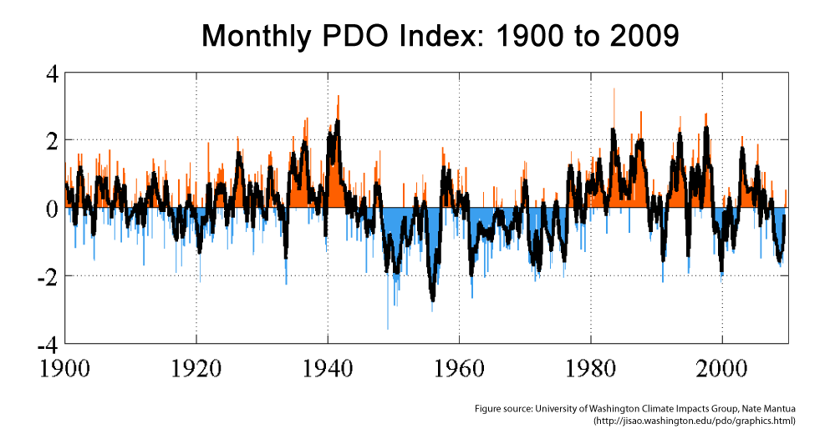
Pacific Decadal Oscillation (PDO)
Pacific Decadal Oscillation (PDO)
Researchers have found evidence for just two full PDO cycles in the past century: cold PDO regimes prevailed from 1890-1924 and again from 1947-1976, while warm PDO regimes dominated from 1925-1946 and from 1977 through the mid-1990s.
https://climate.ncsu.edu/climate/patterns/pdo

Slide 23
Pacific Decadal Oscillation (PDO
The broad area of above-average water temperatures off the coast of North America from Alaska to the equator is a classic feature of the warm phase of the Pacific Decadal Oscillation (PDO). The warm waters wrap in a horseshoe shape around a core of cooler-than-average water. Impacts from the PDO depend in part on how it is aligned with the ENSO cycle; if the cycles are in opposite phases, then effects will be weakened. However, when both the PDO and ENSO are in the warm phase, meaning ENSO would be in the El Niño phase, expected impacts on the southeast include: Below-average winter temperatures Above-average winter precipitation
https://climate.ncsu.edu/climate/patterns/pdo

Slide 24
Pacific Decadal Oscillation (PDO
Opposite of the warm PDO, the expansive area of below-average water temperatures off the coast of North America from Alaska to the equator signals the cold phase of the PDO. The area of warmer-than-average sea surface temperatures in the central Pacific are surrounded by below-average temperatures near the North American continent. Expected impacts from a cold PDO and ENSO (La Nina) phase on the southeast include: Above-average winter temperatures Below-average winter precipitation
https://climate.ncsu.edu/climate/patterns/pdo

Slide 25
Results

Slide 26
Is Kentucky weather pattern becoming monsoonal?
As can be seen by the various components involved in weather /climate predictions, historical data and how the different systems interact are used in predicting weather/climate effects
May not be enough data to predict if Kentucky is changing from 4 seasons to a monsoonal weather pattern– additional observation and research is needed
Depending on initial year, following data is not classified the same, so hard to confirm some trends (state only vs. county data, not as many data collectors/stream gauges vs. multiple data collectors)
Determine how to analyze data in relation to other factors to determine anomaly or valid data

Slide 27
Conclusion

Slide 28
Is Kentucky weather pattern becoming monsoonal?
Interaction and partnership with farmers for data and initial findings need to continue
Additional information and research on various factors and their interactions need to occur
Is current weather a fluke or trend?
(Little Ice Age not apparent until several years into the cycle)
unknown at this point

Slide 29
References

Slide 30
Reference sites (home for subpages for images used)
©
North Carolina Climate Office (https://climate.ncsu.edu/)
US Climate Data 2020 | version 3.0 | by Your Weather Service (https://www.usclimatedata.com/climate/frankfort/kentucky/united-states/usky0919)
Time and Date AS (https://www.timeanddate.com/weather/usa/frankfort/climate)

Slide 31
Acknowledgement

Slide 32
Thank you to:
Kentucky State University
Kentucky Academy of Science
Farmers in Kentucky
Many agencies/organizations at local, state and national levels, such as:
Department of Agriculture
Conservation districts
Non-profits
Agri-businesses
AFRI-Geotech-Small Farms Grant Enhancing Productivity, Diversification, and Sustainability by Infusing Geospatial Technology in Small and Medium-Sized Farms
SARE PROJECT # ES20-158 Grant Helping Agricultural Professionals and Mentoring Farmers to Train Previously Unreached Farmers about Sustainable Agriculture

