Slide 1
Do we eat more when sleeping less? A case study in the Fruit fly
Ladan Abbasi, Erica Hassoun, Jason Ho, Dae-Sung Hwangbo
Department of Biology, University of Louisville

Slide 2
Introduction

Slide 3
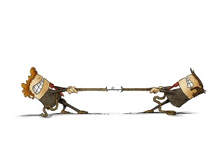
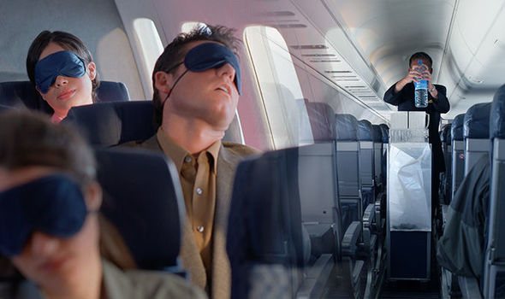
Sleep-feeding conflict
Sleep and feeding are two mutually exclusive behaviors.
At any given time, individual can either sleep or feed.
Both behaviors are important for survival, yet a tight balance between them is crucial for survival.

Slide 4
Hypothesis
We were interested to know more about sleep-feeding conflict using Drosophila melanogaster (fruit fly) as a model organism.
Research Question: Do we see a negative correlation between sleep and feeding in fruit flies?
To answer the question, we took advantage of Drosophila Sleep Inbred Panel (SIP) lines that are artificially selected for short or long sleep and measured their food consumption.
Hypothesis: long-sleep flies have less food intake and short-sleep flies have high food intake.

Slide 5
Method

Slide 6
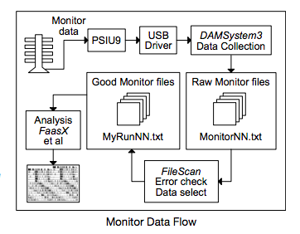
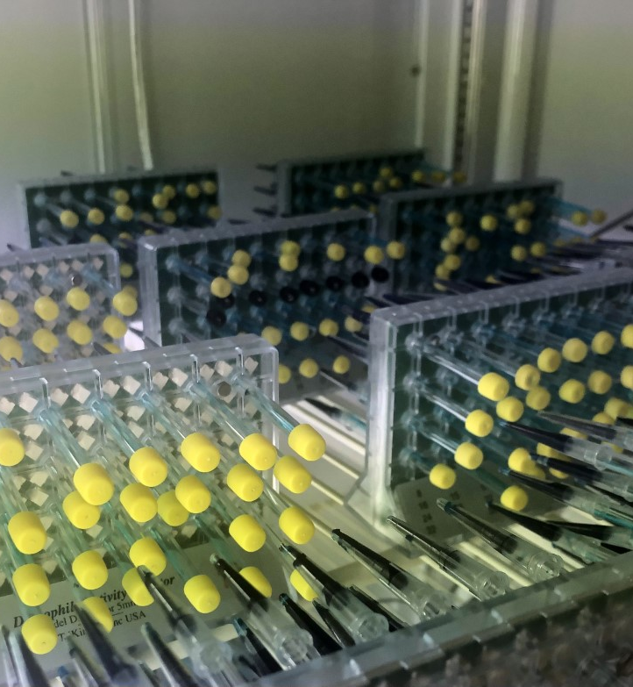
MEASURING SLEEP: DROSOPHILA ACTIVITY MONITOR
The Drosophila Activity Monitor (DAM) system, (TriKinetics, Waltham, MA), is a set of devices for recording Drosophila locomotor behavior that is widely used around the world.
The DAM system records infrared beam breaks of flies walking in glass tubes.
Each DAM monitor has 32 channels recording locomotor behavior of individual flies. With many monitors used in an experiment, hundreds of individuals can be tracked simultaneously.
The tubes housing flies during an experiment contain fly food, allowing monitoring of behavior over many days or even weeks (Cichewicz&Harish,2018).

Slide 7
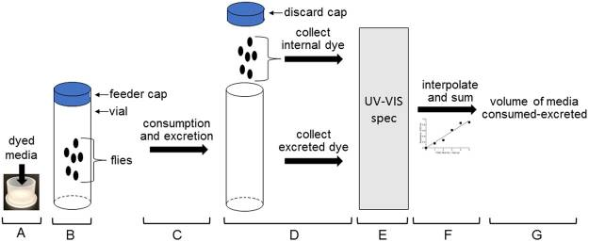
MEASURING FOOD CONSUMPTION: CONSUMPTION-EXCRETION ASSAY
In consumption-excretion method, flies consume solid food labeled with a blue dye, and the volume of food consumed is reflected by the sum of the dye inside of and excreted by flies (shell BC. et al, 2018).

Slide 8
Experimental design
Food consumption
We used 37 SIP lines, male only, a sample size of 555.
Measured food consumption after 48 hours using con-ex method.
Sleep
37 SIP lines, male only, a sample size of 592 at a single-fly resolution.
Recorded sleep over a 24h window using DAM system.

Slide 9
Results

Slide 10
Sleep pattern in SIP lines
Long sleeper
Short sleeper

Slide 11
Food intake in SIP lines
Long sleeper
Short sleeper

Slide 12
Inverse sleep-feeding correlation
Pearson’s coefficient | -0.648447057
p value |  | 0.00003

Slide 13
Discussion

Slide 14
Our results confirm
short and long sleep phenotypes in SIP lines.
a negative correlation between sleep and feeding where long sleepers eat less and short sleepers eat more.
Under optimal conditions, foraging and sleep are balanced allowing individuals to survive. A deviation from this balance may be detrimental.
Future experiments:
Looking at lifespan of SLP lines.
Analyzing starvation resistance of SLP lines.
Ultimately, figuring out the neurocircuits involved in sleep-feeding regulation.

Slide 15
Acknowledgment
My PI: Dr. Dae-Sung Hwangbo
Undergraduate students:
Erica Hassoun
Jason Ho
University of Louisville

