Slide 1
Effects of Water Content on Textural Characteristics of Fish Sausages Prepared from Deboned Silver Carp Meat
Changzheng Wang* and Lingyu Huang
College of Agriculture, Community and the Sciences
Kentucky State University

Slide 2
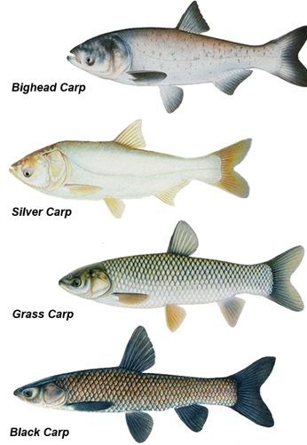
Introduction
Asian carp is a catchall name for species of silver, bighead, grass, and black carp from Southeast Asia;
Asian carp were imported into the U.S. in the 1970s to filter pond water in fish farms in Arkansas.
Flooding allowed them to escape and establish reproducing populations in the wild by the early 1980s.

Slide 3
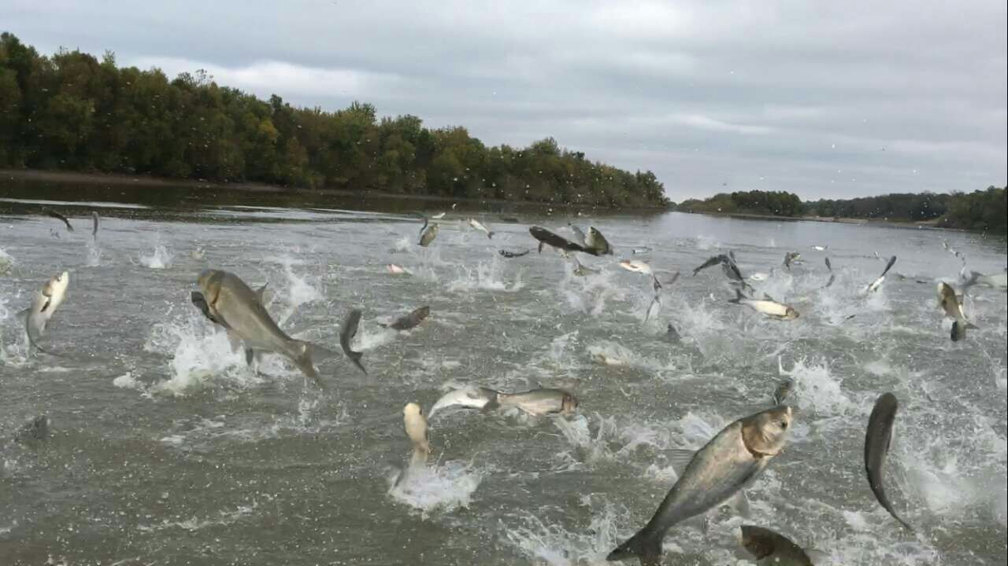
Introduction
Asian carp competes for food with native species;
Asian carp poses a threat to boaters. The fish can leap out of the water when disturbed, often colliding with people and causing injuries.
There is an urgent need to reduce or eliminate this invasive species.

Slide 4
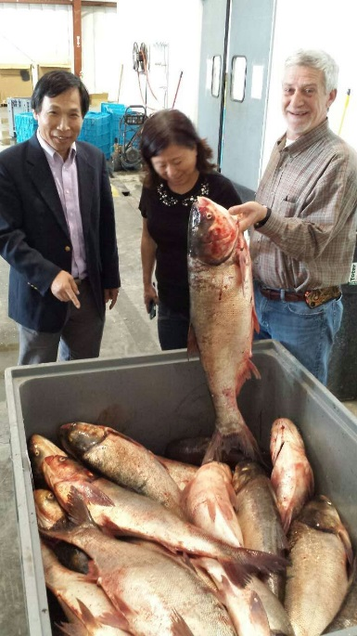
Introduction
Harvesting Asian carp for human consumption
“If you can’t beat them, eat them”

Slide 5
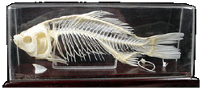
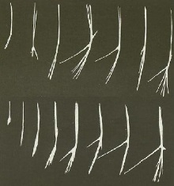
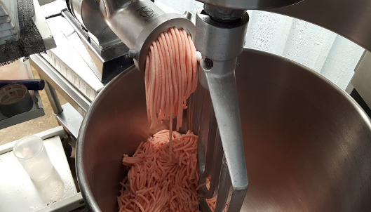
Introduction
Asian carp is widely consumed in Asia and Europe
Asian carp contains intramuscular bones
Mechanic deboning damage the tissue structure, making it hard to serve it in the familiar fillet form

Slide 6
Introduction
Deboned Asian carp meat can be used to make sausages, but the sausages may have a texture harder than desired;
Preliminary studies showed that the texture of the sausages might be improved with the addition 10% corn starch;
Addition of water may also help to modify the textural properties of sausages made from Asian carp meat.

Slide 7
Objective
To determine the effects of water content on the textural characteristics of sausages made from deboned silver carp meat.

Slide 8
Materials and Methods
Silver carp captured from Lake Barkley were deboned and ground through a 3-mm screen by a commercial fish processor;
Samples of deboned silver carp meat were mixed with 0, 5, 10, 15, 20 or 30% water with spices for 30 minutes in a blender (KSM75WH; KitchenAid, Benton Harbor, MI) at the speed setting of 4.

Slide 9
Materials and Methods
Mixed meat paste was stuffed into synthetic casing with a manual sausage stuffer, and heated for 30 minutes in a water bath at 90ºC.
Sausages were cooled in ice and allowed to reach room temperature before 2.5 cm sections were cut out and used for analysis of texture profiles with a texture analyzer (TA.XT Plus, Texture Technologies Corp., Hamilton, MA) in triplicates.

Slide 10
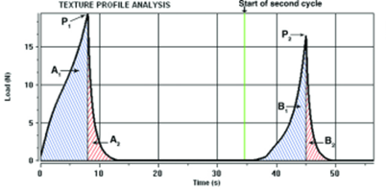
Materials and Methods
Textural profile analysis mimics the mouth’s biting activity, allowing analysis of how food responds when chewed. It allows for multiple textures to be analyzed in one test. During the test, a platen disk probe (100-mm diameter) descends to the target distance (e.g. at 35% strain) and then at 75% strain to rupture the sausage (mimicking the eating process). A typical stress/strain analysis is shown in the Figure.

Slide 11
Results

Slide 12
Hardness of the Sausages
Results
Notes:
% of water content showed the medium of the hardness

Slide 13
Adhesiveness of Sausages
Results
Notes:
The sausages with 10% of water content showed the highest adhesiveness

Slide 14
The springiness of sausages
Results
Notes:
The sausage with 10% of water content represent the highest sprininess

Slide 15
Chewiness of the sausages
Results
Notes:
The sausages with 10-15% of water content showed the medium of the chewiness

Slide 16
Summary
1. Increasing water content decreased the hardness of sausage linearly, indicating the strength of the gel formed was lowered by the addition of water;
2. Adhesiveness was lowest in value (meaning highest adhesiveness) when 10% of water was added.
3. Springiness of the sausage reached the highest level with 10% water addition.

Slide 17
Conclusion
Our results suggest that 10% of water added into the meat paste may help to improve the textual quality of sausages made from deboned Asian carp meat by reducing the hardness and increasing the adhesiveness of sausages.
The results need to be verified with a taste panel in the future.

