Slide 1
Development of Verbal Scent Detecting Algorithm Using Machine Learning to Analyze GCC Signals
Alexandra Driehaus, Dr. Vladimir Dobrokhotov, and Dr. Ivan Novikov
Western Kentucky University
Department of Physics and Astronomy

Slide 2
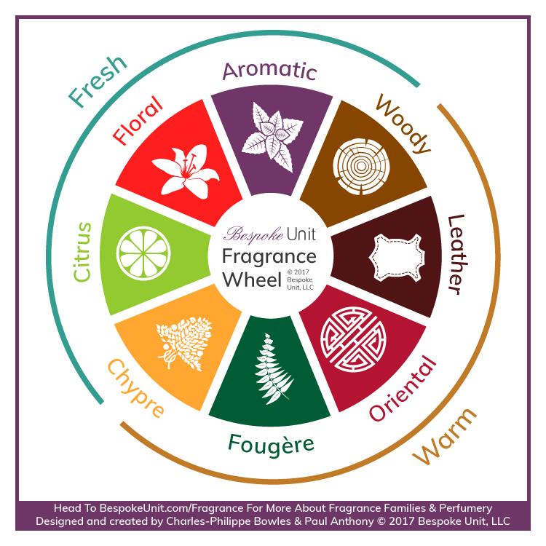
Introduction
Scents are grouped into families based on their verbal descriptions.
These families include citrus, aromatic, woody, oriental, green, leather, and floral.
In his Atlas of Odor Character Profiles (1985), Andrew Dravnieks found the verbal descriptions of 160 chemicals
He surveyed about 140 people with 146 descriptors for each chemical
Cinnamon was found to have 76% applicability for Cinnamon Bark Oil
These descriptors can be used to group the chemicals into their scent families.

Slide 3
Scent Demand
Many are working with chemical formula and scent.
Development of an Electronic Nose for Olfactory System Modelling using Artificial Neural Network (2018) Roa and Fernandez
Applied an e-nose to general odor classification
Analysis of Fragrances in Cosmetics by Gas (1995) Spectrometry and Rastogi
Applied gas chromatography techniques to analyze different cosmetics, including lotions and perfumes

Slide 4
Introduction to the Problem
How to generate a verbal description of scent without human interaction
Quantifying olfactory perception: Mapping olfactory perception space by using multidimensional scaling and self-organizing maps (2003) Mamlouk, et. al.
Olfactory perception of chemically diverse molecules (2016) Keller and Vosshall
Approach:
Take the scents from the Atlas and categorize them into their scent families
Generate their respective chromatograms through Multisensory Gas Chromatography (MGC)
These will be the base for the convolutional neural network
Generate chromatograms for unknown scents
Use these to determine the scents of unknown scents
We seek to measure chromatograms and provide verbal description of scents.

Slide 5
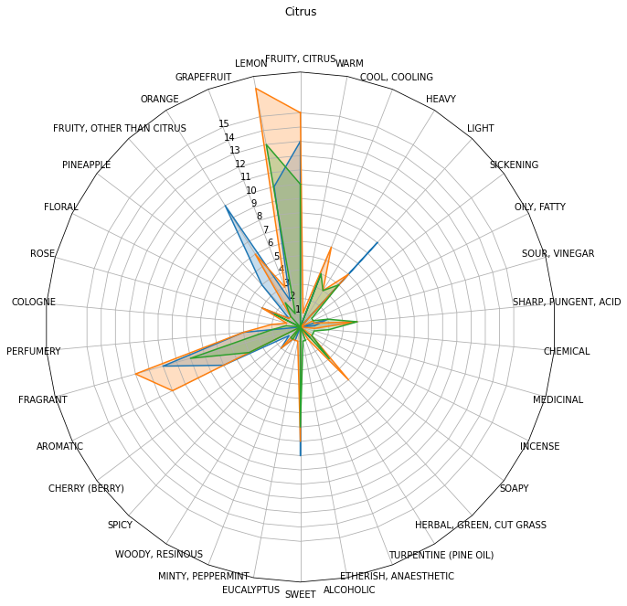
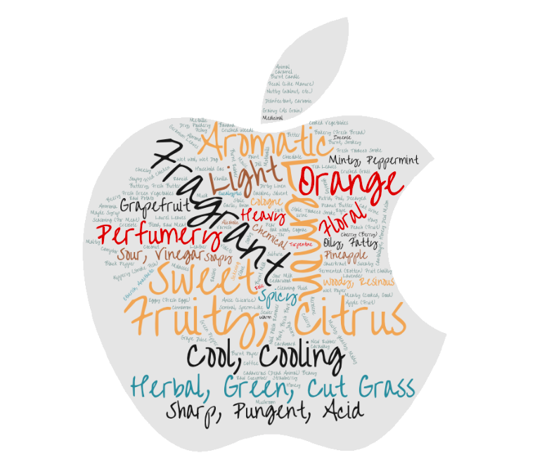
Scent Family: Citrus
Three chemicals from the Atlas were found to be consistent with the citrus family description.
These were:Limonene, Citral, and Citralva
Citrus scents, for example, have notes of lemon, orange, and grapefruit.
These are plots of the applicability of the family.

Slide 6
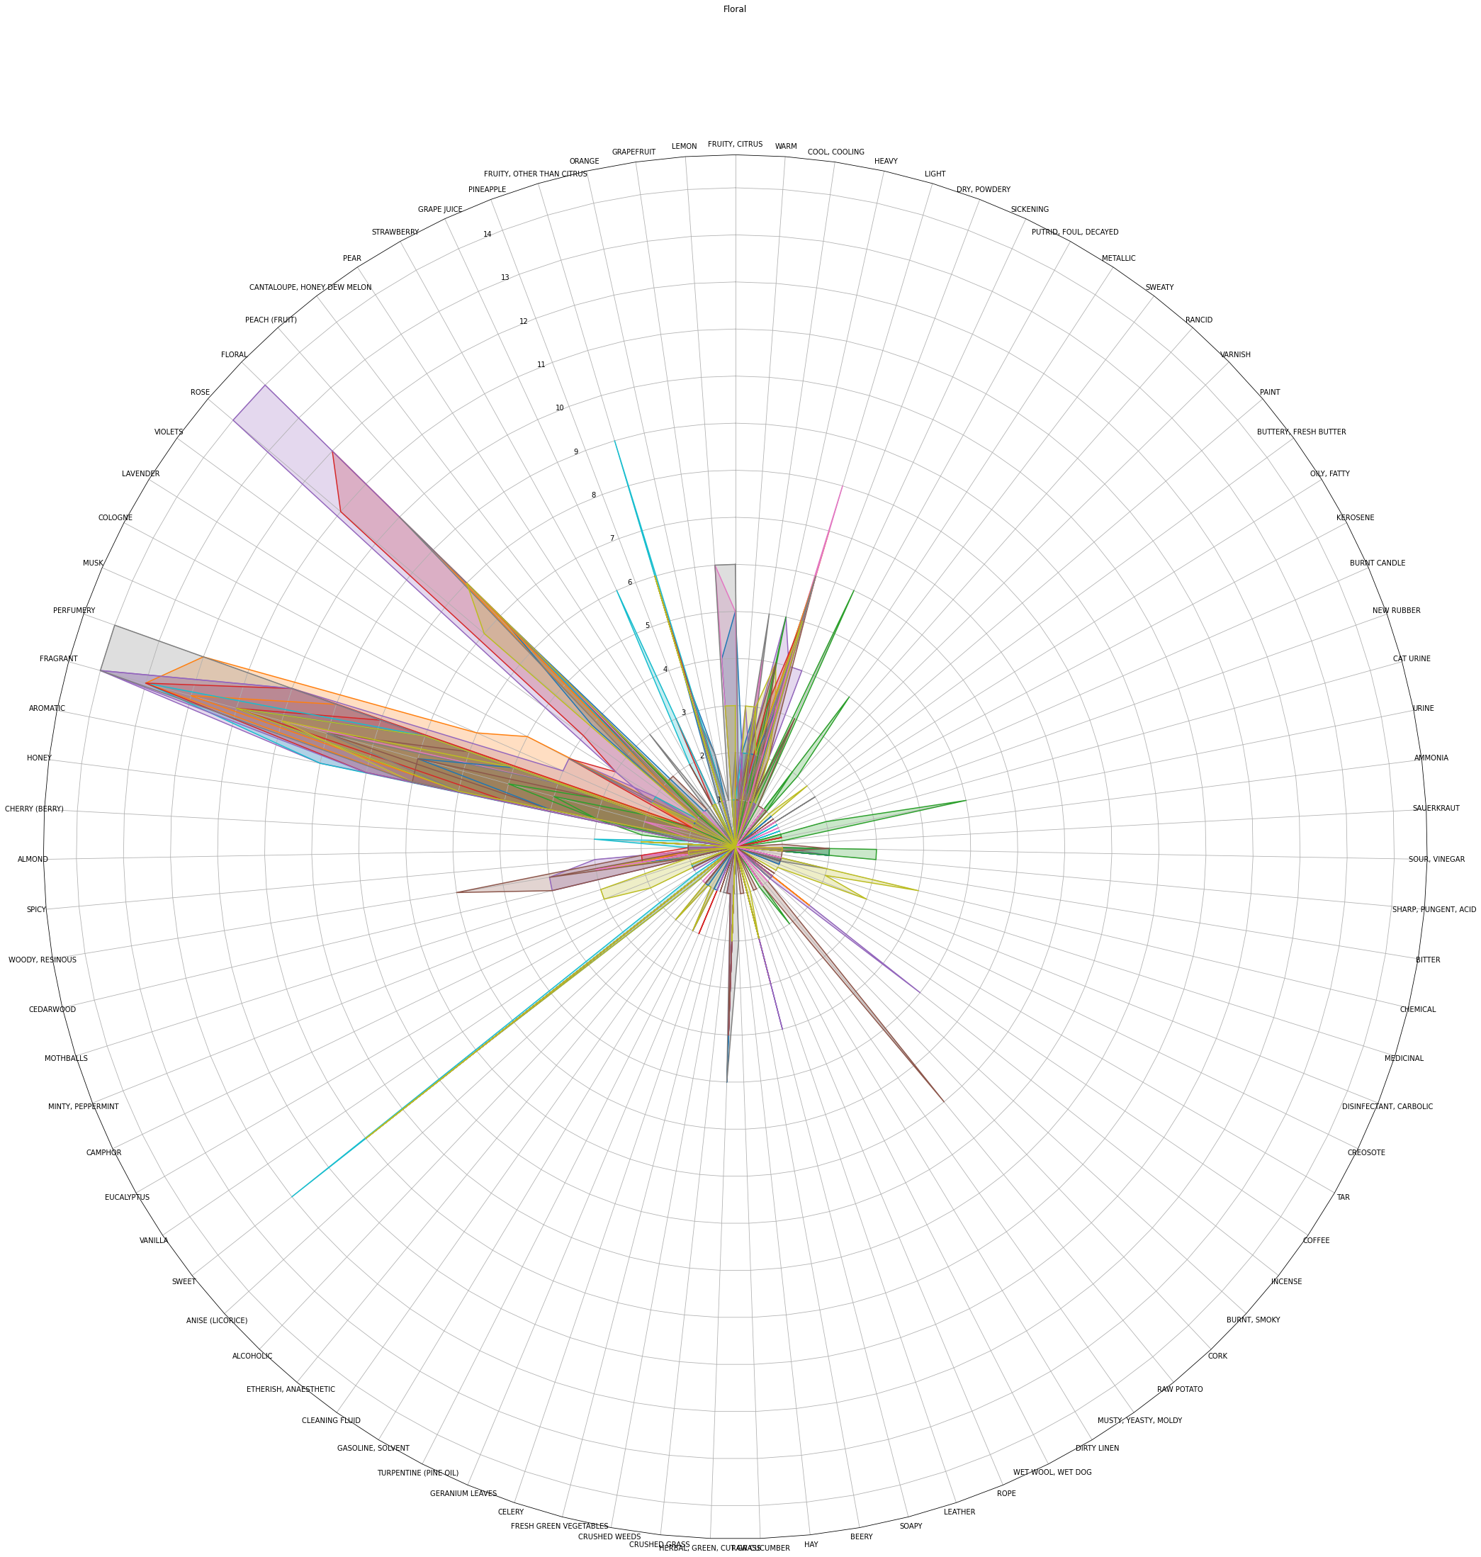
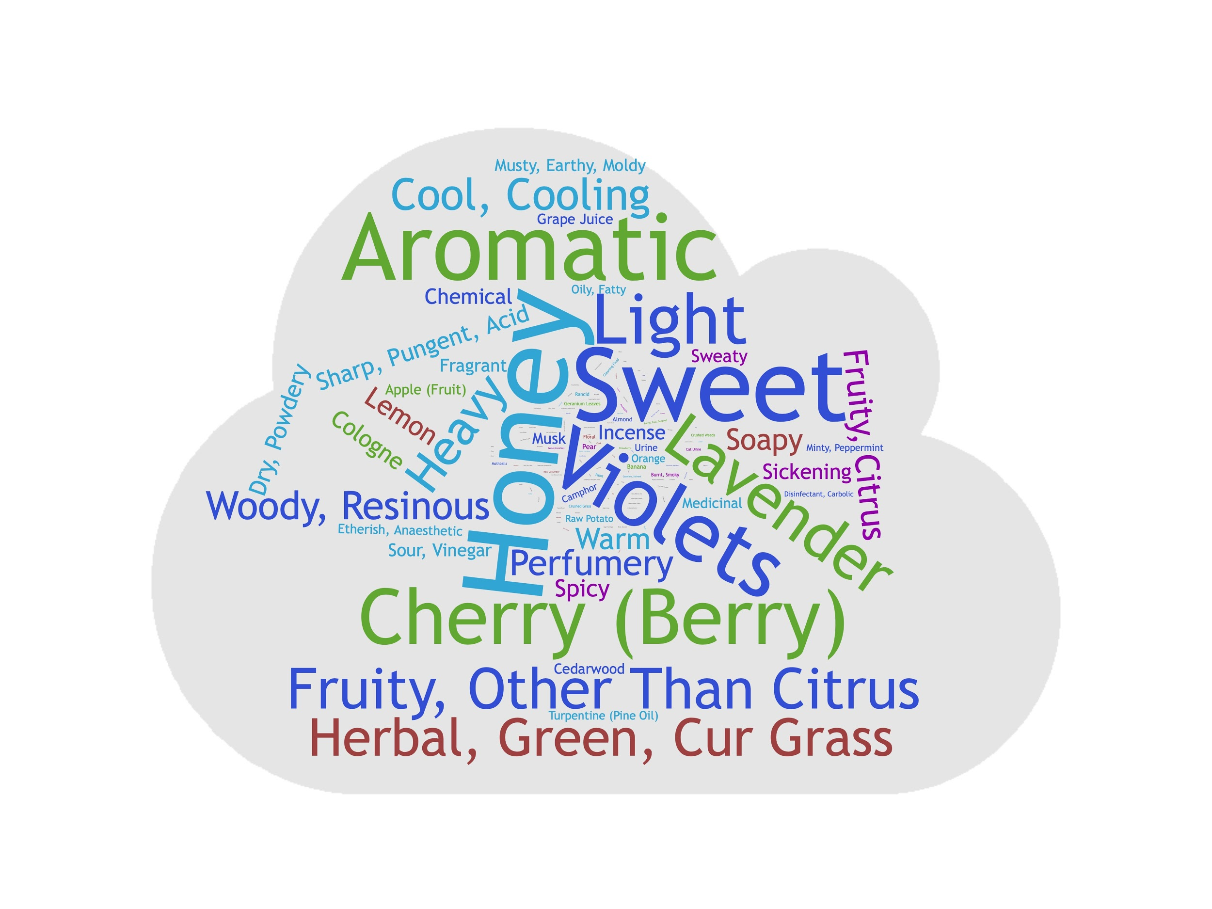
Scent Family: Floral
Nineteen chemicals from the Atlas were found to be consistent with the floral family description.
Floral scents, for example, have notes of roses and lavender.
These are plots of the applicability of the family.

Slide 7
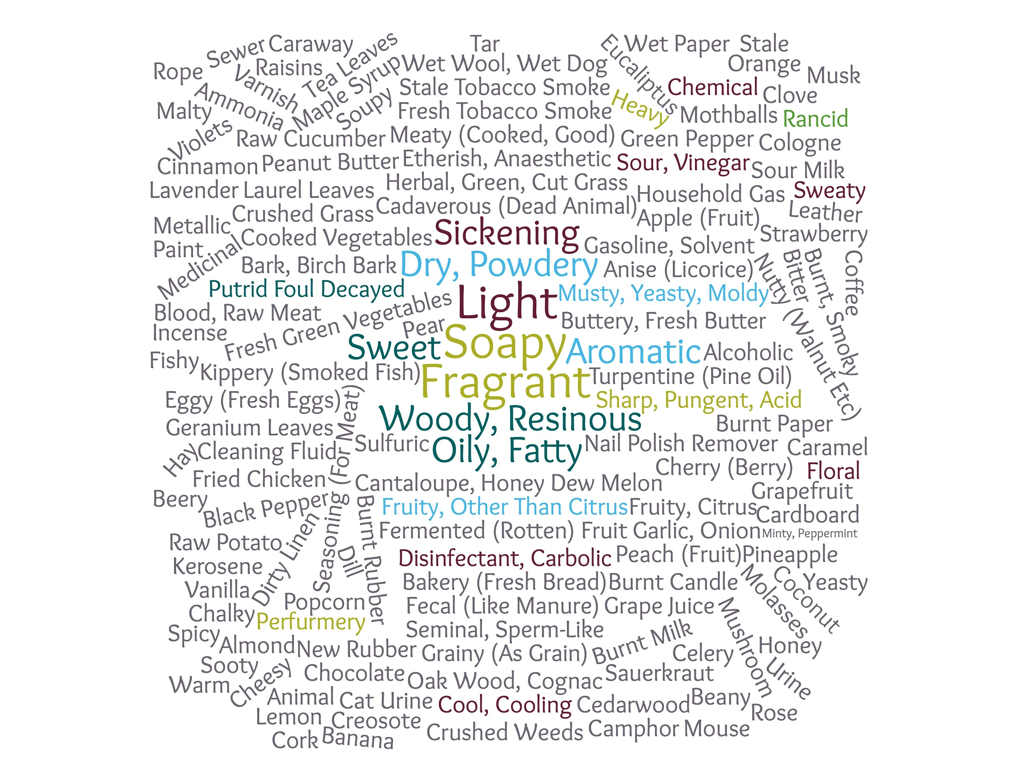
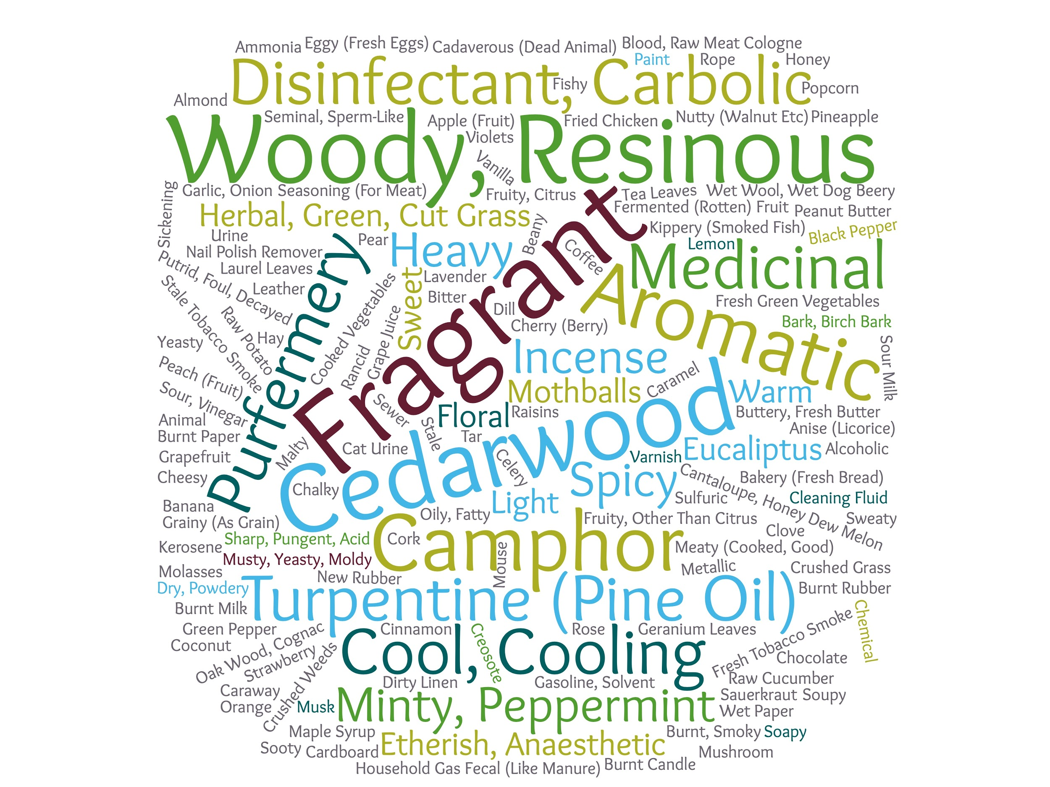
Scents from the Same Family
The verbal descriptions of scents from the same family are similar. These are both chemicals from the woody family: Oceanic Ether (Top) and Patchouli Oil (Bottom)
The woody family often has notes of cedarwood and patchouli.

Slide 8
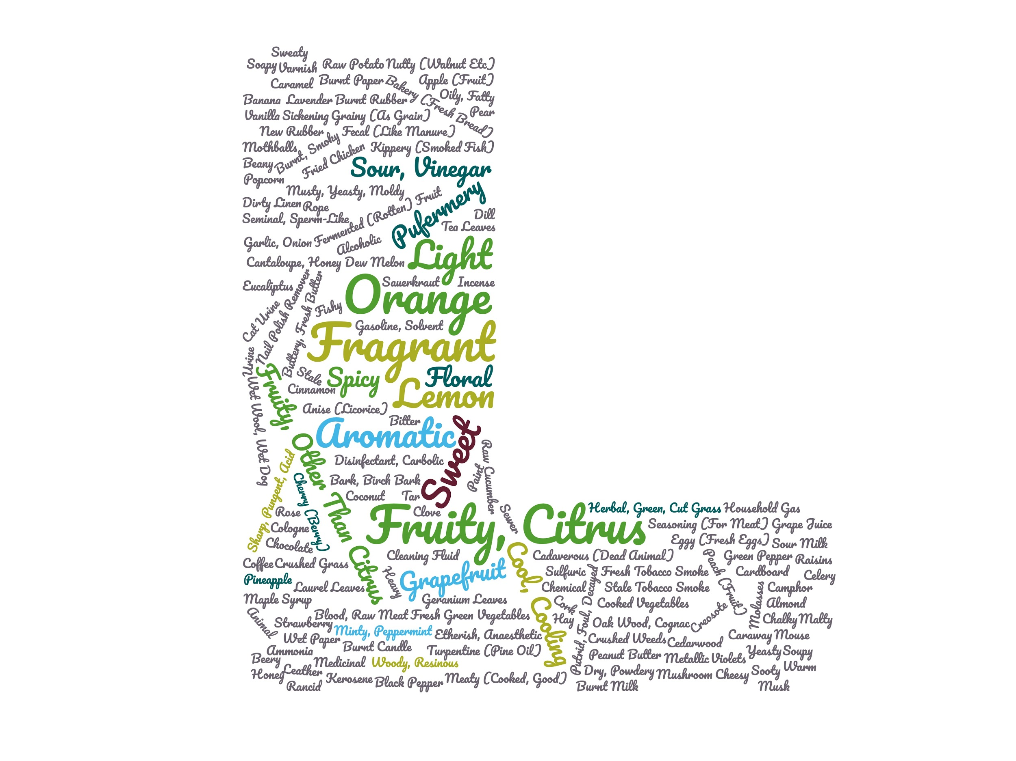
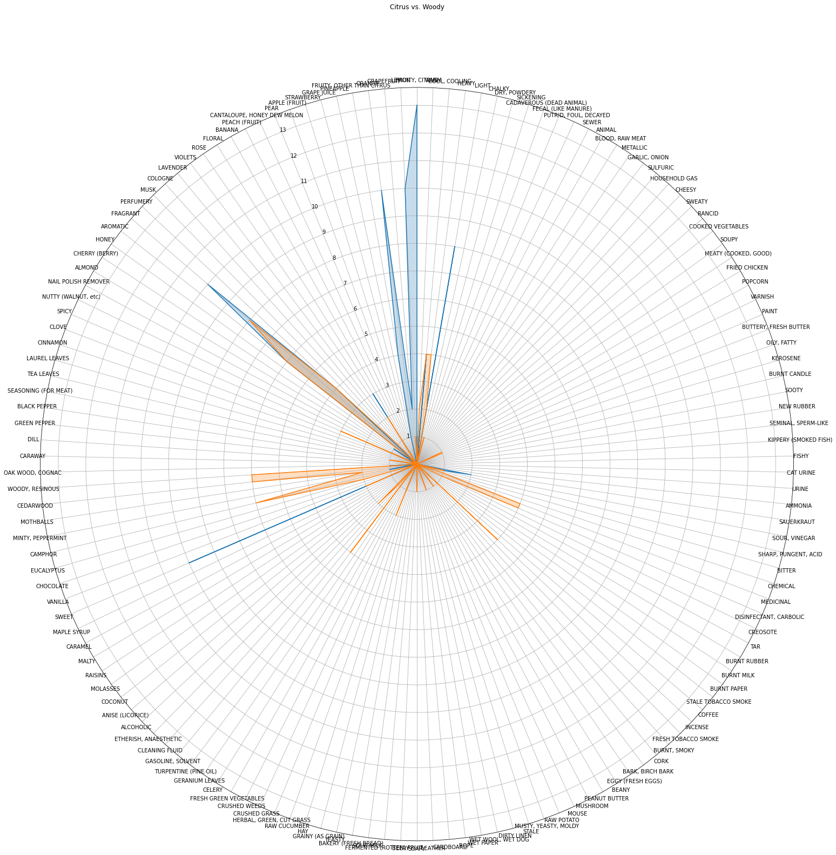
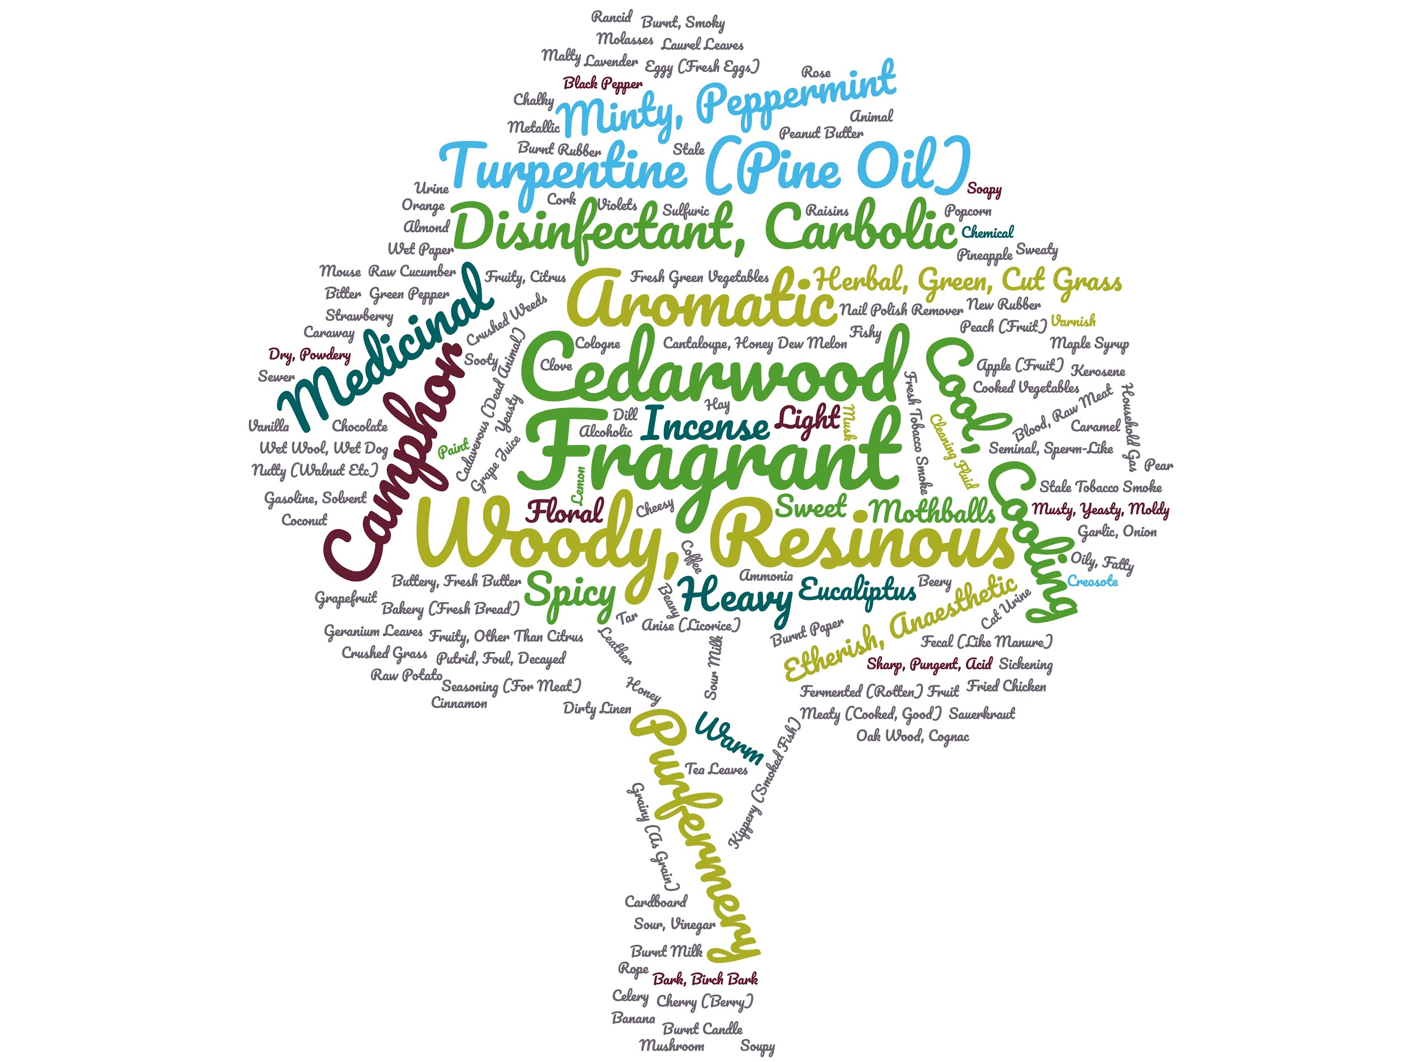
Limonene and Patchouli Oil
Limonene is a citrus scent and Patchouli Oil is woody.

Slide 9
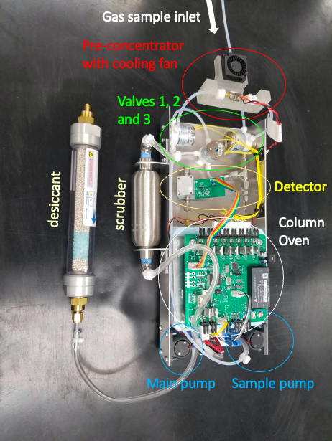
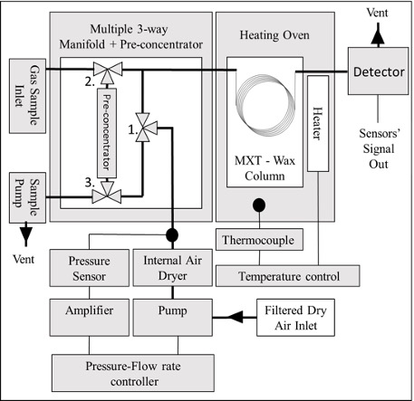
Multisensory Gas Chromatography
MGC collects data by using the apparatus to analyze scented chemicals
Creates a chromatogram for each scent

Slide 10
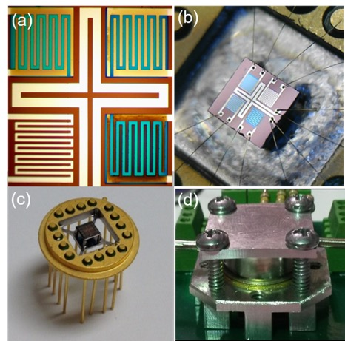
Multisensory Detector
The multisensory detector
Recovery and response in ms
No long-term drift
3% Performance variance
The 4 sensor has four regions
SnO₂
Dual Oxide; SnO₂/TiO ₂
SnO₂ coated with Au/Pd
SnO₂ coated with Pt nanoparticles

Slide 11
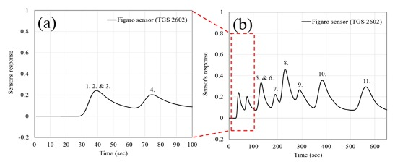
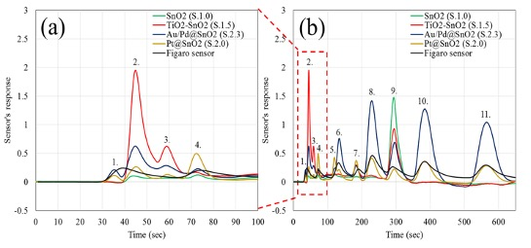
Preliminary Experimental Results
Chromatographic data can be used to determine chemical structure.
Conventional Detectors (top)
Non-selective MOX detector
Many peaks are stacked
Novel Detector (bottom)
Selective MOX Detector
Peaks are more distinct

Slide 12
Future Work
Perform the experiment
With known scents:
To build the base for the convolutional neural network
Formulate the algorithm
Perform the experiment (again)
With unknown scents
Generates a verbal description
Test the validity of the experiment
Check that the generated description matches the manufacturer’s description

