Slide 1
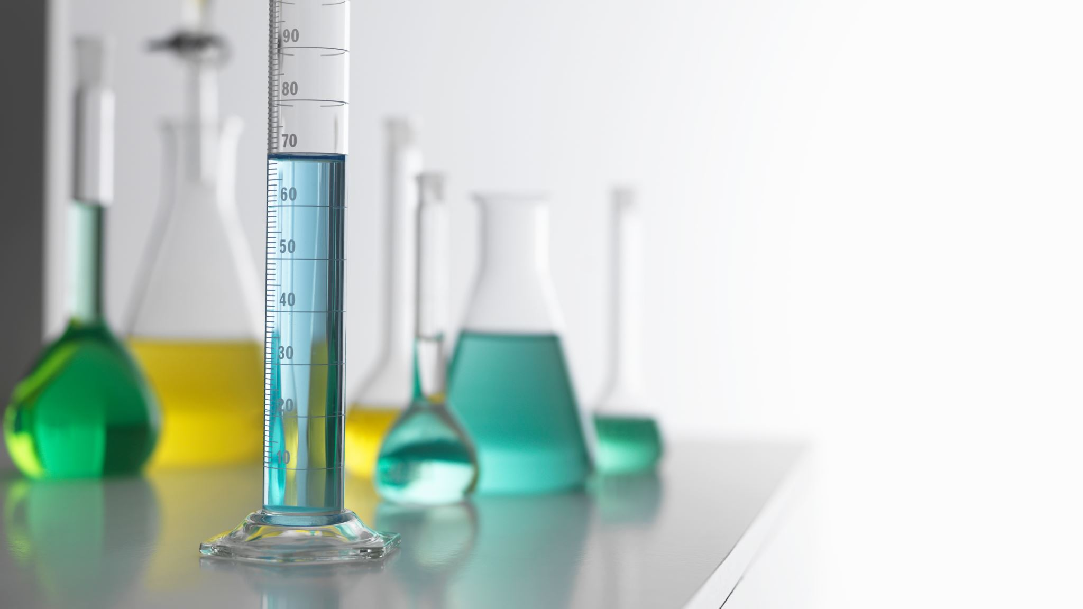
Chemical Fingerprinting of Commercially Available Saffron: High-Performance Thin Layer Chromatography
Shreya V. Patel*, Avinash M. Topè, Leigh Whittinghill, Hideka Kobayashi
Kentucky State University, 400 E Main Street, Frankfort, Kentucky 40601, USA

Slide 2
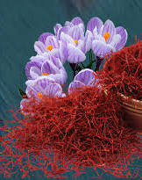
Saffron: Crocus sativus L
Climate and Regions: cold winters, warm summers, and low humidity.
The largest exporters of saffron:
Spain (45.9%), Afghanistan (17.9%), Hong Kong (5.2%), Morocco (0.8%) and India (0.7%).
The current global export value of saffron: $119 million.
One kilogram of saffron: $3,500 to $160,000.
One of the most expensive spices.
Price is based on the origin and purity.
https://www.sultanspice.co.nz/wp-content/uploads/2019/04/Saffron-3.png

Slide 3
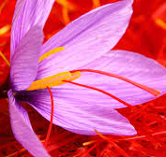
Saffron: Dried Stigma
Orange-red filaments harvested from the saffron flower.
2300 BC; medicinal and culinary properties
Nutrients: riboflavin, thiamine, magnesium, calcium, iron, manganese, copper, zinc, reducing sugar, starch, flavonoids and protein.
Medicinal properties: Antidepressant, aphrodisiac, cardiotonic, carminative, anti-inflammatory, hepatoprotective, hypnotic, labor-inducing/emmenagogue, and bronchodilation properties.

Slide 4
Saffron: Major Chemical Constituents
Intense natural yellow coloration, bittersweet taste, and a powerful aroma.
Seasoning and flavoring agent in several regional food preparations.
Safranal, crocin, and picrocrocin are considered three important constituents in quality control evaluations of saffron.
Factors that affect their density and ratio:
Agricultural and environmental conditions
This density and ratio are considered primary factors in determining the quality of saffron.

Slide 5
Growing Saffron
Growing high-quality saffron for commercial use is a challenging, labor-intensive and expensive process in North America, making United States as one of the major importers of saffron.
The procedure of planting saffron bulbs is relatively simple.
Harvesting stigmata is labor intensive as the blossoms are too delicate to be harvested mechanically.
Each flower of C. sativus L. has 3 stigma threads that weigh approximately 2 mg each.
Thus, about 150,000 flowers are needed to yield 1 kg of saffron stigma.
Due to its medicinal value, expensive costs, market value and limited availability, the potential for deliberate adulteration of saffron is high.

Slide 6
High Performance Thin Layer Chromatography (HPTLC)
Recent advances in thin layer chromatography (TLC), specifically the development of HPTLC, have made it a more attractive method for the quantification of herbal constituents.
A few advantages of HPTLC:
Analysis of crude samples containing multiple components.
Simultaneous separation of several samples in parallel on the same plate.
Time-saving, rapid, reproducible, precise, low-cost analysis.
Solid stationary phase - evaluated by machine as well as visually because slow-moving fractions on the planar layer are represented as sharp peaks.
Visual detection of separate spots derivatized on the plate using specific and sensitive color stains
A comprehensive chromatographic fingerprint can be established using HPTLC.

Slide 7
HPTLC for Saffron Extracts
Few studies have been reported on analyses evaluating the quality of saffron from different geographical regions, especially using HPTLC.
Bakre et al. (2000) conducted studies to evaluate the authenticity of saffron and demonstrated that crocin and other constituents of saffron could be visualized by the methanol extract method.
Corti et al. (1996) developed a method for quantitative analysis of picrocrocin and crocetin with HPTLC.
The objective of this study is to establish a comprehensive fingerprint profile of saffron samples cultivated across the globe using HPTLC.

Slide 8
Methodology
Sample extraction:
10 mg of saffron was extracted using 10 ml of 80% ethanol (AR grade, Sigma-Aldrich, St. Louis, MO).
The mixture was homogenized and sonicated in the dark for 15 minutes.
The mixture was centrifuged, and the supernatant was stored in a 2-ml auto-sampler vial.
High-performance thin-layer chromatography:
2 µl of each of the 9 saffron extracts were spotted on Merck glass plates pre-coated with silica gel 60 F254 plates.
Solvent system:
2-propanol, ethyl acetate, and water (13:2:1 v/v/v) yielded the best resolution of the saffron fingerprint on the TLC plates.
Scanning and detection of spots:
Air-dried chromatograph plates were scanned at 254 and 310 nm using an ultraviolet cabinet with dual wavelengths (254 and 310 nm).

Slide 9
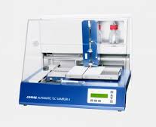
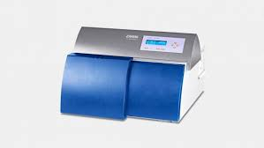
Results
Sample code | R_{f} values at 254 nm
1 | 0.05 | 0.08 | 0.13 | 0.25 | 0.29 | 0.34 | 0.45 | 0.5 | 0.55 | 0.83
2 | 0.05 | 0.08 | 0.14 | 0.25 | 0.29 | 0.34 | 0.45 | 0.5 | 0.55 | 0.82
3 | 0.09 | 0.12 | 0.19 | 0.28 | 0.31 | 0.35 | 0.4 | 0.5 | 0.58 | 0.83
4 |  | 0.11 | 0.17 | 0.34 | 0.47 | 0.57 |  |  |  | 0.81
5 | 0.07 | 0.11 | 0.18 | 0.28 | 0.39 | 0.48 | 0.46 | 0.51 | 0.60 | 0.8
6 |  | 0.11 | 0.17 | 0.28 | 0.39 | 0.36 | 0.47 | 0.51 | 0.75
7 | 0.08 | 0.11 | 0.15 | 0.23 | 0.28 | 0.36 | 0.47 | 0.51 | 0.6 | 0.8
8 | 0.1 | 0.16 | 0.28 | 0.33 | 0.36 | 0.48 | 0.51 | 0.58 | 0.75
9 | 0.1 | 0.16 | 0.28 | 0.33 | 0.36 | 0.48 | 0.51 | 0.58 | 0.75
Sample Code | Sample Origin | Number of Peaks at 254 nm | Number of Peaks at 310 nm
1 | Spain | 10 | 9
2 | Kashmir Valley | 10 | 9
3 | Afghanistan | 10 | 10
4 | Afghanistan | 6 | 8
5 | Kashmir | 10 | 9
6 | Morocco | 9 | 10
7 | Afghanistan | 8 | 9
8 | Spain | 9 | 8
9 | Iran | 9 | 11
Sample code | R_{f} values at 310 nm
1 | 0.05 | 0.08 | 0.14 | 0.19 | 0.25 | 0.34 | 0.45 | 0.5 |  |  | 0.81
2 | 0.05 | 0.085 | 0.14 | 0.19 | 0.25 | 0.3 | 0.34 | 0.45 |  |  | 0.81
3 |  | 0.08 | 0.12 | 0.19 | 0.25 | 0.30 | 0.4 | 0.5 | 0.55 | 0.62 | 0.81
4 |  | 0.08 | 0.11 |  | 0.29 | 0.37 | 0.48 | 0.52 |  | 0.6 | 0.8
5 |  | 0.11 | 0.18 | 0.28 | 0.33 | 0.37 | 0.47 | 0.51 | 0.56 |  | 0.8
6 | 0.07 | 0.10 | 0.17 | 0.23 | 0.28 | 0.33 | 0.46 | 0.51 |  | 0.6 | 0.8
7 |  | 0.08 | 0.15 | 0.26 | 0.33 | 0.36 | 0.47 | 0.51 | 0.57 | 0.75
8 |  | 0.10 | 0.15 | 0.28 |  | 0.37 | 0.47 | 0.51 |  | 0.61 | 0.8
9 | 0.08 | 0.11 | 0.15 | 0.22 | 0.28 | 0.37 | 0.43 | 0.48 | 0.51 | 0.6 | 0.8

Slide 10
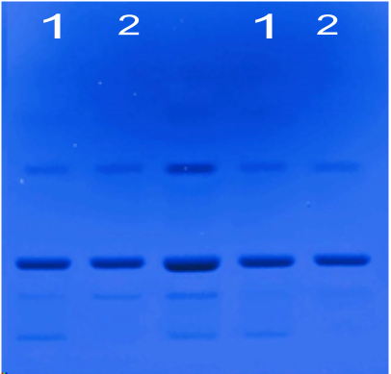
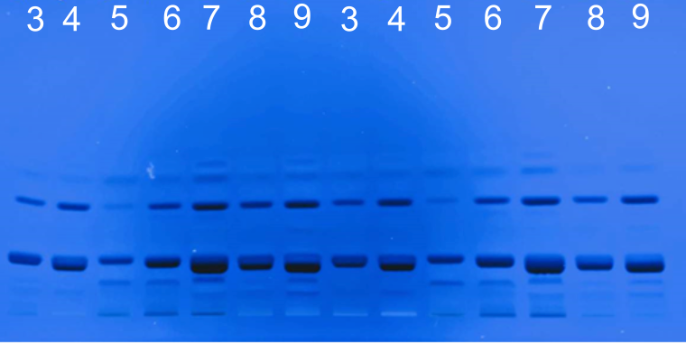
Chemical Fingerprints of Saffron Extracts under UV light

Slide 11
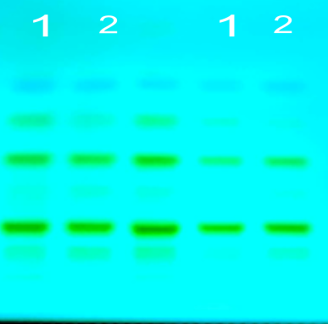
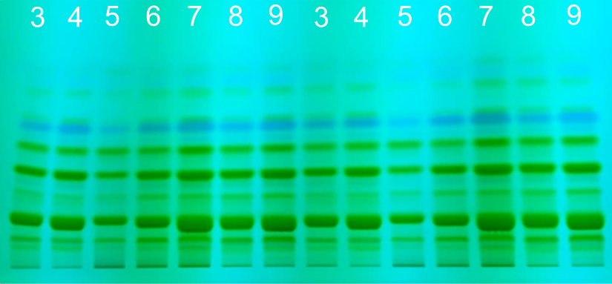
Chemical Fingerprints of Saffron Extracts under UV light

Slide 12
Discussion
Due to its pharmacological significance and culinary uses as well as high market value, saffron is frequently subjected to adulteration.
This presentation displays the preliminary results from fingerprint analysis of saffron extracts of products from different countries and identifies the solvent system to develop these extracts.
These preliminary results demonstrate the potential application of HPTLC technique to determine the composition of saffron extracts.

Slide 13
Discussion
For the current study, we report fingerprints of nine saffron samples obtained from six different countries/regions using HPTLC while scanning at 254 nm and 310 nm.
Results from few other studies aimed at quantifying safranal, picrocrocin, and crocin using HPTLC have indicated a higher response of safranal and better linearity between peak areas at 310 nm while the preferred wavelength for identification and separation of picrocrocin and crocin is at 254 nm.
Additional studies will be conducted to identify and quantify the active ingredients such as crocin, picrocrocin, and safranal in these samples using reference standards.
To the best of our knowledge, this is the first study reporting chemical fingerprinting of saffron samples from major exporting countries using HPTLC.

Slide 14
Acknowledgements
This work is supported by 1890 Institution Teaching, Research and Extension Capacity Building Grant (CBG) Program Grant # 2019-38821-29115; Accession #1018229 from the USDA
Kentucky Academy of Science

Slide 15
References
Saffron Market Trends, Prices, and Suppliers. (n.d.). Tridge. Retrieved April 23, 2020 from https://www.tridge.com/products/saffron
Pathan SA, Alam S, Jain GK, Zaidi SMA, Akhter S, Vohora D, Khar RK, and Ahmad FJ. (2010). Quantitative analysis of safranal in saffron extract and nanoparticle formulation by a validated high-performance thin-layer chromatographic method. Phytochemical Analysis 21(3): 219-223. https://doi.org/10.1002/pca.1184.
Kabiri M, Rezadoost H, and Ghassempour A. (2017). A comparative quality study of saffron constituents through HPLC and HPTLC methods followed by isolation of crocins and picrocrocin. Lebensmittel-Wissenschaft & Technologie 84: 1-9. https://doi.org/10.1016/j.lwt.2017.05.033.
Gohari AR, Saeidnia S, and Mahmoodabadi MK. (2013). An overview on saffron, phytochemicals, and medicinal properties. Pharmacognosy Reviews 7(13): 61-66. https://doi.org/10.4103/0973-7847.112850.
Thachil AF, Mohan R, and Bhugra D. (2007). The evidence base of complementary and alternative therapies in depression. Journal of Affective Disorders 97(1-3): 23-35. https://doi.org/10.1016/j.jad.2006.06.021.
Bhandari PR. (2015). Crocus sativus L. (saffron) for cancer chemoprevention: A mini review. Journal of Traditional and Complementary Medicine 5(2): 81-87 . https://doi.org/10.1016/j.jtcme.2014.10.009
Chatterjee S, Poduval TB, Tilak JC, and Devasagayam TPA. (2005). A modified, economic, sensitive method for measuring total antioxidant capacities of human plasma and natural compounds using Indian saffron (Crocus sativus). Clinica Chimica Acta 352(1-2): 155–163. https://doi.org/10.1016/j.cccn.2004.09.012.
Mangal AK, Tewari D, Shantha TR, Bansal S, and Mangal, M. (2018). Pharmacognostical standardization and HPTLC fingerprinting analysis of Crocus sativus L. Indian Journal of Traditional Knowledge 17 (3): 592-597. http://nopr.niscair.res.in/handle/123456789/44572
Decker F. (2019). How to Grow Saffron for Profit. Small Business Chronicle.com. Available at: https://smallbusiness.chron.com/grow-saffron-profit-75770.html
Sherma J, and Rabel F. (2019). Thin layer chromatography in the analysis of cannabis and its components and synthetic cannabinoids. Journal of Liquid Chromatography & Related Technologies 42(19-20): 613-628. https://doi.org/10.1080/10826076.2019.1663529
Badyal, PN, Sharma C, Kaur N, Shankar R, Pandey A, Rawal RK. (2015). Analytical techniques in simultaneous estimation: An overview. Austin Journal of Analysis and Pharmaceutical Chemistry. 2: 1037 . https://austinpublishinggroup.com/analytical-pharmaceutical-chemistry/fulltext/ajapc-v2-id1037.php
Shivatare R, Nagore D, and Nipanikar S. (2013). “HPTLC” an important tool in standardization of herbal medical product: A review. Journal of Scientific and Innovative Research 2(6): 1086-1096 . http://www.jsirjournal.com/Vol2Issue6018.pdf
Caballero-Ortega H, Pereda-Miranda R, Riverón-Negrete L, Hernández JM, Medécigo-Ríos M, & Castillo-Villanueva A, and Abdullaev FI. (2004). Chemical composition of saffron (Crocus sativus L.) from four countries. Acta Horticulture 650: 321-326. https://doi.org/10.17660/ActaHortic.2004.650.39.
Bakre SM, Krishnamurthy R, and Shinde BM. (2000). Study of genunity of saffron samples - A case study. Journal of Scientific and Industrial Research. 59: 596-598 . http://nopr.niscair.res.in/handle/123456789/26599
Merck Index (Merck & Co. Inc. Rahway, NJ, US (1968) 8th edn, 294-295 .
Corti P, Mazzei E, Ferri S, Franchi GG, and Dreassi E. (1996). High performance thin layer chromatographic quantitative analysis of picrocrocin and crocetin, active principles of saffron (Crocus sativus L.-Iridaceae): A new method. Phytochemical Analysis 7(4): 201-203. https://doi.org/10.1002/(sici)1099-1565(199607)7:4<201:aid-pca304>3.0.co;2-4
Planar in Chromatography Practices (2003) CAMAG Bibliography Services

Slide 16
THANK YOU

