Slide 1
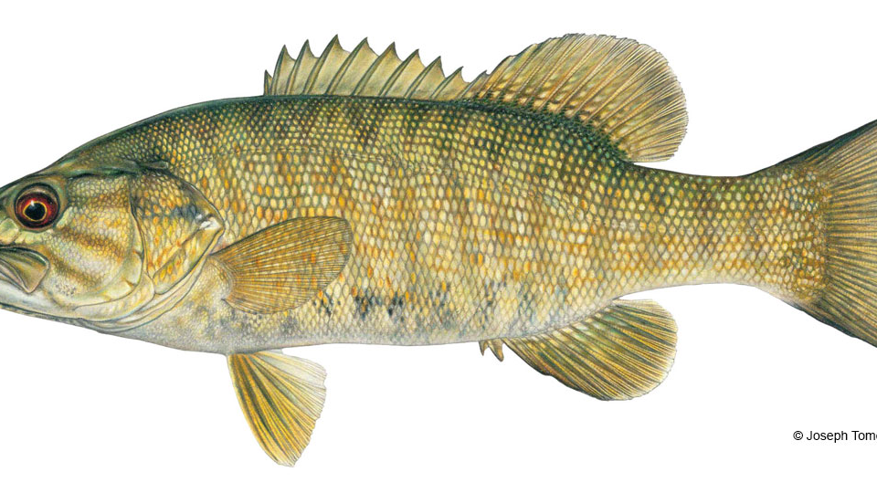
Effects of available forage on habitat selection of fathead minnows (Pimephales promelas) in the presence of predation hazard
Faith Day, Rebecca Piché, Ben Brammell
Asbury University Department of Science and Health
Notes:
Pim – e – fell – ees
Pro- mel- as

Slide 2
Optimal Foraging Theory
Benefit of energy return:
Metabolic Cost¹
Use of energy¹
Predation Cost:
Safety of habitat^{1,2}
Missed Opportunities:
Minimized time defending territory
Reproduction
Thermoregulation²
1- Altendorf (2001)
2- Kie (1999)
Notes:
In order for us to understand the effects of available forage on habitat selection, we need to understnad how fish interact with their environemnt. To do this we need to look at the opitimal foraging theory and its three main ideas: ...
First we look at the benefot of energy return, meamning the metabolic cost and use of energy for fish while foraging. for fish when foraging, they are attempting to reach a positive energy return, meaning that if they are going to use energy to forage, the foodon return must replenish the energy spent.
Even if there is a positive energy return, they have to consider the predation cost. IF there is a high predation cost, the fish is less likely to forage within the area, because of the safety of the habitat.
Finally, if they spend too much time foraging, there is the potential of missed oppo, ushc as ... which can be detrimental to the species

Slide 3
Selecting Habitats
Brown (1999) and McNamara (1991) established the apprehension and vigilance levels
Apprehension and vigilance then alters the habitat selection
Notes:
Now that we understnad the OFT, we can better understand how this alters the selection of habitat.
Prey must select their optimal level of vigilance in response to their perceptions of a predator's whereabouts. Prey must select a baseline level of apprehension that determines their level of vigilance. If prey set their level of apprehension too high, they miss valuable feeding opportunities. If they set it too low, they likely are to be killed by the predator.
The giving up density of a forager, which is behaving optimally, should correspond to a harvest rate that just balances the metabolic costs of foraging, the predation cost of foraging, and the missed opportunity cost of not engaging in alternative activities
Their habitat selection should then correspond.

Slide 4
The habitat selection of fat head minnows
will be altered by the presence of food.

Slide 5
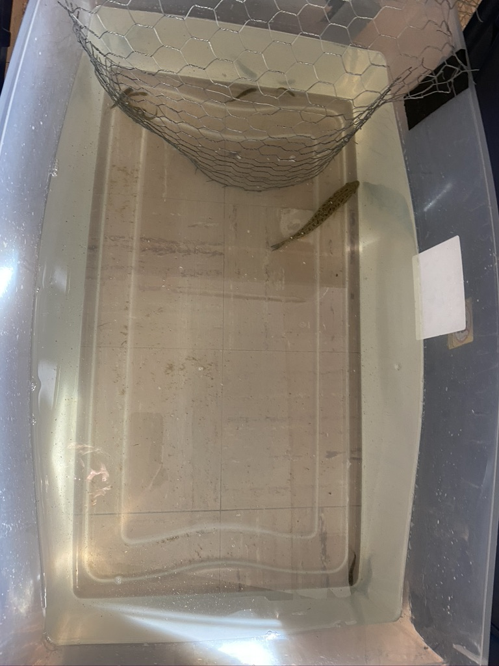
Habitat
CLOSED
OPEN

Slide 6
Condition 1: Food absent
A smallmouth bass (Micropterus dolomieu) was acclimated for 5 minutes
Fathead minnows (8) were added into the open habitat
Readings were taken every 30 seconds for 20 minutes
Conditions: Lights off, Sunlight only, 25°C water temp

Slide 7
Condition 2: Food present
A smallmouth bass was acclimated for 5 minutes
Bloodworms were added
Fathead Minnows (8) were added into the open habitat
Readings were taken every 30 seconds for 20 minutes
Conditions: Lights off, Sunlight only, 25°C water temp

Slide 8
Results: Effect of the presence of food on habitat selection of Pimephales promelas.

Slide 9
Results
Average number of FHM foraging outside of the refuge
Trial | Food Absent | Food Present
1 | 0.05 | 1.47
2 | 1.28 | 3.55
3 | 1.97 | 2.8
4 | 1.90 | 0.55
5 | 0.60 | 2.23
6 | 1.56 | 3.36
7 | 2.66 | 3.31
8 | 1.26 | 3.51
9 | 2.28 | 2.65
10 | 1.31 | 3.4
 | t-Test
 |  | Food Absent | Food Present
 | Mean | 1.49 | 2.68
 | Variance | 0.60 | 1.00
 | P= | 0.004
Notes:
An independent-samples t-Test was performed on the mean number of fish found outside of the protective barrier on ten trials with a series of 30-second intermittent measurements and statistical evidence was found suggesting fish were more likely to venture out when bloodworms were present (M = 2.68) than when bloodworms were not present (M = 1.49), t(18) = -2.98, p <.01.

Slide 10
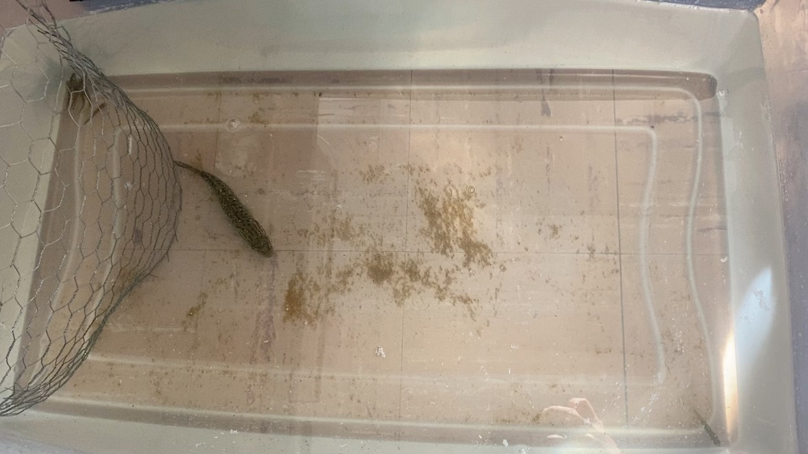
Discussion: Overview of Observed Behavior
Both groups willingly left the refuge
FHM moved freely through open habitat in the presence of food
FHM remained primarily in the corner of the open habitat without food present
SMB typically remained near the refuge
Notes:
There were a couple of points that were not neeessarily conevyed through the data.
In all of the trials FHM left the refuge, however what differed was how much and how often.
When food was present, they moved freely throughout the container showing what i would consider foraging behavior, meaning they were eating, swimming through the middle of the container, and not remaining the corner or the closed habitat.
When food was absent, they left the closed habitat less and when they did they remained primareily in the far corner of the container. They did not forage around or swim freely.
The smallmouth bass remained close to the closed habitat unless there were FHM foraging.

Slide 11
Implications
FHM habitat selection changed in the presence of the bloodworms
Allows us to better understand the optimal foraging in the Cyprinid species, specifically to habitat selection and feeding
Insight into the vigilance and apprehension decisions of the Cyprinid species

Slide 12
Future Directions
Consider effect of predatory hazard by increasing the number of predators
Evaluate varying food densities and their effect on foraging

Slide 13
Acknowledgments
Jennifer at B and B Tackle
Dr. Nesselroade
Asbury University Department of Science and Health

Slide 14
Sources
Altendorf K.B, Laundré J.W., González C.A., Brown J.S Assessing Effects of Predation Risk on Foraging Behavior of Mule Deer, Journal of Mammalogy, Volume 82, Issue 2, May 2001, Pages 430–439, https://doi.org/10.1644/1545-1542(2001)082<0430:AEOPRO>2.0.CO;2
BrownJ.S., Laundré J.W., Gurungm M., The Ecology of Fear: Optimal Foraging, Game Theory, and Trophic Interactions, Journal of Mammalogy, Volume 80, Issue 2, 20 May 1999, Pages 385–399, https://doi.org/10.2307/1383287
Kie, J.G. Optimal Foraging and Risk of Predation: Effects on Behavior and Social Structure in Ungulates, Journal of Mammalogy, Volume 80, Issue 4, 6 December 1999, Pages 1114–1129, https://doi.org/10.2307/1383163
McNamara, J. M., & Houston, A. I. (1992). Evolutionarily stable levels of vigilance as a function of group size. Animal Behaviour, 43(4), 641-658. https://doi.org/10.1016/S0003-3472(05)81023-1

