Slide 1
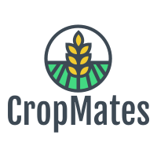
CropMates
A low-cost and efficient IoT and AI-based integrated system for the detection and treatment of crop diseases and deficiencies that maximize the quality and quantity of crops to potentially eradicate world hunger.

Slide 2
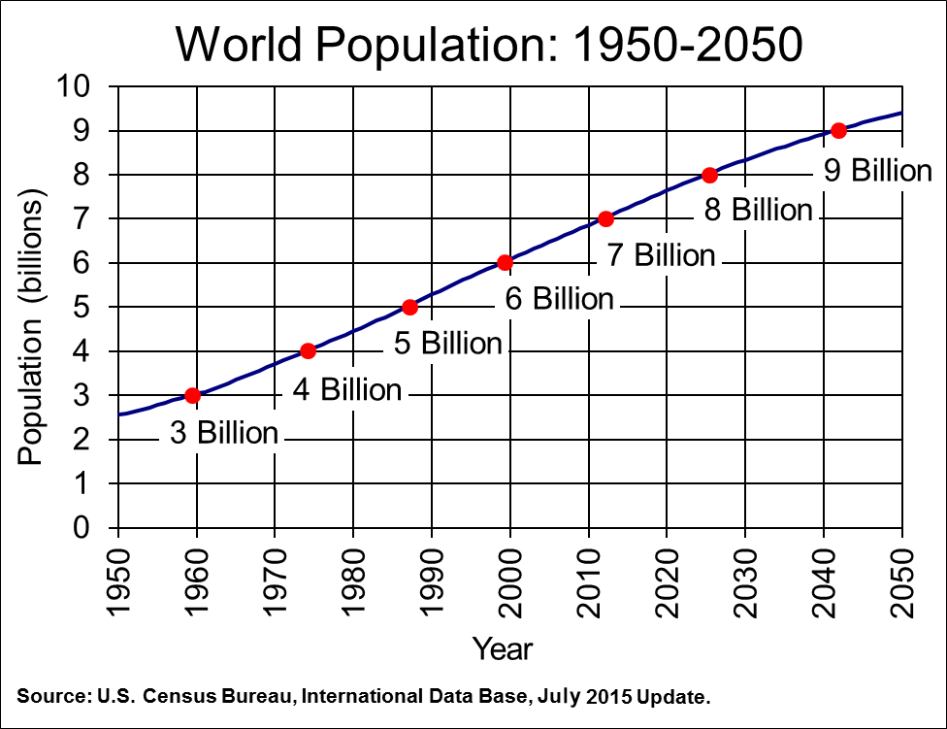
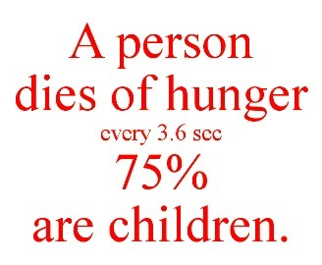
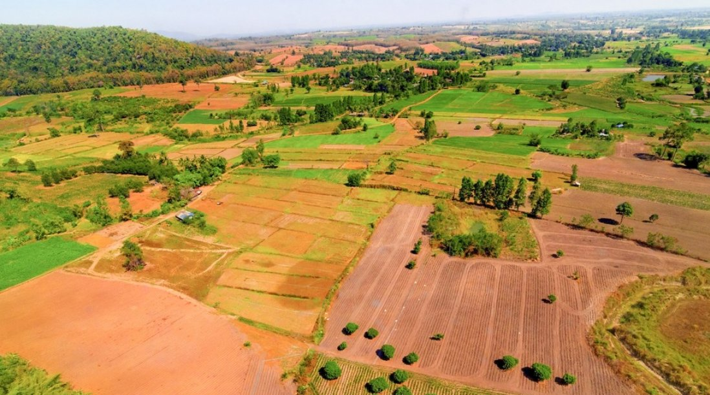
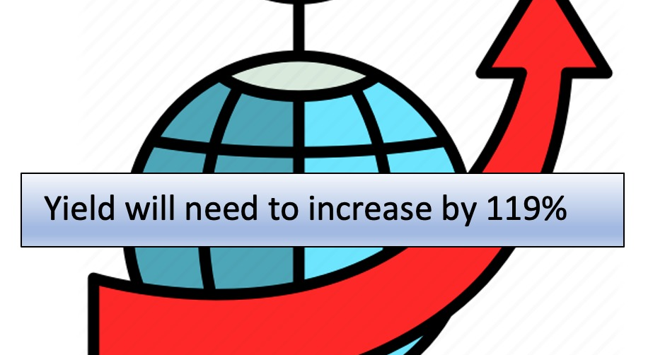

Slide 3
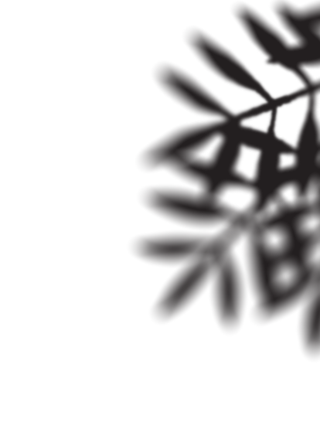
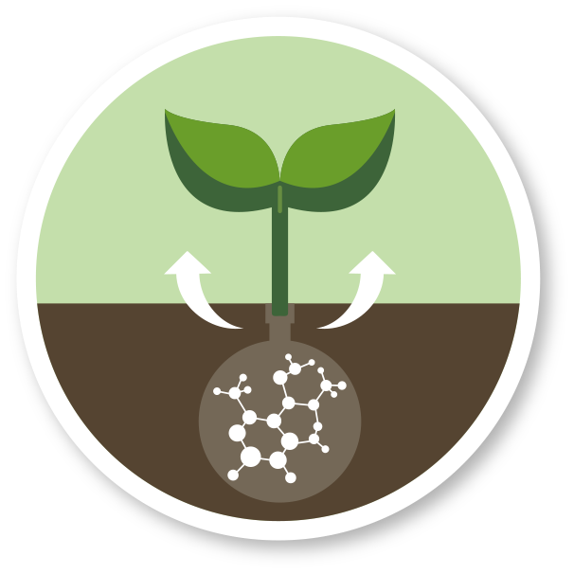
Ways to increase crops
Deficiencies and diseases cause losses of as much as 60% of the most important crops.
Reduce Plant Diseases
Optimum Nutrients for the crops

Slide 4
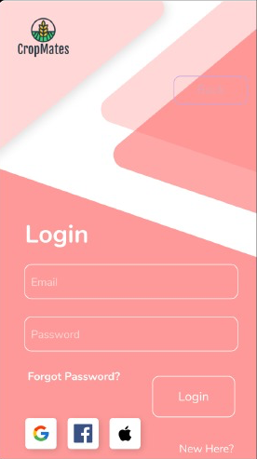
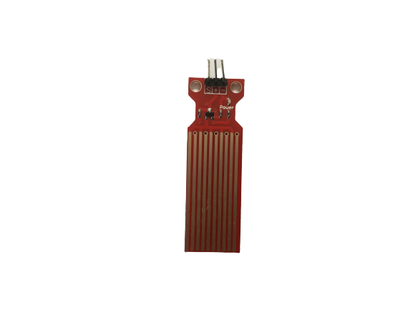
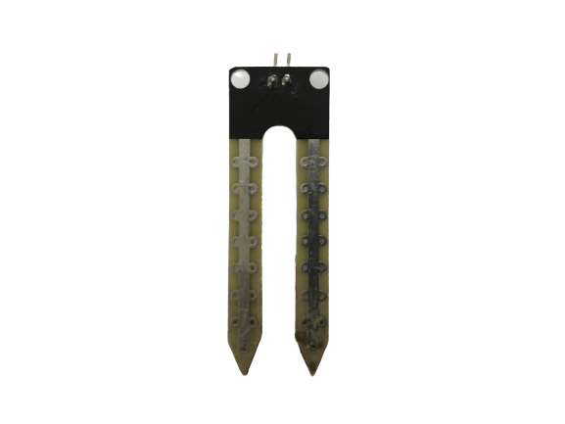
CropMates Introduction
CropMates: Drone + Sensors + App + Algorithms
CropMates Drone
App
Sensors

Slide 5
CropMates Workflow
CropMates
Detection
Plant Disease
Nutrient Deficiency
Recommendation
Pesticide
Fertilizer
Water

Slide 6
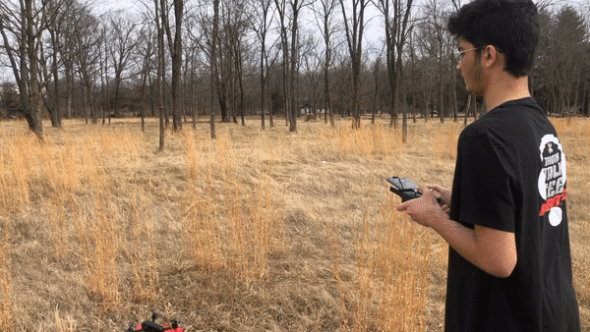
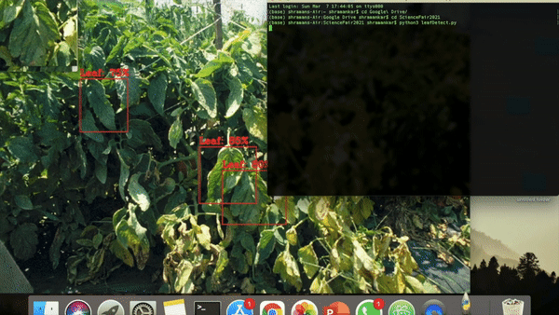
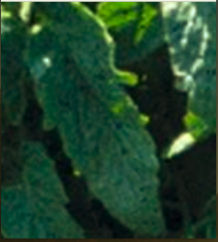
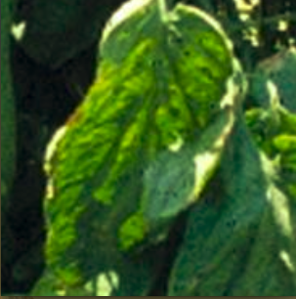
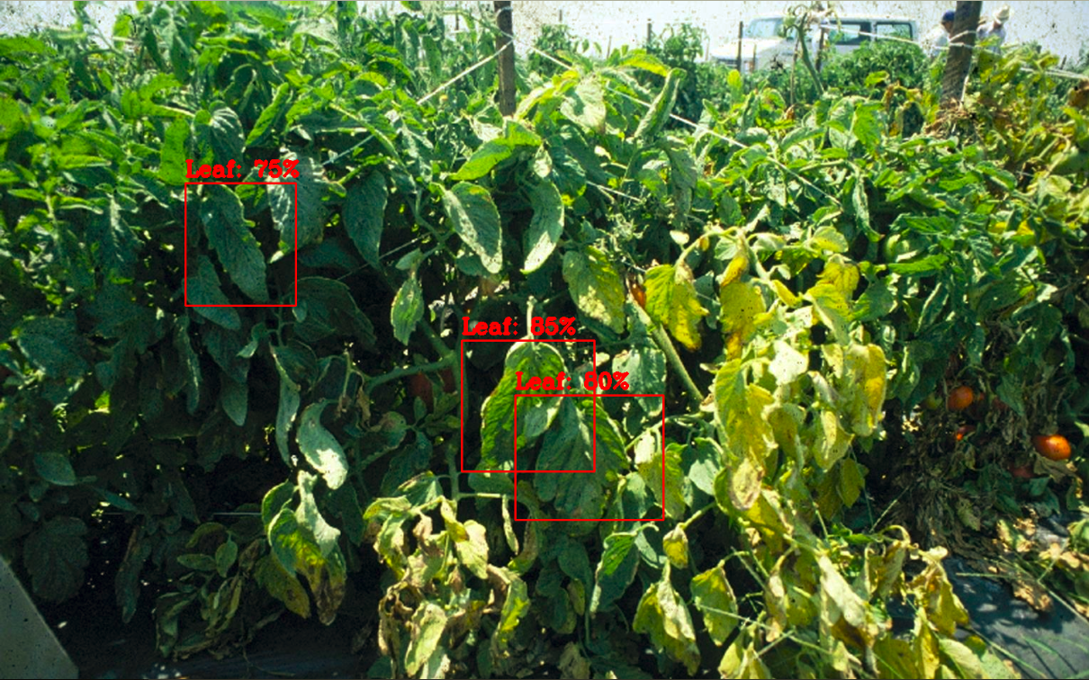
Crop Disease Detection Workflow Part 1 – Detect a Leaf
This drone Is flown by me
leafDetect in action

Slide 7
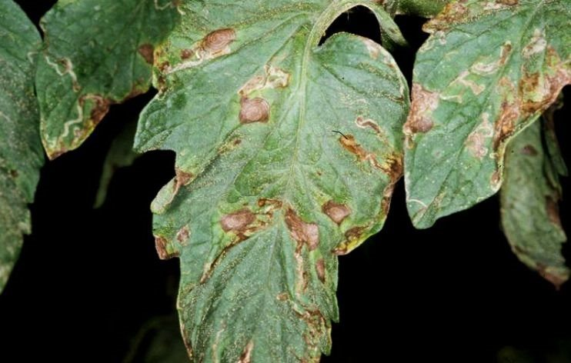
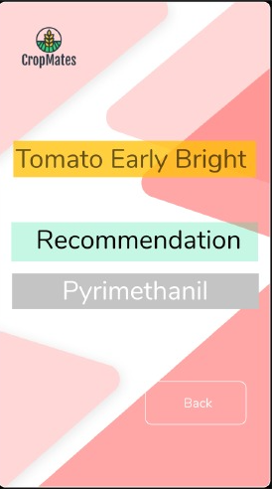
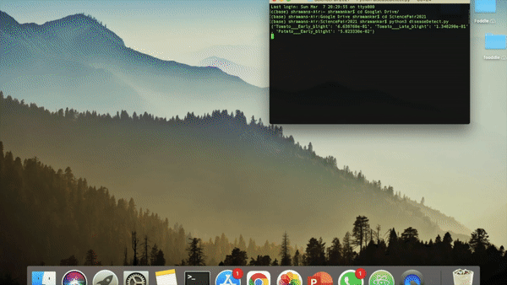
Crop Disease Detection Workflow Part 2
diseaseDetect in action

Slide 8
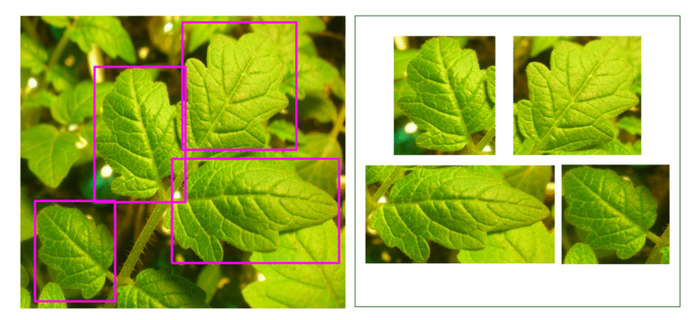
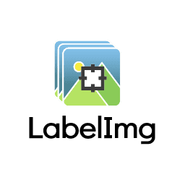
leafDetect Algorithm
leafDetect Algorithm
Training Images – 200 images
YOLO Architecture

Slide 9
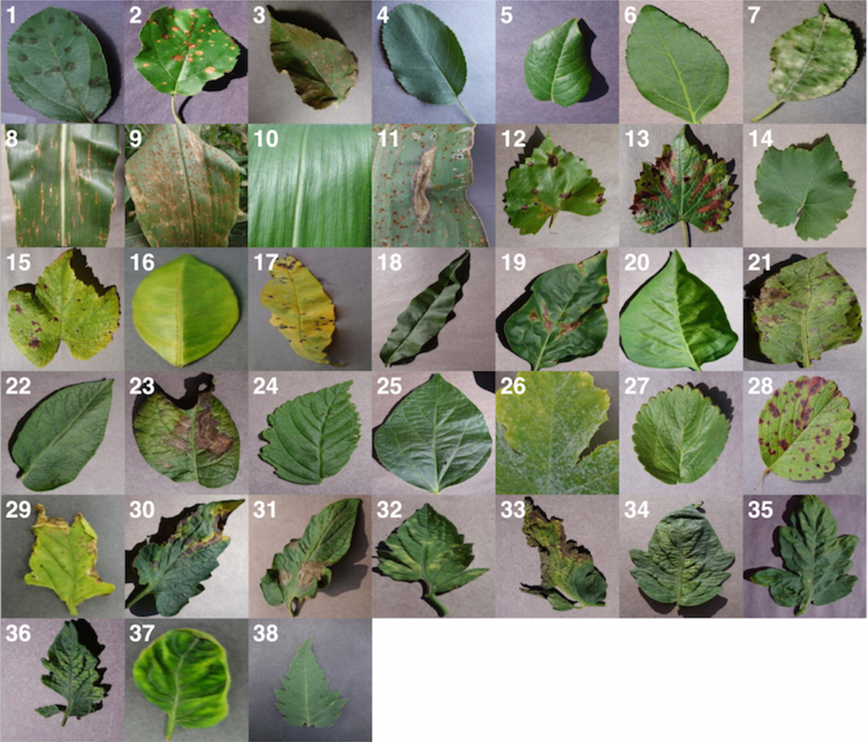
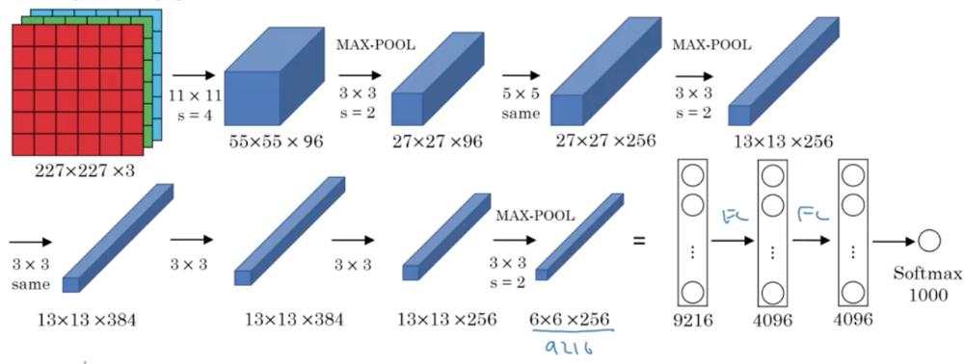
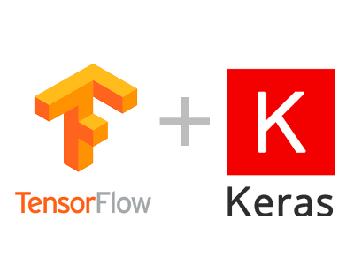
diseaseDetect algorithm
diseaseDetect Algorithm
38 Classes of Diseases and 87,000 leaves images

Slide 10
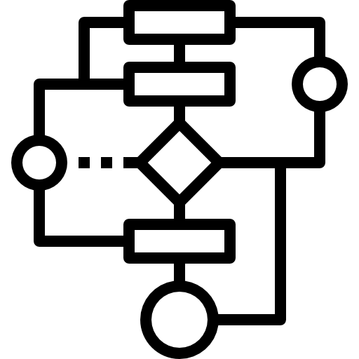
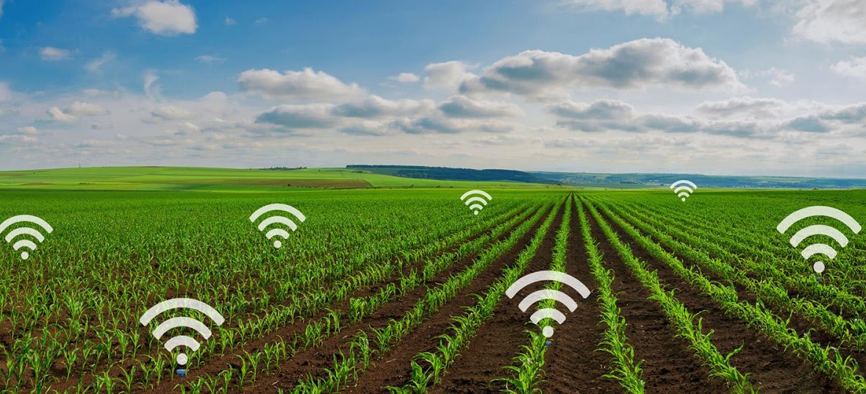
Crop Nutrient Deficiency Detection Workflow
Data streamed to algorithm
Soil Sensor Data
Nutrient Data Stored
in the Database
Results are shown in the app
nutrientDetect
Intervention: Type and amount of Fertilizer

Slide 11
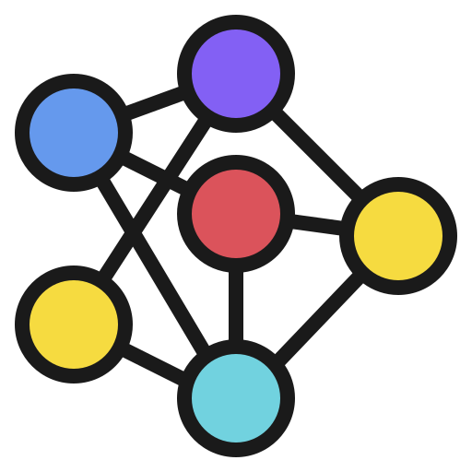
nutrientDetect Algorithm
nutrientDetect Algorithm
20,000 Datasets
Artificial Neural Network
Dataset Columns: Calcium, Magnesium, Potassium, Sulfur, Nitrogen, Lime, Carbon, Phosphorus, Moisture

Slide 12
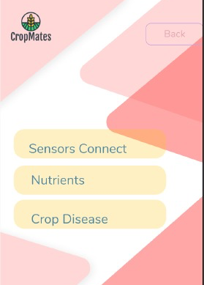
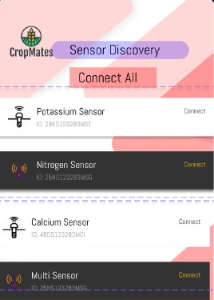
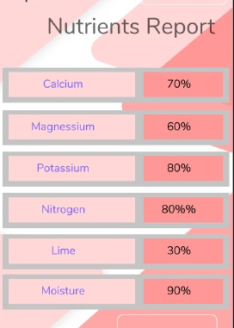

Slide 13
Result: leafDetect
Average – 77%

Slide 14
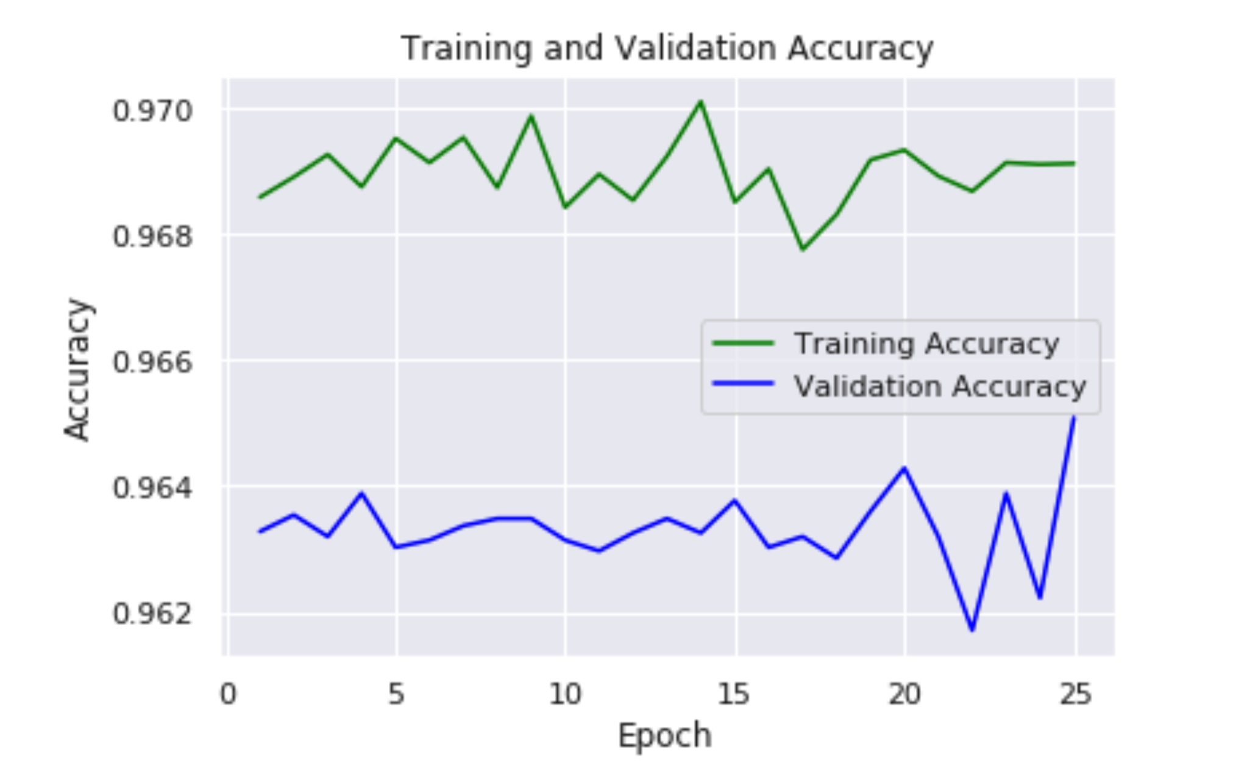
Accuracy of the diseaseDetect Algoithm

Slide 15
Results of the nutrientDetect Algorithm

Slide 16
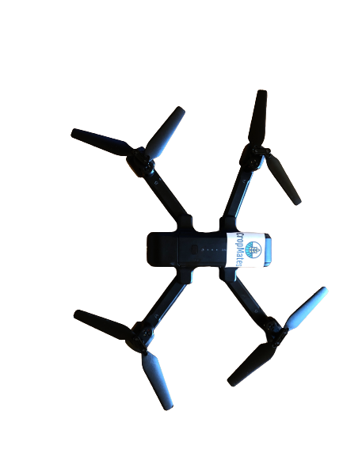
Conclusion

Slide 17
Mentors at Discovery Education
Mentors at Tata Consultancy Services
My Science Teacher Ms. Contie
Rootbound Farm
Xylem Ignite

Slide 18
References
Marjanovic, I. (n.d.). Crop Diseases: The Nightmare of Every Farmer. Retrieved December 30, 2020, from https://blog.agrivi.com/post/crop-diseases-the-nightmare-of-every-farmer
Hall, J. (2016, January 4). Plant disease. Retrieved December 30, 2020, from https://www.britannica.com/science/plant-disease
Daniels, E. (2017, March 11). 14 Common Plant Diseases: How to Identify & Treat Them. Retrieved December 30, 2020, from https://www.proflowers.com/blog/plant-diseases
Stewart, W., & Roberts, T. (2012). Food Security and the Role of Fertilizer in Supporting it. Procedia Engineering, 46, 76-82. doi:10.1016/j.proeng.2012.09.448
Village, P. (2018, December 17). [87K rgb images of healthy and diseased crop leaves which is categorized into 38 different classes.]. Unpublished raw data.
Pjreddie. (n.d.). Pjreddie/darknet. Retrieved December 30, 2020, from https://github.com/pjreddie/darknet/wiki/YOLO:-Real-Time-Object-Detection
Saha, S. (2018, December 17). A Comprehensive Guide to Convolutional Neural Networks - the ELI5 way. Retrieved December 30, 2020, from https://towardsdatascience.com/a-comprehensive-guide-to-convolutional-neural-networks-the-eli5-way-3bd2b1164a53

Slide 20
Appendix

Slide 21
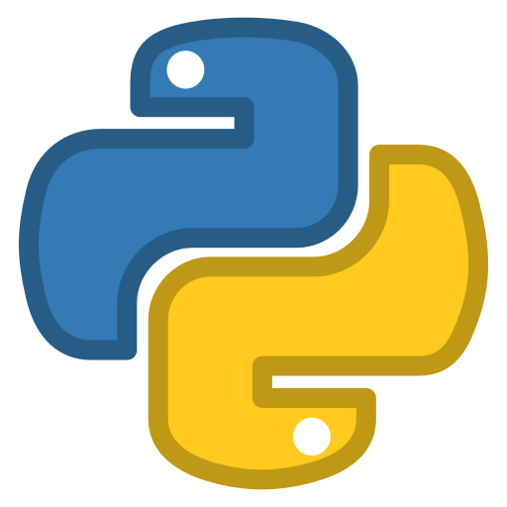
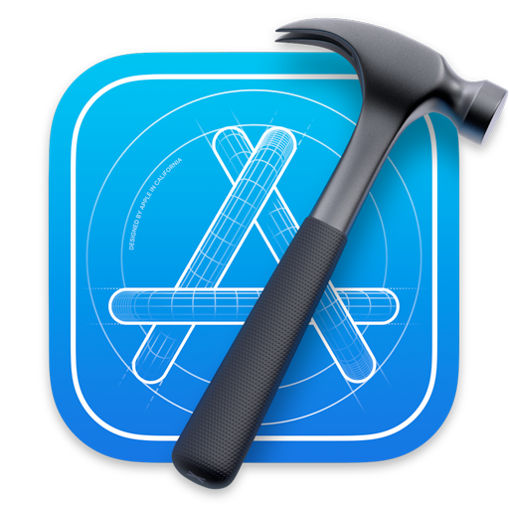
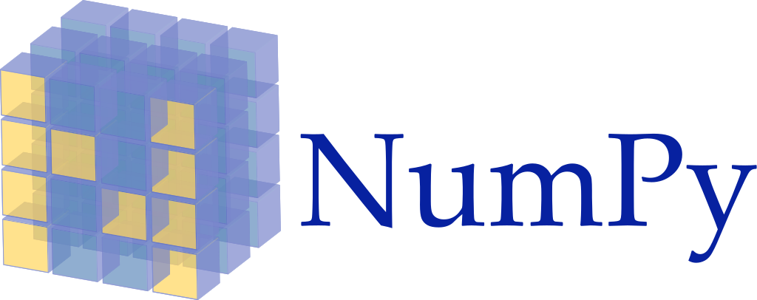
Johny 5 IoT Framework
Google Cloud Firestore Database
Technology Stack
Python
Xcode

Slide 22
How IOU is measured?
9
90
8
10
56
7
__________________
56
=
53%
9
90
+72 – 56
72
8

Slide 23
Sensor to App Data Flow

Slide 24
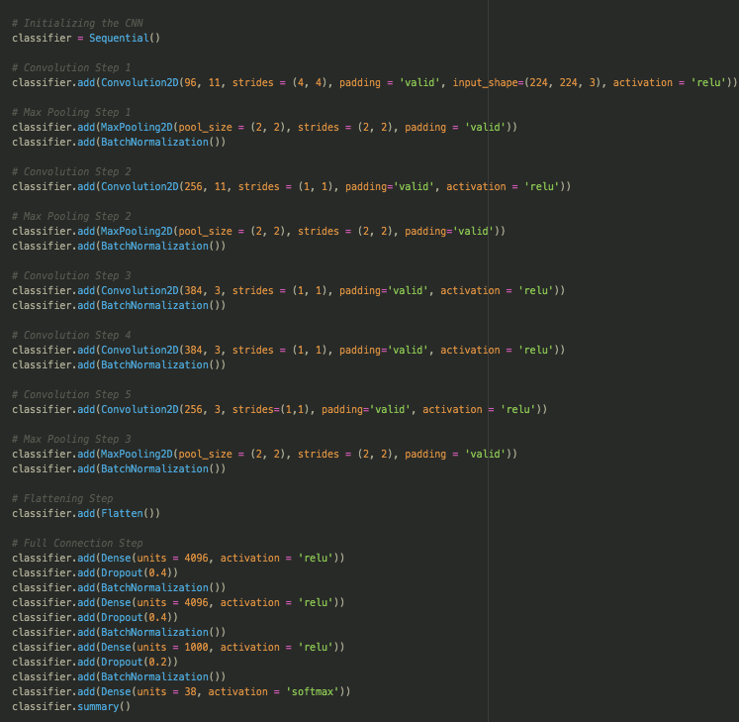
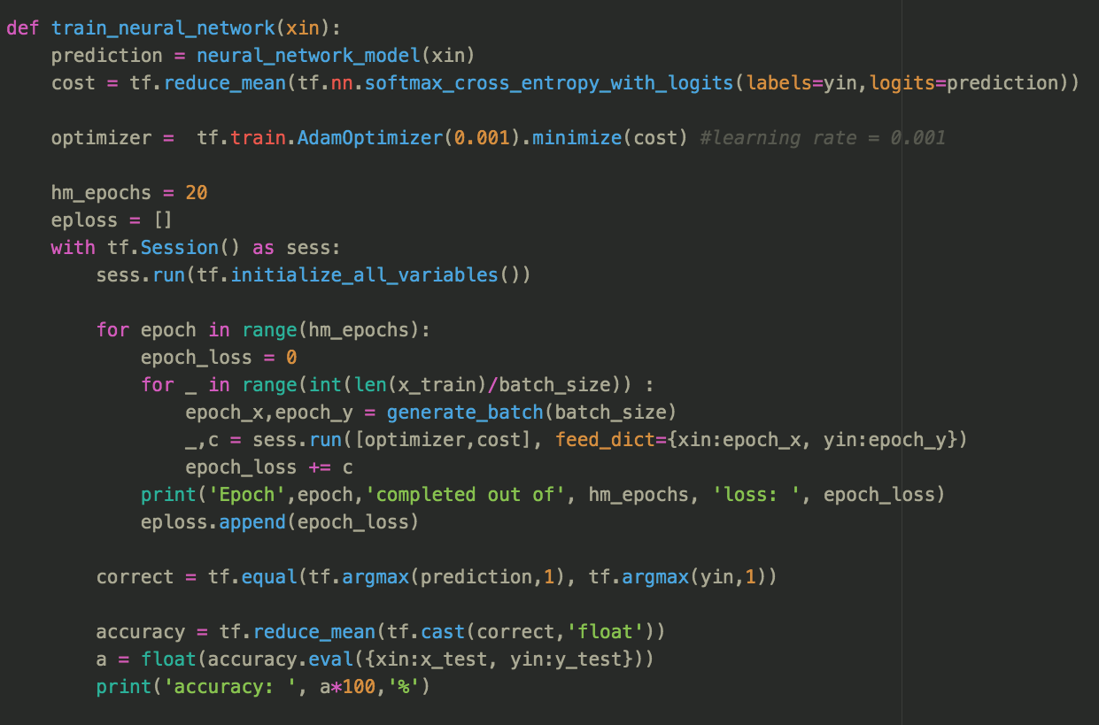
Code Snippets
Configuration of the DarkNet model for the YoloV3 model.
The Neural Network optimization algorithm for the deficiency detection algorithm.
Alex net architecture for the disease classification algorithm.
Code for connecting the sensors to the database.

