Slide 1
NextCare: An Intelligent System for the Low-Cost Early Diagnosis and Real-Time Monitoring of Parkinson’s Disease using Machine Learning, Signal Processing and Wearable Technology
By Shreyas Kar

Slide 2
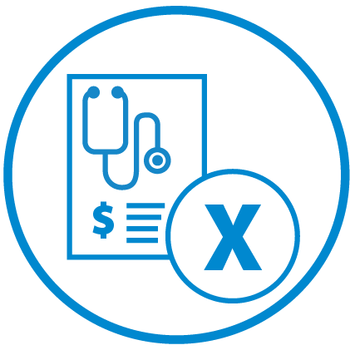
Purpose: Issues with PD Diagnosis
Inaccurate Diagnosis
Late Diagnosis

Slide 3
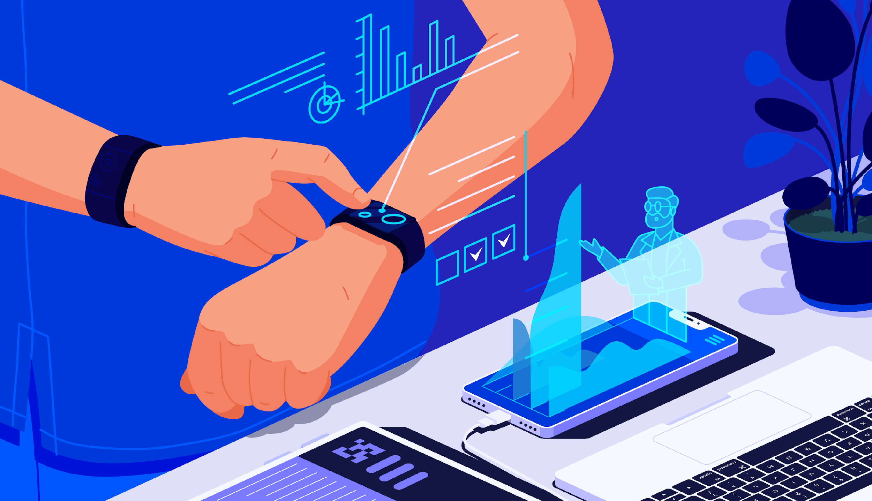
Purpose: Issues with PD Monitoring
Shortage of Neurologists
Lack of Monitoring

Slide 4
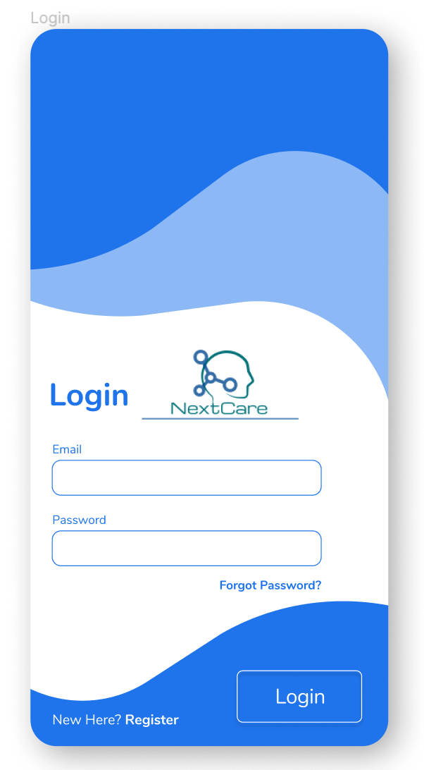
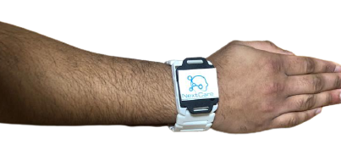
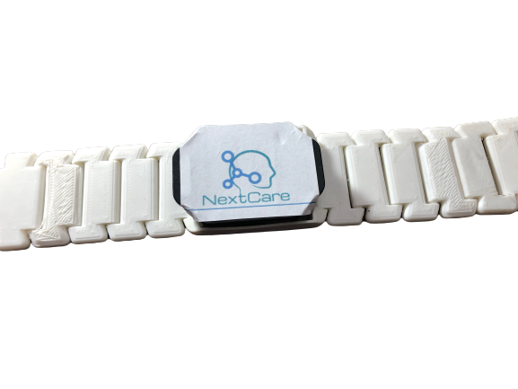
NextCare
3D printed Wearable Device + App
Algorithms for
Early Diagnosis by voice.
Continuous monitoring of tremor.

Slide 5
NextCare
Diagnosis
Monitoring
Voice Pattern
Tremor

Slide 6
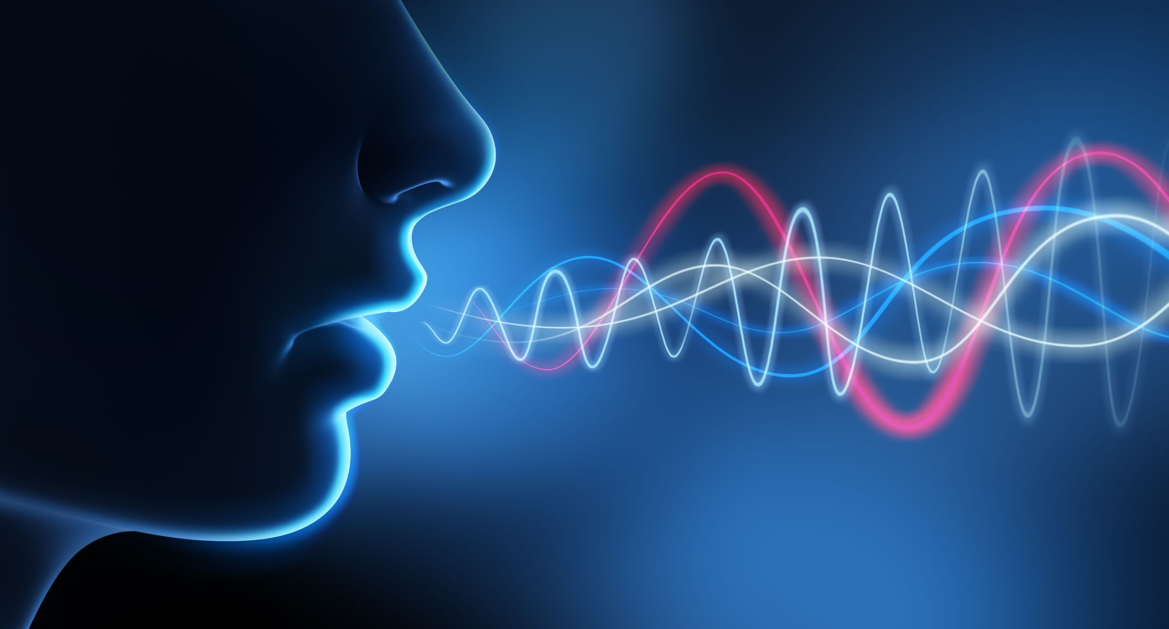
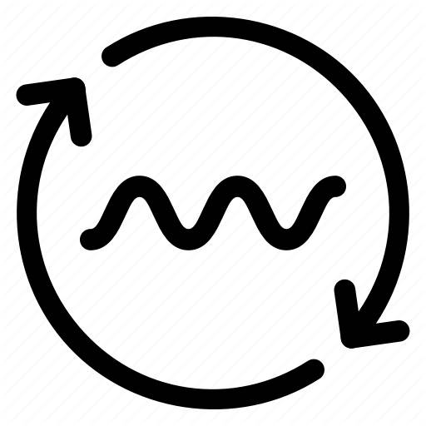
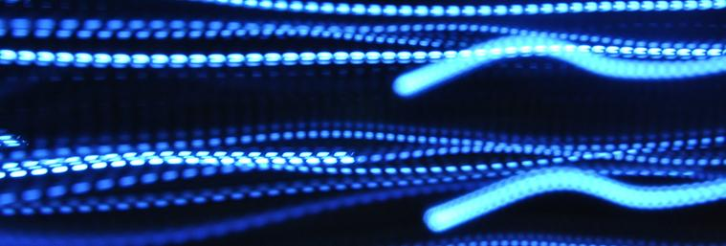
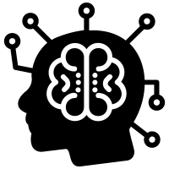
Voice Biomarker
Diagnosis
Approach
Voice is first markers of Parkinson’s Disease
Signal Processing
Machine Learning
Change in voice pattern is not apparent

Slide 7
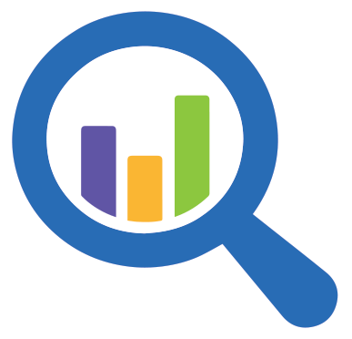
Diagnosis
Feature Computation
Voice Sample
Signal Processing
Voice Attributes
(50)
Shimmer, Jitter, RPDE,
PPE, Spread etc.
PCA + Heat Map
Features
(2)
PPE, Spread1
Data

Slide 8
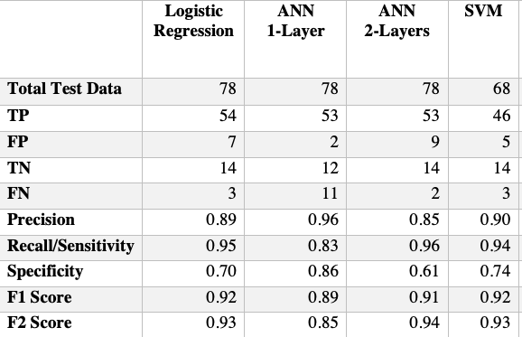
Model Training and Testing
Success Criterion: 0.87 F2 score
Artificial Neural Network (ANN)
Logistic Regression
Support Vector Machine (SVM)
Diagnosis
F2 = 0.94
F2 = 0.93
F2 = 0.93
Data

Slide 9
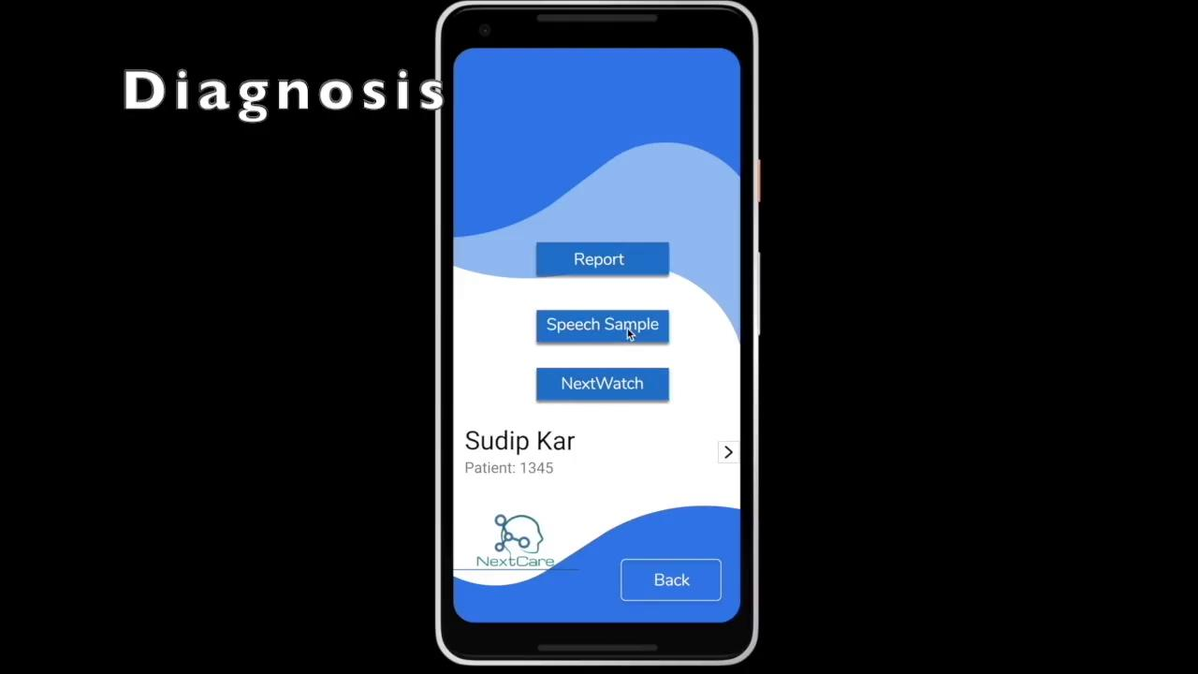
Demo - NextCare Diagnosis
Diagnosis

Slide 10
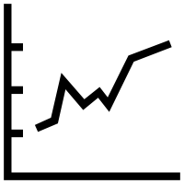
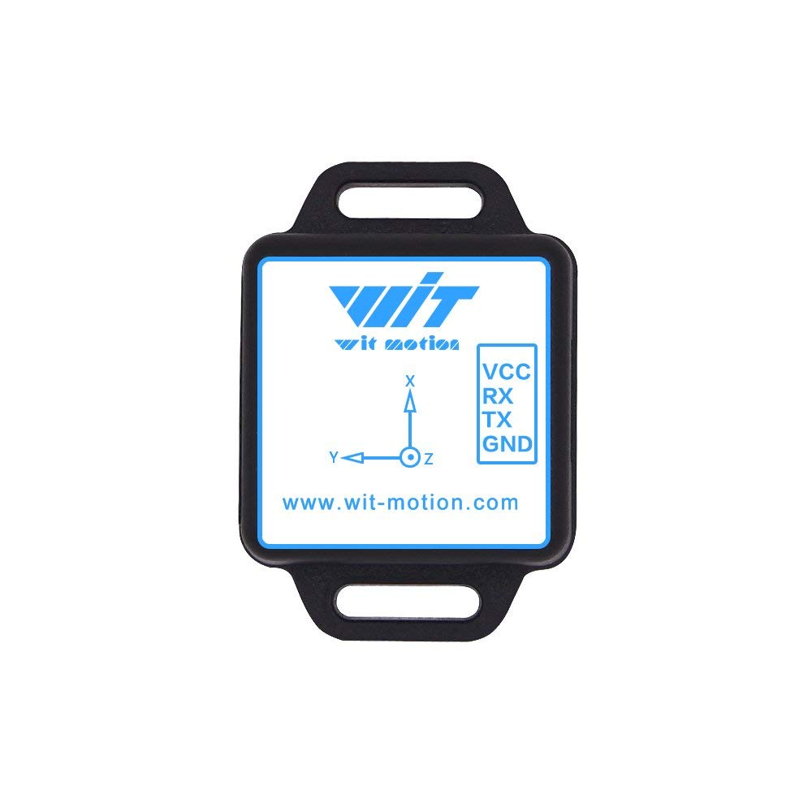
NextCare Monitoring System
Monitoring
Real Time Tremor Visualization
Bluetooth
Tremor Amplitude
and Constancy
NextCare App
Cloud Database
Algorithm
UPDRS
IMU
/Inertial Sensors
NextCare App
Algorithm
UPDRS *Chart

Slide 11
Parkinsonian Tremor Quantification by Amplitude and Frequency
Monitoring
Amplitude
Normalized Peak Power Sum of all axes in IMU sensor.
Tremor Score
Constancy
Tremor score computed every 15 min for a span of week.
Data

Slide 12
NextCare Monitoring Results
Monitoring
Accuracy: 94.1%
Accuracy: 91.1%
Data

Slide 13
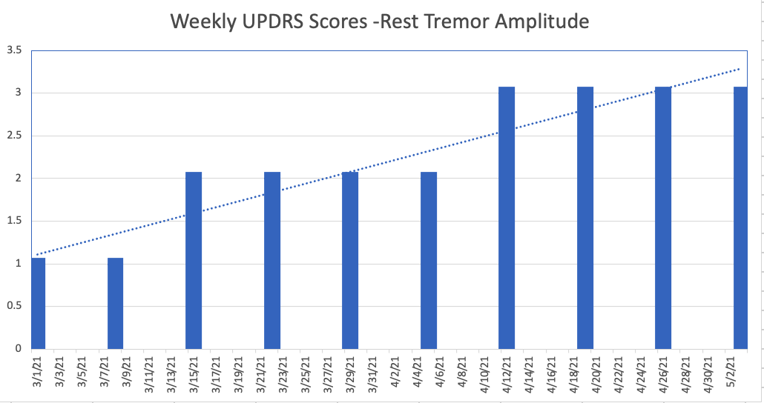
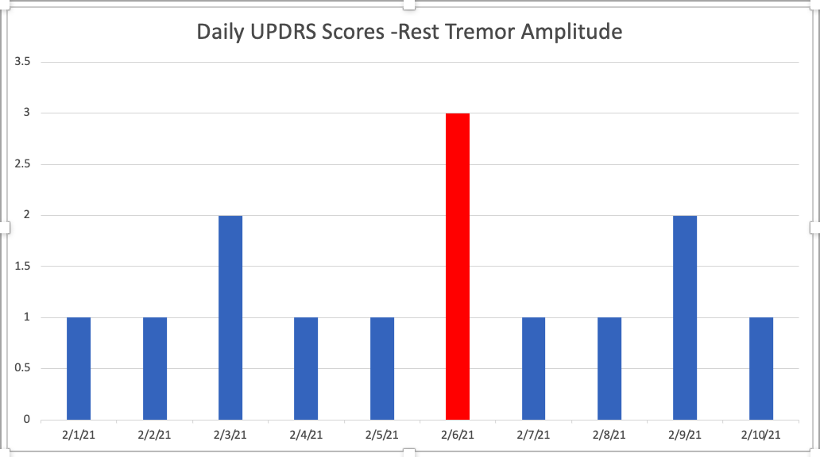
NextCare Monitoring Use Cases
Monitoring
Indicative of Treatment Failure
If NextCare not there and patient is treated on a bad day (2/6/21)

Slide 14
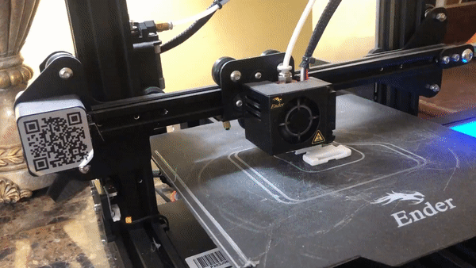
Wearable Device Construction
Constructed using Google SketchUp Software and Ender 3 Pro 3D Printer , PLA Filament

Slide 15
Demo - NextCare Monitoring
Monitoring

Slide 16
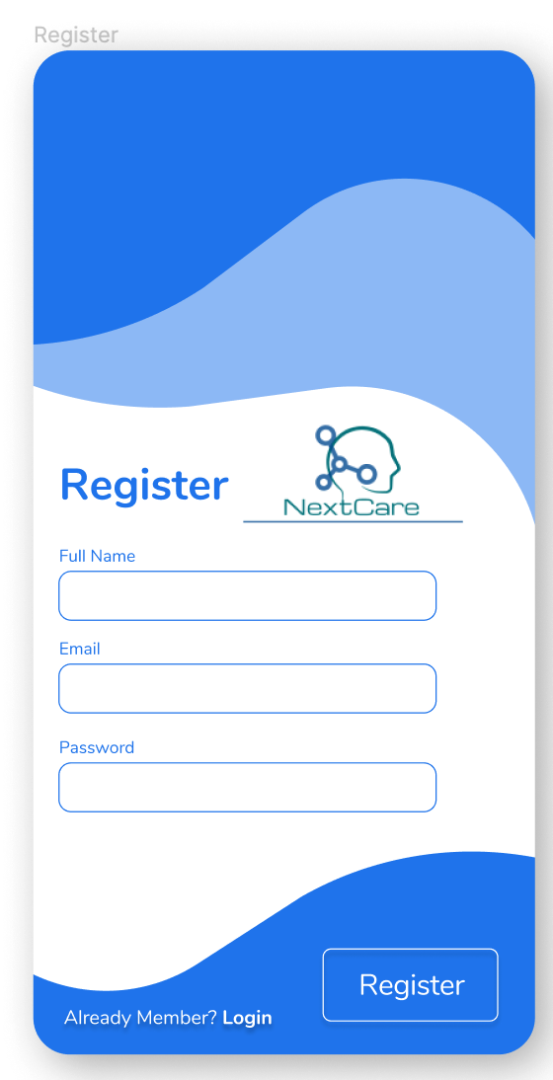
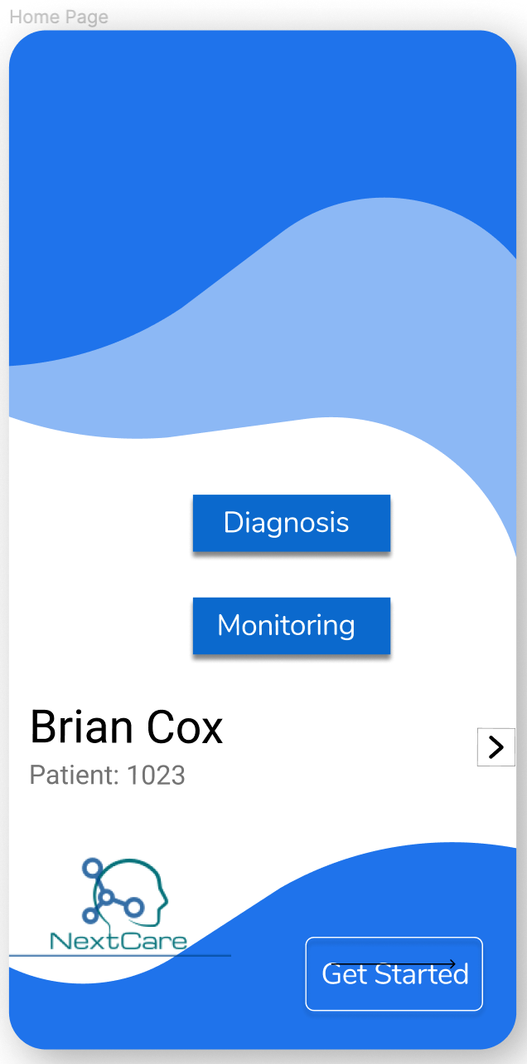
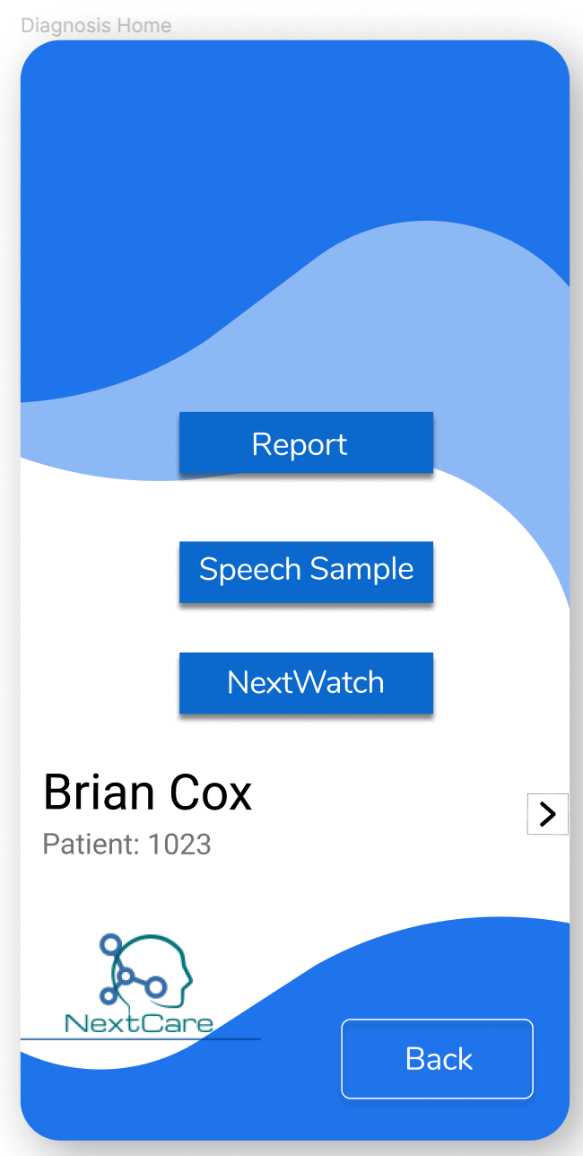
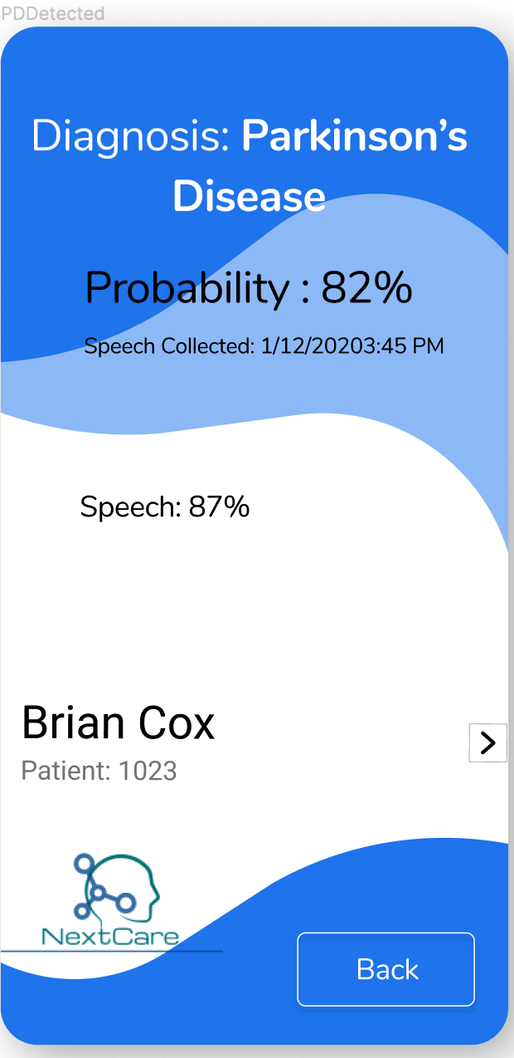
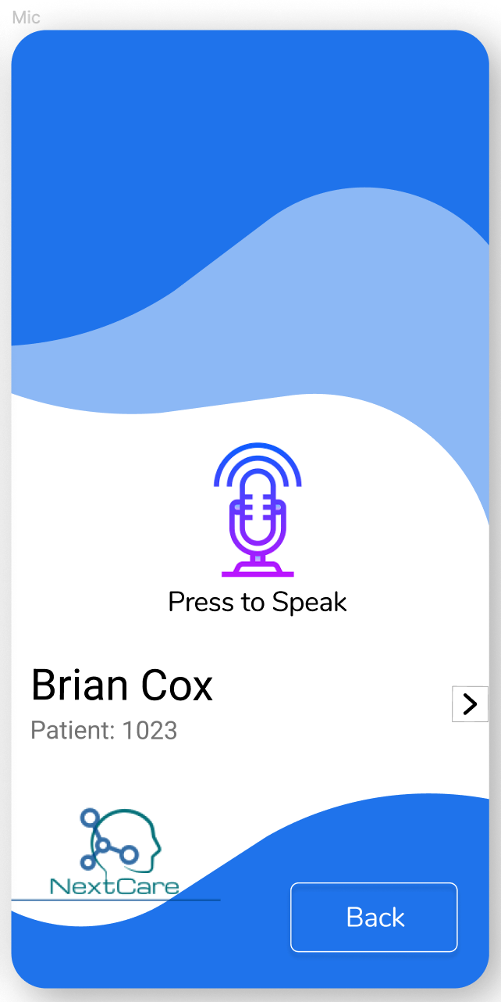
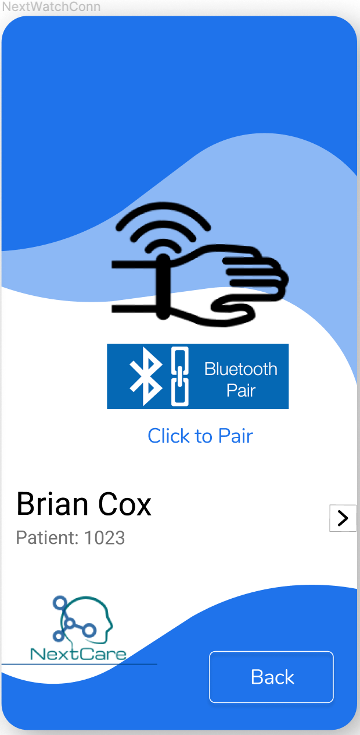
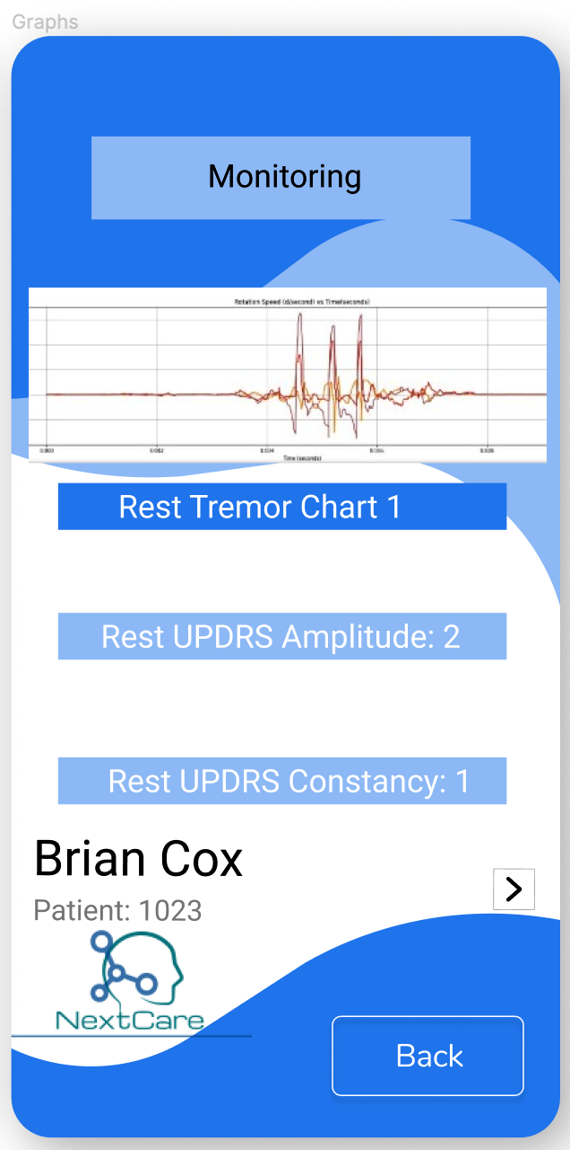
NextCare Mobile App
Registration
Login
Home
Diagnosis
Home
PD Diagnosis
Voice
Collection
Connect
Device
Monitoring
Tremor
A few Screens

Slide 17
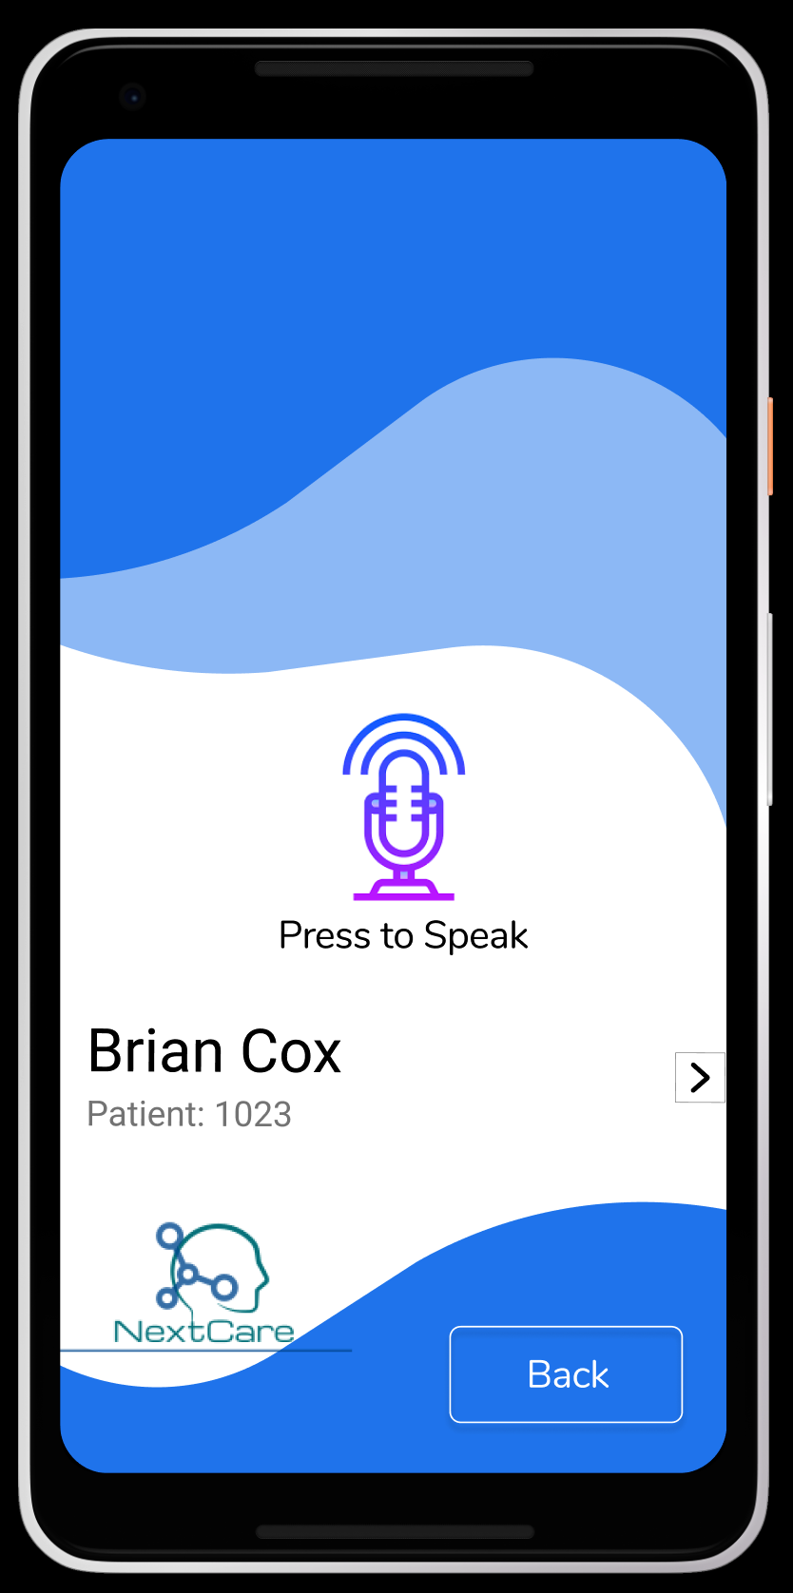
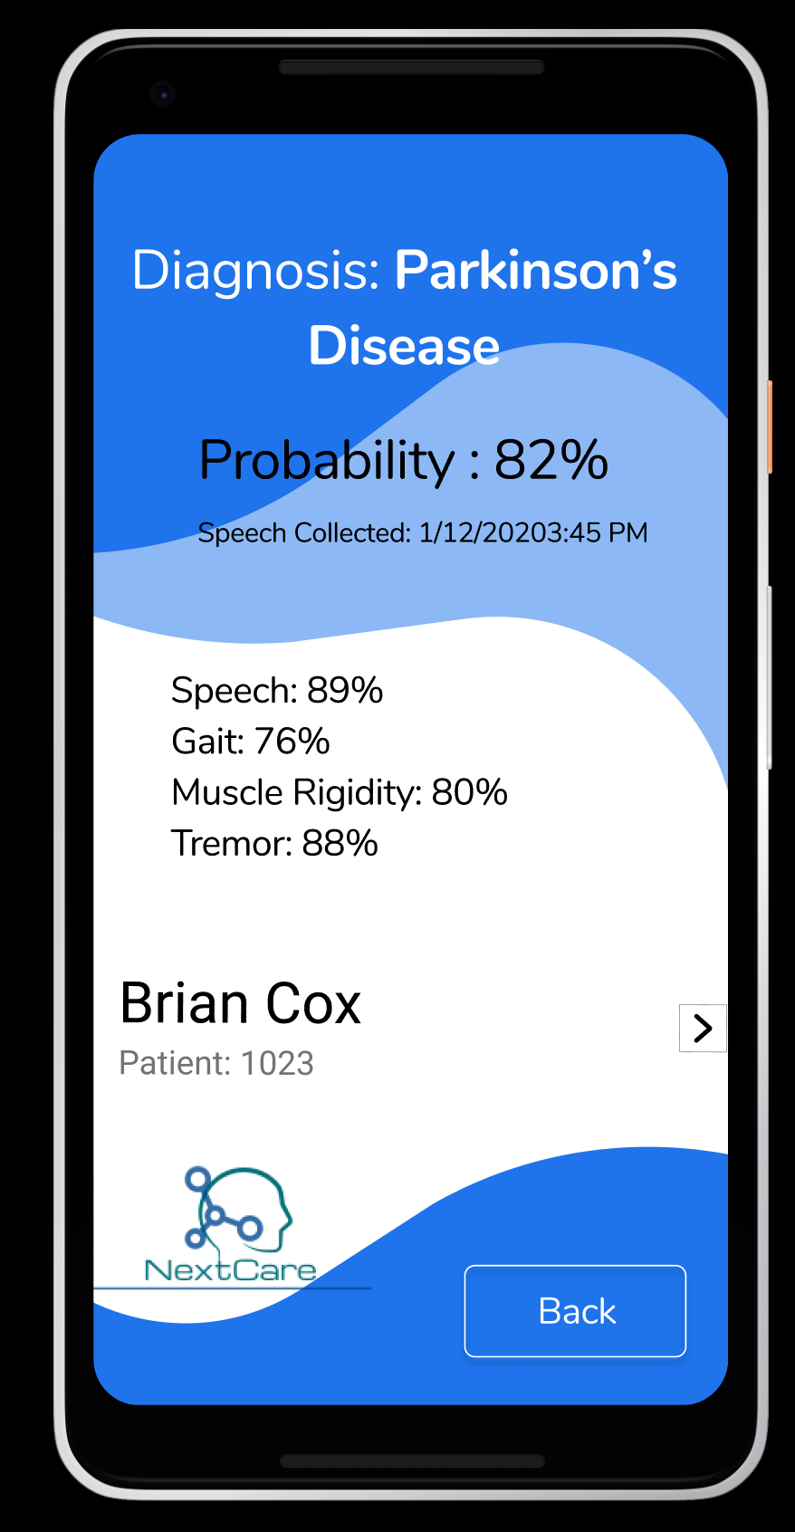
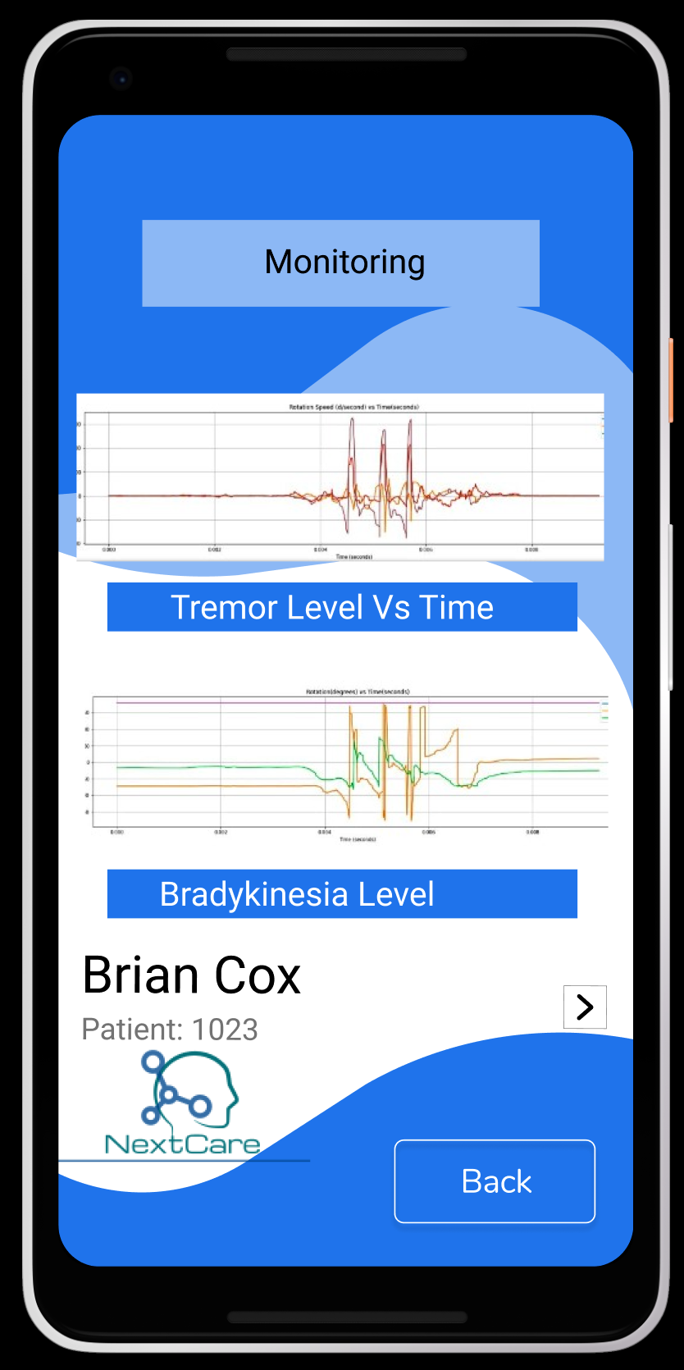
Conclusion: NextCare at a Healthcare Setting
Diagnosis
Diagnosis 5 years before existing methods.
19% better accuracy than existing methods.
Patient’s 30s voice sample collected by NextCare App
Doctor checks result on NextCare App
Monitoring
Google Cloud Firestore Database
Doctor checks real-time report on NextCare App
NextCare receiver app on phone or Laptop
NextWatch on a patient

Slide 18
Acknowledgment
Dr. Peter Campbell: Researcher University of Louisville Department of Anatomical Sciences and Neurobiology
Dr. Joseph Neimat: Chairman of Department of Neurological Surgery at the University of Louisville
Michael. J. Fox Foundation: Funding clinical trials that provided the data for training and testing models.

Slide 19
Next Step
Add Bradykinesia and Gait to monitoring.

Slide 20
Thank you!

Slide 21
Appendix

Slide 22
Works Cited
Ahire, J. B. (2018, August 29). The Artificial Neural Networks handbook: Part 1. Retrieved from https://medium.com/coinmonks/the-artificial-neural-networks-handbook-part-1-f9ceb0e376b4.
Bhandari, S. (2019, June 19). Dopamine: What It Is & What It Does. Retrieved from https://www.webmd.com/mental-health/what-is-dopamine#1.
Brid, R. S. (2018, September 28). Linear Regression: Is a Line Reasonable ? Retrieved from https://medium.com/greyatom/linear-regression-is-a-line-reasonable-b1c8f94d03d7.
'Exploiting Nonlinear Recurrence and Fractal Scaling Properties for Voice Disorder Detection', Little MA, McSharry PE, Roberts SJ, Costello DAE, Moroz IM. BioMedical Engineering OnLine 2007, 6:23 (26 June 2007)
F 0.5 and F2 Scores. (2016, June 13). Retrieved from https://www.litigationsupporttipofthenight.com/single-post/2016/06/13/F-05-and-F2-Scores.
How Parkinson's Disease Is Diagnosed. (n.d.). Retrieved from https://www.hopkinsmedicine.org/health/treatment-tests-and-therapies/how-parkinson-disease-is-diagnosed.

Slide 23
Works Cited Continued
Mayfield Brain & Spine. (n.d.). Parkinson's Disease (PD). Retrieved from https://mayfieldclinic.com/pe-pd.htm.
Online Courses From Top Universities. Join for Free. (n.d.). Retrieved from https://www.coursera.org/learn/machine-learning/home/welcome.
Parkinson's disease. (2018, June 30). Retrieved from https://www.mayoclinic.org/diseases-conditions/parkinsons-disease/symptoms-causes/syc-203760
Ray, S., & Business Analytics and Intelligence. (2019, September 4). 7 Regression Types and Techniques in Data Science. Retrieved from https://www.analyticsvidhya.com/blog/2015/08/comprehensive-guide-regression/.
Schwab, P., & Karlen, W. (2019). PhoneMD: Learning to Diagnose Parkinson’s Disease from Smartphone Data. Proceedings of the AAAI Conference on Artificial Intelligence, 33, 1118–1125. doi: 10.1609/aaai.v33i01.33011118
Tsoulos, I. G., Mitsi, G., Stavrakoudis, A., & Papapetropoulos, S. (2019). Application of Machine Learning in a Parkinsons Disease Digital Biomarker Dataset Using Neural Network Construction (NNC) Methodology Discriminates Patient Motor Status. Frontiers in ICT, 6. doi: 10.3389/fict.2019.00010
Tucker, C., Han, Y., Nembhard, H. B., Lee, W.-C., Lewis, M., Sterling, N., & Huang, X. (2015). A data mining methodology for predicting early stage Parkinsons disease using non-invasive, high-dimensional gait sensor data. IIE Transactions on Healthcare Systems Engineering, 5(4), 238–254. doi: 10.1080/19488300.2015.1095256
What Is Parkinson's?: Parkinson's Foundation. (n.d.). Retrieved from https://www.parkinson.org/understanding-parkinsons/what-is-parkinsons.
Zhang, K., & Demner-Fushman, D. (2017, July 1). Automated classification of eligibility criteria in clinical trials to facilitate patient-trial matching for specific patient populations. Retrieved from https://www.ncbi.nlm.nih.gov/pmc/articles/PMC6080677/

Slide 24
QALYs gain - Early Detection of PD

Slide 25
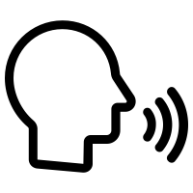
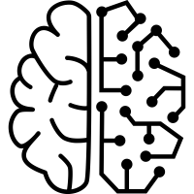
Overall Process Flow Diagnosis System
Diagnosis
NextCare App
Computes Voice
Features
PD
Diagnosis
Algorithm
ML Algorithm

Slide 26
Monitoring
Real-time Visualization of Tremor (Sensor Data)
Data

Slide 27
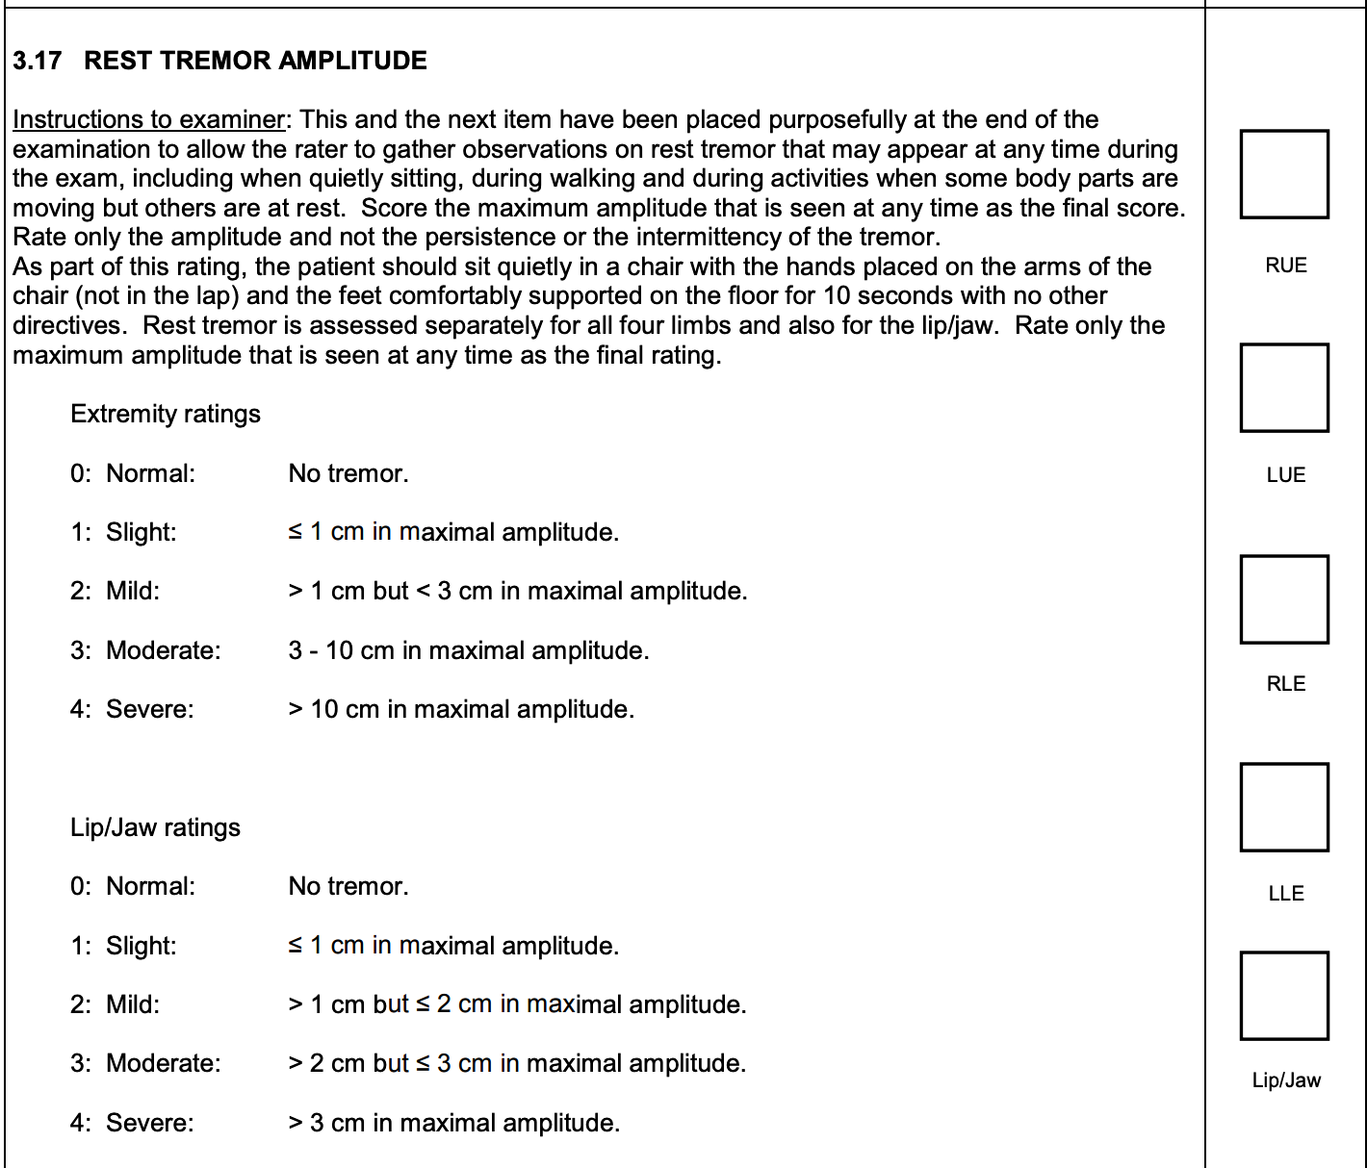
Quantification of UPDRS
Monitoring
Tremor Amplitude Constancy Tremor

Slide 28
Features for ML Algorithms
Diagnosis
1. Pitch Period Entropy
Voice Sample
Conversion
Pitch Sequence
39.87*log(Fundamental Frequency
/50)
Semitone Scale
Entropy of Probability Distribution
PPE
2. Spread1

Slide 29
Privacy
Created an authentication mechanism so only neurologist and patient can view data
All personally identifiable data encrypted before entering the database.

Slide 30
Comparison to Existing Methods
Most Intelligent Systems for Parkinson’s only perform monitoring
My system provides for early diagnosis of PD
First system to use UPDRS scale for monitoring, exactly replicating what a neurologist would see.

Slide 31
Limitations
Tradeoff between invasiveness and performance
Collecting more features would slightly increase performance

