Slide 1
Forecasting Stock Prices
Salil Kothari

Slide 2
Purpose
Understanding how the stock market performs is incredibly valuable, but constant price fluctuations make this difficult.
One way the stock market’s performance can be predicted is through a machine learning program.
Determine which time duration of stock data will best train the programming model to achieve the highest prediction accuracy.

Slide 3
Hypothesis
After testing the accuracy of datasets differing in time duration, the shortest time duration will result in the most accurate prediction since it is the most relevant to the current time.

Slide 4
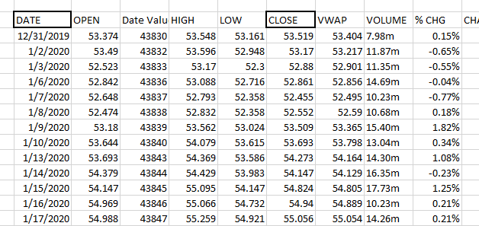
Example of Stock Data
Stock data from the last 1, 5, 10, 20, and 50 years was obtained from the Coca Cola Investor’s website.

Slide 5
Methodology
4-Jan | 52.760
5-Jan | 52.180
6-Jan | 50.520
7-Jan | 49.960
8-Jan | 51.080
11-Jan | 50.200
12-Jan | 50.110
13-Jan | 50.160
14-Jan | 49.230
15-Jan | 48.700
19-Jan | 48.510
20-Jan | 48.680
21-Jan | 48.950
22-Jan | 48.490
25-Jan | 48.780
26-Jan | 49.290
27-Jan | 48.530
28-Jan | 49.150
29-Jan | 48.150
The Stock data was inputted into the program, which resulted in the predicted prices for the month of January 2021.
The month’s predicted prices were compared to the actual prices to calculate accuracy.
Average accuracy was calculated from ten trials.
Actual Prices (Jan 2021)

Slide 6
Methodology – About the Program
The program was created in Python using Google Colab.
I used Tensorflow, scikit-learn, pandas, numpy, and many other libraries for their various functions.
Tensorflow and sk-learn are machine learning libraries.
Tensorflow’s python interface keras was also used.
The model was Sequential and mainly used LSTM layers for prediction.
Program is run
File uploaded
Data is prepared
Training datasets are created
Model is created
Program ends
Prediction and graph
Model is tested
Model is fitted
Model is compiled

Slide 7
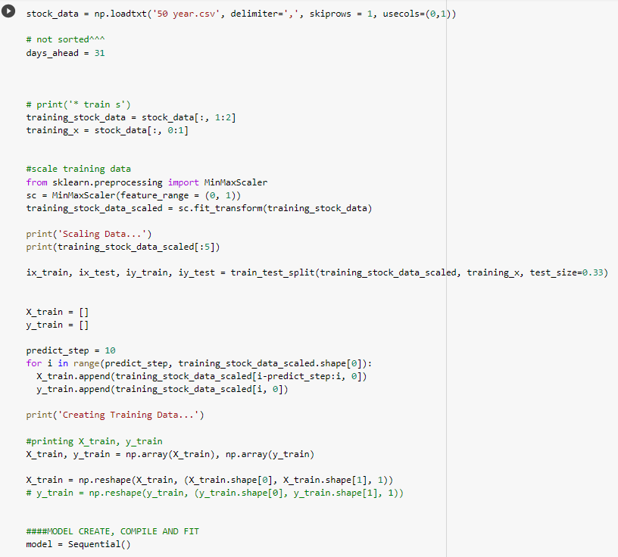
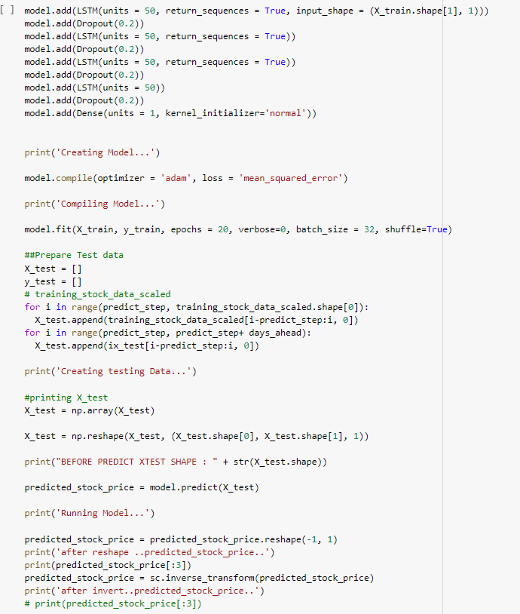
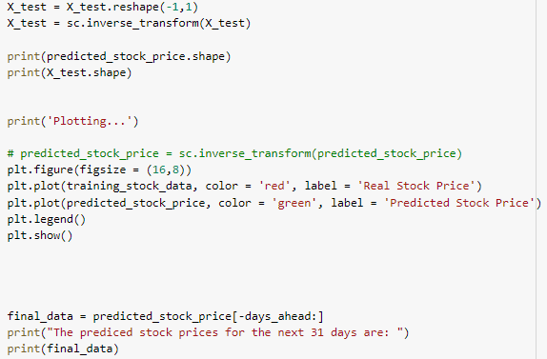
Sample Code

Slide 8
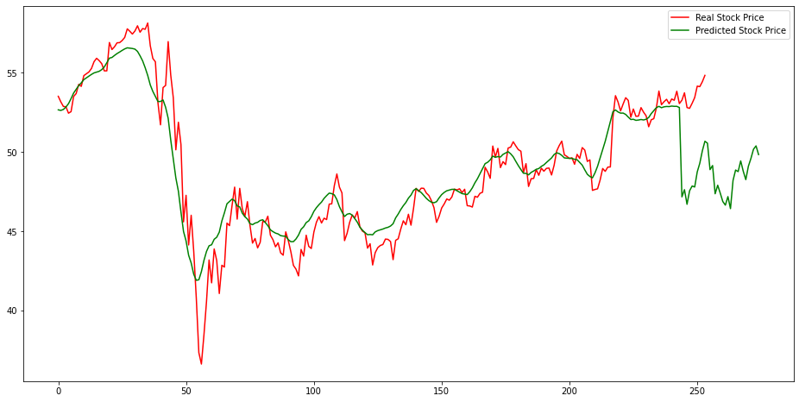
Results – 1 Year
The predicted values were very accurate, with all average accuracies over 90%.
The average accuracy of the ten trials was 96.472%.
The prediction differed from the actual by $2-3.
 | TRIAL | 1 | Accuracy
 | ActualPrice
4-Jan | 52.760 | 48.404 | 0.917
5-Jan | 52.180 | 48.189 | 0.924
6-Jan | 50.520 | 47.878 | 0.948
7-Jan | 49.960 | 48.194 | 0.965
8-Jan | 51.080 | 48.918 | 0.958
11-Jan | 50.200 | 51.930 | 0.966
12-Jan | 50.110 | 52.602 | 0.950
13-Jan | 50.160 | 52.884 | 0.946
14-Jan | 49.230 | 51.935 | 0.945
15-Jan | 48.700 | 51.224 | 0.948
19-Jan | 48.510 | 51.915 | 0.930
20-Jan | 48.680 | 51.178 | 0.949
21-Jan | 48.950 | 50.245 | 0.974
22-Jan | 48.490 | 51.199 | 0.944
25-Jan | 48.780 | 50.725 | 0.960
26-Jan | 49.290 | 51.162 | 0.962
27-Jan | 48.530 | 50.903 | 0.951
28-Jan | 49.150 | 52.026 | 0.941
29-Jan | 48.150 | 52.306 | 0.914
Avg Accuracy |  |  | 0.947
Price
The green line has a sharp decrease towards the end of the graph.
The earlier dip is from March 2020 (beginning of recession).
The later (green line) is the prediction for January.
Example Trial

Slide 9
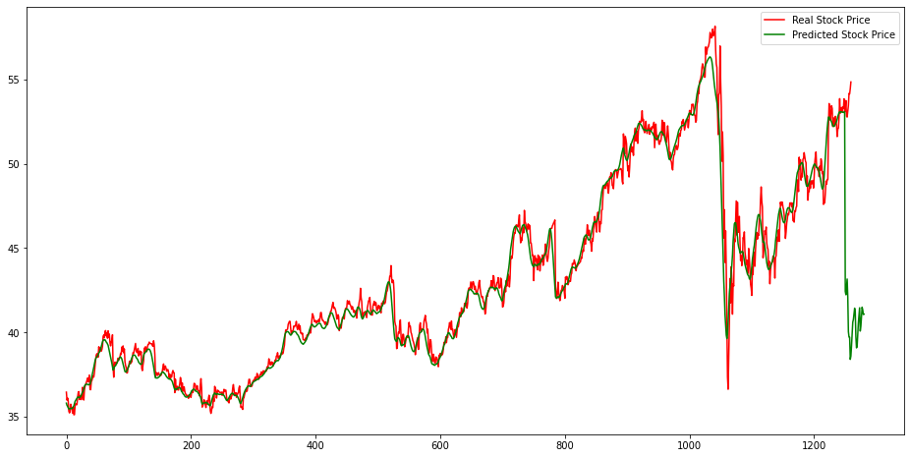
Results – 5 Year
Predictions for this set were less accurate than the 1-year dataset.
The average accuracy of the ten trials was 86.681%.
The prediction differed from the actual by $5-8.
 | TRIAL | 1 | Accuracy
 | ActualPrice
4-Jan | 52.76 | 46.923 | 0.889
5-Jan | 52.18 | 47.572 | 0.912
6-Jan | 50.52 | 47.014 | 0.931
7-Jan | 49.96 | 46.323 | 0.927
8-Jan | 51.08 | 45.899 | 0.899
11-Jan | 50.2 | 43.293 | 0.862
12-Jan | 50.11 | 41.447 | 0.827
13-Jan | 50.16 | 41.528 | 0.828
14-Jan | 49.23 | 40.404 | 0.821
15-Jan | 48.7 | 40.308 | 0.828
19-Jan | 48.51 | 40.090 | 0.826
20-Jan | 48.68 | 40.131 | 0.824
21-Jan | 48.95 | 41.372 | 0.845
22-Jan | 48.49 | 42.825 | 0.883
25-Jan | 48.78 | 45.538 | 0.934
26-Jan | 49.29 | 46.233 | 0.938
27-Jan | 48.53 | 46.945 | 0.967
28-Jan | 49.15 | 46.171 | 0.939
29-Jan | 48.15 | 45.943 | 0.954
Avg Accuracy |  |  | 0.886
Price
The dip in this graph is much larger than the one in the 1-year graph.
Example Trial

Slide 10
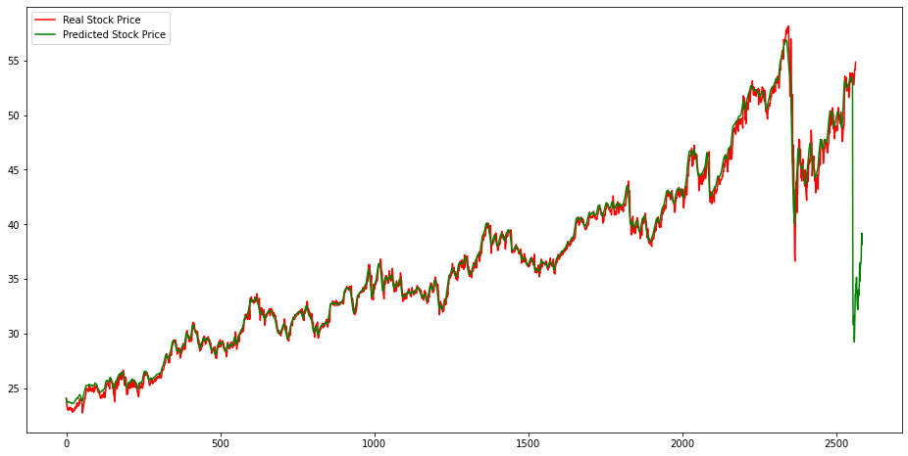
Results – 10 Year
 | TRIAL | 1 | Accuracy
 | ActualPrice
4-Jan | 52.76 | 33.100 | 0.627
5-Jan | 52.18 | 33.951 | 0.651
6-Jan | 50.52 | 35.124 | 0.695
7-Jan | 49.96 | 32.588 | 0.652
8-Jan | 51.08 | 34.124 | 0.668
11-Jan | 50.2 | 36.807 | 0.733
12-Jan | 50.11 | 35.725 | 0.713
13-Jan | 50.16 | 36.519 | 0.728
14-Jan | 49.23 | 36.445 | 0.740
15-Jan | 48.7 | 34.823 | 0.715
19-Jan | 48.51 | 36.734 | 0.757
20-Jan | 48.68 | 38.420 | 0.789
21-Jan | 48.95 | 40.020 | 0.818
22-Jan | 48.49 | 38.958 | 0.803
25-Jan | 48.78 | 40.443 | 0.829
26-Jan | 49.29 | 39.219 | 0.796
27-Jan | 48.53 | 39.513 | 0.814
28-Jan | 49.15 | 39.625 | 0.806
29-Jan | 48.15 | 39.347 | 0.817
Avg Accuracy |  |  | 0.745
The average accuracy from the ten trials was 73.770%.
The prediction differed from the actual by $10-12.
Price
In this graph, the predicted dip is even larger than March 2020 stock market crash.
Example Trial

Slide 11
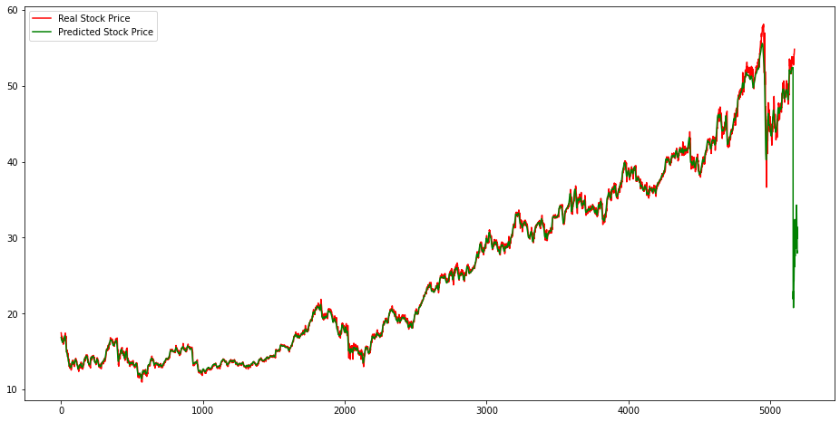
Results – 20 year
 | TRIAL | 1 | Accuracy
 | ActualPrice
4-Jan | 52.76 | 24.960 | 0.473
5-Jan | 52.18 | 24.539 | 0.470
6-Jan | 50.52 | 22.707 | 0.449
7-Jan | 49.96 | 24.389 | 0.488
8-Jan | 51.08 | 24.586 | 0.481
11-Jan | 50.2 | 26.790 | 0.534
12-Jan | 50.11 | 28.629 | 0.571
13-Jan | 50.16 | 27.891 | 0.556
14-Jan | 49.23 | 24.393 | 0.495
15-Jan | 48.7 | 25.506 | 0.524
19-Jan | 48.51 | 22.359 | 0.461
20-Jan | 48.68 | 23.870 | 0.490
21-Jan | 48.95 | 25.709 | 0.525
22-Jan | 48.49 | 24.256 | 0.500
25-Jan | 48.78 | 25.099 | 0.515
26-Jan | 49.29 | 26.022 | 0.528
27-Jan | 48.53 | 25.820 | 0.532
28-Jan | 49.15 | 21.488 | 0.437
29-Jan | 48.15 | 22.442 | 0.466
Avg Accuracy |  |  | 0.500
The average accuracy from the ten trials was 53.002%.
The prediction differed from the actual by $23-26.
Some were almost $30 off.
Price
This prediction projects the price to dip so low, that it returns to the price of nearly a decade ago.
Example Trial

Slide 12
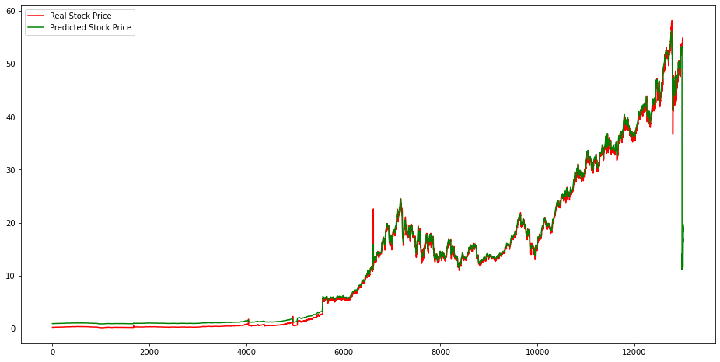
Results – 50 year
 | TRIAL | Trial 1 | Accuracy
 | ActualPrice
4-Jan | 52.76 | 7.863 | 0.149
5-Jan | 52.18 | 8.562 | 0.164
6-Jan | 50.52 | 9.527 | 0.189
7-Jan | 49.96 | 11.241 | 0.225
8-Jan | 51.08 | 11.692 | 0.229
11-Jan | 50.2 | 13.127 | 0.262
12-Jan | 50.11 | 14.386 | 0.287
13-Jan | 50.16 | 15.481 | 0.309
14-Jan | 49.23 | 15.561 | 0.316
15-Jan | 48.7 | 15.918 | 0.327
19-Jan | 48.51 | 12.518 | 0.258
20-Jan | 48.68 | 10.588 | 0.218
21-Jan | 48.95 | 8.178 | 0.167
22-Jan | 48.49 | 7.752 | 0.160
25-Jan | 48.78 | 3.987 | 0.082
26-Jan | 49.29 | 4.768 | 0.097
27-Jan | 48.53 | 5.257 | 0.108
28-Jan | 49.15 | 4.543 | 0.092
29-Jan | 48.15 | 5.298 | 0.110
Avg Accuracy |  |  | 0.197
These predictions were the least accurate of all.
The average accuracy from the ten trials was 26.288%.
The prediction differed from the actual by $35-42.
Price
The price drop at the end was the largest seen in any of the datasets.
This drop projected that the price will decrease to that of 30 years ago.
Example Trial

Slide 13
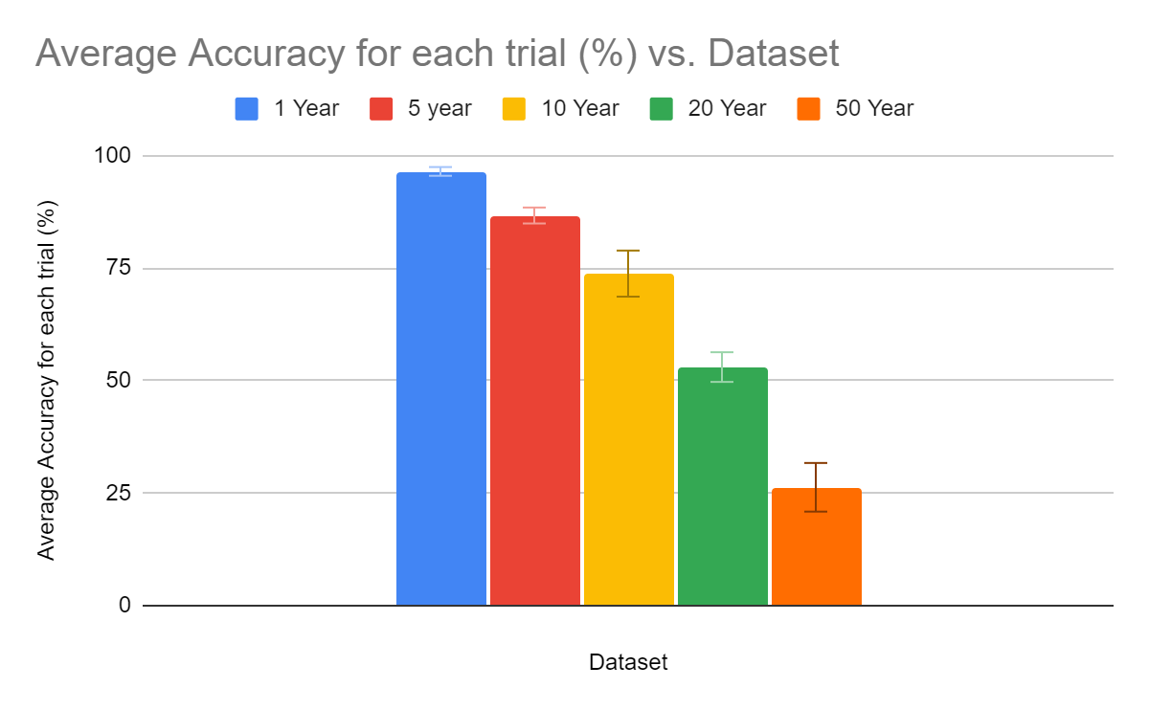
Results - Average Accuracy

Slide 14
Conclusion
After testing the program, a trend was revealed, and the results supported the hypothesis.
The shorter and more relevant datasets resulted in the most accurate predictions.
This is advantageous for forecasting the performance of companies while only needing small amounts of data.
Future directions: study different components of the dataset, different companies, and shorter datasets.

