Slide 1
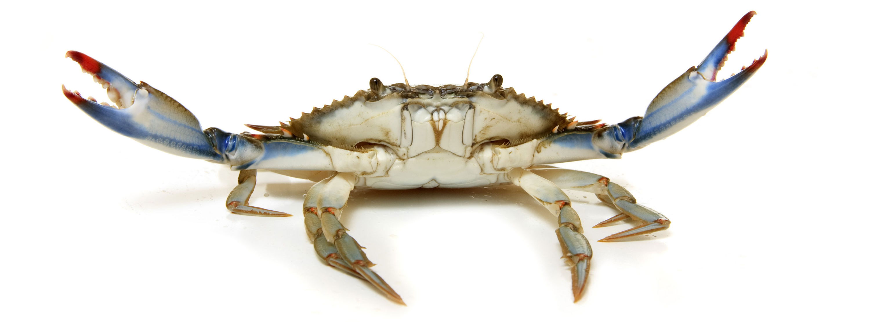
The Effect of TEA, 4-AP and in Combination on Primary Sensory Neurons in a Crustacean Model
Hannah Tanner
Lab of Dr. Robin Cooper, PhD

Slide 2
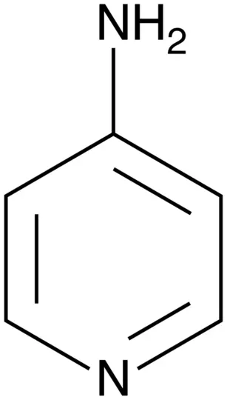
Tetraethylammonium chloride (TEA)
4-Aminopyridine
(4-AP)

Slide 3
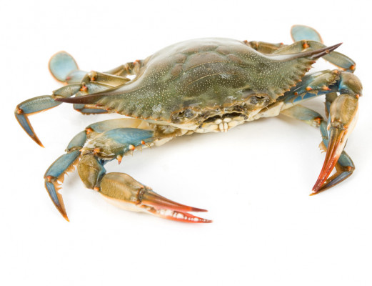
Model Organism: Blue Crab

Slide 4
Notes:
Dissected, suction electrode placed in it.

Slide 5
Control Group: Saline
A: Saline
solution changed
exercised 20x
B: Saline
solution changed
exercised 20x
C: Saline
2 sec

Slide 6
100mM 4-AP
A: Saline
solution changed to 100mM 4-AP
waited 10 minutes
exercised 20x
B: 100mM 4-AP
solution changed to saline washout
waited 10 minutes
exercised 20x
C: Saline wash
2 sec

Slide 7
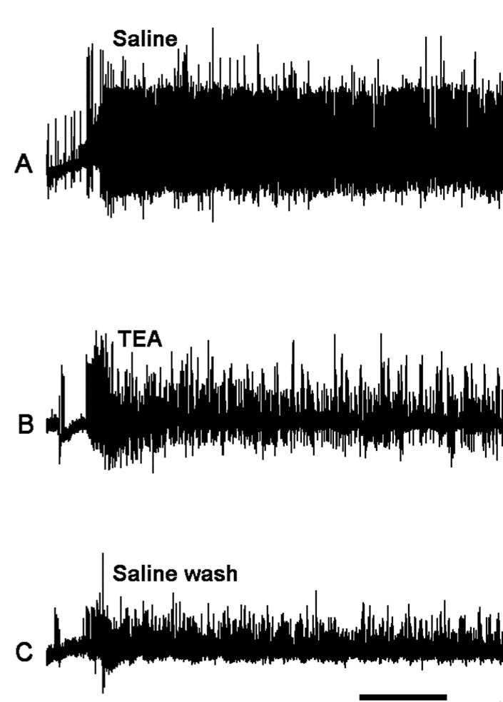
50mM TEA
A: Saline
solution changed to 50mM TEA
waited 20 minutes
exercised 20x
B: 50mM TEA
solution changed to saline washout
waited 20 minutes
exercised 20x
C: Saline wash
2 sec

Slide 8
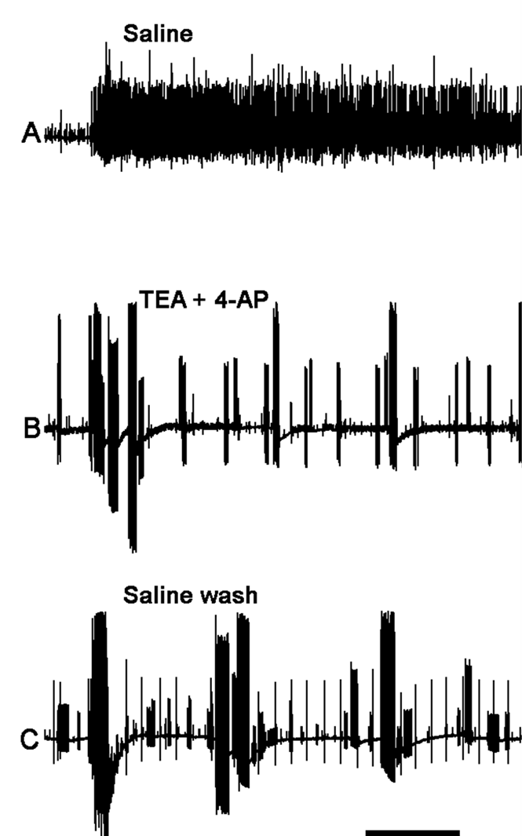
50mM TEA and 100mM 4-AP
A: Saline
solution changed to 50mM TEA and 100mM 4-AP
waited 20 minutes
exercised 20x
B: 50mM TEA and 100mM 4-AP
solution changed to saline washout
waited 20 minutes
exercised 20x
C: Saline wash
2 sec

Slide 9
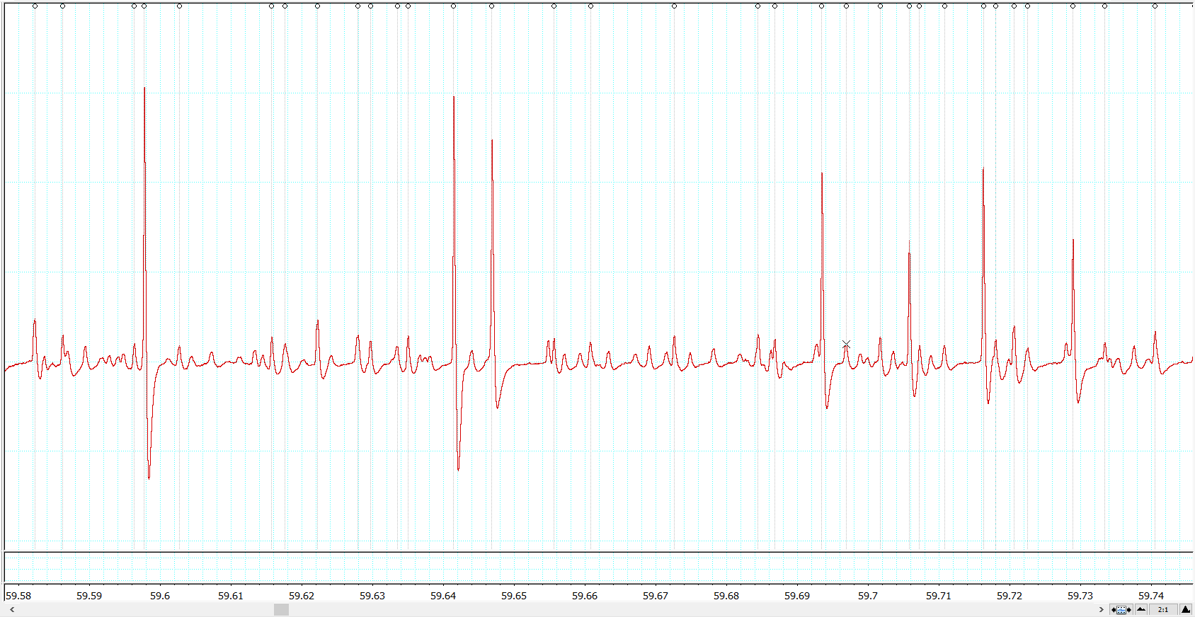
Counting

Slide 10
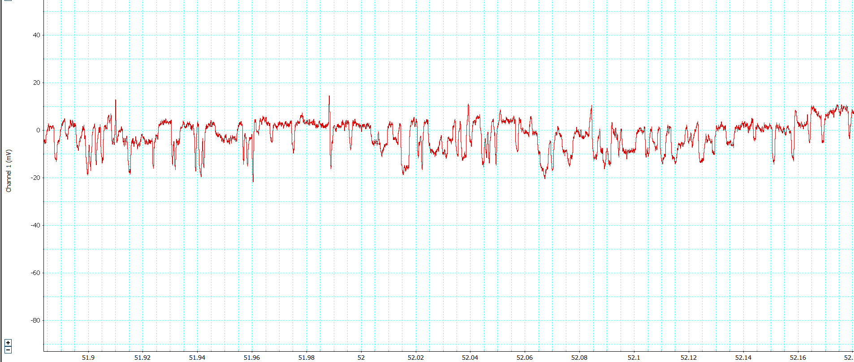
????

Slide 11
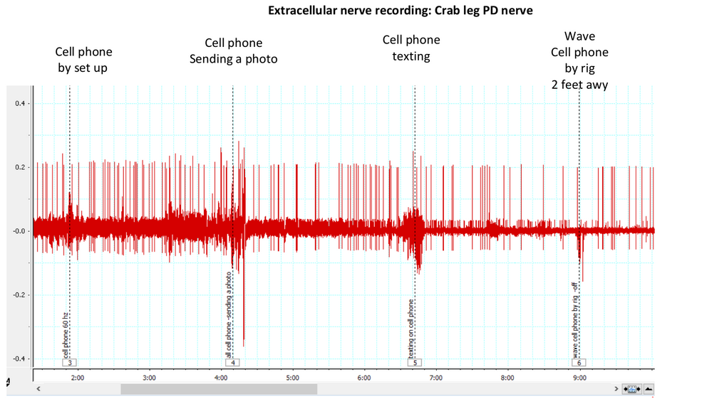

Slide 12
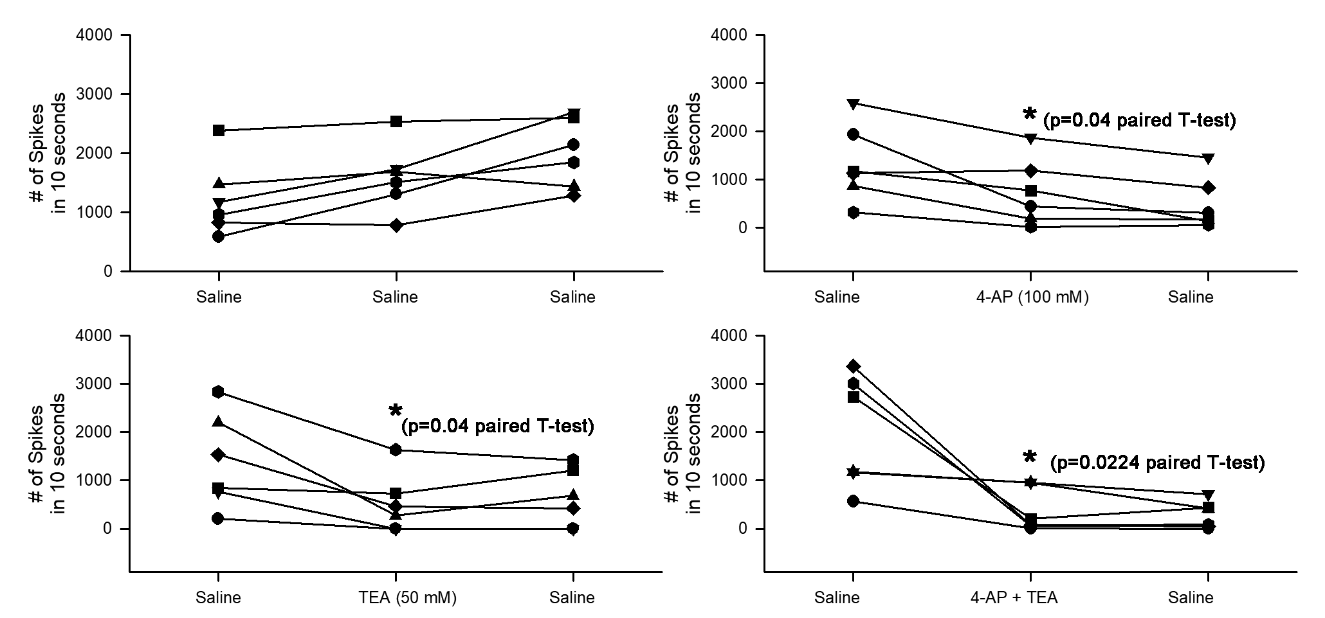
Number of spikes in each preparation within a 10 second interval

Slide 13
Percent Decrease
Compound | Decreased By
100mM 4-AP | 51.15%
4-AP washout | 66.91%
50mM TEA | 78.88%
TEA washout | 57.95%
50mM TEA + 100mM 4-AP | 70.55%
TEA + 4-AP washout | 80.48%

Slide 14
Conclusion
1. 4-AP at 100mM concentration depressed the activity of the primary sensory neurons.
2. Likewise, TEA at 50mM concentration also depressed sensory nerve activity.
3. When 4-AP and TEA were combined, the activity was depressed at a less than additive effect of the two compounds effect combined.

Slide 15
Replication and Validity
Course-based
Undergraduate
Research
Experience
Waterman, Rory, and Jen Heemstra, eds. Expanding the CURE model: course-based undergraduate research experience. Research corporation for science advancement, 2018.

Slide 16
Replication and Validity
A
>
Authentic
Course-based
Undergraduate
Research
Experience
Waterman, Rory, and Jen Heemstra, eds. Expanding the CURE model: course-based undergraduate research experience. Research corporation for science advancement, 2018.

Slide 17
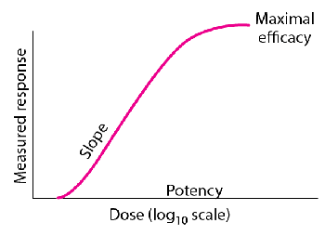
Future Directions

Slide 18
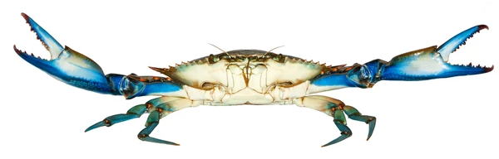
Thank you! Questions?

