Slide 1
Yield and Quality of Eggplant, Solanum melongena, Grown in Various Soil Amendments
Eric T. Turley, Rance Paxton, and George F. Antonious
College of Agriculture, Community, and the Sciences, Kentucky State University, Frankfort, KY 40601

Slide 2
Introduction
Use of soil amendments as a source of soil nutrients in fruit & vegetable production is growing worldwide.
Problems with soil deterioration and erosion associated with conventional farming practices also drives the increasing use of soil amendments.
Escalating production costs associated with escalating costs of fuel and fertilizers have generated considerable interest in less expensive and more environmentally friendly production alternatives.

Slide 3
Soil Amendments
Sewage Sludge (SS)
Chicken Manure (CM)
Biochar (BIO)
Chitin (CH)
No Mulch (NM)
Sewage Sludge mixed with biochar (SS+BIO)
sewage sludge mixed with chitin (SS+CH)
chicken manure mixed with biochar (CM+BIO)
chicken manure mixed with chitin (CM+CH)

Slide 4
Sewage Sludge Benefits
The U.S. Environmental Protection Agency, Water Environment Federation and Association of Metropolitan Sewage Agencies all promote sewage sludge (biosolids) recycling as an environmentally safe and cost-effective solution for managing waste disposal.
When conducted in accordance with state and federal regulations, use of sewage sludge benefits communities and supports environmental protection efforts with an excellent source of safe plant nutrients.

Slide 5
Sewage Sludge Benefits cont.
EPA supports sewage sludge (biosolids) recycling and encourages composting and land application of biosolids.
The use of sewage sludge(biosolids) can:
  • Improve crop production
  • Reduce soil erosion and protect water quality
  • Provide topsoil for recreational uses
  • Reclaim strip-mined lands
  • Enrich forestland
  • Conserve landfill space
  • Provide economic incentives

Slide 6
Benefits of Chicken Manure
Chicken Manure adds organic matter, increases the water holding capacity, and beneficial biota in soil.
Chicken manure provides N, P, and K to plants (more than horse, cow, or steer manure).
Chicken Manure contains necessary macro and micro-nutrients.

Slide 7
Benefits of Chicken Manure cont.
Chicken manure is naturally free from parasites and diseases that are likely to be present in the manure of meat-consuming animals.
Chicken manure is organic, so there are fewer chances of harsh chemicals entering the soil if gardening is being done organically.

Slide 8
Biochar

Slide 9
Biochar
Biochar is the charcoal-like byproduct of the process of pyrolysis, or the anaerobic thermal decomposition of organic materials (generally plant-based residues).
Less risk of reduced crop yield during dry seasons;
Reduce the need for chemical fertilizers containing N and P;
Help retain N and S in soil, which also reduces emissions;
Facilitate reestablishment of vegetation on sterile ground;
Inhibit the growth of molds or mildews;
Filter out contaminants from shallow soil water;
Remove heavy metals and acids from abandoned mine ponds;
Bind toxins and prevent their leaching into surface and ground water.

Slide 10
Benefits of Chitin
Chitin is a long-chain polymer, an amide derivative of glucose. This polysaccharide is a primary component of cell walls in fungi, the exoskeletons of arthropods, such as crustaceans and insects, the radulae of mollusks, cephalopod beaks, and the scales of fish and skin of lissamphibians, making it the second most abundant polysaccharide in nature.
Chitin is a good inducer of plant defense mechanisms for controlling diseases and it has potential for use as a soil fertilizer to improve fertility and plant resilience that may enhance crop yields.
It is the second most abundant polysaccharide, after cellulose, and rich in N, Ca, Mg and other vital minerals required for healthy microbial activity. When released in the soil, chitin increases the availability of N to soil microbes and plants.

Slide 11
Study Objective
To assess the impact of soil amendments on the yield and quality of eggplant grown in amended soil.

Slide 12
Method
Plants were grown in 27 plots, with 9 different soil treatments (eight soil amendment treatments and native soil used as a control) replicated three times.
All eggplant were harvested and graded according to United States Department of Agriculture (USDA) Grading Standards.

Slide 13
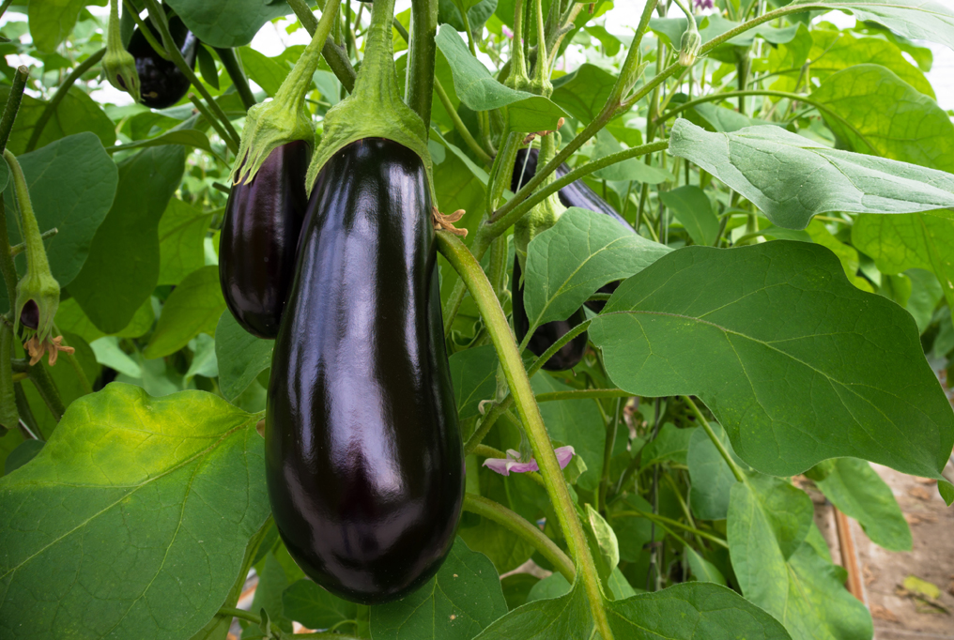
Eggplant Variety (cv. Nadia)

Slide 14
Experimental Plot Design

Slide 15
Quality of Eggplant-USDA Grade

Slide 16
Quantity of Eggplant Fruit

Slide 17
Total Yield & Weight of Eggplant

Slide 18
Conclusion
Results revealed that eggplant yield obtained from Chicken Manure treatment was significantly greater for total yield compared to all other soil treatments.
Chicken manure only and Chitin only amended soil had the greatest number of eggplant fruit in USDA grades: US Fancy, US No.1, and US No.2 compared to all other soil treatments.

Slide 19
Conclusion
Our research shows that of all research amendments, the use of Chicken Manure Only or Chitin Only amended soil gives the greatest total yield and greatest USDA marketable graded eggplant fruit.

Slide 20
ACKNOWLEDGMENTS
This investigation was supported by a grant from the United States Department of Agriculture, National Institute of Food and Agriculture (USDA/NIFA) to Kentucky State University (KSU) under agreement No. KYX-10-18-65P Accession 1017900.
Special thanks to:
Steve Diver and Staff- University of Kentucky South Farm
Graduate Assistant: Anjan Nepal

Slide 21
References
Sanders A (2017) Benefits of Chicken Manure. Garden Guides. https://www.gardenguides.com/89749-benefits-chicken-manure.html
Gaskell M The effects of manure, compost, and feather meal on soil nitrogen dynamics, beneficial soil microorganisms, and bell pepper yield. Research report submitted to the Organic Farming Research Foundation, 2001, 14pp.
Hernando S, Lobo MC, Polo A (1989) Effect of application of a municipal refuse compost on the physical and chemical properties of a soil. Science and the Total Environment 81/82: 589-596.
Marchesini A, Allievi L, Comotti E, Ferrari A (1988) Long-term effects of quality-compost treatment on soil. Plant and Soil 106: 253-261.
National Research Council (2002) Biosolids Applied to Land: Advancing Standards and Practices, 2002, 346pp. National Academic Press.
SAS Institute, SAS/STAT Guide, SAS Inc., SAS Campus Drive, Cary, NC 27513, USA, 2001.
Stratton, M.L.; Rechcigl, J.E. Organic mulches, wood products, and compost as soil amendments and conditioners. In: Handbook of Soil Conditioners. Wallace A, Terry R (eds), Marcel Dekker, Inc., New York, 1998, pp. 43-95.
U.S. Environmental Protection Agency. Municipal solid waste in the United States: Facts and figures-1999. 2001 EPA/530-R-01-014.
USEPA. Standards for disposal of sewage sludge; final rules: Part II. Federal Resister, February 19, 1993, pp. 9247-9415.
Woodbury, P.B. Trace elements in municipal solid waste composts. Biomass and Bioenergy 1992, 3, 239.
Shamshina, Julia & Oldham, Tetyana & Rogers, Robin. (2019). Applications of Chitin in Agriculture. 10.1007/978-3-030-16581-9_4.

Slide 22

Thank You

