Slide 1
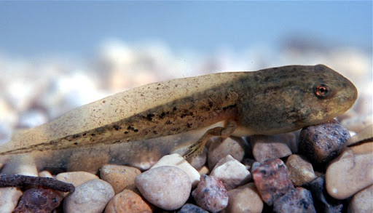
Consumptive and non-consumptive effects of wood frog (Lithobates sylvaticus) tadpoles on invertebrate communities
Brady P. Parlato and Cy L. Mott
Department of Biological Sciences, Eastern Kentucky University, Richmond KY, 40475, USA

Slide 2
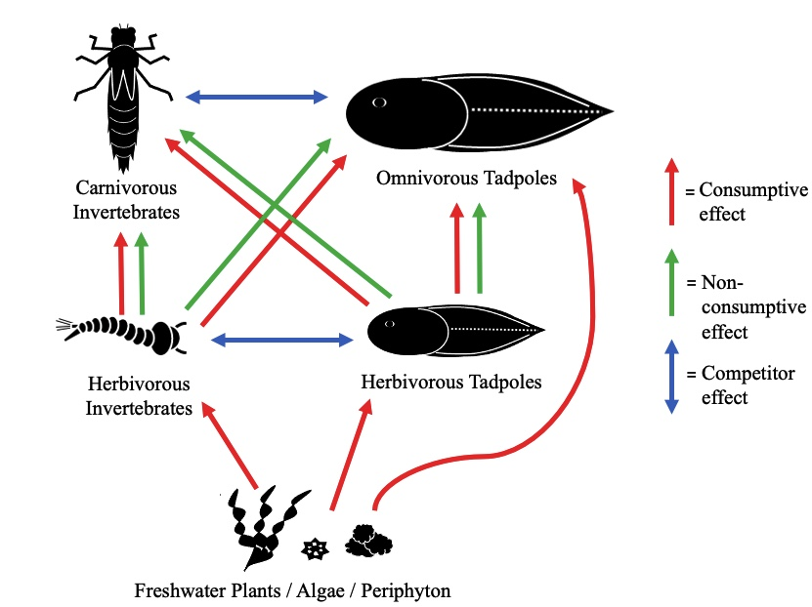
Consumptive and Non-consumptive Predatory Effects of Tadpoles?
Recent evidence suggests that tadpoles feed on:
Algae / Plant Matter
Zooplankton and Small Macroinvertebrates
Other Tadpoles
In addition to competition, tadpoles likely have important consumptive and non-consumptive effects on invertebrate communities.

Slide 3
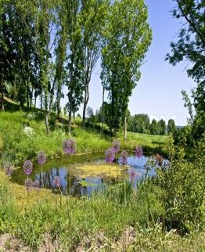
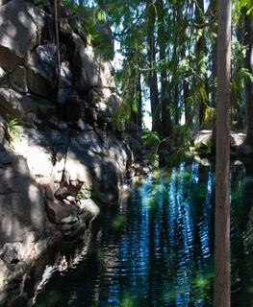
What Factors Influence Predatory Effects of Tadpoles?
Predatory effects of tadpoles on invertebrates are likely influenced by certain factors:
Degree of Habitat Shading
Tadpole Body Size

Slide 4
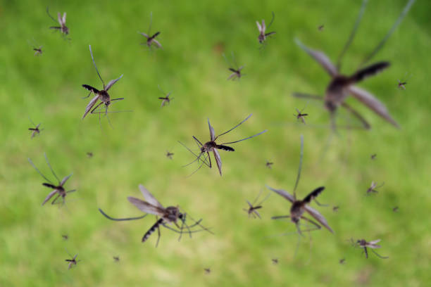
Why Study Predatory Effects of Tadpoles?
Often the dominant vertebrate consumers in fishless ponds.
Nearly 40% of amphibians are at risk of extinction and they play valuable ecological roles:
Disease Vector Control
Nutrient Cycling
Energy Transfer
Aquatic Nutrients / Energy
Loss of tadpoles and their roles as predators could have severe ecological consequences.
Terrestrial Nutrients / Energy

Slide 5
Objective 1
Determine proportions of omnivory and quantify invertebrates consumed by Lithobates sylvaticus (wood frog) tadpoles from ephemeral ponds in the Daniel Boone National Forest (DBNF).

Slide 6
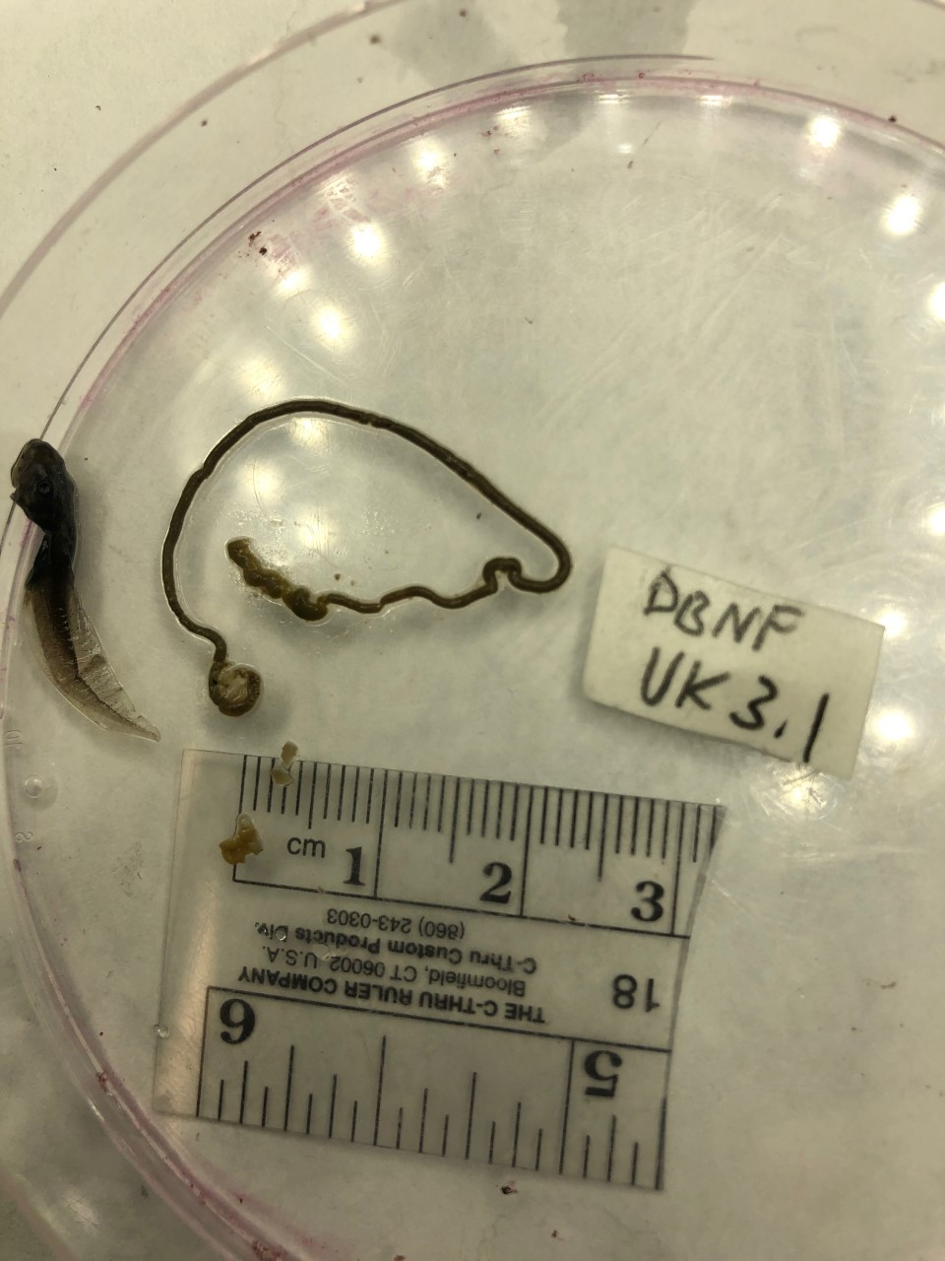
Materials and Methods Objective 1: Gut Content Analyses
Hypothesis: Proportions of omnivory will be higher than strict herbivory or detritivory in sampled tadpoles.

Slide 7
Objective 2
Use mesocosms to investigate the presence of consumptive and non-consumptive predatory effects of tadpoles on invertebrates.

Slide 8
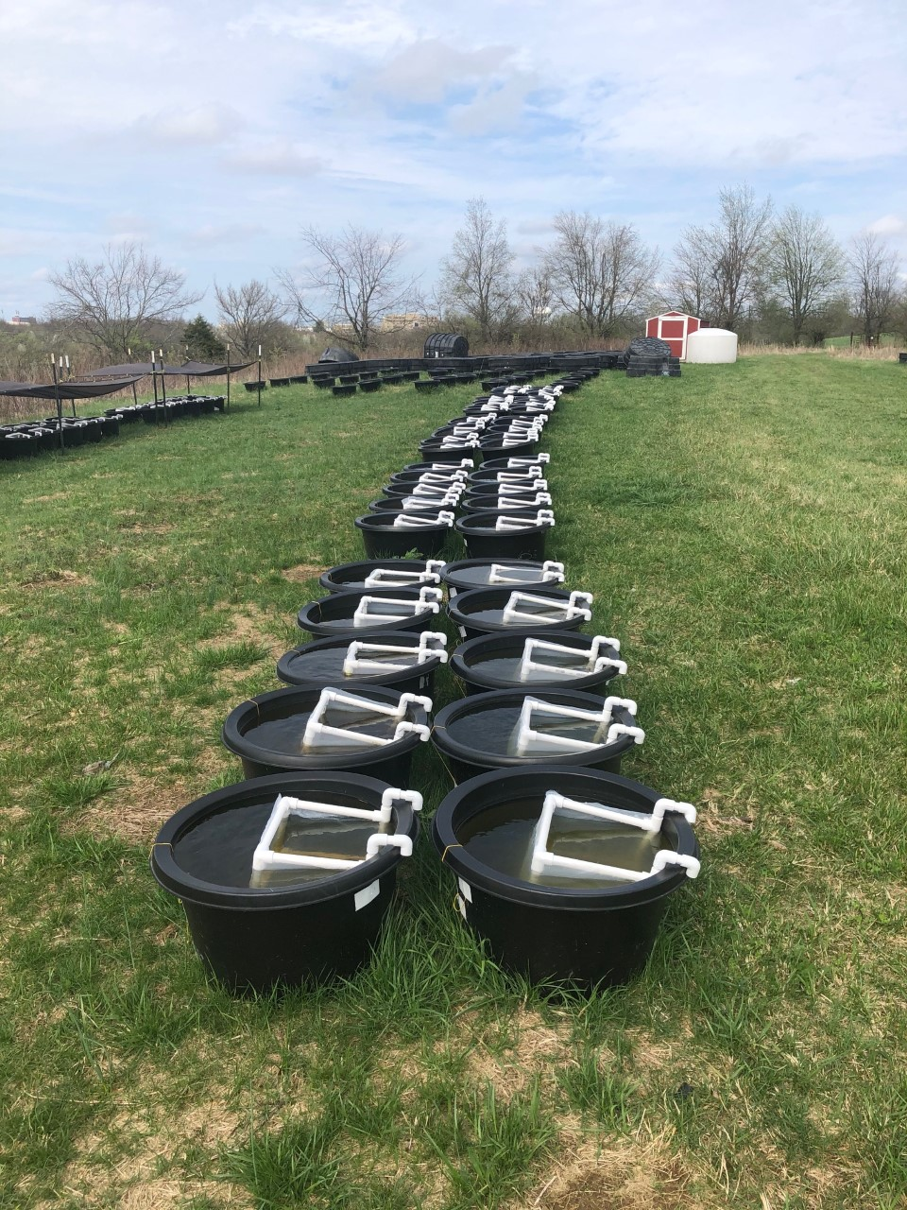
Objective 2. Consumptive and Non-Consumptive Effects of Tadpole Predators
250 ml Collected Invertebrate Solution
607.5 cm³ Leaves
20 ml Bloodworm Solution
Hypothesis: Invertebrate abundance will be lowest and community structure will be most negatively impacted in the presence of free-swimming tadpoles.

Slide 9
Objective 3
Determine if degree of habitat shading and tadpole body size influence predatory effects of tadpoles on invertebrates.

Slide 10
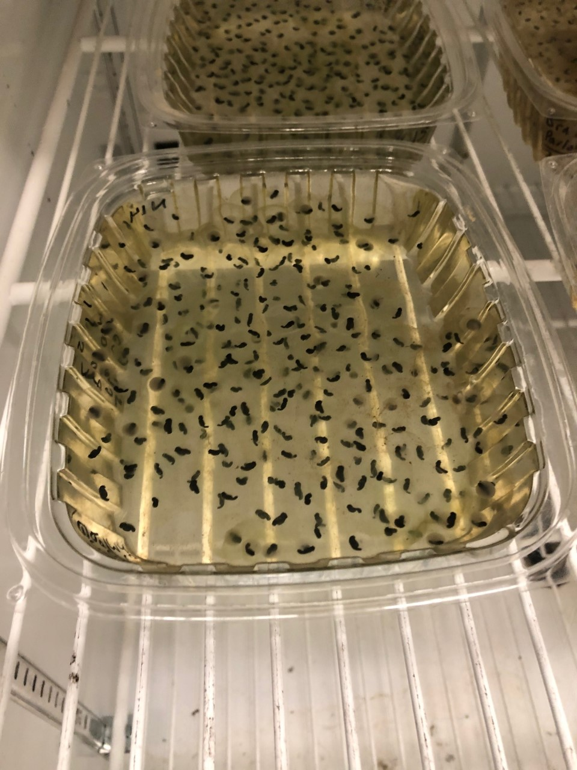
Objective 3. Effects of Shading and Tadpole Body Size
Hypothesis: Invertebrate abundance will be lowest and community structure
will be most negatively impacted in the presence of large, free-swimming tadpoles in shaded
conditions.

Slide 12
Statistical Analyses
Objective 1:
Chi-Square Test of Independence to compare proportions of omnivory versus strict herbivory.
MANOVA to compare abundances of consumed invertebrates by taxon across ponds.
Objective 2:
MANOVA, ANOVA, and Tukey HSD Tests to compare macroinvertebrate and zooplankton abundance among tadpole presence treatments
Objective 3:
MANOVA, ANOVAs, and Tukey’s HSD Tests to compare total macroinvertebrate and zooplankton abundance across size, shading, and tadpole presence treatments.
ANOSIM to test for consumptive and non-consumptive effects of tadpoles on invertebrate community structure

Slide 13
Results – Objective 1: Do Wood Frog Tadpoles Engage in Omnivory?
Proportion of Omnivorous Tadpoles Among 11 Ponds in DBNF
Average # Invertebrates Consumed by Tadpoles Among 11 Ponds in DBNF
Proportion of Omnivorous Tadpoles
Average # Invertebrates Consumed by Tadpoles

Slide 14
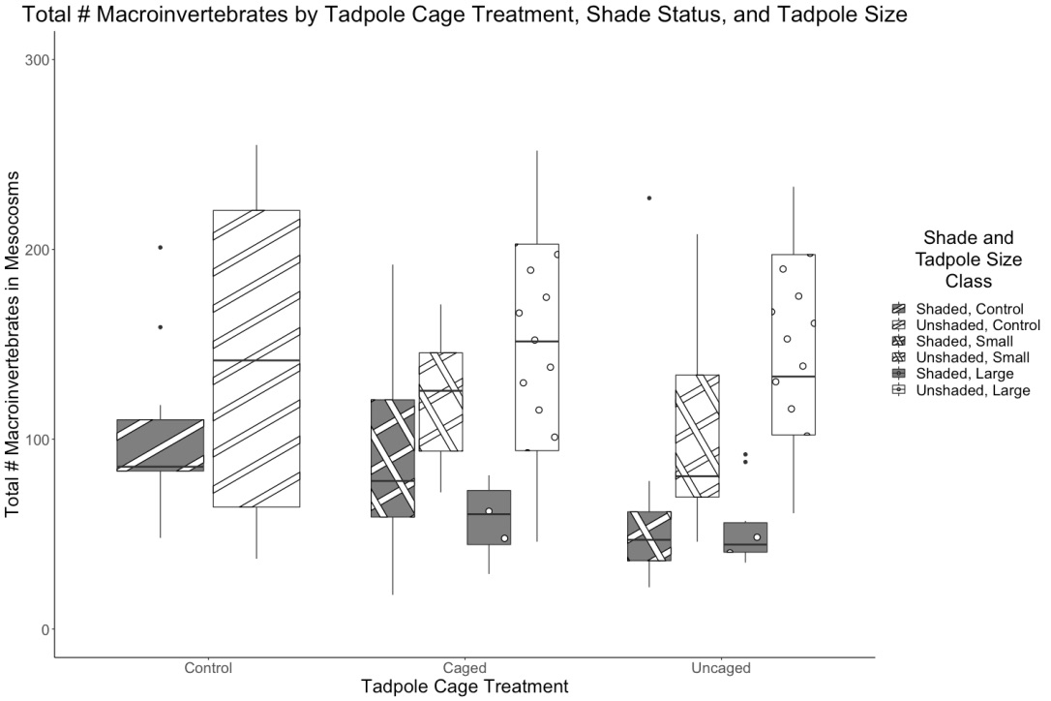
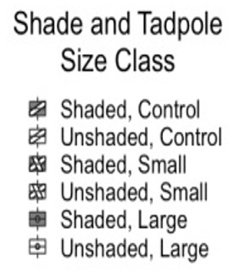
Objectives 2 and 3: Do Tadpoles Have Consumptive and Non-consumptive Effects on Invertebrates, and Are These Effects Influenced by Habitat Shading and Body Size?
Total # Macroinvertebrates by Cage, Shade, and Tadpole Size Treatment

Slide 15
Total # Zooplankton by Cage, Shade, and Tadpole Size Treatment

Slide 16
Discussion Wood Frog Tadpoles are Primarily Omnivorous
Results suggest that omnivory in wood frog tadpoles is driven by hydroperiod length, adult fitness, and gape size.
In addition, tadpoles that developed in unshaded conditions grew faster than shaded individuals.
Omnivory
Herbivory

Slide 17
Consumptive and Non-consumptive Effects of Tadpoles on Invertebrates
Tadpoles had greater consumptive relative to non-consumptive effects on invertebrates, mainly on zooplankton. However, non-consumptive effects were still important, and may have occurred via different mechanisms:

Slide 18
Effects of Tadpoles on Invertebrates are Linked to Habitat Shading and Body Size
Overall invertebrate abundances were generally lower in shaded conditions and in the presence of larger, free-swimming tadpoles. Possible mechanisms for reduced invertebrate abundance?

Slide 19
Conclusion
L. sylvaticus tadpoles feed on invertebrates and have consumptive and non-consumptive effects on invertebrate communities that are mediated by habitat shading and tadpole body size.
Questions for future studies:
1. Are tadpoles targeting invertebrates as prey, or just consuming them as bycatch?
2. What chemical cues, if any, are tadpoles producing that are causing non-consumptive effects on invertebrates?
3. Are predatory invertebrates having similar non-consumptive effects on tadpoles?

Slide 20
Acknowledgements
I would like to thank the following individuals / organizations for their contributions to my thesis research:
Dr. Cy Mott (Faculty Advisor)
Dr. Amy Braccia and Dr. Valerie Peters (Thesis Committee Members)
Dr. Stephen Richter and Dr. David Brown (Research Guidance)
Aaron Devine, Sandra Elliott, Renae Steinberger, Idris Irihamye, and Ian Kratzer (Assistance with Proposal Writing and Fieldwork)
EKU Graduate School, College of Science, and Department of Biological Sciences (Financial and Educational Support)
KDFWR, USFS, and EKU IACUC (Approvals and Permits)
Kentucky Academy of Science, Society for the Study of Amphibians and Reptiles, EKU Division of Natural Areas, and KY TWS (Funding Sources)

Slide 21
Literature Cited
Blaustein, L., and J. Margalit. 1996. Priority effects in temporary pools: nature and outcome of mosquito larva-toad tadpole interactions depend on order of entrance. Journal of Animal Ecology 65:77-84.
Borges, F. D. F., Stéfani, M. V. D., and Amaral, L. A. D. 2014. Quality of the effluents of bullfrog tadpole ponds. Boletim Do Instituto de Pesca 409-417.
Gu, L., Qin, S., Lu, N., Zhao, Y., Zhou, Q., Zhang, L., Sun, Y., Huang, Y,. Lyu, K., and Yang, Z. 2020. Daphnia mitsukuri traits responding to predation cues alter its population dynamics. Ecological Indicators 117:106587.
Juanes, F., and D. O. Conover. 1995. Size-structured piscivory: advection and the linkage between predator and prey recruitment in young-of-the-year bluefish. Marine Ecology Progress Series 128:287-304.
Martin, T. H., L. B. Crowder, C. F. Dumas and J. M. Burkholder. 1992. Indirect effects of fish on macrophytes in Bays Mountain Lake: evidence for a littoral trophic cascade. Oecologia 89:476-481.
Peacor, S. D., and E. E. Werner. 2000. Predator effects on an assemblage of consumers through induced changes in consumer foraging behavior. Ecology 81:1998-2010.
Pfennig, D. W. 1999. Cannibalistic tadpoles that pose the greatest threat to kin are most likely to discriminate kin. Proceedings of the Royal Society of London. Series B: Biological Sciences 266:57-61.
Ramamonjisoa, N., Iwai, N., and Natuhara, Y. 2016. Post-metamorphic costs of carnivorous diets in an omnivorous tadpole. Copeia 104:808-815.
Riessen, H. P., and Trevett-Smith, J. B. 2009. Turning inducible defenses on and off: adaptive responses of Daphnia to a gape‐limited predator. Ecology 90:3455-3469.
Schalk, C. M., C. G. Montaña, K. O. Winemiller, and L. A. Fitzgerald. 2017. Trophic plasticity, environmental gradients and food‐web structure of tropical pond communities. Freshwater Biology 62:519-529.
Schiesari, L., E. E. Werner, and G. W. Kling. 2009. Carnivory and resource-based niche differentiation in anuran larvae: implications for food web and experimental ecology. Freshwater Biology 54:572-586.
Stuijfzand, S. C., Engels, S., Van Ammelrooy, E., and Jonker, M. 1999. Caddisflies (Trichoptera: Hydropsychidae) used for evaluating water quality of large European rivers. Archives of environmental contamination and toxicology 36:186-192.
Whiles, M. R., M. I Gladyshev, N. N. Sushchik, O. N. Makhutova, G. S. Kalachova, S. D. Peterson, and K. J. Regester. 2010. Fatty acid analyses reveal high degrees of omnivory and dietary plasticity in pond-dwelling tadpoles. Freshwater Biology 55:1533-1547.

Slide 22
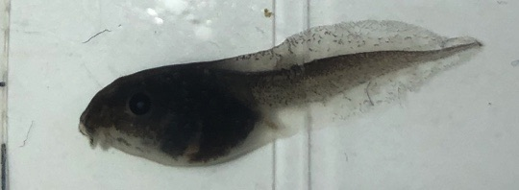
Questions? Email: brady_parlato@mymail.eku.edu Twitter: @BradyParlato

