Slide 1
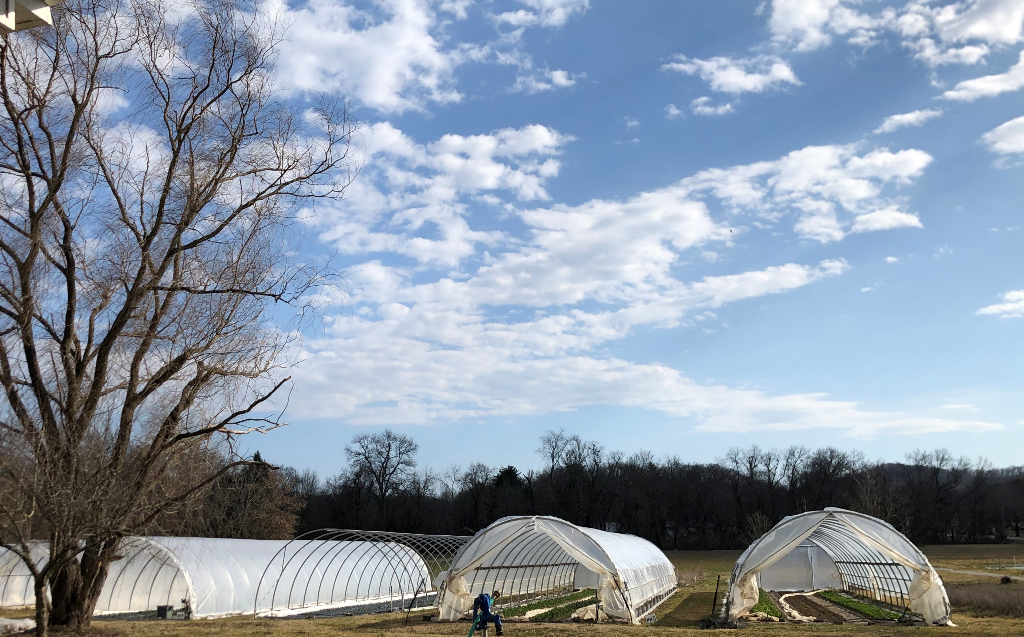
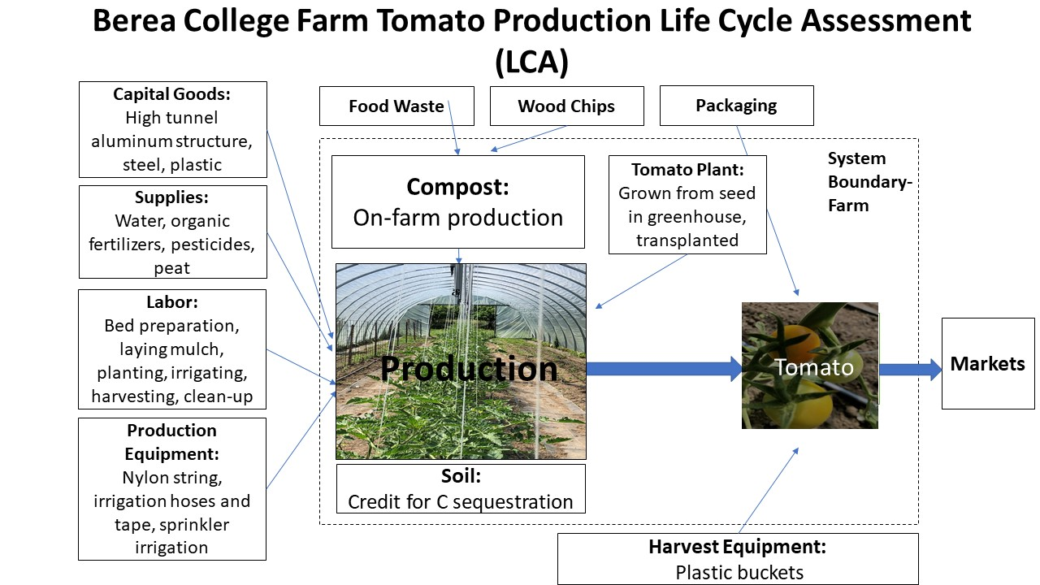
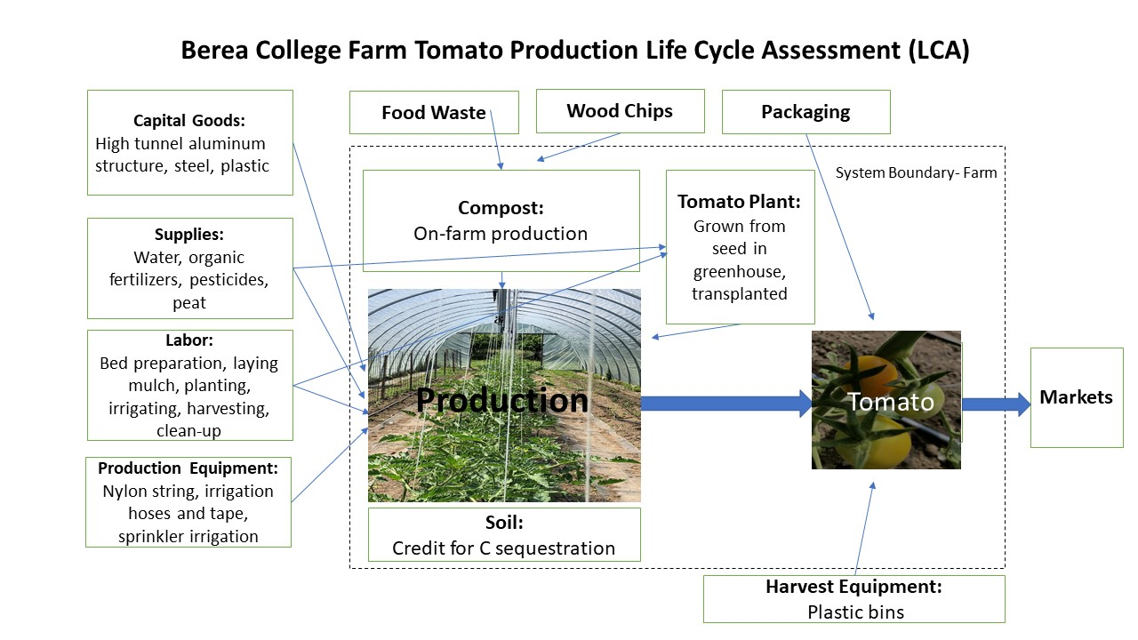
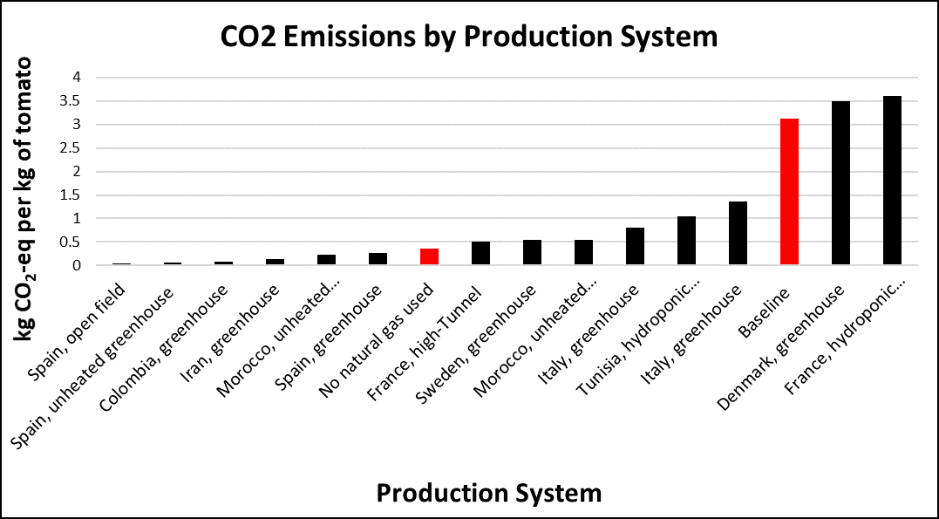
A Life Cycle Assessment of Tomato Production at the Berea College Farm
Life Cycle Assessment of Berea College Tomatoes
Hallie Whitehead
Agriculture and Natural Resources ‘23
Background: The Farm
The Berea College Farm produced an average of 825 kg of tomatoes per year from 2019-2020, to help supply the Dining Hall and Farm Store.
Results
Using the EUPHOROS LCA tool, it was found that the Farm’s GWP for tomato production is 3.13 kgCO2-eq per kg of fruit produced. This is a high number compared to other production systems found around the world, and research revealed a lower yield compared to others as well. As shown in Figure 2, GHG emissions would decrease to 0.36 kgCO2-eq if the Farm discontinued natural gas usage.
Other Production Systems
To contextualize the Greenhouse Gas (GHG) emissions found at the Farm, yields and GHG emissions from other open field, greenhouse, and high tunnel production systems were compared.
Conclusions
The GWP for tomato production at the College Farm is higher than most other systems, which is cause for concern.
In order to reduce GHG emissions, future work should include:
•Decreasing the amount of natural gas used for production on the College Farm
•Increasing tomato yields through pest management
Figure 1. Life Cycle Assessment Diagram
Life Cycle Assessment (LCA)
This procedure measures the full impact of an object or system and is trending globally as a way to analyze and compare the amount of pollutants emitted during the production of a product. A list of production inputs is entered into the software as seen in Figure 1, and the Global Warming Potential (GWP) is calculated.
Other Production Systems
This bar graph represents CO₂ emissions by production system, including the College Farm, and represents lower emissions achieved when simulated without using natural gas heating
Conclusions
Acknowledgements
I would like to thank Horticulture Supervisor Janet Meyer, Professor Sean Clark, my research partner Victor Faluyi, and the URCPP committee.
Citations
Torrellas, M.; Antón, A.; López, J.C.; Baeza, J.P.; Parra; P, Muñoz; J.I., Montero LCA of a tomato crop in a multi-tunnel greenhouse in Almeria Int. J. Life Cycle Assess., 2012, 863-875.
Montero, J.; Ruijs, M. EUPHOROS environment simulation tool. Wageningen University.
Figure 2. Emissions by production system

