Slide 1
Chromatographic Studies on some Selective Estrogen Receptor Modulators used in Doping in Sports
Ruth Speidel
Dr. Karim Abdelhay
Eastern Kentucky University

Slide 2
Background

Slide 3

World Anti-Doping Agency (WADA)

Slide 4
Toremifene
Selective Estrogen Receptor Modulator
  Hormone Modulator
Medical Use: Breast Cancer and Osteoporosis
Doping Use: Increase Testosterone Levels (in men)
Blocks estrogen activity
  Prevents gynecomastia (unlike anabolic steroids)

Slide 5
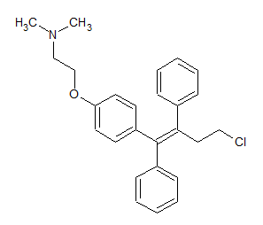
Toremifene
Absorption:
  Peak plasma concentration 2-6 hours
Distribution:
  99.7% binds to plasma protein
Elimination:
  Majority in feces

Slide 6
Trimetazidine
Metabolic Modulator
Medical Use: treat angina pectoris (not FDA approved)
Doping Use:
  decrease contractility
  increase fatty acid oxidation (ATP production)

Slide 7
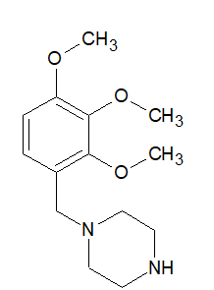
Trimetazidine
Absorption:
  Peak plasma concentration 2 hours
Distribution:
  Weakly binds to plasma proteins
Elimination:
  Approximately 80% eliminated in the urine
  Approximately 60% unchanged parent compound
Dazsi, C.A. Trimetazidine in Practice :Review of the Clinical and Experimental Evidence. Am J Therap 2016, 23: 871-879

Slide 8
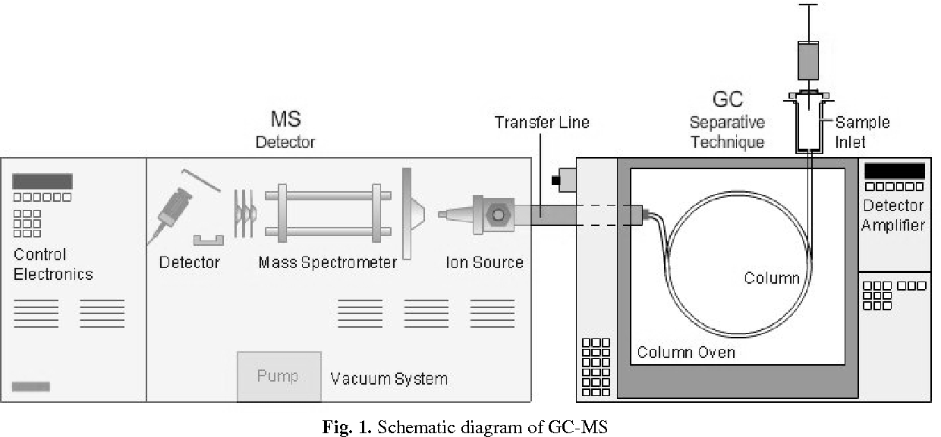
GC-MS
Gas Chromatography- Mass Spectroscopy
Gas Chromatography
  Column: HP-5ms (5%-phenyl)-methlpolysiloxane
  Mobile Phase: Helium
Mass Spec
  Ionization Source (Electron Ionization)
  Mass Analyzer (Quadrupole)
  Detector (Electron Multiplier)

Slide 9
Method Development and Method Optimization

Slide 10
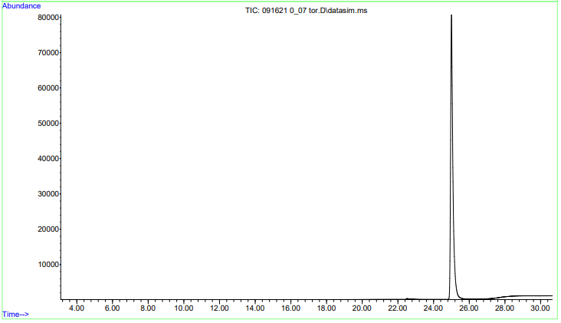
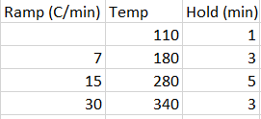
Method Development Toremifene
Retention Time: 24.9 min
Inlet
  250ºC
  10 psi
Auxiliary Heater
  280ºC
Temperature Program

Slide 11
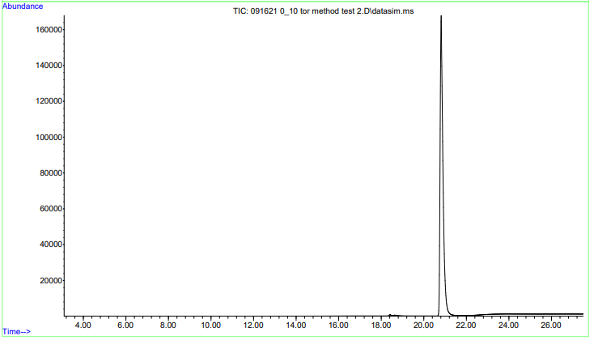
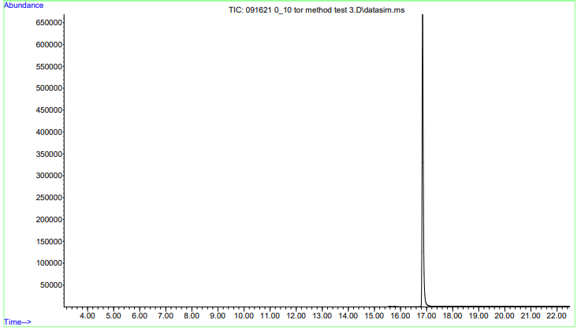
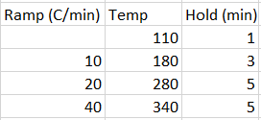
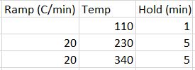
Method Optimization Toremifene
Retention Time: 20.8 min
Inlet & Aux heater
  Same
Temperature Program
Retention Time: 16.8 min
Inlet & Aux heater
  Same
Temperature Program

Slide 12
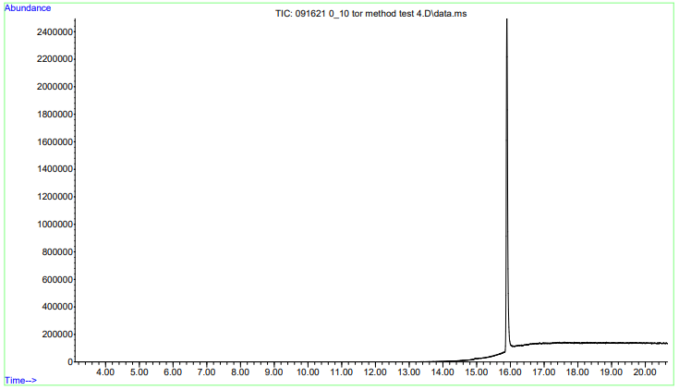
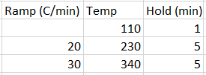
Method Optimization Toremifene
Retention Time: 15.9 min
Inlet & Aux heater
  Same
Temperature Program

Slide 13
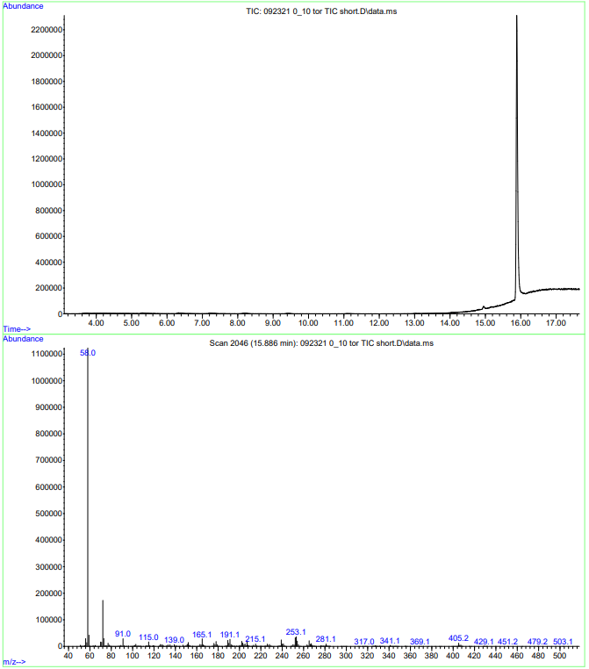
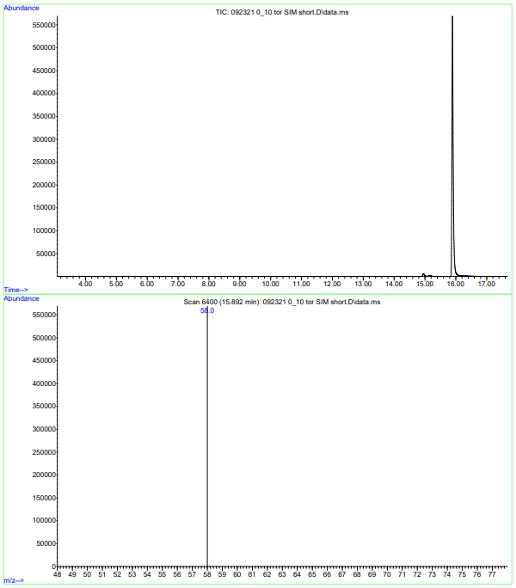
SIM Toremifene

Slide 14
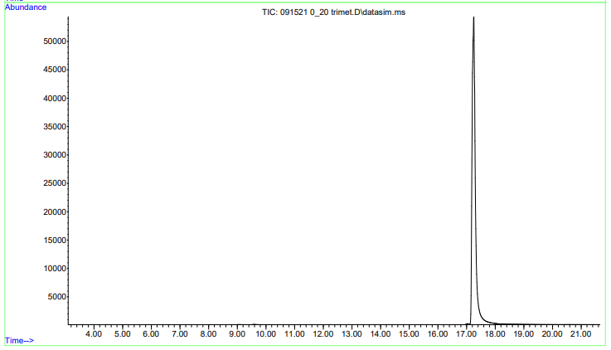
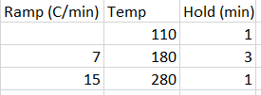
Method Development Trimetazidine
Retention Time: 17.3 min
Inlet
  250ºC
  10 psi
Auxiliary Heater
  280ºC
Temperature Program

Slide 15
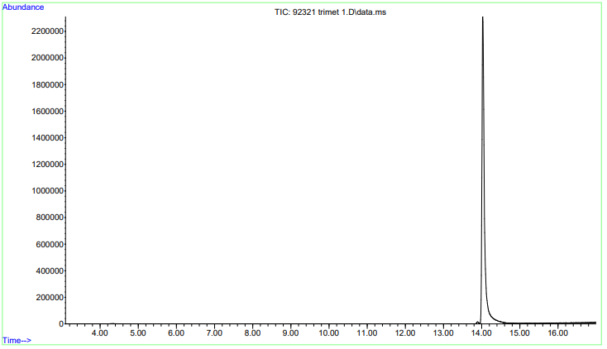
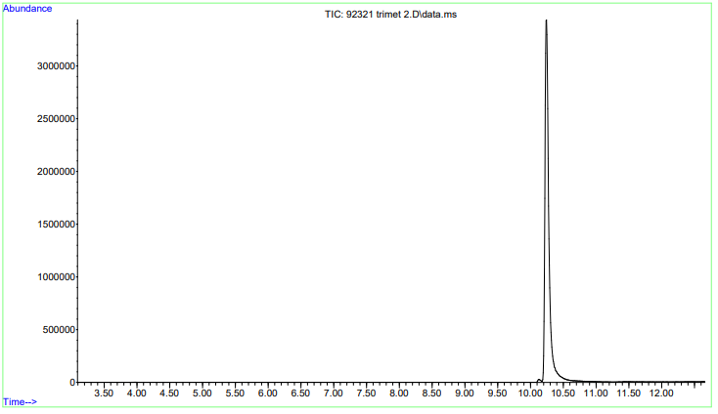
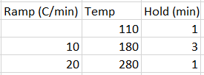
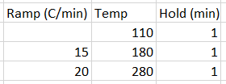
Method Optimization Trimetazidine
Retention Time: 14.0 min
Inlet & Aux heater
  Same
Temperature Program
Retention Time: 10.2 min
Inlet & Aux heater
  Same
Temperature Program

Slide 16
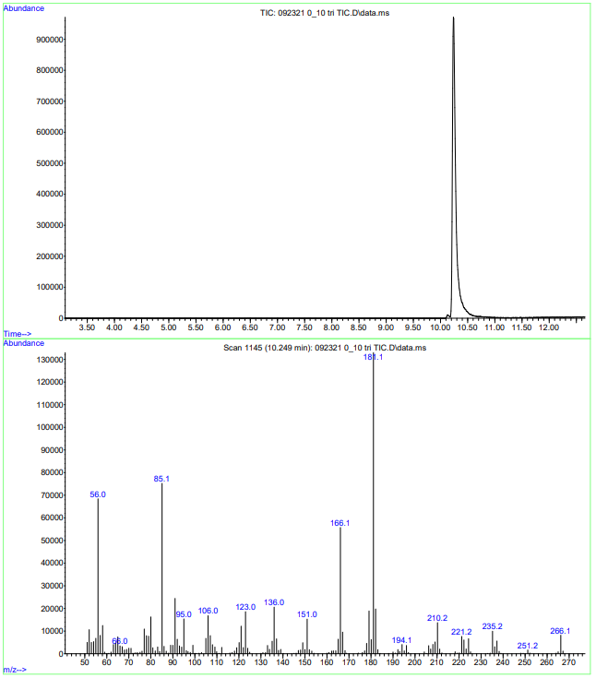
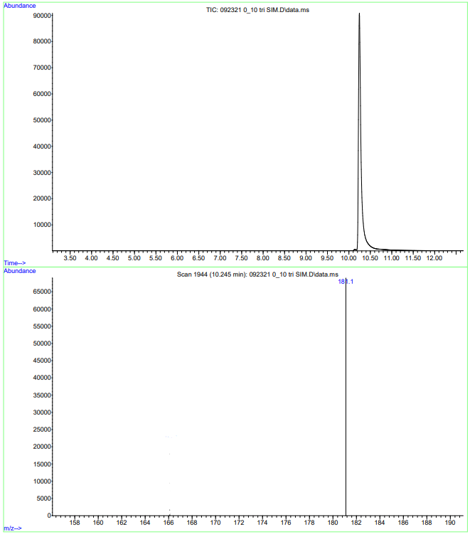
SIM Trimetazidine

Slide 17
Calibration

Slide 18
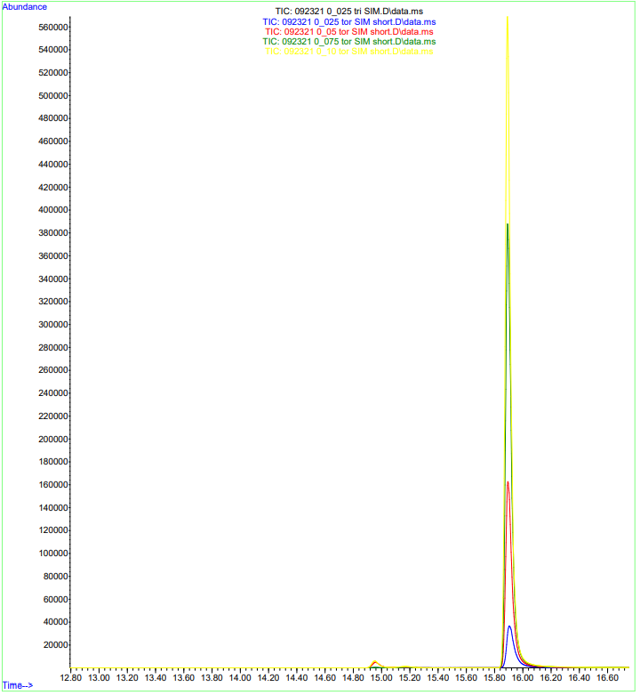
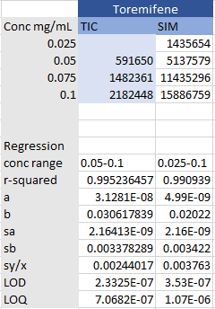
External Calibration Toremifene

Slide 19
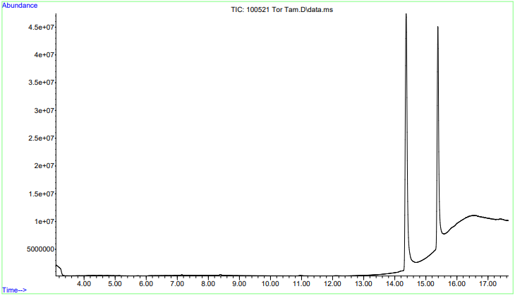
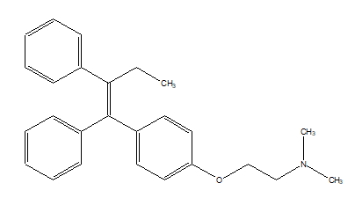
Internal Standard Toremifene
Toremifene
Tamoxifen

Slide 20
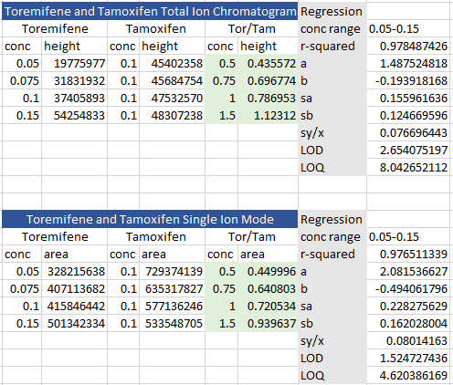
Internal Standard Toremifene

Slide 21
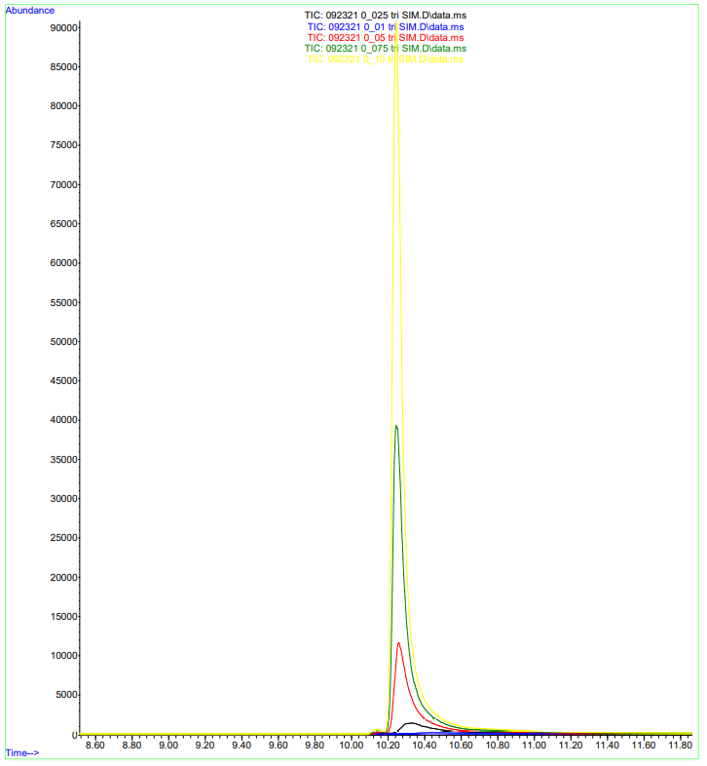
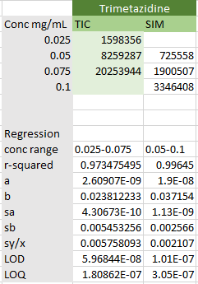
External Calibration Trimetazidine

Slide 22
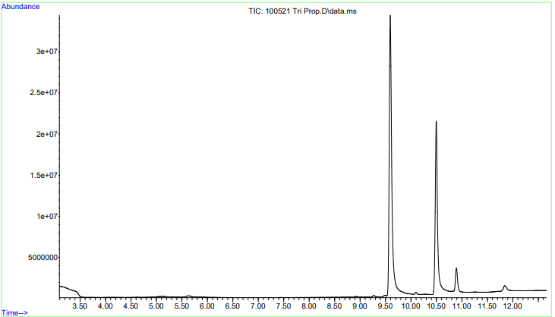
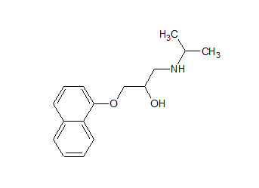
Internal Standard Trimetazidine
Trimetazidine
Propranolol

Slide 23
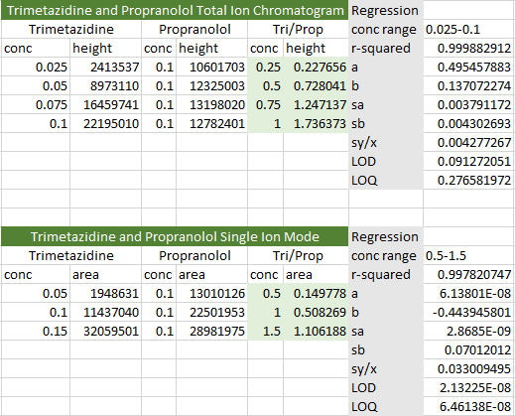
Internal Standard Trimetazidine

Slide 24
Biological Fluids

Slide 25
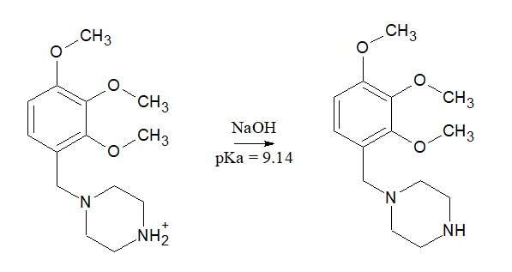
Trimetazidine in Urine
Liquid Extraction
  Add NaOH to urine until pH≈12
  Extract with 7 mL of Chloroform

Slide 26
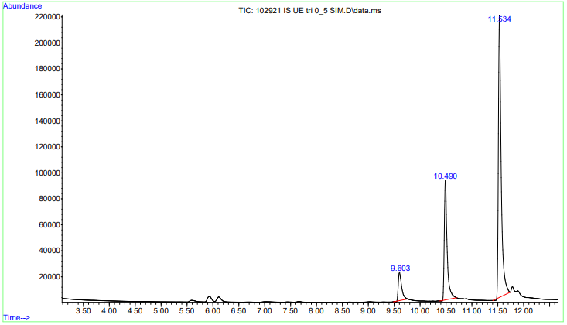
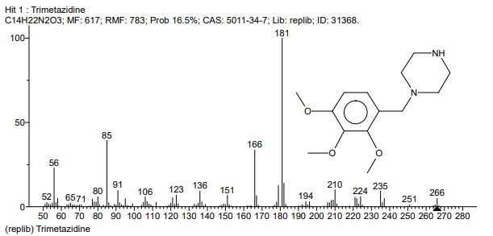
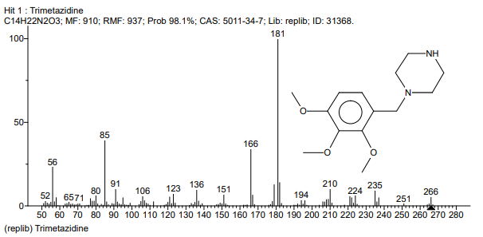
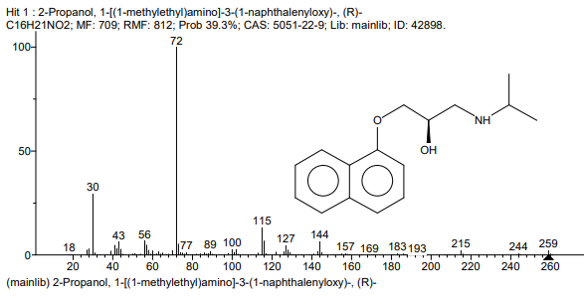
Trimetazidine in Urine

Slide 27
Next Steps
Use biological fluids
  Toremifene in Plasma
Method Validation
  Demonstrate that it is suitable for its intended purpose

Slide 28
Acknowledgements
Huge THANK YOU to Dr. Abdelhay
Thank you to my committee members
Dr. Jamie Fredricks
Dr. Jerome May
Dr. Cindy Tran

