Slide 1
The Legacy Cycle of Problem-Based Learning in Middle Grades Mathematics: Sword Art Escape Room
Cassidy Day and Rece Johnson

Slide 2
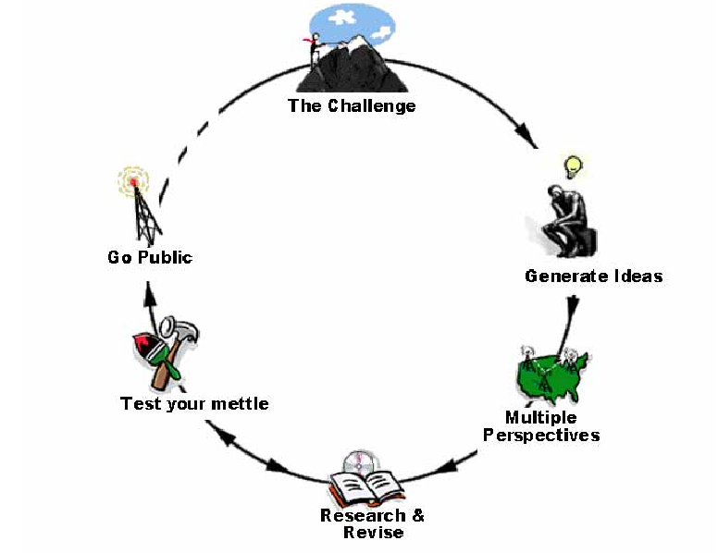
The Legacy Cycle
A cyclical process of active research and reflection

Slide 3
The Grand Challenge
Students enter a virtual reality escape room - Sword Art Online(SAO). Shortly after doing so, the grandmaster announces that the log out button has disappeared. The only way to exit the game is for students to clear all of the floors, and defeat the final boss on floor 100. In order to do so, students must create an escape manual on how they defeated the boss on each floor.

Slide 4
Standards and Objectives
KY.8. G.6 Explain a proof of the Pythagorean Theorem and its converse.
KY.8. G.7 Apply the Pythagorean Theorem to determine unknown side lengths in right triangles in real-world and mathematical problems in two and three dimensions.
KY.8. G.8 Apply the Pythagorean Theorem to find the distance between two points in a coordinate system.
The eighth grade students will be able to explain a proof of the Pythagorean Theorem using the “Cheesy Proof” with 90% accuracy.
The eighth grade students will identify the missing leg and hypotenuse sides using the Pythagorean Theorem with 90% accuracy.
The eighth grade students will be given two points on the coordinate plane and will apply the Pythagorean Theorem to determine the distance between the points with 90% accuracy.

Slide 5
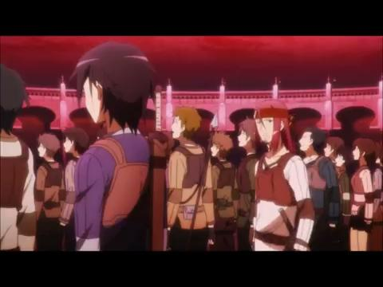
The Anchor Video
Anchor Video
The anchor video adds relevance to the unit by connecting it to something in students’ everyday lives.
It introduces components of a STEM lesson, specifically the use of technology, engineering, and mathematics.
The grand challenge is introduced with further elaboration after completing the “Generating Ideas” handout.

Slide 6
Calendar
Day Two
Bellringer
“Cold Calling” - Answering the Bellringer questions
“Math Social Distancing”
Pass out “Recording Data Sheet”
Class Discussion - Are the individuals following CDC guidelines?
Day One
Show Anchor Video - Introduce Grand Challenge
Pass out “Generating Ideas” handout
Think-Pair-Share of “Generating Ideas” handout
Students work in pairs to complete “A Cheesy Proof” handout
“Cold Calling” - Class discussion on “A Cheesy Proof” handout
Watch TedTalk Video of other proofs
Complete “Real-World Applications” handout with opposite partner
Review “Real-World Applications” handout
Exit Slip

Slide 7
Calendar
Day Five
Finish creating “Go Public” PowerPoint Presentation
Day Six
“Go Public” presentations with parents
Day Three
“How Viruses Spread” computer program activity with handout
Think-Pair-Share to create idiom about what students learned from “How Viruses Spread” activity
Exit Slip
Start SAO Escape Room
Day Four
SAO Escape Room
Start creating “Go Public” PowerPoint Presentation if students finish SAO Escape Room Early

Slide 8
Student Assessment
“Generating Ideas” handout
Assess prior knowledge
Think-Pair-Share
“A Cheesy Proof” review
Cold Calling
Lesson 2 Bellringer
Cold Calling
“How Viruses Spread” activity
Creating an idiom
Think-Pair-Share
Exit Slips
Formative assessment
“Go Public” Presentation
Summative assessment

Slide 9
Go Public Expectations
Students work together to clear each floor and create the escape manual.
Students should include an image of the boss for each floor they defeated along with their work showing how they cleared the floor.
Using their mathematical knowledge.
Students should “pitch” their escape manual to the “editors” at Rece & Cassidy publishing house to help others escape the game.

Slide 10
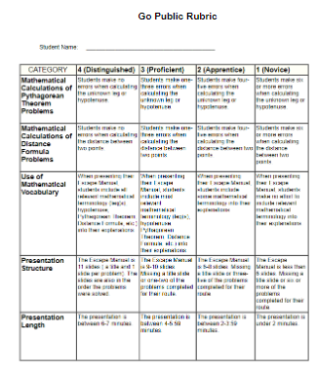
Go Public Rubric

Slide 11
Lessons Learned
Time Management
Stay focused
Avoid mulitasking
Collaborate
Cohesive
Plan in advance
Take Breaks
Avoid brain blocks
Take time and come at the task with fresh eyes
Make it fun for you as well as the students
Plan with interests in mind

