Slide 1
A Meta-Analytic Look at the PCL-R and Recidivism
Savanah Medley B.A.
Clinical Psychology Graduate Student
Eastern Kentucky University

Slide 2
What is Recidivism?
Recidivism is the tendency of a convicted criminal to reoffend
Recidivism is measured by criminal acts that resulted in rearrest, reconviction or return to prison with or without a new sentence during a three-year period following the prisoner's release

Slide 3
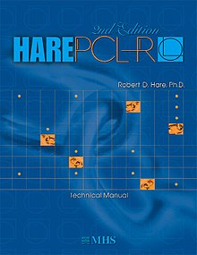
What is the PCL-R?
Psychopathy Checklist- Revised
Used for indicating a dimensional score, or a categorical diagnosis, of psychopathy (also referred to as antisocial personality disorder) for clinical, legal, or research purposes

Slide 4
What was done?
Meta-analysis is a quantitative, formal, epidemiological study design used to systematically assess the results of previous research to derive conclusions about that body of research.

Slide 5
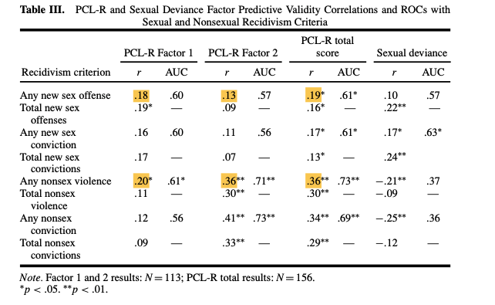
Example of the studies

Slide 6
What did we find?

Slide 7
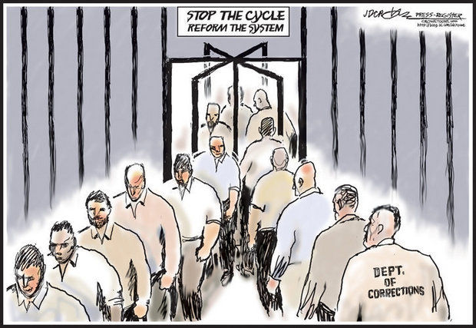
What does this mean moving forward?

Slide 8
Questions?

