Slide 1
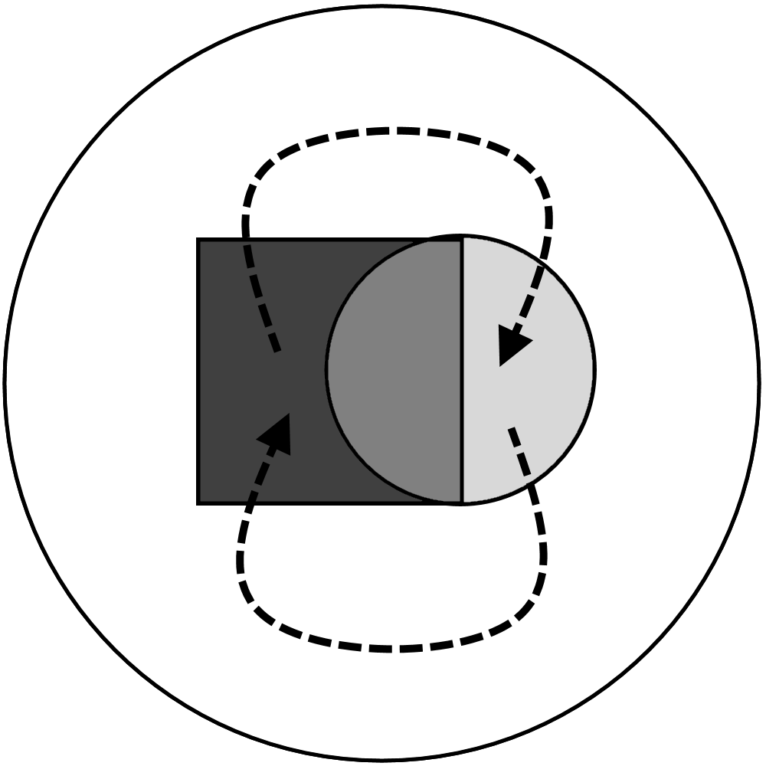
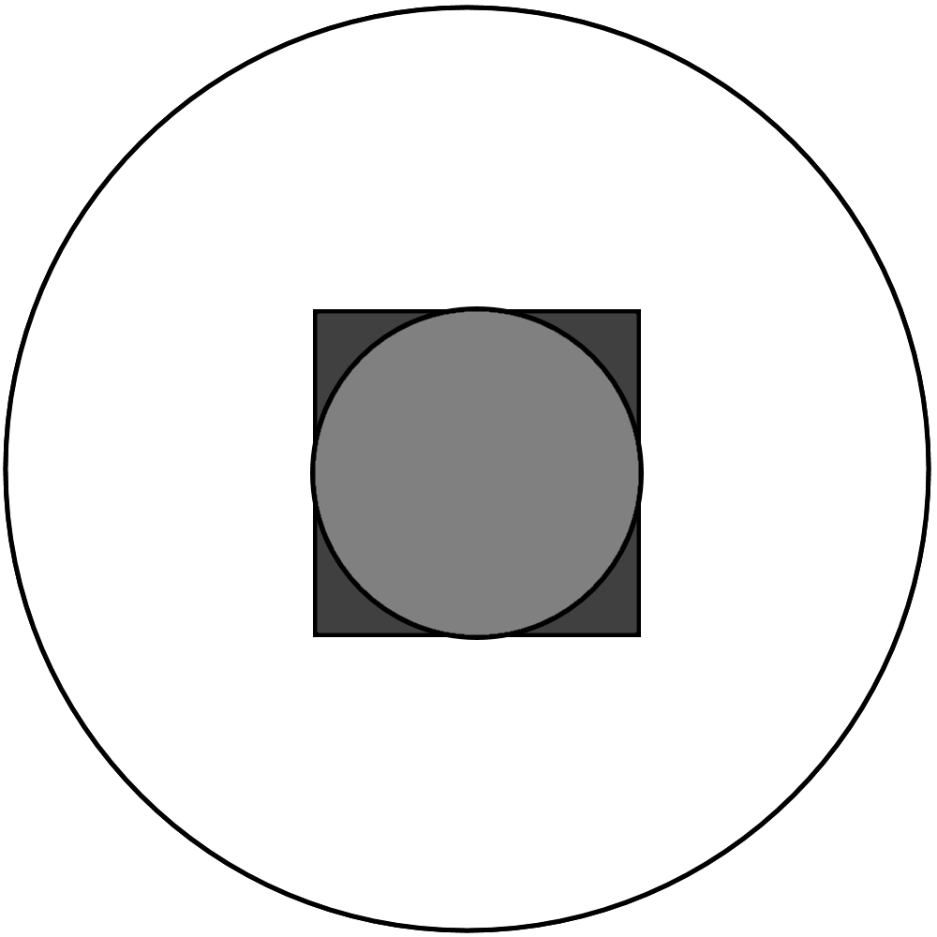
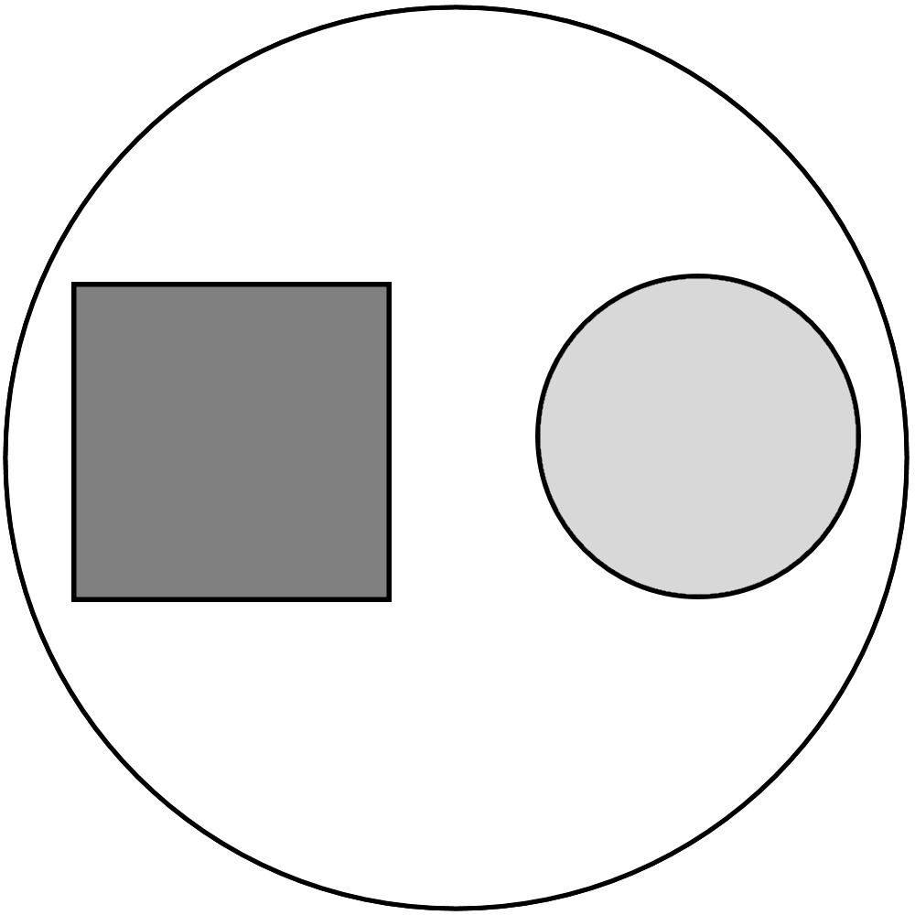
Science and Religion in Symbiosis: A Collaborative Learning Experience
for Biology Majors in a Liberal Arts Undergraduate Setting
Darla French, Dept of Biology (darlafrench@upike.edu) & James Browning, Dept of Religion (jamesbrowning@upike.edu)
Abstract
This poster highlights an innovative teaching collaboration in which a biology professor & a religion professor linked 2 undergraduate courses. Students were co-enrolled in REL 383 Religion & Science (Dr. Browning) & BIO 383 The Nature of Science (Dr. French), both discussion-based courses. Each instructor taught their own course & was embedded in the other’s. Students participated in a variety of high-impact, non-cognitive teaching practices, including leading discussions & doing experiential learning activities, all intentionally planned & executed to allow exploration of connections between Science & Religion and articulation of personal worldviews.
Four Heuristic Models of Interactions between Science (S) & Religion (R)
First described by Ian Barbour in his classic text, Religion and Science: Historical and Contemporary Issues (1997), depictions of these four models developed organically when, early on in the course, we asked our students to draw their ideas of the relationship between S and R. Examples of student work are included below, alongside diagrams of the four models that best represent each. For complete descriptions of each model, please see accompanying handout below.
WE WANT TO HEAR FROM YOU!!
Help us clarify a vision for development of a set of resources to assist K-12 science teachers in understanding connections between Science (S) & Religion (R) in order to increase comfort in addressing this topic with your own students.
Please email us with your thoughts or leave comments on our clipboard below!
Questions on which we would love to hear your feedback:
Do your students have S & R questions and if so, what are they?
What issues do your students have with the relationship between S & R? (internal, external)
What is our best route to getting information into the hands of practicing teachers?
What should our end-product look like? (conceptual vs. practical)
Course Structure
Discussion-based: Two 75-minute classes (BIO 383) & three 50-minute classes (REL 383)/week
Required books & discussion topics listed on accompanying handout below
Variety of high-impact, non-cognitive teaching practices (Kuh, G.D. 2008. High-Impact Educational Practices: What they are, who has access to them, and why they matter.; and Sedlacek, W.E. 2004. Beyond the Big Test: Non-cognitive Assessment in Higher Education.)
Leading discussions, giving presentations (oral communication)
Weekly reflections (personal journey; written communication)
Experiential learning activities – Visiting lab & chapel, attending Louisville Festival of Faiths (festivaloffaiths.org – Example theme “Faith & Science”), in-class discussion with visiting experts, visual representation of perceived relationship between Science & Religion
CONFLICT
DIALOGUE
Closing Thoughts
Effects of participating in these courses carries over into other courses: Truly high-impact. Conversations begun here continued both outside classroom & in other courses.
Extensions into single-course, team-taught experience in Fall 2019: REL 389 Religion & Nature = Specific application of what we have learned in our collaborative process.
BIO 383 just got approved as permanent addition to undergraduate course catalog. Collaboration between BIO 383 & REL 383 approved as fulfillment of new “Engaging Our World” category of Gen Ed core requirements.
INTEGRATION
INDEPENDENCE
In a Student’s Words
My future goals are to attend medical school and become a family physician. Discussing the “hard” topics will be my job, and being in a class with my peers where I was forced to discuss the “hard” topics has better prepared me for my future. My personal goal was to open myself to new ideas and experiences in science and religion, and I believe my instructors’ goal of challenging our written, oral, and critical thinking skills in these areas have been exceeded. I believe I have reached my personal goals, and I hope that I have met my instructors’ goals for me. Personally, I never thought I would be able to lead my peers in an hour discussion, but I did it not once but twice. I believe that I put a lot of effort into this course, different effort than I have put into any course before, but the change I have seen in myself definitely equals or exceeds the effort I put in.
Literature Cited
For a complete list of books used with students in these courses, please see accompanying handout.
Acknowledgements
Thanks to Jess Shadrick for designing diagrams of 4 models; to UPIKE Admin for continued support of experimental collaboration; and our students, Haley Osborne, Brittany Reels, Megan Slone, Coy Rogers, and Ted Allen for allowing us to share their work on a larger stage.

