Slide 1
Cognitive Behavioral Therapy as an Effective Treatment Option for PTSD and Behavioral Issues Stemming from Sexual Assault: A Meta- Analysis
Kalee Northern
Graduate student at EKU

Slide 2
Background
Estimated sexual assault every 68 seconds in the United States
Undergraduate Students
Female: 26.4 %
Male: 6.8 %

Slide 3
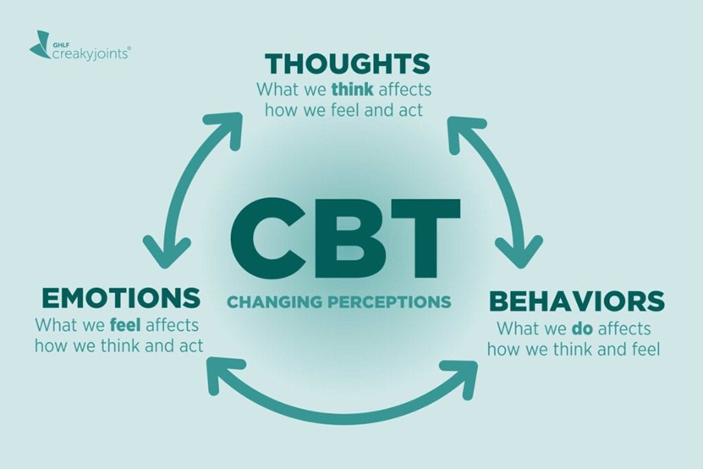
Background cont.
Cognitive Behavioral Therapy
Cognitive distortions and behaviors
Emotional regulation
Coping strategies

Slide 4
Studies
18 studies
IV: CBT
DV: PTSD or Behavioral Issues
Key Words: sexual abuse, sexual assault, CBT effectiveness, Cognitive behavioral treatment, PTSD, and behavioral problems

Slide 5
Computation of Effect Sizes
1. CBT Pre and Post-test means
2. Divided by Average Standard Deviations

Slide 6
Effect Sizes
Overall d= 1.05
Very strong relationship

Slide 7
Moderator Variables
Trauma (PTSD scale): d= 0.61
Mood: d= 1.58
Behavioral Problems: d= 0.88
Sexual Behaviors: d= 1.62

Slide 8
Moderator Variables
Type of Issue Being Addressed

Slide 9
Conclusions
Strong relationships across the board
Effective means for treatment

Slide 10
Implications
Systematic treatment Plans
Trauma focused adaptors
Safe spaces

Slide 11
Future Directions
Different moderator variables
Age
Type of assault
Perpetrator type

Slide 12
Questions?

