Slide 1
DEVELOPMENT OF A SOLAR PANEL EMULATOR TIFFANY FALCH and ALEJANDRO VILLASENOR ADVISOR: DR. ZEEL MAHESHWARI
Notes:
Hi, My name is Tiffany Falch and Alejandro Villasenor. Our project it the development of a solar panel emulator.

Slide 2
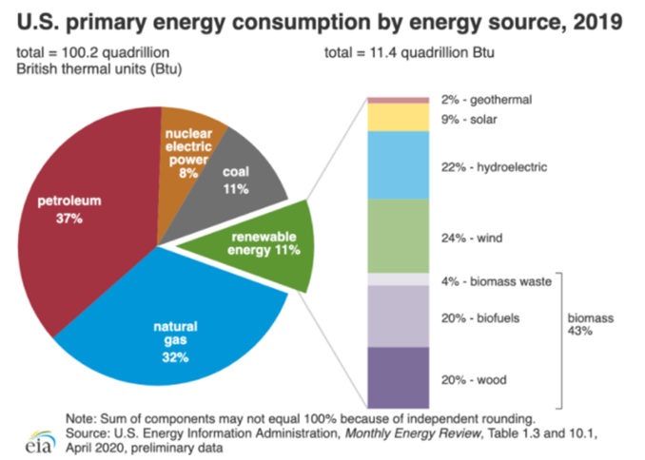
INTRODUCTION
Most energy comes from non-renewable resources
Hundreds of years to make non-renewable resources
Damaging to environment and all living things
Renewable resources reduce non-renewable resources
Solar panel energy most common renewable resources
Development of a Solar Panel Emulator
Notes:
energy sources that are the most commonly used are non-renewable resources. which takes 100’s of years to create and these resources that we are using have a damaging effect on the environment along with living things. Such as ourselves. Renewable resources will help reduce the use of non-renewable resources. Solar panel energy is one of the more common ways to make renewable resources. With that being said has is why the development of a solar panel emulator is important to understand and to study.

Slide 3
STATEMENT OF PROBLEM
High non-renewable resources consumption
Photovoltaic system can reduce the consumption of non-renewable resources
Develop solar panel emulator for testing purposes in a laboratory setting
Notes:
The problem is that the consumption of non-renewable resources is vary high. With the help of a photovoltaic system to reduce the consumption of non-renewable recourse comes the cost. Solar panel system are base off of the amount of watts that the building consume. Which makes the cost of a photovoltaic system high for universities to have for there students to be able to study and use on other projects. SO, The development of a solar panel emulator for testing purposes in a laboratory setting is much needed.

Slide 4
OBJECTIVES
The following objectives are:
Design a solar panel emulator that will be used for laboratory purposes
Build a simulation model of the solar panel emulator using LabVIEW
Keep the cost of the solar panel emulator low
Keep the solar panel emulator simple to build
Study the effect of solar radiance and temperature of PV panels
Notes:
The objective of this study is to design a PV emulator that will be used for laboratory purposes, with the using of LabVIEW to make a simulation model of a PV emulator, keeping cost low, keeping the PV emulator simple and to be able to study the effect of solar radiance and temperature of PV panels.

Slide 5
LITERATURE REVIEW
In the past researchers have used the following model/software to develop PV emulators.
Single diode PV model/ dual diode PV model
MATLAB /LabVIEW
Dual diode model is more complex when compared to the single diode model and is rarely chosen in emulator studies
For this project, single diode model is chosen for simplicity
Solar PV model was simulated in LabVIEW to create easy user interface
Notes:
In the past researchers have used the following model/software to help in the develop PV emulators. The Single diode PV model/ dual diode PV model along with MATLAB /LabVIEW are found to be commonly used. The Dual diode or double diode model is more complex when it is compared to the single diode model and is rarely chosen in emulator studies. For this project, the single diode model has been chosen for simplicity and a Solar PV model has been simulated in LabVIEW to create easy user interface.

Slide 6
METHODOLOGY
Develop solar panel emulator
Characteristics of a real-time solar panel
Test the effect of solar radiation
Test the effect of temperature variation
LabVIEW to generate a I-V and P-V curve
Single-Diode Model has been used
Notes:
The methodology used to develop a solar panel emulator that has the characteristics of a real-time solar panel. With test of the effect of solar radiation and the effect of temperature variation. A LabVIEW system is able to generate a I-V and a P-V curve. A Single-Diode Model method has been used throughout the project

Slide 7
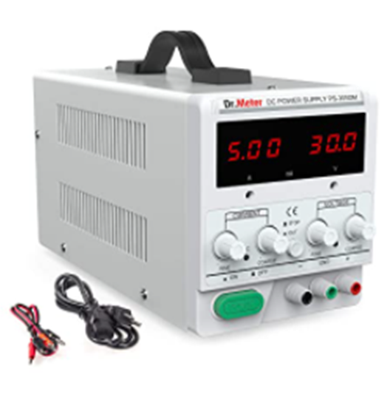
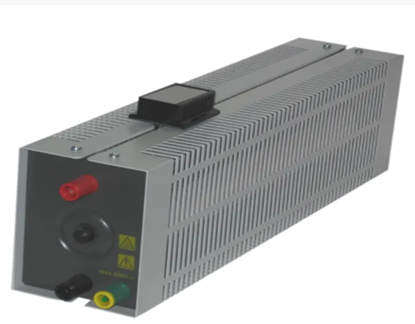
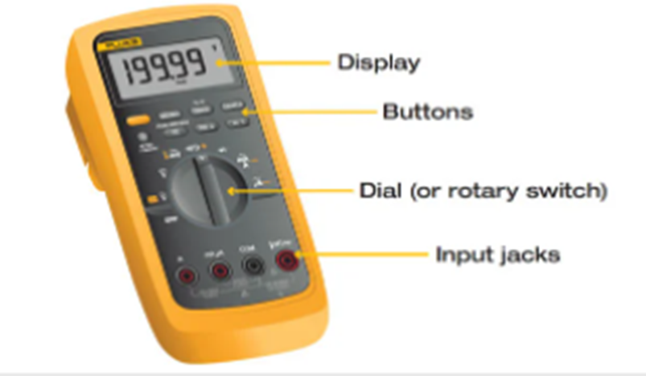
MATERIALS
DC power supply
Rheostat resistor
Multi-meter
LabVIEW Software
Notes:
The hardware that is used in the development of a PV emulator is a DC power supply, Two rheostat resistors, and two multi-meters. The software system LabVIEW is used to make a simulation model of a PV emulator.

Slide 8
SCHEMATIC
Notes:
This is the schematic that is used. As you can tell here the + output of the DC power supply is connoted to the + of the Rheostat resistor that is in series, the – of the series resistor has been connoted to the + of the rheostat resistor that is acting as the load. The – of the load resistor is then connoted to the – of the DC power supply. A multimeter has been connoted to each one of the rheostat resistors.

Slide 9
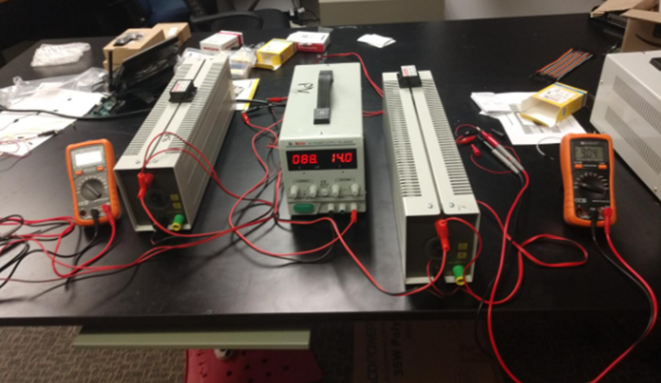
RESULTS
Test effect of solar radiation and the effect of temperature variation
Test are done to find the MMPT
Rheostat resistor acted as load and series
Create a graph on Excel using the data
LabVIEW has been used to generate the I-V and P-V curve of a solar panel emulator
Notes:
This system is able to test the effect of solar radiation and the effect of temperature variation. the Maximum power point tracking also done. MMPT is used in a PV system to track the maximum amount of power that is given by the solar radiation or the temperature on the solar panel. All the data that is collected is put into Excel to be able to create a graph and charts.

Slide 10
EFFECT OF SOLAR RADIATION CASE I
EFFECT OF SOLAR RADIATION CASE I TABLE
EFFECT OF SOLAR RADIATION CASE I GRAPH
# of test | Vs (v) | Ipv (mA) | Vl (v) | Rl (ohms) | Rs (ohms) | Power (mW)
1 | 14 | 629 | 1.95 | 5 | 20 | 1226.55
2 | 14 | 508 | 4.3 | 10 | 20 | 2184.4
3 | 14 | 436 | 5.7 | 15 | 20 | 2485.2
4 | 14 | 364 | 6.74 | 20 | 20 | 2453.36
5 | 14 | 333 | 7.5 | 25 | 20 | 2497.5
6 | 14 | 292 | 8.05 | 30 | 20 | 2350.6
7 | 14 | 260 | 8.85 | 35 | 20 | 2301
Notes:
the effect of solar radiation, the resistor series (Rs) is changed 3 times throughout the test and the rheostat resistor load (Rl) is changed seven time for each case. Each case will have 14 volts. For case 1 there is 14 volts on the power supply, the resistor series is set to 20 ohms, and resistor load starts at 5 ohms and counts in increments of five up to 35 ohms. the MMPT happens when the resistor load (Rl) is at 25 ohms and the resistor series (Rs) is at 20 ohms. When both resistor should be the same to get the maximum power. There's a few reasons for why this shows the opposite. One reason being that one of the resistor is off by a small amount or a wire in the system is loose.

Slide 11
EFFECT OF SOLAR RADIATION CASE 2
EFFECT OF SOLAR RADIATION CASE 2 TABLE
EFFECT OF SOLAR RADIATION CASE 2 GRAPH
# of test | Vs (v) | Ipv (mA) | Vl (v) | Rl (ohms) | Rs (ohms) | Power (mW)
1 | 14 | 304 | 2.32 | 10 | 40 | 705.28
2 | 14 | 241 | 4.38 | 20 | 40 | 1055.58
3 | 14 | 212 | 5.86 | 30 | 40 | 1242.32
4 | 14 | 184 | 6.95 | 40 | 40 | 1278.8
5 | 14 | 160 | 7.8 | 50 | 40 | 1248
6 | 14 | 142 | 8.56 | 60 | 40 | 1215.52
7 | 14 | 130 | 8.99 | 70 | 40 | 1168.7
Notes:
For case 2 The resistor series (Rs) is set to 40 ohms and the rheostat resistor load (Rl) starts at 10 ohms then counts in increments of ten up to 70 ohms. the MMTP is found at resistor load (Rl) is at 40 ohms and resistor series (Rs) is at 40 ohms making the maximum power point being 1278.8 mW. this shown here that when voltage starts to increase than the current is will start to decrease. This can be seen thought out all the cases.

Slide 12
EFFECT OF SOLAR RADIATION CASE 3
EFFECT OF SOLAR RADIATION CASE 3 TABLE
EFFECT OF SOLAR RADIATION CASE 3 GRAPH
# of Test | Vs (v) | Ipv (mA) | Vl (v) | Rl (ohms) | Rs (ohms) | Power (mW)
1 | 14 | 166 | 4.78 | 30 | 60 | 793.48
2 | 14 | 148 | 5.77 | 40 | 60 | 853.96
3 | 14 | 133 | 6.62 | 50 | 60 | 880.46
4 | 14 | 121 | 7.28 | 60 | 60 | 880.88
5 | 14 | 109 | 7.89 | 70 | 60 | 860.01
6 | 14 | 101 | 8.37 | 80 | 60 | 845.37
7 | 14 | 93 | 8.79 | 90 | 60 | 817.47
Notes:
For case 3 the resistor series (Rs) has been set to 60 ohms, rheostat resistor load (Rl) starts at 10 ohms and counts in increments of ten up to 90 ohms. The MMPT found at 60 ohms for both the resistor load (Rl) and resistor series (Rs).

Slide 13
EFFECT OF TEMPERATURE VARIATION CASE I
EFFECT OF TEMPERATURE VARIATION CASE I TABLE
EFFECT OF TEMPERATURE VARIATION CASE I GRAPH
# of Test | Vs (v) | Ipv (mA) | Vl (v) | Rl (ohms) | Rs (ohms) | Power (mW)
1 | 7 | 149 | 1.15 | 10 | 40 | 171.35
2 | 7 | 124 | 2.16 | 20 | 40 | 267.84
3 | 7 | 105 | 2.88 | 30 | 40 | 302.4
4 | 7 | 89 | 3.5 | 40 | 40 | 311.5
5 | 7 | 78 | 3.93 | 50 | 40 | 306.54
6 | 7 | 69 | 4.26 | 60 | 40 | 293.94
7 | 7 | 64 | 4.58 | 70 | 40 | 293.12
Notes:
The effect of the temperature variation test the effect of temperature on the solar panel emulator. The voltage is changed three times once for each case and the rheostat resistor load (Rl) is changed seven time for each time voltage has been changed. The resistor series (Rs) is set to 40 ohms and remains the same throughout the test. The resistor load start at 10 and count up to 70 for each case in this study. For case 1 the voltage is 7 volts. The MMPT is found at 40 ohms for both resistor making the maximum power 311.5 mW.

Slide 14
EFFECT OF TEMPERATURE VARIATION CASE 2
EFFECT OF TEMPERATURE VARIATION CASE 2 TABLE
EFFECT OF TEMPERATURE VARIATION CASE 2 GRAPH
# of Test | Vs (v) | Ipv (mA) | Vl (v) | Rl (ohms) | Rs (ohms) | Power (mW)
1 | 14 | 437 | 3.53 | 10 | 40 | 1542.61
2 | 14 | 364 | 6.43 | 20 | 40 | 2340.52
3 | 14 | 307 | 8.75 | 30 | 40 | 2686.25
4 | 14 | 267 | 10.34 | 40 | 40 | 2760.78
5 | 14 | 235 | 11.66 | 50 | 40 | 2740.1
6 | 14 | 210 | 12.67 | 60 | 40 | 2660.7
7 | 14 | 190 | 13.48 | 70 | 40 | 2561.2
Notes:
For case 2 the voltage is 14 volts. the rheostat resistor load (Rl) reaches 40 ohms along with the resistor series then the power is at its maximum point 2760.78 mW. It is seen here that the current will decrease as the voltage increases.

Slide 15
EFFECT OF TEMPERATURE VARIATION CASE 3
EFFECT OF TEMPERATURE VARIATION CASE 3 TABLE
EFFECT OF TEMPERATURE VARIATION CASE 3 GRAPH
# of Test | Vs (v) | Ipv (mA) | Vl (v) | Rl (ohms) | Rs (ohms) | Power (mW)
1 | 21 | 437 | 3.53 | 10 | 40 | 1542.61
2 | 21 | 364 | 6.43 | 20 | 40 | 2340.52
3 | 21 | 307 | 8.75 | 30 | 40 | 2686.25
4 | 21 | 267 | 10.34 | 40 | 40 | 2760.78
5 | 21 | 235 | 11.66 | 50 | 40 | 2740.1
6 | 21 | 210 | 12.67 | 60 | 40 | 2660.7
7 | 21 | 190 | 13.48 | 70 | 40 | 2561.2
Notes:
For case 3 the voltage is 21 volts. when both the resistors reached 40 ohms that the MMPT is found. The maximum power is 2760.78 mW. Both of the effect of solar radiation and the effects of temperature variation have shown that the MMPT is found when the resistor series and resistor load equal the same amount along with when the current will decrease as the voltage increases.

Slide 16
LABVIEW: FRONT PANEL
Notes:
LabVIEW is used to generate the I-V and P-V curve of a solar panel emulator system. On the front panel is where the waveform chart, the XY graph, inputs, outputs, vertical pointer slide and stop button are located. The inputs is where the data is entered and running the system shows the outputs that are calculated. the waveform chart shows real-time change in the energy to irradiation line.

Slide 17
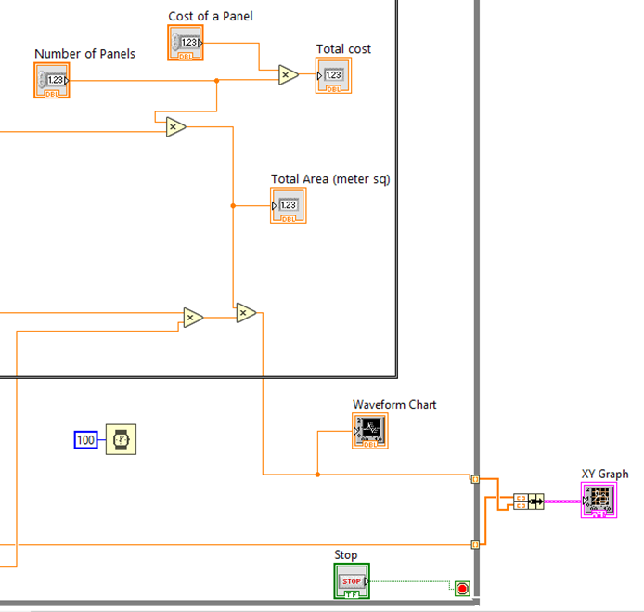
BLOCK DIAGRAM OF LABVIEW
Notes:
The block diagram is where all for the formulas are wired, SubVI have been add to better understand, and a while loop. The while loop is used to keep repeating the formulas at least a 100 times to make the waveform chart. There is a stop button that will stopped the system form running.

Slide 18
REFERENCES
“30V/5A DC Bench Power Supply, PS-305DM, Dr.meter.” Dr.meter,
A.A. de Melo Bento and R. Perci Santiago, "A Low Cost Photovoltaic Panel Emulator," 2019 IEEE 15th Brazilian Power Electronics Conference and 5th IEEE Southern Power Electronics Conference (COBEP/SPEC), 2019, pp. 1-5, doi: 10.1109/COBEP/SPEC44138.2019.9065629.
“Arcol 100Ω Wirewound Rheostat 1.8A, Vrh320 100R K: Arcol.” RS Components Export, export.rsdelivers.com/product/arcol/vrh320-100r-k/arcol-100%CF%89-wirewound-rheostat-18a-vrh320-100r-k/8276413.
El-Sharkawi, Mohamed A. Electric Energy: An Introduction. CRC Press, 2013.
“File:LabVIEW Logo.jpg.” Wikipedia, Wikimedia Foundation, 6 July 2017, en.wikipedia.org/wiki/LabVIEW#/media/File:LabVIEW_Logo.jpg.
Fluke. “What Is a Digital Multimeter?” Fluke, 31 Oct. 2016, www.fluke.com/en-us/learn/blog/electrical/what-is-a-digital-multimeter.
Jones, Marc. “The Guide to Renewable vs. Non-Renewable Energy Sources.” Sunpro Solar, 26 Aug. 2020, www.gosunpro.com/news/renewable-vs-non-renewable-energy-sources/.
Lu, Dylan D.c., and Quang Ngoc Nguyen. “A Photovoltaic Panel Emulator Using a Buck-Boost DC/DC Converter and a Low Cost Micro-Controller.” Solar Energy, vol. 86, no. 5, 2012, pp. 1477–1484., doi:10.1016/j.solener.2012.02.008.
Thoubboron, Kerry. “Solar Arrays: What Are They &amp; Why Do You Need Them?: EnergySage.” Solar News, EnergySage, 3 Jan. 2020, news.energysage.com/installing-a-solar-array-everything-you-need-to-know/.

Slide 19
CONCLUDING REMARKS
Notes:
The objective of this project was to create a solar panel emulator for purpose of a laboratory uses only. The Effect of Solar Radiation and the Effect of Temperature Variation test have been done and these Test are done to find the MMPT. It can also be shown that for the effect of Temperature Variation the higher the voltage the higher the power and for the Effect of Solar Radiation the lower the resistor series than the higher the power output. LabVIEW has been used to generate the I-V and P-V curve of a solar panel emulator system that will later be used in the project in the future. The schematic above is the future method to study because of covid-19 and hardware shipping delays the original method see here was change to the method talked about today.

