Slide 1
Traumatic Brain Injury, Substance Use, and Recidivism in Inmates
Rachel Taylor

Slide 2
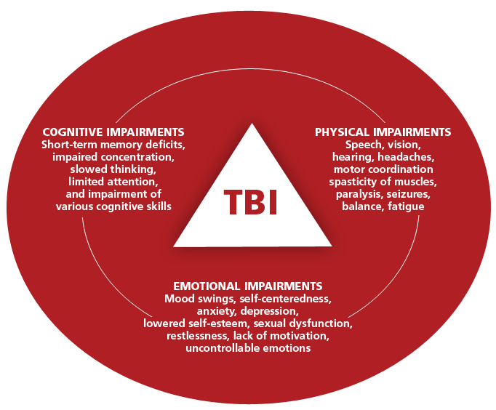
TBI Statistics
In the US:
224,000 TBI-related hospitalizations
61,000 TBI-related deaths
69 million TBIs sustained yearly worldwide

Slide 3
TBI in Prison
Prevalence 5x that of the general population
TBI linked to:
Aggression
Poor impulse control
Deficits in memory and attention
Increased risk of substance abuse

Slide 4
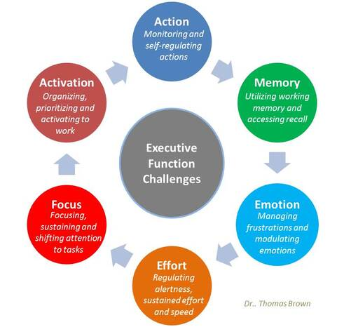
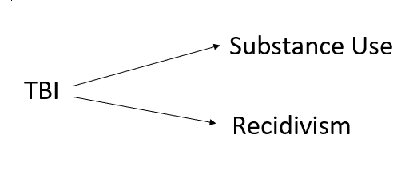
What is the relationship between TBI, substance use, and recidivism?
TBI in Inmates: 46%
Some estimates are significantly higher
TBI in General Population: 8.5%
Recidivism: Relapse into crime

Slide 5
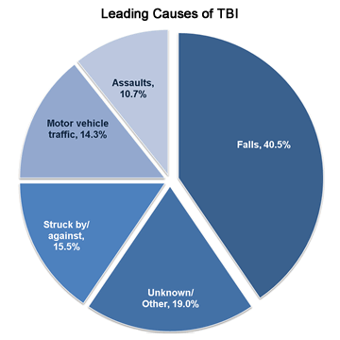
Increased IPV TBI in Inmates
Higher likelihood of experiencing inter-personal violence
Incarcerated women:
Up to 90% have experienced IPV
2x more likely to have multiple TBIs
6x more likely to report violence-related TBIs

Slide 6
Method
Search Terms:
Traumatic Brain Injury or TBI or Head Injury
Substance Use or Substance Abuse
Recidivism
Studies Measuring Substance Use
Alcohol: 1
Drugs: 1
Multiple Substances: 5

Slide 7
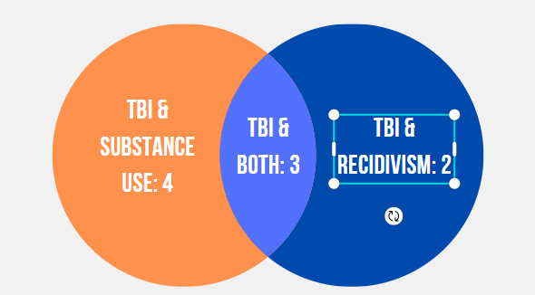
Method
Relationship Evaluated:
TBI and Substance Use: 4
TBI and Recidivism: 2
TBI and Both: 3
Techniques Used for Evaluation:
Interview
Survey
Self-Report
Administrative Data

Slide 8
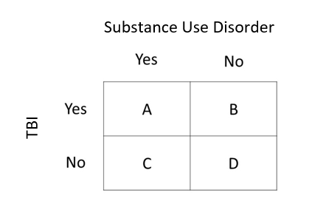
Odds Ratio
A measure of association between an exposure and an outcome

Slide 9
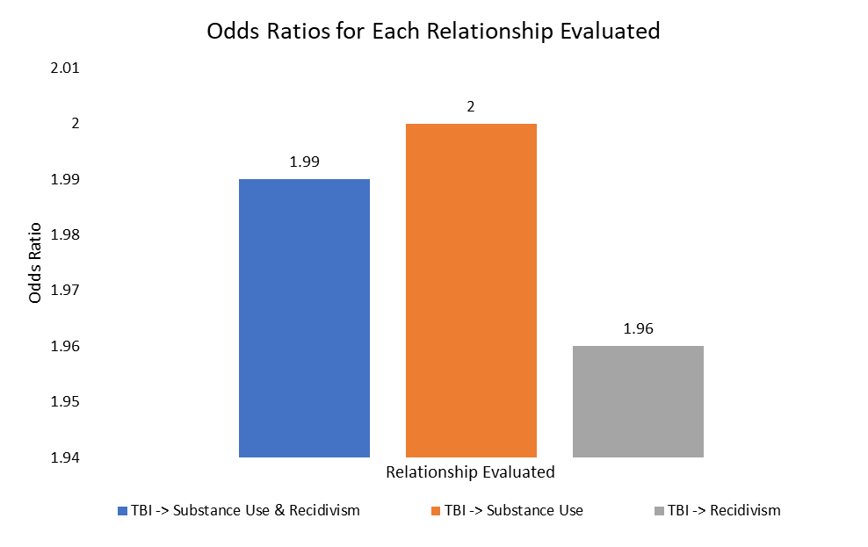
Results
TBI→Substance Use + Recidivism: 1.99
TBI→Substance Use: 2.00
TBI→Recidivism: 1.96

Slide 10
Confounding Variables
Trauma
Mental Illness
Antisocial Personality
Environment
Social Circle

Slide 11
Future Directions
Investigate the Confounding Variables
Moderate Relationship → Room for other variables
Investigate Specific Manifestations of TBI Deficits
TBI → Recidivism
TBI → Substance Use
TBI → Executive Dysfunction → Recidivism/Substance Use

Slide 12
Implications
Treatment Implications
Adopting neuropsychological interventions could improve:
Current substance abuse treatments
Recidivism rates
Re-entry
Probation/Parole outcomes

Slide 13
Questions?

