Slide 1

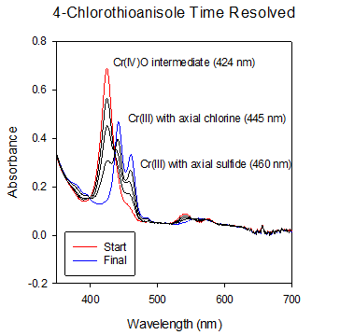
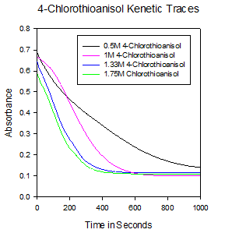
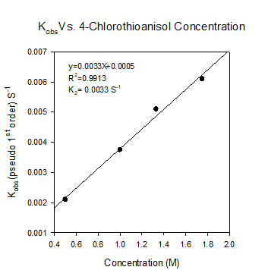
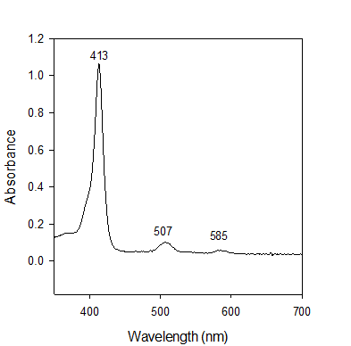
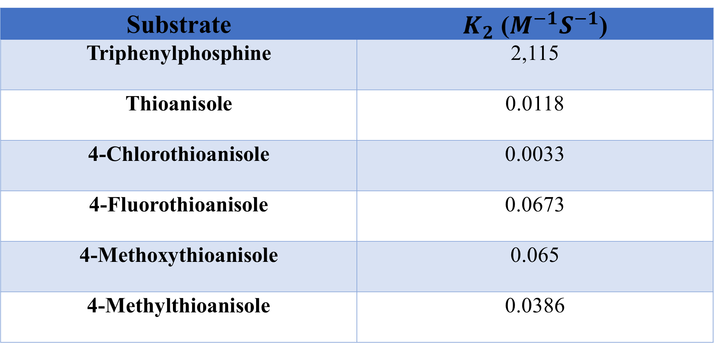
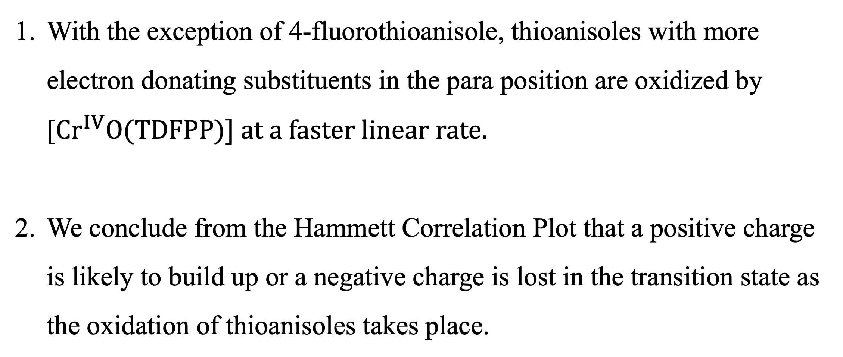
Synthesis and kinetic studies of high-valent chromium(IV)-oxo species supported by a Tetrakis-2,6-diflourophenyl porphyrin
Tristan Skipworth, Mardan Khashimov, Fox Bratcher, and Rui Zhang*
Department of Chemistry, Western Kentucky University
Introduction and Significance
Kinetics Reaction Profile
Hammett Correlation Plot Analysis
The cytochrome P450 superfamily of enzymes catalyze numerous oxidation reactions in nature. These enzymes have inspired the use of various synthetic metal complexes as biomimetic catalysts. In this study, electron withdrawing tetrakis-2,6-difluorophenyl porphyrin (H2TDFPP) and its chromium(III) complex were synthesized using the Linvsey and Groves methods respectively. The corresponding chromium(IV)-oxo intermediate was formed through the chemical oxidation of the chromium(III) precursor with 5 equivalence of iodobenzene diacetate (PhI(OAc)₂ ) as the oxygen source. Kinetic studies were then performed utilizing a variety or organic substrates including triphenylphosphine, thioanisole, and thioanisole derivatives to provide mechanistic insights into the identities of the active oxidants and oxidation reaction pathways of important catalysts.
Synthesis
Figure 3. Hammett Correlation Plot of thioanisole and thioanisole derivatives with 4-fluorothioanisole omitted as it was an extreme outlier. This was the case with two other complexes studies in our lab.
Figure 2. Kinetics study with [Cr^{IV}O(TDFPP)] generated with 5 equivalence of PhI(OAc)₂ with 4-chlorothioanisole as the substrate. Left image is the time resolved spectra showing the decay of the Cr^{IV} species to the Cr^{III} species. Top right is the kinetic traces for the kinetics data of the varying concentrations, and the bottom right is the observed rate constants for the varying concentrations. Kinetic data was obtained using a stop flow and UV-Vis.
Conclusion
With the exception of 4-fluorothioanisole, thioanisoles with more electron donating substituents in the para position are oxidized by [${Cr}^{IV}O(TDFPP)] at a faster linear rate.$
We conclude from the Hammett Correlation Plot that a positive charge is likely to build up or a negative charge is lost in the transition state as the oxidation of thioanisoles takes place.
Kinetic Data of Oxidation of Organic Substrates
UV-Vis Spectroscopy
Substrate | $K_{2}$ ($M^{−1}S^{−1}$)
Triphenylphosphine | 2,115
Thioanisole | 0.0118
4-Chlorothioanisole | 0.0033
4-Fluorothioanisole | 0.0673
4-Methoxythioanisole | 0.065
4-Methylthioanisole | 0.0386
Acknowledgments
This research is funded by the National Science Foundation (CHE 1464886 and 1764315)
Figure 1. UV-vis spectrum of [H₂TDFPP] (left) in CH₂Cl₂, [Cr^{III}(TDFPP)Cl] (middle) in CH₂Cl₂, and [Cr^{IV}O(TDFPP)] generated with 5 equivalence of PhI(OAc)₂ (right) in CH₂Cl₂
Table 1. Observed rate constants for reactions of [Cr^{IV}O(TDFPP)] generated with
5 equivalence of PhI(OAc)₂ with triphenylphosphine, thioanisole, and thioanisole derivatives.

