Slide 1
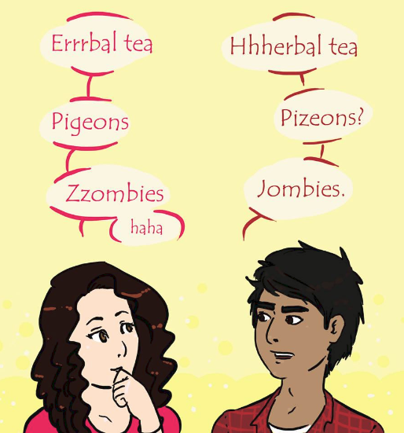
Non-Native English-Speaking Instructors and Online Learning Katelyn McClure, Christian Phillips, Benjamin Meadows, Hung-Tao M. Chen Department of Psychology, Eastern Kentucky University
INTRODUCTION
It has been previously shown that non-native English speaking (NNES) instructors have been rated lower within course evaluations and are typically criticized for their accents (Rubin, 1992; Subtirelu, 2015).
An obvious assumption is to assume this is because of racial biases and stereotypes.
Another reason, though, could be due to increased anxiety levels due to intergroup communication anxiety that is only heightened when paired with existing anxiety due to online education.
Questions:
Do NNES instructors bring about more anxiety in students?
Do students perform better on recall questions when paired with a NES instructor?
METHOD
Design & Materials (n$=64$)
Within-groups design with two conditions: 1.) Starting with the NNES instructor and 2.) starting with NES instructor.
Procedure
1.) Participants are assigned to one of two conditions.
2.) Participants answer preliminary questions about knowledge on airplane flight.
3.) Participants watch a sample lecture and are exposed to sample questions.
4.) Participants watch two lecture videos with one of the instructors introducing two forces of flight.
5.) Participants answer recall questions after each video and fill out an anxiety scale after both videos.
6.) Participants watch two lecture videos with other instructor over two other forces of flight.
7.) Participants answer recall questions after each video and fill out an anxiety scale after both videos.
8.) Participants answer Chinese Language Experience Scale and demographic information.
RESULTS
The study is currently ongoing and is in a preliminary data collection phase. So far, we have witnessed an increased level of anxiety in students when faced with an NNES instructor and we are running results to see if the same can be found in memory recall.
REFERENCES
Rubin, D. L. (1992). Nonlanguage factors affecting undergraduates’ judgements of nonnative English-speaking teaching assistants. Research in Higher Education, 33(4), 511-531.
Subtirelu, N. (2015). “She does have an accent but…”: Race and language ideology in students’ evaluations of mathematics instructors on RateMyProfessor. Language in Society, 44, 35-62. https://doi.org/10.1017/S00474045414000736
Notes:
Hello and welcome to the presentation for Non-Native English-Speaking Instructors and Online Learning. My name is Katelyn McClure and I am a first-year student of the experimental psychology master’s program at Eastern Kentucky University and conduct research under the guidance of Dr. Michael Chen. This study focuses on the differences in memory recall and self-reported anxiety levels in students comparting native English-speaking instructor and non-native English-speaking instructors. *Next Slide*

Slide 2
INTRODUCTION
It has been previously shown that non-native English speaking (NNES) instructors have been rated lower within course evaluations and are typically criticized for their accents (Rubin, 1992; Subtirelu, 2015).
An obvious assumption is to assume this is because of racial biases and stereotypes.
Another reason, though, could be due to increased anxiety levels due to intergroup communication anxiety that is only heightened when paired with existing anxiety due to online education.
Questions:
Do NNES instructors bring about more anxiety in students?
Do students perform better on recall questions when paired with a NES instructor?
Notes:
Rubin and Subtirelu have found that non-native English speaking (NNES) instructors have been rated lower within course evaluations and are typically criticized for their accents. An easy assumption to made for this phenomenon is that it is due to racial stereotypes and biases. Another probable explanation, though, is the anxiety someone feels when communicating with someone outside of their group which is heightened even more in an online environment.
Previous research has shown that when a native English-speaker (NES) conversates with an NNES, their level of anxiety becomes naturally higher (Ahn, 2010; Hammer et al., 1998; Immamura et al., 2016; Stephan et al., 1999). This anxiety may stem from higher levels of cognitive load (Ahn, 2010; Mayer et al., 2003; King & Finn, 2017) and intergroup communication anxiety (Berger, 1979; Berger & Calabrese, 1975; Gudykunst, 1993; Stephan & Stephan, 1985; Stephan et al., 1999). Cognitive load has been shown to be raised when communicating with an NNES both biological and psychologically. Biologically, it has been shown that more brain areas are activated in individuals communicating with NNES than when they are communicating with NES. Psychologically, students learning information from NNES show poorer performance on transfer tests and self-reported higher levels of anxiety. This anxiety can be related to intergroup anxiety which is the feeling of discomfort or anxiety while interacting with someone from a different group. This has been shown to affect how individuals from each group interpret each other and what can be recalled from the conversations that occur.
Other previous research has also shown that online learning environments already produce increased amounts of anxiety in students. This has been shown to affect students’ studying habits and levels of stress, but not directly affect student achievement in their classes. When paired with anxiety caused by interacting with an NNES instructor, it is possible that this can lead to a hinderance students’ learning.
No previous research has been conducted to test these concepts together as an interaction or otherwise. Our current study seeks to look at this and see if having an NNES or NES instructor affects recall and self-reported anxiety. *Next Slide*

Slide 3
METHOD
Design & Materials (n$=$ 64)
Within-groups design with two conditions: 1.) Starting with the NNES instructor and 2.) starting with NES instructor.
Procedure
1.) Participants are assigned to one of two conditions.
2.) Participants answer preliminary questions about knowledge on airplane flight.
3.) Participants watch a sample lecture and are exposed to sample questions.
4.) Participants watch two lecture videos with one of the instructors introducing two forces of flight.
5.) Participants answer recall questions after each video and fill out an anxiety scale after both videos.
6.) Participants watch two lecture videos with other instructor over two other forces of flight.
7.) Participants answer recall questions after each video and fill out an anxiety scale after both videos.
8.) Participants answer Chinese Language Experience Scale and demographic information.
Notes:
Our study is currently ongoing, but we have collected some preliminary data. We had 64 undergraduate psychology students from EKU participate in the study and they received outside activity credits that are required for some classes for participating. Each participant was randomly assigned to one of two conditions through an online survey site called Qualtrics. Each condition contained four lecture videos describing four important forces of flight with two of the four videos being taught by an NNES instructor and the other two by a NES instructor.
Before watching the lecture videos, participants were asked to answer preliminary questions about their knowledge on airplane flight. Afterwards, participants watched two lecture videos taught by either the NNES or NES instructor and were asked recall questions after each video. After the recall questions for the second video, participants were asked to fill out a self-reported anxiety scale. The process was repeated for the last two lecture videos except with the opposite instructor from the first two videos. Once they filled out the anxiety scale the second time, they were asked to fill out a scale based on their experience with the Chinese language and accent and demographics information. *Next Slide*

Slide 4
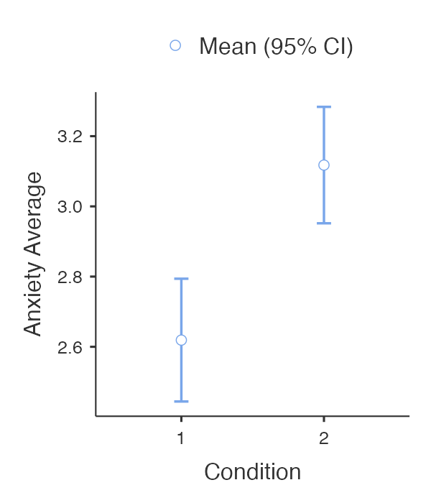
RESULTS
The study is currently ongoing and is in a preliminary data collection phase. So far, we have witnessed an increased level of anxiety in students when faced with an NNES instructor and we are running results to see if the same can be found in memory recall.
Notes:
Once again, preliminary data for this study is being collected and is currently ongoing. For the 64 preliminary participants, we conducted a one-way ANOVA to calculate differences between anxiety for the NNES instructor and NES instructor. So far, it shows that participants viewings of the NNES instructor brings about higher levels of anxiety than when participants viewed the NES instructor. We are currently working on analysis for memory recall to determine differences but are anticipating on finding participants to have higher recall from viewing the NES instructor rather than the NNES instructor.
That is all for this presentation. Does anyone have any questions?

