Slide 1
Do Anxiety Levels Affect Sleep?: A Meta-Analysis
Katelyn mcclure, b.s. Psychology

Slide 2
Introduction
264 million adults with anxiety (World Health Organization, 2017)
Anxiety vs. Our Body

Slide 3
The Importance of Sleep
~ 7 hours of sleep for an adult.
Symptoms of no sleep/poor sleep:
Attention Lapses
Reduced Cognition
Mood Swings
Delayed Reactions

Slide 4
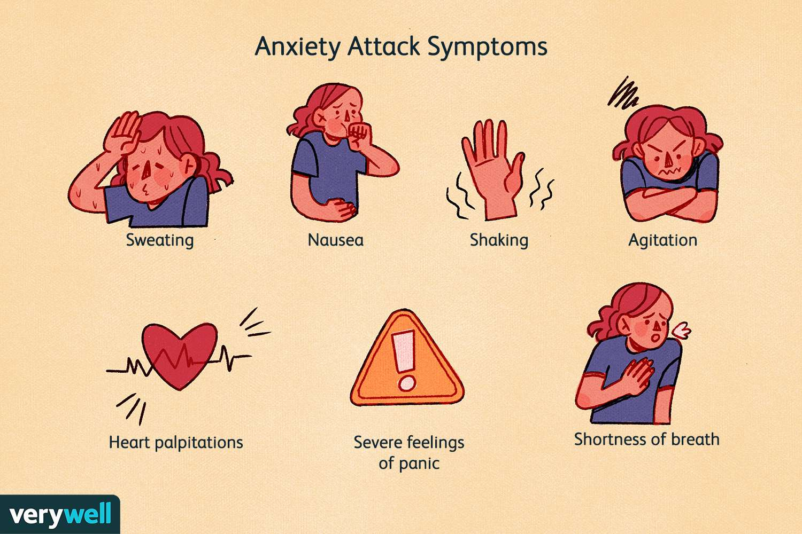
How Anxiety Affects Us
Anxiety: Feeling of worry or unease.
Physical Symptoms:
Tense Muscles
Shakiness
Nausea
Mental Symptoms:
No Control
Impending Doom
Extreme Nervousness

Slide 5
The Purpose of this Study
How much anxiety affects sleep.
Difference between adults and children and adolescents?

Slide 6
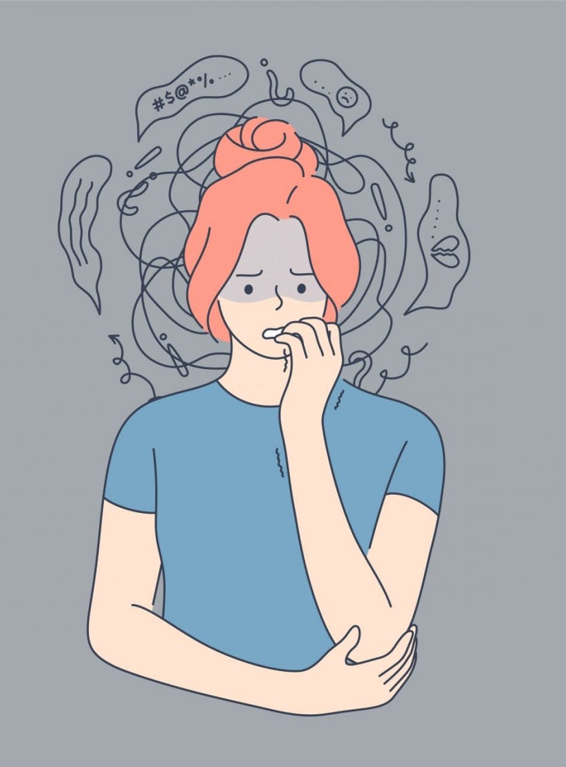
The Studies
Databases:
PsycINFO Academic Search Ultimate
CINAHL
Terms:
“anxiety disorder or anxiety or generalized anxiety disorder”
“sleep”

Slide 7
Methodology
20 studies with reported correlation coefficient, r.
Negative Directionality = Anxiety and Sleep Quality
Positive Directionality = Anxiety and Total Sleep Time
Moderator = Adult or Child and Adolescent

Slide 8
Results
Negative Directionality
Total: r = .3
Adult: r = .51
Children and Adolescents: r = .21
Positive Directionality
Total: r = .37
Adult: r = .38
Children and Adolescents: r = .37
Total Average: r = .35

Slide 9
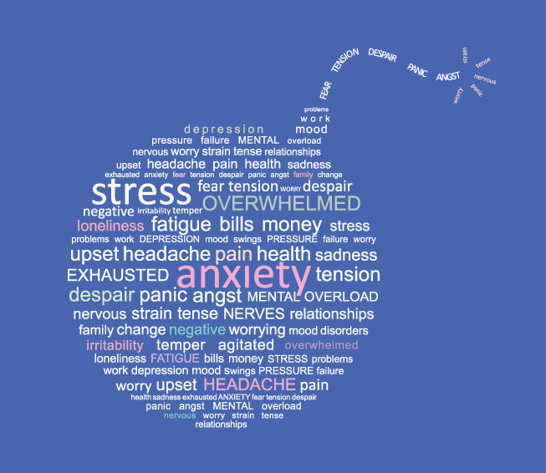
Implications
Anxiety has a moderate impact on sleep.
Be aware of feelings of anxiety to help our physical and mental health.

Slide 10
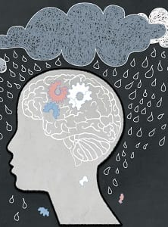
Future Directions
Anxiety may have a bigger impact on sleep for certain populations.
What activities are best a reducing anxiety before going to sleep?

