Slide 1
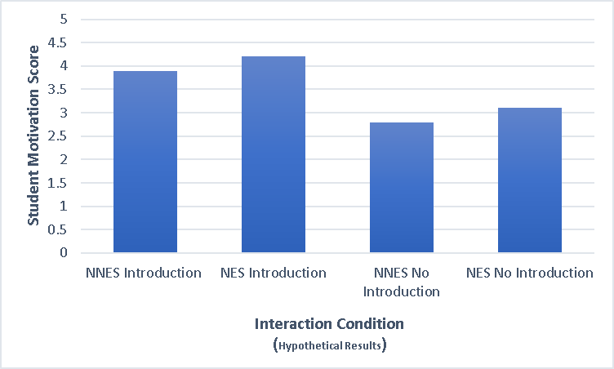
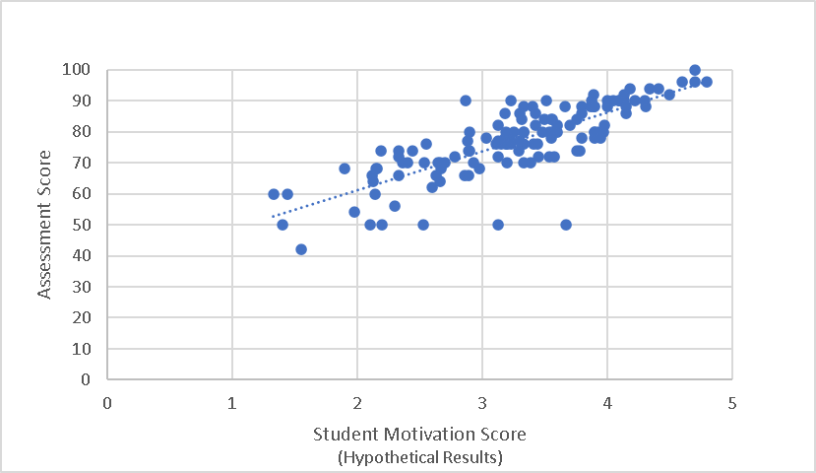
Effects and Implications of Contact Hypothesis in the Online Classroom
Benjamin Meadows, Katelyn McClure, Christian Phillips & Michael Chen
Department of Psychology, Eastern Kentucky University
INTRODUCTION
Interactions between Native English-speaking (NES) students and Non-Native English-speaking (NNES) instructors often lead to relatively more negative student perception and negative course evaluations due to the instructor’s accent.
Contact Hypothesis suggests that biases between groups can be reduced through positive contact.
Questions:
Is the Contact Hypothesis applicable to an asynchronous online classroom setting?
If NES students know more about their NNES instructors, would they be more motivated to learn?
Will students who are more motivated to learn do better on assessments?
METHOD
Design & Materials (n=128)
Between-subjects design with four conditions: 1) NES with introduction, 2) NNES with introduction, 3) NES without introduction, and 4) NNES without introduction
Procedure
Airplane Design Knowledge Pre-Test
Watch either ( 1.NES with introduction, 2. NNES with introduction, 3. NES without introduction, or 4. NNES without introduction.)
Watch 4 video lectures about airplane design showing NES or NNES instructors’ face.
Answer Recall Questions after each lecture.
Take Eklöff student motivation scale.
6. Answer Questions about Chinese accent bias.
7. Answer Demographics questions.
REFERENCES
Eklöff, H. (2010). Student Motivation and Effort in the Swedish TIMSS Advanced 2008 Field Study. Proceedings of the 4th international research conference, 2010. Presented at the The 4th IEA International Research Conference, Gothenburg, June, 2010. Retrieved from http://urn.kb.se/resolve?urn=urn:nbn:se:umu:diva-41093
Pettigrew, T. F. & Tropp, L. R. (2006). A meta-analytic test of intergroup contact theory. Journal of Personality and Social Psychology, 90(5) 751-83. doi: 10.1037/0022-3514.90.5.751
Subtirelu, N. C. (2015). “She does have an accent but…”: Race and language ideology in students' evaluations of mathematics instructors on RateMyProfesors.com. Language in Society, 44, 35-62. doi:10.1017/S0047404514000736
White, F. A., Verrelli, S., Maunder, R. D., & Kervinen, A. (2019). The Journal of Sex Research, 56(9), 1179– 1191. doi: https://doi.org/10.1080/00224499.2018.1491943
RESULTS
(Hypothetical) Participants taking the instructor introduction condition displayed increased student effort compared to sample lecture condition.
(Hypothetical) Participants who scored higher on motivation scale scored higher on assessments.

Slide 2
Effects and Implications of Contact Hypothesis in the Online Classroom
Benjamin Meadows, Katelyn McClure, Christian Phillips & Michael Chen
Department of Psychology, Eastern Kentucky University
INTRODUCTION
Interactions between Native English-speaking (NES) students and Non-Native English-speaking (NNES) instructors often lead to relatively more negative student perception and negative course evaluations due to the instructor’s accent.
Contact Hypothesis suggests that biases between groups can be reduced through positive contact.
Questions:
Is the Contact Hypothesis applicable to an asynchronous online classroom setting?
If NES students know more about their NNES instructors, would they be more motivated to learn?
Will students who are more motivated to learn do better on assessments?

Slide 3
Effects and Implications of Contact Hypothesis in the Online Classroom
Benjamin Meadows, Katelyn McClure, Christian Phillips & Michael Chen
Department of Psychology, Eastern Kentucky University
ACCENT BIAS IN THE CLASSROOM
In research conducted by Nicholas Subtirelu at Georgetown University, NNES professors of Asian descent received worse instructor reviews by students on “RateMyProfessors.com”
NES students used hyperbolic language to describe their interactions with NNES professors such as: “You can’t understand a word she says.” or “Do NOT take this professor, he can’t speak English”.
Ratings reflected a “dominant language ideology”

Slide 4
Effects and Implications of Contact Hypothesis in the Online Classroom
Benjamin Meadows, Katelyn McClure, Christian Phillips & Michael Chen
Department of Psychology, Eastern Kentucky University
WORD/SYLLABLE STRESS IN ENGLISH
According to research conducted by Andree Lepage and Darlene LaCharité at Laval University, Native English Speakers have ingrained preferences for certain word/syllable stressors.
“PAR-lia-ment” and “Par-lia-MEN-tary” have different word stressors in different syllables even though they are very similar.
English necessitates reducing stress in one syllable in order to add emphasis in another. Ex: “PHO-to-GRAPH” and “pho-TO-graphy”.

Slide 5
Effects and Implications of Contact Hypothesis in the Online Classroom
Benjamin Meadows, Katelyn McClure, Christian Phillips & Michael Chen
Department of Psychology, Eastern Kentucky University
CONTACT HYPOTHESIS
Theorized by Dr. Gordon Allport in 1954.
Suggests that inter-group conflict can be reduced by interaction under four conditions:
Interaction has institutional support
Interaction is under equal status
Interaction involves cooperation
Interaction is toward similar goals
According to meta-analysis by Thomas F. Pettigrew at the University of California, Santa Cruz and Linda R. Tropp at Boston College, 94% of samples suggested an inverse rela tionship between contact and prejudice.
Our study wants to examine if this effect applies to online asynchronous environments like online college classrooms.

Slide 6
Effects and Implications of Contact Hypothesis in the Online Classroom
Benjamin Meadows, Katelyn McClure, Christian Phillips & Michael Chen
Department of Psychology, Eastern Kentucky University
METHOD
Design & Materials (n=128)
Between-subjects design with four conditions: 1) NES with personal introduction, 2) NNES with personal introduction, 3) NES without personal introduction and 4.) NNES without personal introduction
Procedure
Airplane Design Knowledge Pre-Test
Watch either ( 1.NES with personal introduction, 2. NNES with personal introduction, 3. NES without personal introduction, or 4. NNES without personal introduction.)
Watch 4 video lectures about airplane design showing NES or NNES instructors’ faces.
Answer Recall Questions after each video lecture.
Take Eklöff student motivation scale.
Answer Questions about Chinese accent bias.
Answer demographics questions.

Slide 7
Effects and Implications of Contact Hypothesis in the Online Classroom
Benjamin Meadows, Katelyn McClure, Christian Phillips & Michael Chen
Department of Psychology, Eastern Kentucky University
RESULTS
(Hypothetical) Participants taking the instructor introduction condition displayed increased student effort compared to sample lecture condition.
(Hypothetical) Participants who scored higher on motivation scale scored higher on assessments.

Slide 8
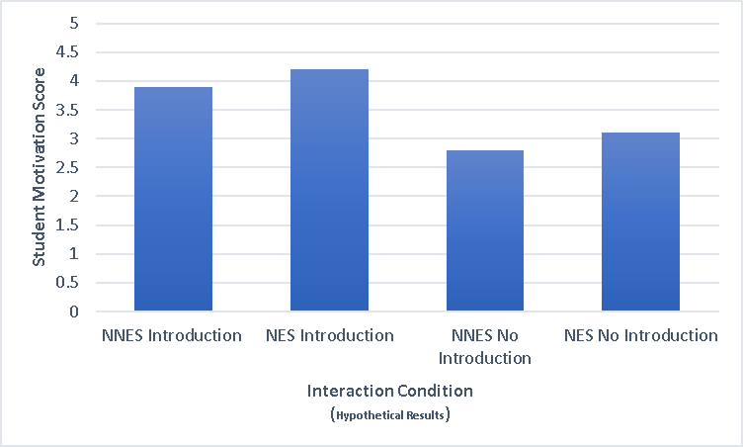
Effects and Implications of Contact Hypothesis in the Online Classroom
Benjamin Meadows, Katelyn McClure, Christian Phillips & Michael Chen
Department of Psychology, Eastern Kentucky University

Slide 9
Effects and Implications of Contact Hypothesis in the Online Classroom
Benjamin Meadows, Katelyn McClure, Christian Phillips & Michael Chen
Department of Psychology, Eastern Kentucky University

Slide 10
Effects and Implications of Contact Hypothesis in the Online Classroom
Benjamin Meadows, Katelyn McClure, Christian Phillips & Michael Chen
Department of Psychology, Eastern Kentucky University
Implications
Should we change how online courses are structured?
Do Native English-Speakers have the same bias toward all Non-Native English accents?

Slide 11
Effects and Implications of Contact Hypothesis in the Online Classroom
Benjamin Meadows, Katelyn McClure, Christian Phillips & Michael Chen
Department of Psychology, Eastern Kentucky University
Questions/Feedback
benjamin_meadows6@mymail.eku.edu

Slide 12
Effects and Implications of Contact Hypothesis in the Online Classroom
Benjamin Meadows, Katelyn McClure, Christian Phillips & Michael Chen
Department of Psychology, Eastern Kentucky University
REFERENCES
Eklöff, H. (2010). Student Motivation and Effort in the Swedish TIMSS Advanced 2008 Field Study. Proceedings of the 4th international research conference, 2010. Presented at the The 4th IEA International Research Conference, Gothenburg, June, 2010. Retrieved from http://urn.kb.se/resolve?urn=urn:nbn:se:umu:diva-41093
Pettigrew, T. F. & Tropp, L. R. (2006). A meta-analytic test of intergroup contact theory. Journal of Personality and Social Psychology, 90(5) 751-83. doi: 10.1037/0022-3514.90.5.751
Subtirelu, N. C. (2015). “She does have an accent but…”: Race and language ideology in students' evaluations of mathematics instructors on RateMyProfesors.com. Language in Society, 44, 35-62. doi:10.1017/S0047404514000736
Lepage, A. & LaCharité, D. (2015) Perceptions of intelligibility and RTs: Accent-Tolerant vs Non-Accent-Tolerant Listeners. In: Mompean J.A., Fouz-González J. (eds) Investigating English Pronunciation. Palgrave Macmillan, London. https://doi.org/10.1057/9781137509437_5

