Slide 1
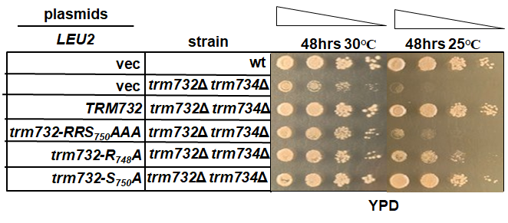
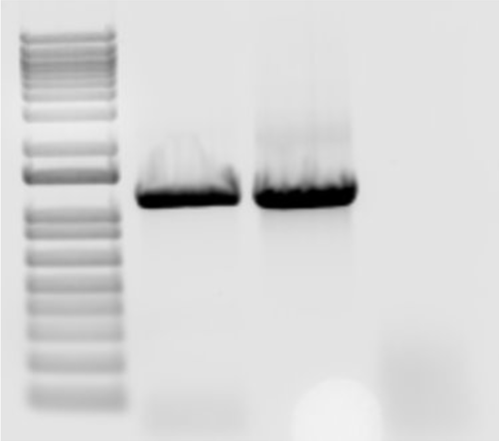
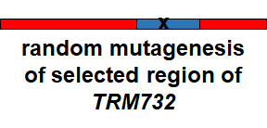
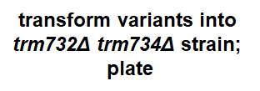
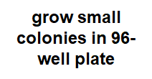
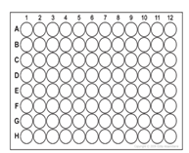
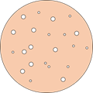
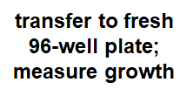
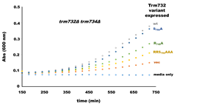
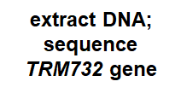
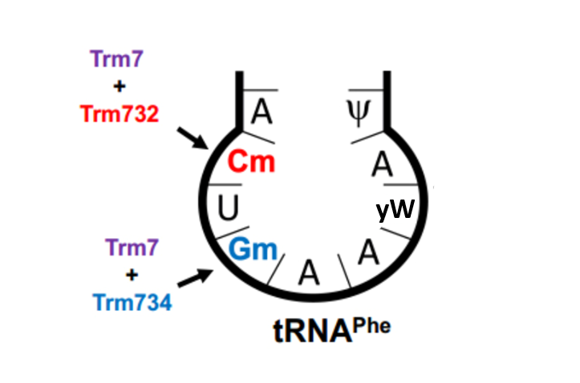
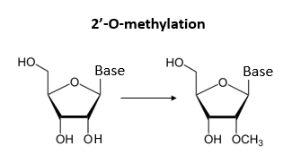
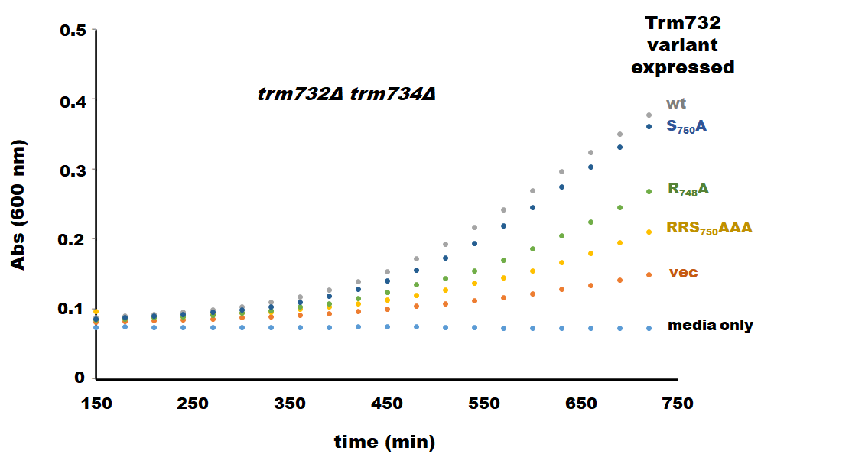
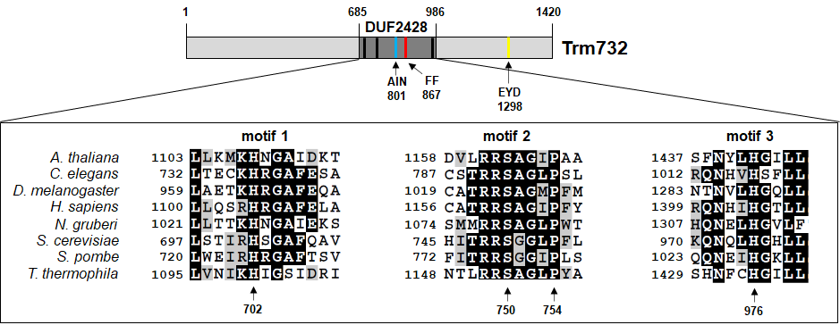
Strategies for identifying important residues in the tRNA modification protein Trm732
Morgan E. Fraley, Alexandra K. Mullins, Holly M. Funk, and Michael P. Guy
Department of Chemistry & Biochemistry, Northern Kentucky University, Highland Heights, KY 41076
Abstract
Residues important for Trm732 function
Testing efficiency of PCR to identify mutations using different DNA extraction methods
Post-transcriptional tRNA modifications are required for efficient protein translation. Proteins involved in forming tRNA modifications are being studied to understand their role and function. In yeast, the Trm7 methyltransferase forms a complex with Trm732 to modify tRNA at position 32. In humans, lack of Trm7 causes intellectual disability. Little is known about the function of Trm732, although we have shown that one conserved motif in Trm732 is important for tRNA modification. We are identifying other residues important for function using two strategies. First, we compare Trm732 proteins of different organisms using protein alignments to determine conserved regions to mutate for testing. Second, we are expressing randomly mutated Trm732 variants in a sick strain that lacks Trm732. Lack of rescue of strain indicates that the mutation present is harmful to protein function. DNA from these colonies is extracted and sequenced to determine the mutation that causes loss of Trm732 function.
Zymo Kit
Freeze/Thaw
Plasmid Ext.
1500
From protein alignment, tested growth for conserved regions to indicate importance in function.
The single mutant, R748A, grew poorly compared to S750A.
Poor growth of R748A indicates its importance in the function of Trm732.
1000
Background
tRNAs are modified at the anticodon loop by the methyltransferase enzyme Trm7 in yeast.
Posttranscriptional tRNA modifications are critical for translation
Trm7 interacts with protein Trm732 to 2’-O-methylate C₃₂ and with protein Trm734 to modify G₃₄ of tRNA^{Phe1,2}
In yeast, the lack of these modifications at both C₃₂ and G₃₄ on tRNA^{Phe} results in a severe growth defect^{1,2}
In humans, mutations in the TRM7 human homolog (FTSJ1) cause non-syndromic X-linked intellectual disability^{3,4}
Random Mutagenesis Strategy
Diagnostic Gel of Trm732 R748A DNA Extracted by Different Methods and PCR amplified with Primers for Area of Mutation
Sequence Comparison of Trm732 R748A Mutation
The PCR product was sequenced and found to have the expected mutation.
Detection of mutation confirms that PCR method is efficient, and that overall random mutagenesis method should work to identify important residues.
Trm732 variants growth curve
Future Directions
Generate and test a protein variant library to identify important residues in Trm732.
Generate and test the Trm732 variants, AIN₈₀₁, FF₈₆₇, EYD₁₂₉₈.
Trm732 protein alignment
Acknowledgements
Thanks to the National Institutes of Health, Kentucky Biomedical Research Infrastructure Network, and NKU for funding. We also thank the NKU Department of Chemistry & Biochemistry for its support, as well as all members of the Guy research team for their assistance throughout the project.
References
Pintard, L., Lecointe, F., Bujnicki, J. M., Bonnerot, C., Grosjean, H., and Lapeyre, B. (2002). Trm7p catalyses the formation of two 2'-O-methylriboses in yeast tRNA anticodon loop. Embo J 21, 18112.
Guy, M.; Podyma, B.; Preston, M.; Shaheen, H.; Krivos, K.; Limbach, P.; Hopper, A.; Phizicky, E. Yeast Trm7 Interacts With Distinct Proteins For Critical Modifications Of The Trnaphe Anticodon Loop. RNA 2012, 18, 1921-1933.
Freude, K., Hoffmann, K., Jensen, L. R., Delatycki, M. B., des Portes, V., Moser, B., Hamel, B., van Bokhoven, H., Moraine, C., Fryns, J. P., et al. (2004). Mutations in the FTSJ1 gene coding for a novel S-adenosylmethionine-binding protein cause nonsyndromic X-linked mental retardation. Am J Hum Genet 75, 305-309
Ramser J, Winnepenninckx B, Lenski C, Errijgers V, Platzer M, Schwartz CE, Meindl A, Kooy RF. A splice site mutation in the methyltransferase gene FTSJ1 in Xp11.23 is associated with non- syndromic mental retardation in a large Belgian family (MRX9). J Med Genet. 2004 Sep;41(9):679-83.
Hirata, A.; Okada, K.; Yoshii, K.; Shiraishi, H.; Saijo, S.; Yonezawa, K.; Shimizu, N.; Hori, H. Structure of TRNA Methyltransferase Complex of Trm7 and Trm734 Reveals a Novel Binding Interface for TRNA Recognition. Nucleic Acids Res 2019, 47 (20), 10942–10955.
Trm732 contains a conserved DUF2428 domain in eukaryotic organisms.
Motif 2, RRSGLP, has been shown to be important for function in our lab.
Three more conserved regions in alignment have been identified and are currently being tested: AIN₈₀₁, FF₈₆₇, and EYD₁₂₉₈.
Growth of strains in 96-well plate as proof of principle indicating feasibility of random mutagenesis method.
The same strains were used to produce a growth curve to further compare R748A and S750A. Supports spot test results as R748A grows more slowly than S750A.

