Slide 1
Testing The Limits of the Rspec Explorer Spectroscope
Jacob M. Wagoner
Dr. Jennifer Birriel
Morehead State University

Slide 2
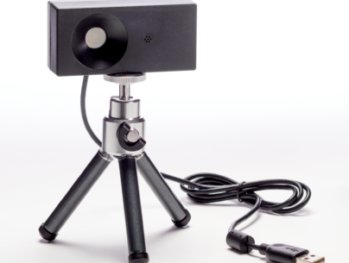
Rspec System and software
Slit-less diffraction grating spectroscope
USB connection to computer
Passively powered by USB connection
Spectral range: 390 – 700nm.
Auto focus
Wavelength calibrated
Software: Acquisition and Analysis.
Designed for classroom demonstrations.
Simple to use

Slide 3
Beyond Optical Spectroscopy
Rspec can be recalibrated for infrared detection

Slide 4
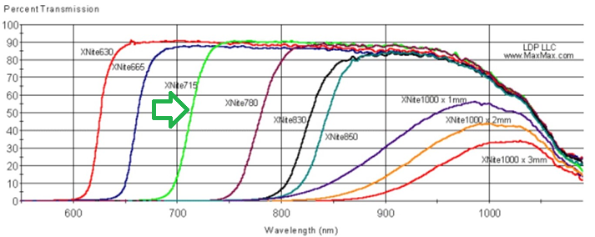
RSPEC Infrared Spectral Response
Xnite715 – Halogen bulb flashlight with IR filter

Slide 5
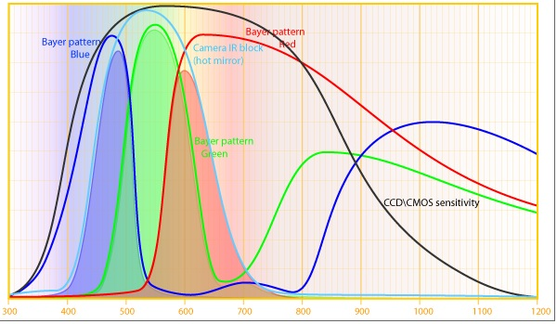
Chip Response
Absorption from glass cover and grating.

Slide 6
Hydrogen Gas Discharge

Slide 7
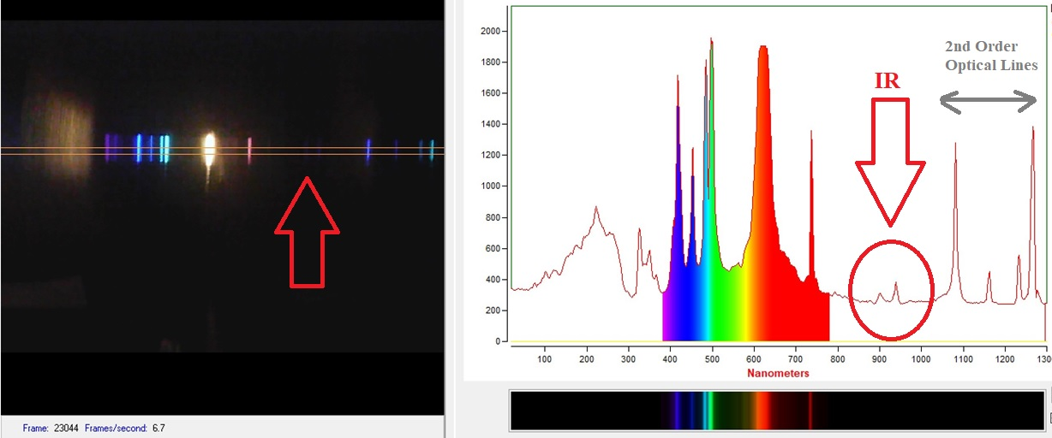
He Gas

Slide 8
Rspec Infrared ?
Not good for infrared spectroscopy
BUT a good demonstration of absorption of IR by glass,etc.

Slide 9
Raman Scattering?
Inspiration
Article Methodology
Diffraction grating taped to smartphone camera
Laser pointers: Green & Blue < 5 mW
100, 10 second exposures coadded
Requires student to wavelength calibrate with know spectral lines
Time consuming, challenging

Slide 10
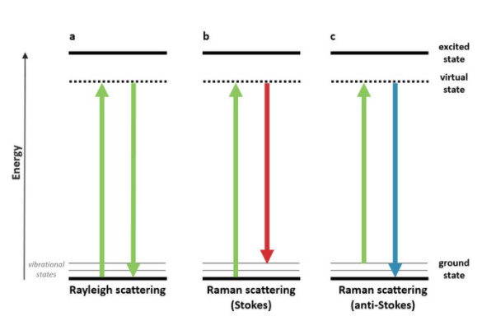
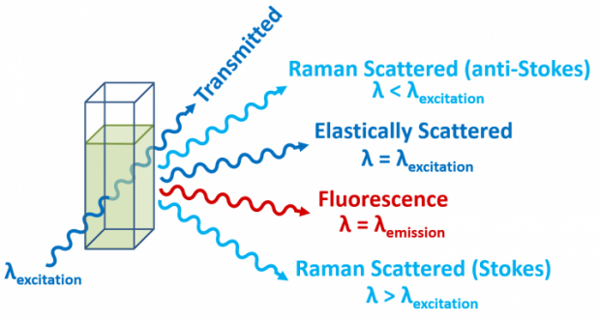
Raman Scattering

Slide 11
Experimental Approach
Raman shift is wavelength dependent
Only redshifted Stokes line detectable with RSpec
Materials:
50 mW Blue (405 nm) and Green (532 nm) laser pointers
Distilled H20
Black background
Slit
Raman lines should be detected transverse direction of laser beam

Slide 12
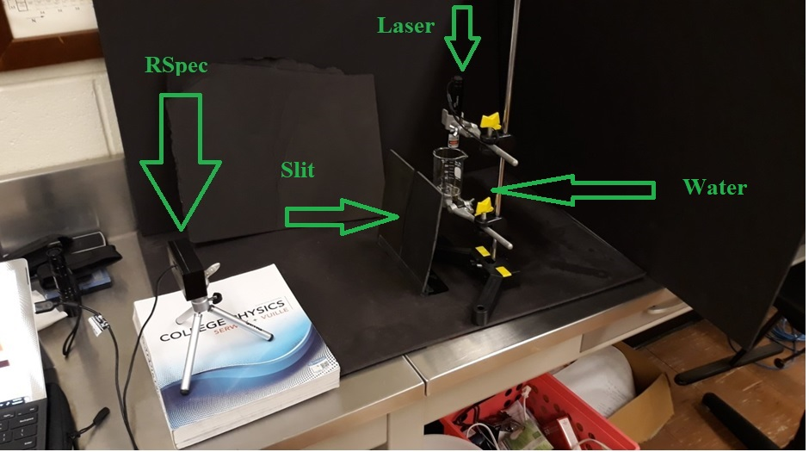
Experimental Setup

Slide 13
Distilled water 405nm Laser

Slide 14
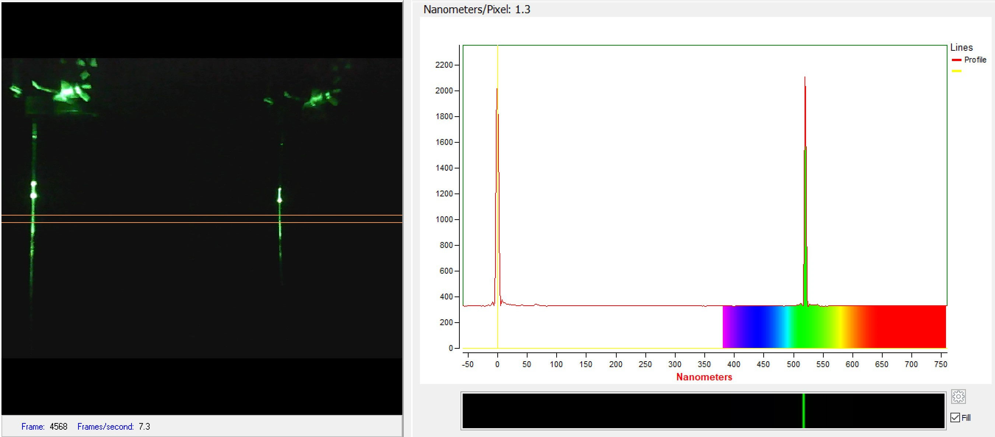
Distilled Water 532nm Laser

Slide 15
Raman Scattered Lines ?
Expected at
~470 nm for 405 nm excitation
~640 nm for 532 nm excitation
Research paper using cell phones demonstrates the line should be easily detected above background.
Not visible in our spectra
RSpec video auto adjusts based on brightest image
Rspec camera mode doesn’t allow user to adjust ISO or exposure time

Slide 16
Conclusion
Infrared spectroscopy is limited but…
Xnite 715 can be used to show “instrumental profile”
Can show students some infrared from sources
Cannot show IR lines from discharge tubes
Raman spectroscopy
Need to adjust ISO and exposure time
Probably need to “jailbreak” camera software to achieve
Rspec great device for bright optical emission and absorption spectroscopy – like gas discharge tubes, light bulbs, glowsticks.

