Slide 1

Circularizing Chromosome VII in Saccharomyces cerevisiae
Duncan McGinnis and Dr. Melissa Mefford
Morehead State University and Craft Academy

Slide 2
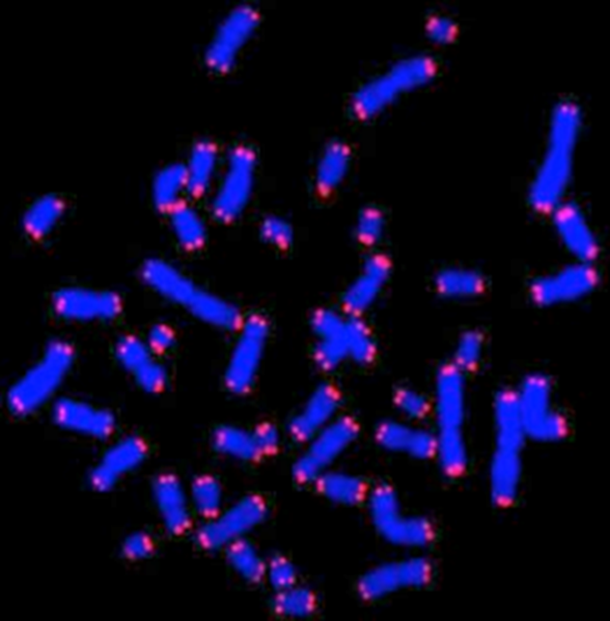
Telomeres
Long repeated sequences of DNA at the ends of linear chromosomes
Telomeres shorten with age
Involved in human health concerns

Slide 3
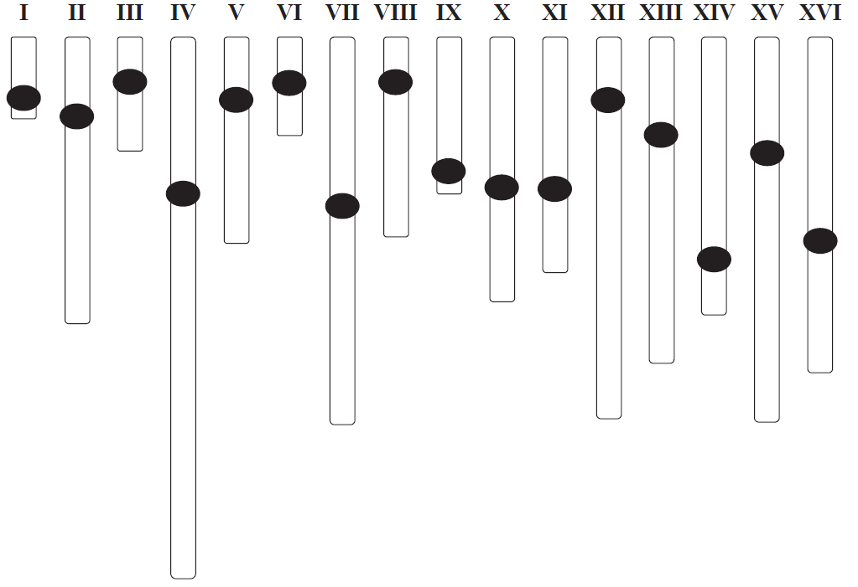

Circular vs. Linear
Why have linear chromosomes and telomeres?
Study telomeres by removing them
  Hypothesize chromosomes still be functional
  Study viability and fitness vs normal linear chromosomes
  Insights into why telomeres evolved

Slide 4
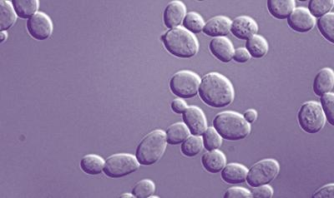
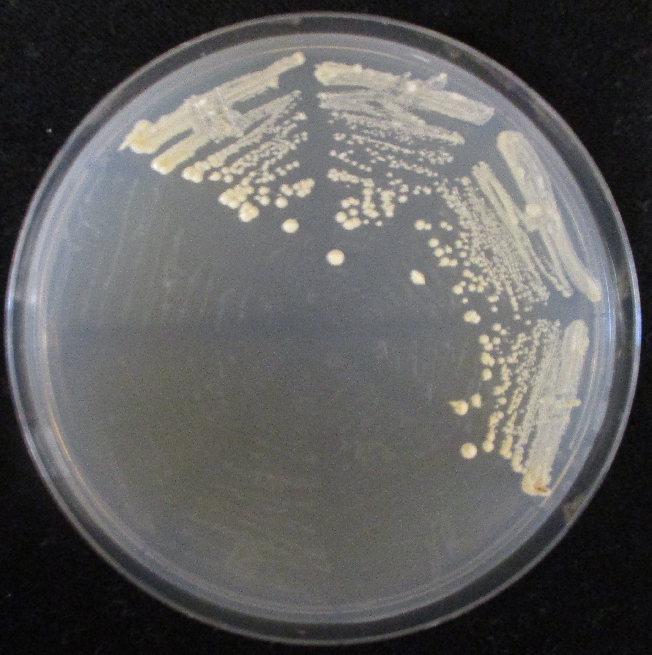
Budding Yeast
Saccharomyces cerevisiae is our organism of choice
  Is eukaryotic with linear chromosomes and telomeres
  Single celled
  Easy to transform and integrate new DNA into cells
  Lots of selectable marker genes- HIS3, LEU2, URA3

Slide 5
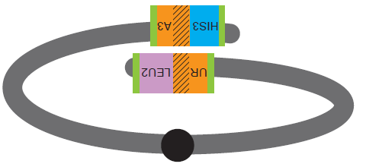


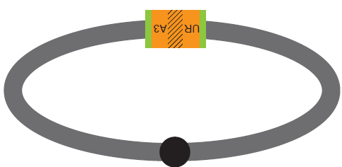

Overview
1. Create Left and Right cassettes
3. Allow recombination of homologous
regions
Left Arm Cassette
Right Arm Cassette
2. Integrate L and R cassettes into
Chromosome VII

Slide 6
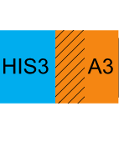
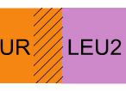
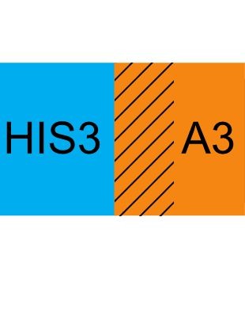
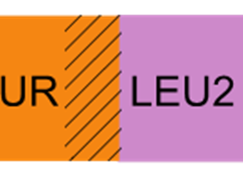
Step 1- Build Cassettes
Left arm cassette
Right arm cassette
Cassettes are pieces of DNA with multiple functional regions
Create DNA cassettes to integrate into Ch. VII
Only HIS3 and LEU2 are functional
Both URA3 halves include a region of homology
1st round
PCR
2nd round
2nd round
PCR
= homology w/ Ch. VII
= homology w/ URA3

Slide 7
Step 2- Integration
Transform cassettes separately
Plate cells on dropout media to select for integrants
Use PCR reactions with a colonies genomic DNA to confirm integration
LC integration
LC presence
+ control
RC integration
+ control
RC presence

Slide 8
Step 3- Recombination
Double integrants encouraged to recombine URA3 sequences
  Other marker genes and both telomeres will be lost
  All genes originally on chromosome will be intact
  URA3 gene will be functional
  Select for circularized chromosomes on –uracil media

Slide 9
Both Cassettes Created with PCR
Ladder
HIS3
URA3 LC
URA3 RC
LEU2
LC
RC
Ladder

Slide 10
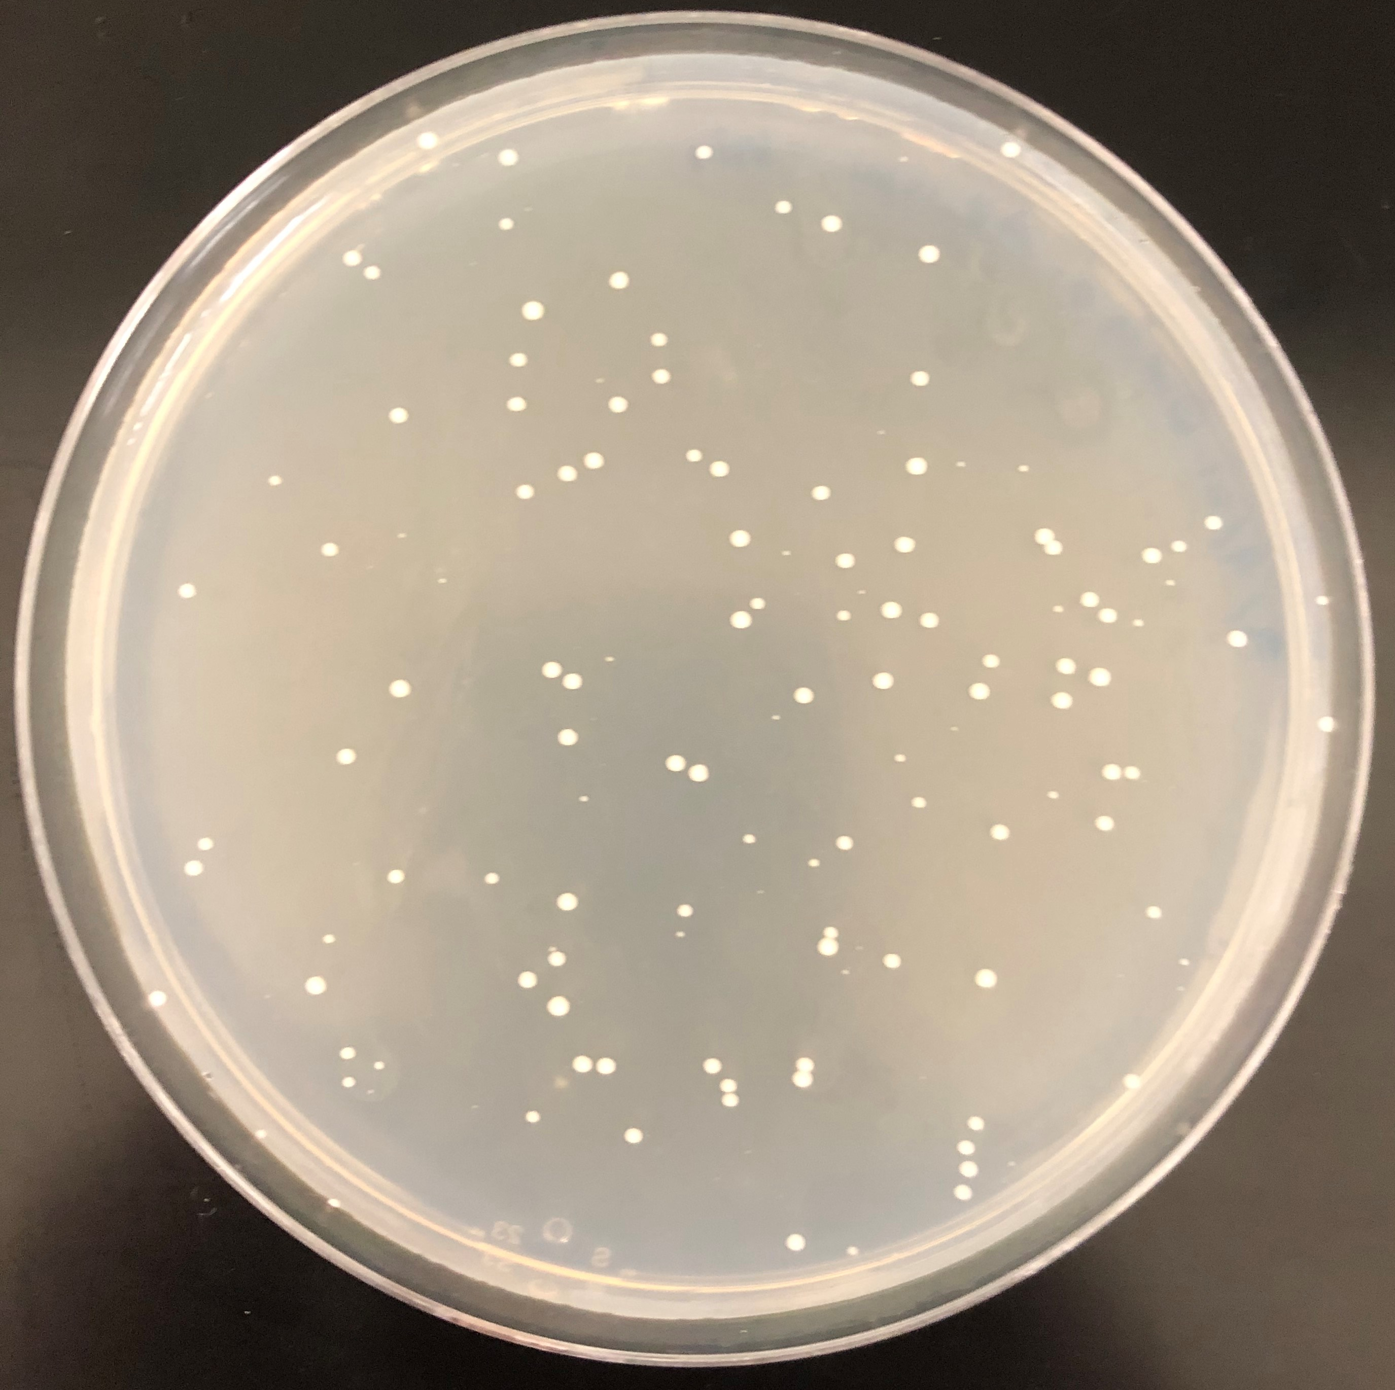
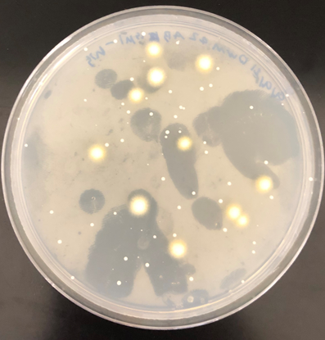
Left cassette –histidine plates
Transformations
Two rounds of transformations so far
Isolated genomic DNA from 20 left cassette candidates
All have left cassette present, but no integrants confirmed
+ ctrl
LC
LC Int

Slide 11
Next Steps
  Test latest round of transformations for integrants
  Integrate other cassette and select for circularized chromosomes

Slide 12
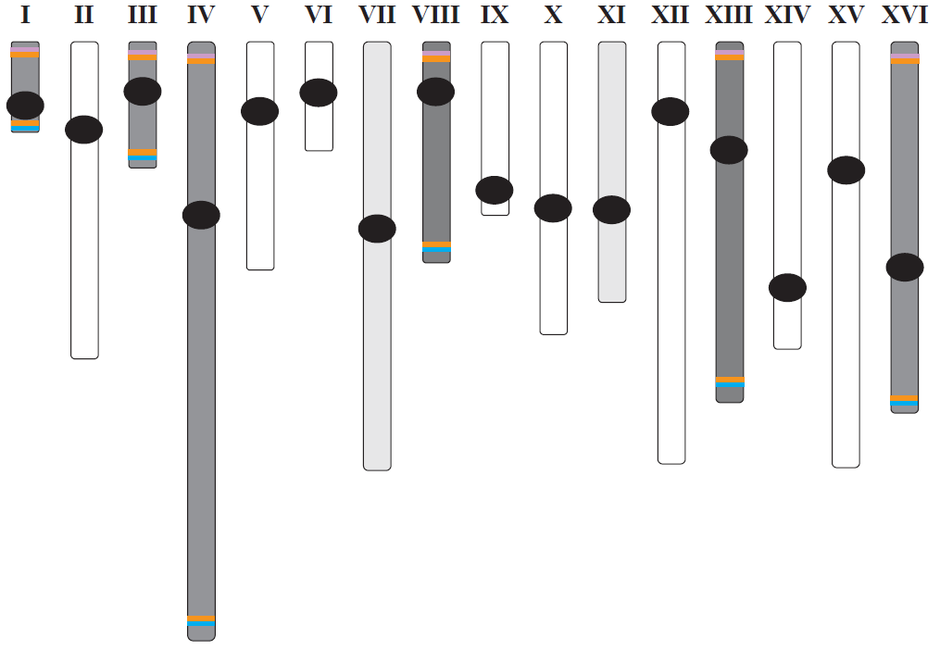
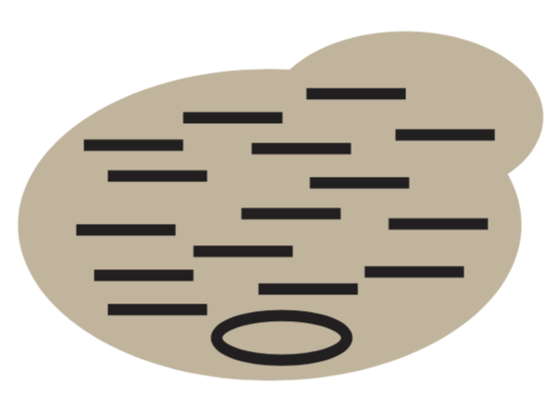
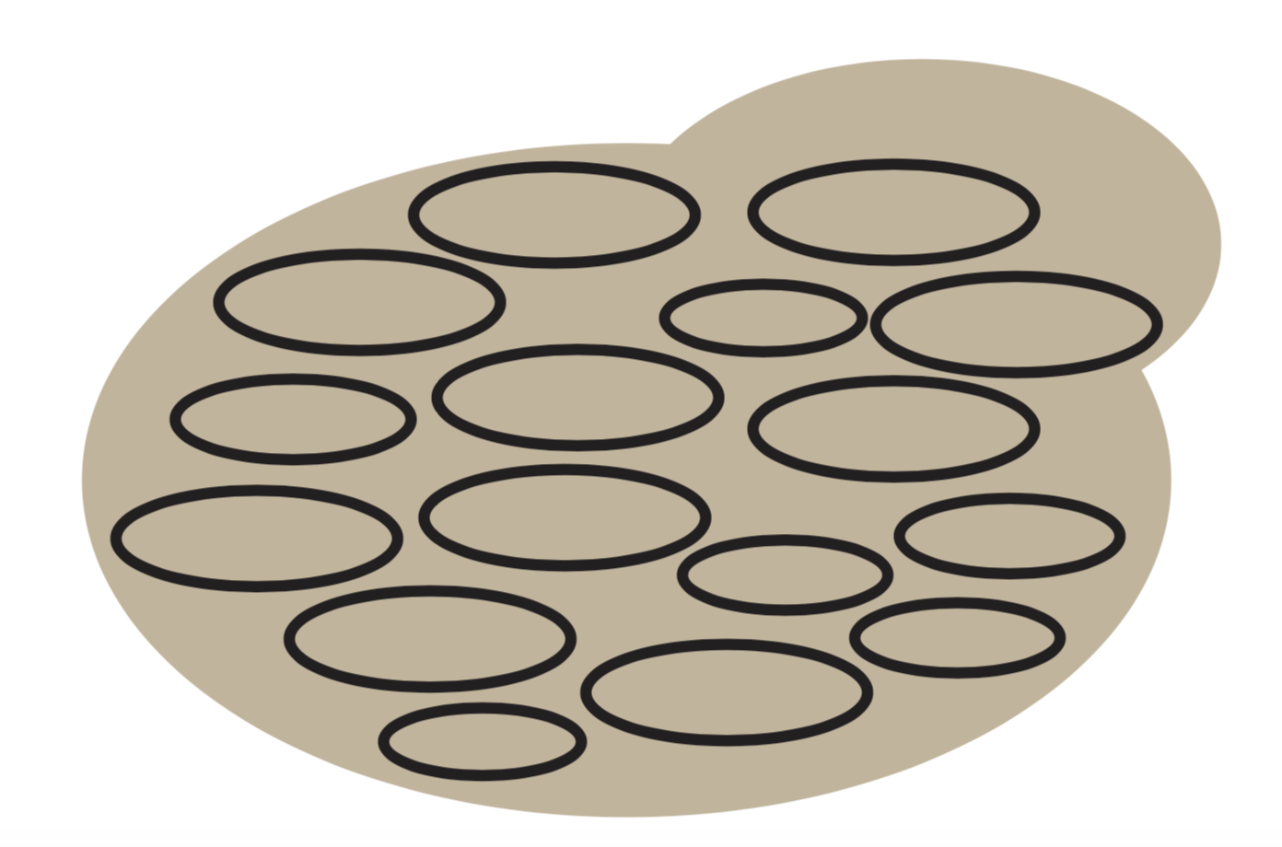
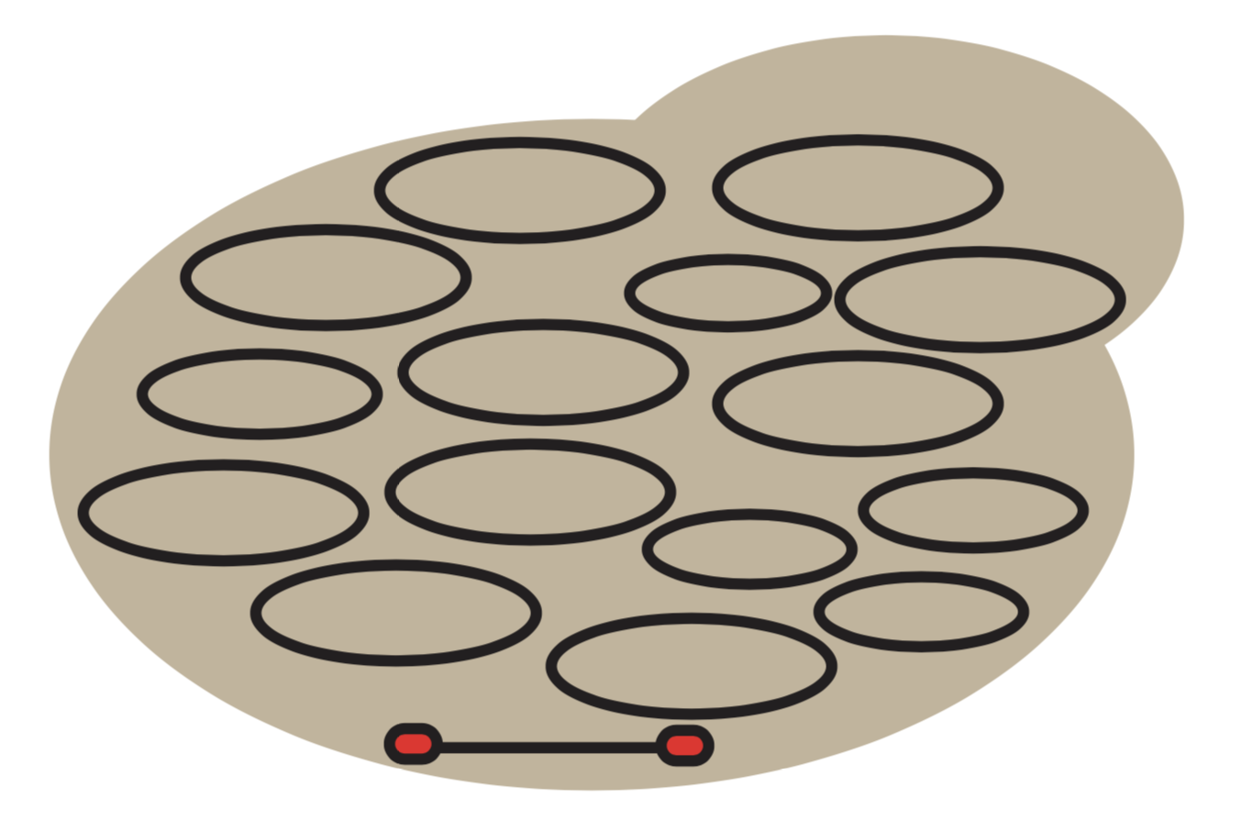
Long term goals
  Circularize other chromosomes
  Observe fitness of circularized chromosome strains
  Mate and sporulate circular chromosome strains to check meiosis
  Produce strains with all but one and all chromosomes circularized

Slide 13

Acknowledgements
  Funding
  MSU
  KY INBRE (NIGMS P20GM103436)
  Dr. Melissa Mefford
  Keenan Conley
  Madison Frazier
  Blake Hoover
  Chisom Iloegbunam
  Duncan McGinnis
  MacKenzie Neal
  Hailey Reitz

Slide 14
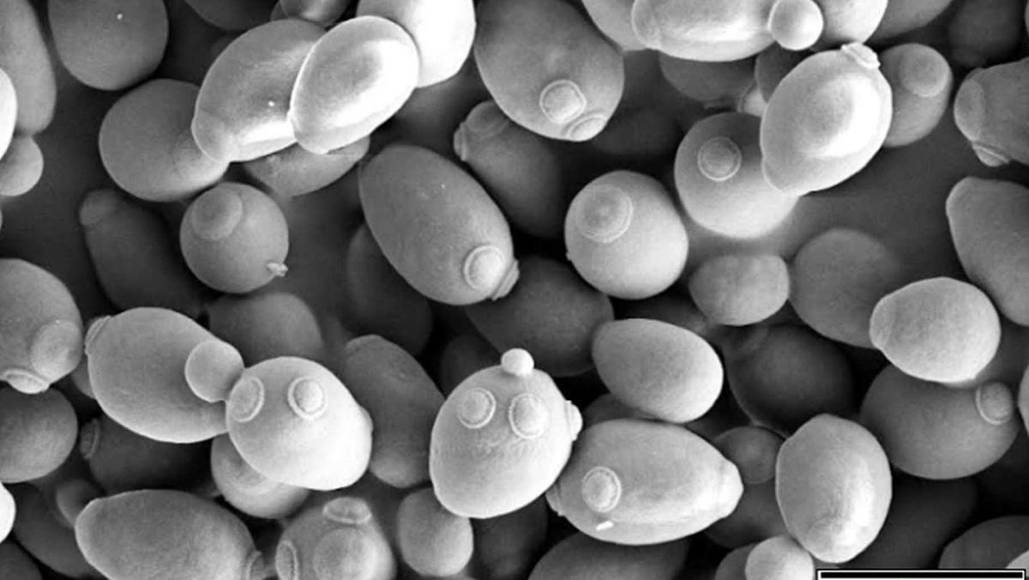
Questions?

