Slide 1
Relationship between parental depression and their reflective functioning and emotion coaching strategies.
Wright, L., Gallenstein, K., Whitenack, M., & Kidwell S.

Slide 2
Parental Depression
Depression is defined as “a negative affective state, ranging from unhappiness and discontent to an extreme feeling of sadness, pessimism, and despondency, that interferes with daily life (American Psychological Association, 2013).”
  Examples: lack of energy, feeling of worthlessness, a lack of interest in daily activities
It has been shown that depressed parents tend to have more negative emotions and hostility toward their child as well as to be more pessimistic about their parenting abilities (Lovejoy et al, 2000).
Depressed parents have been shown to have children with increased emotional and behavioral difficulties (Hagal & Paley, 2020).
Emotion coaching and parental reflective functioning have both been associated with parental depression.

Slide 3
Emotion Coaching
Emotion Coaching is the parent’s ability to promote their child’s emotion regulation and manage their responses.
“EC parents are aware of low-intensity emotions in themselves and their children, view children’s negative emotion as an opportunity for intimacy or teaching, validate and label emotion, and help children learn strategies for dealing with emotion causing situations” (Katz, Maliken, & Stettler, 2012, p 638).
The opposite of this is dismissing/disapproving.
Depressed parents use less positive parenting strategies and tend to have difficulties in emotion regulation (Loechner et al., 2019).

Slide 4
Reflective Functioning
Reflective functioning (RF) is one’s ability to understand their own and other’s inner experiences.
Here we look at the parent’s capacity to understand their child’s inner experience, parental reflective functioning (Slade et al., 2005; Fonagy et al., 1998).
This is a part of a larger concept called mentalization. It is an individual’s reflective process regarding their emotions and mental states. It allows for one to interpret and anticipate their own and other’s actions (Fonagy et al., 1998).
Depressed parents tend to show more difficulties in their capacity to engage in accurate reflective functioning (Khoshroo & Seyed Mousavi, 2021).

Slide 5
Hypothesis
Higher parents’ depression scores would be associated with lower reflective functioning skills and higher emotion dismissing scores.

Slide 6
Participants
The participants were 21 families, participating in a larger longitudinal study
Caregivers were mostly mothers, with one father. Caregivers averaged 38 years of age.
Children averaged 16.6 years of age. There were 12 males and 9 females.
Families were reimbursed for their participation.

Slide 7
Methods
Parents Meta and Mindful Emotions Interview (PMEI)
Semi-structured interview about approach to sadness and anger, ranging about 25-60 minutes, based on an interview by Gottman and Katz.
Coded for parental coaching and acceptance of child emotions on a 1-10 scale.
The scores also indicates that a parent is using a strategy of coaching, laissez faire, dismissing or disapproving.
We rated approach to sadness and anger separately.
  Does the parent know how the child is feeling? Can they describe specific experiences? What does the parent do in response to their teen’s feelings?
Inter-rater reliability was very good

Slide 8
Methods
Emotion Dismissing Scale
Disapproving (9-10) | Critical in how they describe their child’s feelings and focus on what is wrong with the emotional behavior.
Dismissing (6-8) | Find their child’s emotions uncomfortable to experience and they want their child to get rid of the emotion quickly.
Laissez Faire (4-5) | Express concern and warmth for child’s emotion, but do not show evidence of coaching.
Emotion Coaching (1-3) | Parents promote their child’s emotion regulation through acceptance and teaching.

Slide 9
Methods
Mothers Empathetic Understanding Procedure (MEUP)
This interview consisted of twelve questions related to two tasks that the parent and teen completed together. This is based on a procedure developed by Koren-Korie and Oppenheim (2001).
The first set of questions were related to what the parent and teen were thinking/feeling while they did a Hot Topics task.
The second set of questions were related to what the parent and teen were thinking/feeling during a reminiscing task.
The interviews were coded using a scale derived from Slade’s (2005) Parent Development Interview RF coding system, summarized on the next slide.
One overall score was derived per parent, and inter-rater agreement was excellent.

Slide 10
Methods
RF Scale for MEUP
1 | Disinterested in understanding child’s experiences
3 | Describes child’s behavior only
4 | Ordinary RF – Some effort to understand child’s internal experience
5 | Engages in reflective process through not completely or consistently
7 | Gains new insights about internal experiences of their child and self

Slide 11
Methods
Center for Epidemiological Studies Depression Scale (CES-D)
This is a 20-item self report measure by Radloff (1977) that asks caregivers to rate how often they experienced symptoms of depression over the past week.
Response options ranged from 0 to 3.
0 indicates none of the time and 3 indicates most or almost all the time.
Scores from 0 to 60, with higher scores indicating greater depressive symptoms.

Slide 12
CES-D Descriptive Results
Range: 2 to 49
Average parent: 18.81 (SD=11.44)
The recommended clinical cut off score for increased likelihood of meeting criteria for a mild MDD episode is 15.
What does this tell us?
  Depressed sample: 14 parents above cutoff, 8 parents below

Slide 13
RF Descriptive Results
Range: 2 to 5
Average: 3.07 (SD = .55)
There was a high level of consistency with the parent’s discussion on the two different tasks.

Slide 14
Emotion Dismissing Scale Descriptive Results
The average parent was rated 6.95 (SD=1.23) for their description of their response to their teen’s sadness.
Ratings were slightly higher for parents’ descriptions about their response to anger (Mean=8.03, SD=1.73), meaning their scores tended to be in the disapproving range.
Ratings of parent’s approach to anger and sadness were highly related [r(19)=.86, p<.01].

Slide 15
Emotion Dismissing Descriptive Results by Category

Slide 16
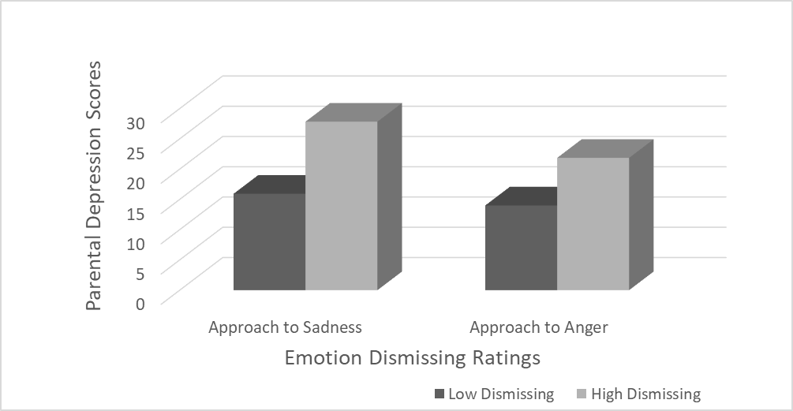
Results: Low vs. High Dismissing Towards Teen Anger & Sadness and Parent’s Depression Scores
No significant results

Slide 17
Results
 |  | Sad | Anger | RF
Depression | Pearson Correlation | .336 | .363 | -.128
No significant results for RF and parental depression.

Slide 18
Discussion
Our hypothesis was not supported.
  Parental depression scores were not associated with lower RF and higher dismissing.
Observations:
  Approaches to Sadness and Anger highly correlated [r(20)=.86, p<.01].
  Low correlation between RF and Emotion dismissing.
    Approach to Sadness and RF: [r(20)= -.163, ns].
    Approach to Anger and RF: [r(20)= -.096, ns].

Slide 19
Limitation & Future Directions
Limitations
  Small Sample Size
  Lack of Range
  Follow up questions
Future Directions
  Examine whether parents have higher RF on the two different tasks.
    The two tasks elicited different emotions.
  Further examination of approach to emotion
    Do parents behave more sensitively and warmly with their kids than the RF score and Emotion dismissing scores indicate?
    Parental warmth and acceptance scale - many parents seemed caring but still wanted the teen to stop having the emotion

