Slide 1
Abundance of Beneficial Insects in a Vip3A X Cry1Ab Bt Protected Sweet Corn Hybrid Bordered by Native Perennial Plants or Pasture in Franklin County, Kentucky: Preliminary Results
Anjana Duwal, John D. Sedlacek, Karen L. Friley, and John Galvin
College of Agriculture, Community, and the Sciences
Kentucky State University
Frankfort, Kentucky 40601

Slide 2
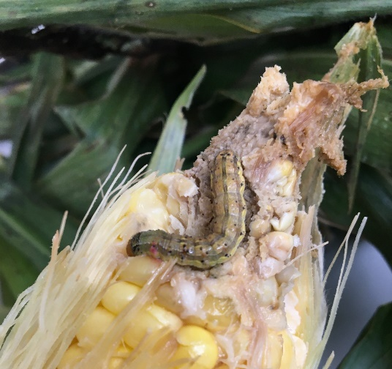
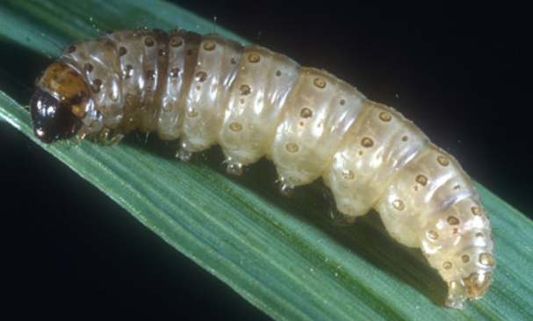
Introduction
Sweet corn, Zea mays L. var saccharata
Warm-season crop
Popular vegetable crop grown in Kentucky
Major insects attacking sweet corn:
European corn borer, Ostrinia nubilalis Hubner
Corn earworm, Helicoverpa zea Boddie
Mainly damage the ears of sweet corn
Reduce the quality and quantity of yield
Successful crops depend on the lack of damage to ears by insects
Corn earworm
European corn borer

Slide 3
Different methods of control
Synthetic chemical methods
-Use of insecticides (Asana II, Mustang Maxx, Permethrin 3.2 XL,
Warrior II, others)
2. Organic insecticide use (some Bts, Entrust)
3. Traditional resistant varieties
4. Physical methods
-Pheromone traps, light traps, etc.
5. Biological control methods
-Predators, parasitoids, pathogens
6. Transgenic insecticidal cultivars (Bt crops)

Slide 4
Vip3A X Cry1Ab Bt corn:
Contains vegetative insecticidal protein (Vip3A) pyramided with Cry protein (Cry1Ab) derived from Bacillus thuringiensis
Resistant against corn earworm, European corn borer, and fall armyworm
Less kernel damage
Natural enemies conserved

Slide 5
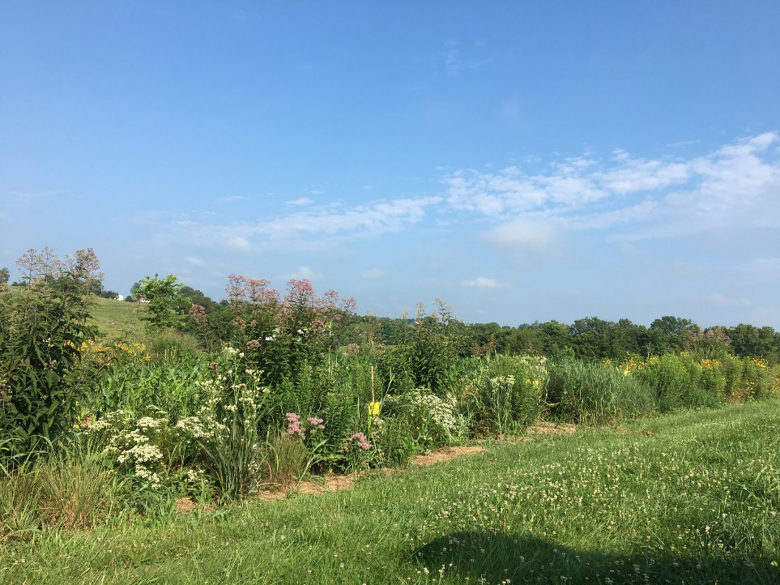
Conservation biological control (CBC)
A sustainable and environmentally sound method of managing sweet corn pests
Collection of management practices for conserving
the natural enemies and enhancing their activity
of predation to suppress pests
Habitat manipulation: a major approach
Performed by growing non-crop vegetation
in or around the main crop
Native perennial plant border

Slide 6
Flowers provide nectar, pollen, prey, and shelter to predatory insects and parasitoids.
Increase their numbers and activity in the main crop
Helps to reduce the use of insecticides, becoming an important part of integrated pest management (IPM)
Planting of Bt corn along with habitat management can be an effective strategy for the management of corn ear pests and conservation of natural enemies.

Slide 7
Beneficial insects found in sweet corn:
Minute pirate bug (Orius sp.)
Big-eyed bug (Geocoris sp.)
Multicolored Asian lady beetle (Harmonia axyridis)
Pink lady beetle (Coleomegila maculata)
Seven spotted lady beetle (Coccinella septempunctata)
Syrphid fly (Sphaerophoria philanthus)
Green lace wing (Chrsoperla carnea)
and so on
-Feed on corn earworm eggs, European corn borer eggs, aphids, and other small insects.

Slide 8
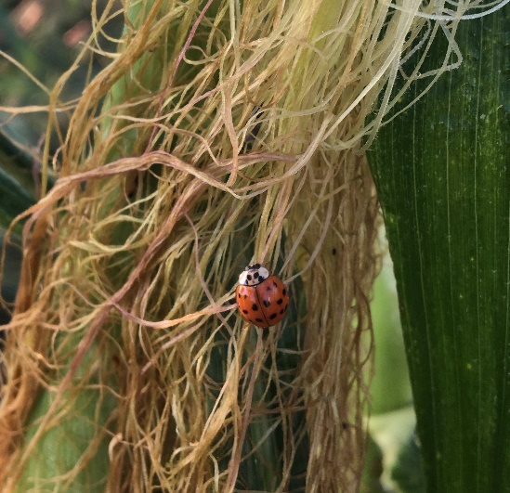
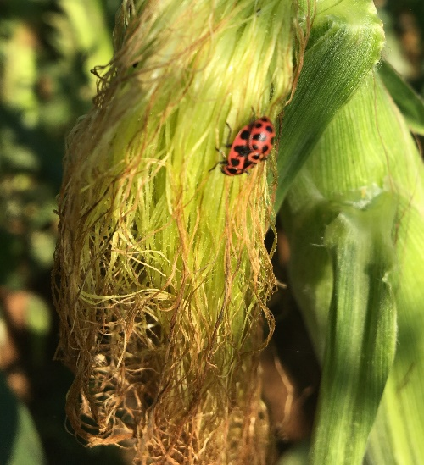
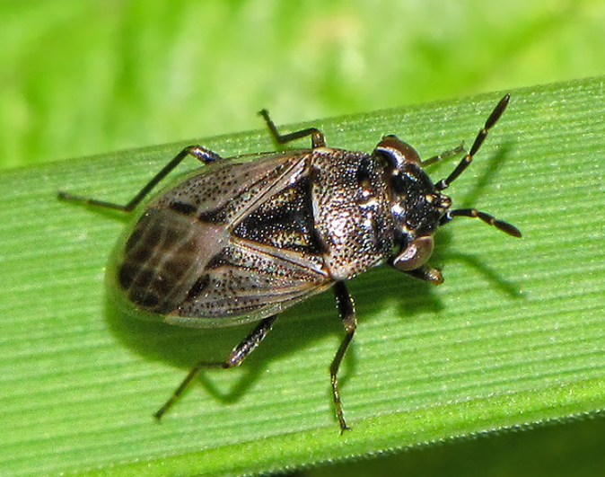
Minute pirate bug
Big-eyed bug
Multicolored Asian lady beetle
Pink lady beetle

Slide 9
Objectives
To determine if habitat management/native perennial border rows enhance beneficial insect diversity and abundance.
To quantify populations of beneficial insects in Bt sweet corn and its near-isogenic hybrid with and without companion native perennial plantings.

Slide 10
Materials and methods
Conducted during the summer of 2021
Kentucky State University Harold R. Benson Research and Demonstration Farm in Franklin County, Kentucky
Randomized complete block design with stratification used
Four replications and four treatments
Two levels of border row treatment (pasture and native perennial) and two levels of corn hybrid treatment (Bt and non-Bt)

Slide 11
Cultivation practices
Land preparation using conventional plowing
Pre-emergent herbicide, Medal II ATZ @ 5.34 litre per ha sprayed to control weeds.
Planted 17 June 2021
Bt hybrid: Attribute II Aspire (Syngenta Seed).
Non-Bt near-isogenic hybrid: Honey Select (Syngenta Seed)
Weeding at 15 days, 30 days, 45 days, and 60 days of planting
Side dressed with urea (34-0-0) @170 kg per ha 30 days after planting
Insecticide, Lamcap II (0.5 cc per litre) applied using drone, twice in weekly interval in the non-Bt sweet corn plots 60 days after planting
Corn harvested 9 September 2021

Slide 12
Habitat management
Native perennial border rows established in 2010
Managed by weeding and straw mulch
Nineteen native perennial species:
Purple coneflower (Echinacea purpurea)
Grey-headed coneflower (Ratibida pinnata)
Rattlesnake master (Erygium yuccifolium)
Thimbleweed (Anemone virginiana)
Joe pye weed (Eupatorium fistulosum)
New England aster (Aster novae-anglica)
Common boneset (Eupatorium perfoliatum)
Foxglove beardtongue (Penstemon digitalis)

Slide 13
Slender mountain mint (Pycantheum tennuifolium)
Hairy beardtongue (Penstemon hirsutus)
Bee balm (Monarda fistulosa)
Prairie switchgrass (Panicum virgatum)
Smooth blue aster (Aster laevis)
Stiff goldenrod (Solidago rigida)
Little bluestem (Schizacharium scoparium)
Prairie dropseed (Sporobolus heterolepis)
Big bluestem (Andropogon gerardii)
Side-oats grama (Bouteloua curtipendula)
Blue lobelia (Lobelia siphilitica)

Slide 14
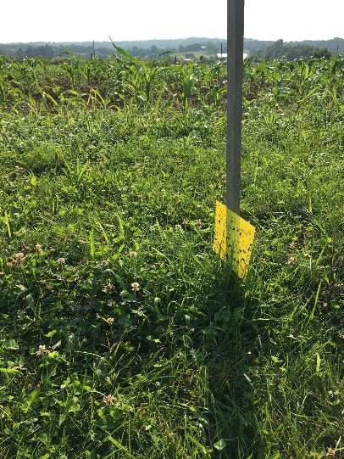
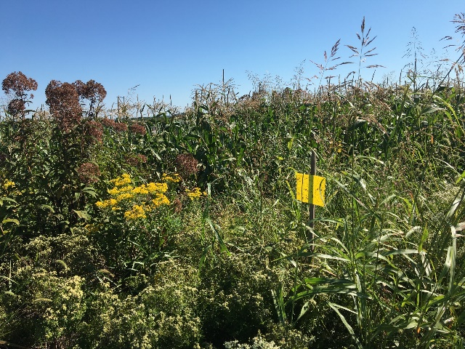
Beneficial insect sampling
Yellow sticky traps 15cm×15cm used
to capture beneficial insects
Traps stapled onto tobacco sticks
Four traps in each border equidistant
from each other
Position: Just above the ground in the pasture border rows
At the height which is at the midpoint of the canopy of surrounding plants in the native perennial border rows
Traps deployed after the beginning of flowering in native perennial border rows
Trap in pasture
border
Trap in native perennial
border

Slide 15
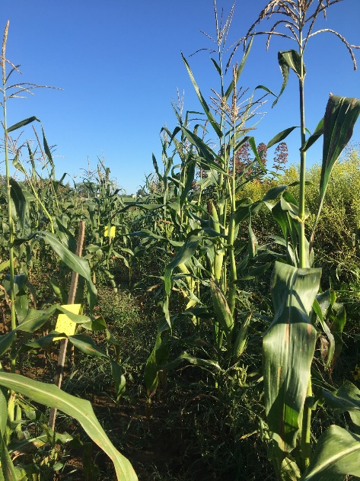
Four traps in the sweet corn plot at ear height; equidistant from each other in the second row of each sweet corn plot
Collected and replaced weekly after tasseling in corn
Traps put in Ziploc bags, labeled and taken to the lab
Beneficial insects identified using a dissecting microscope
Numbers of each species of beneficial insects recorded
Statistical analysis
Analysis of variance (ANOVA) using R programming
Post hoc analysis using Tukey HSD test
Trap in sweet corn plot

Slide 16
Results
Beneficial insect species found:
Minute pirate bug
Pink lady beetle
Multicolored Asian lady beetle
Big eyed bug
Seven spotted lady beetle
Spotless lady beetle

Slide 17
Syrphid flies
Orange spotted lady beetle
Mildew eating lady beetle
Parenthesis lady beetle
Green lace wing
Fourteen spotted lady beetle

Slide 18
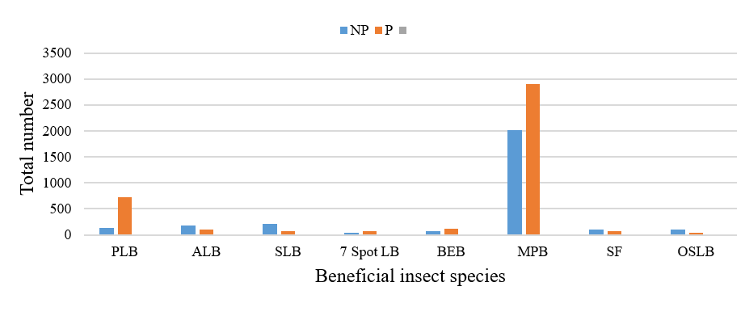
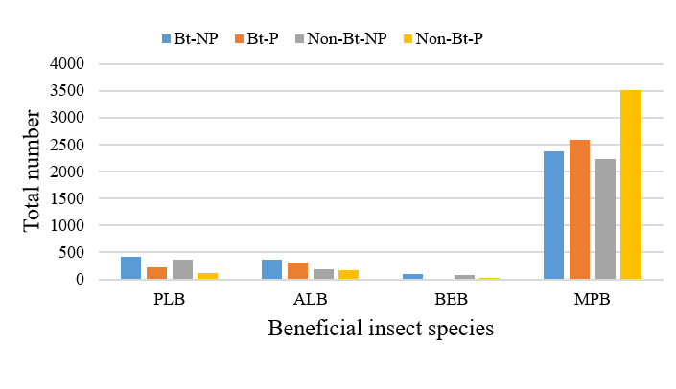
Total number of beneficial insect species found in native perennial and pasture border.
Total number of beneficial insect species found in Bt and non-Bt sweet corn.

Slide 19
Minute pirate bug populations in native perennial and pasture borders on different collection dates

Slide 20
Minute pirate bug populations in sweet corn on different collection dates after sweet corn tasseling

Slide 21
Pink lady beetle populations in native perennial and pasture border rows on different collection dates

Slide 22
Pink lady beetle populations in sweet corn on different collection dates after sweet corn tasseling

Slide 23
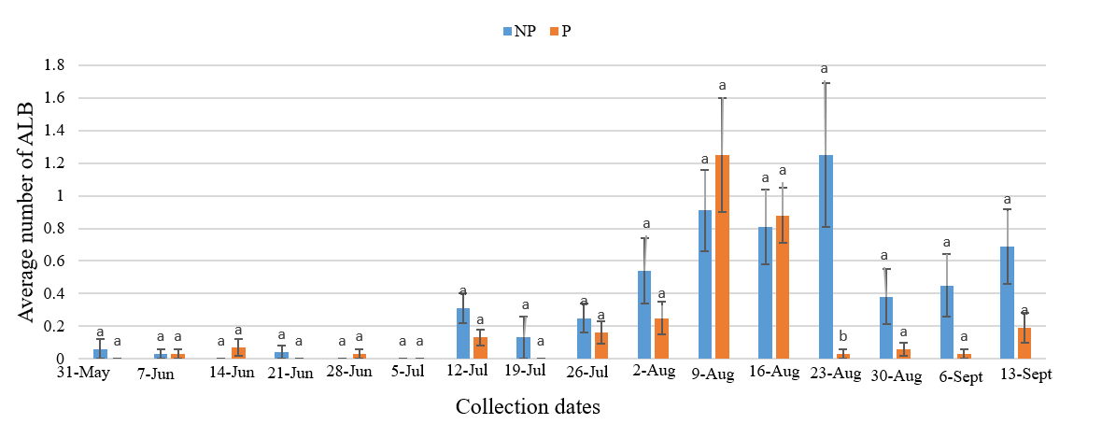
Multicolored Asian lady beetle populations in native perennial and pasture border rows on different collection dates

Slide 24
Multicolored Asian lady beetle populations in sweet corn on different collection dates after sweet corn tasseling

Slide 25
Conclusion
Twelve species of predatory beneficial insects were caught in this study.
The minute pirate bug was the most abundant species in all the habitats, followed by pink lady beetle.
Larger populations of beneficial insects were found in sweet corn than in pasture and native perennial border rows.

Slide 26
There were no significant differences in numbers of minute pirate bugs in any of the four sweet corn habitat types bordered by NP or P borders
There were a greater number of pink lady beetles in Bt corn bordered by NP borders than non Bt corn bordered by pasture borders in late August
There were no significant differences among habitat types for multi colored Asian lady beetles
Populations of beneficial insects may have been influenced by the later planted sweet corn
This research will be repeated during the spring/summer of 2022

Slide 27
Thank you!

