Slide 1
A MACHINE LEARNING-BASED C.A.D
SYSTEM FOR EARLY DETECTION
AND CLASSIFICATIONOF RENAL TUMORS
S. Gayhart, M. Shehata1, 2, A. Switala 1, A. El-Baz 1
1 BioImaging Laboratory, Bioengineering Department, University of Louisville, Louisville, KY, USA.
2 Computer Engineering and Computer Science Department, University of Louisville, Louisville, KY, USA.

Slide 2
Objectives
Clear cell renal cell
carcinoma (ccRCC)
Vs.
Non-clear cell cell
carcinoma (nccRCC)
Malignant renal cell
carcinoma (RCC)
Vs.
Benign mass
Malignant masses
then subtyped

Slide 3
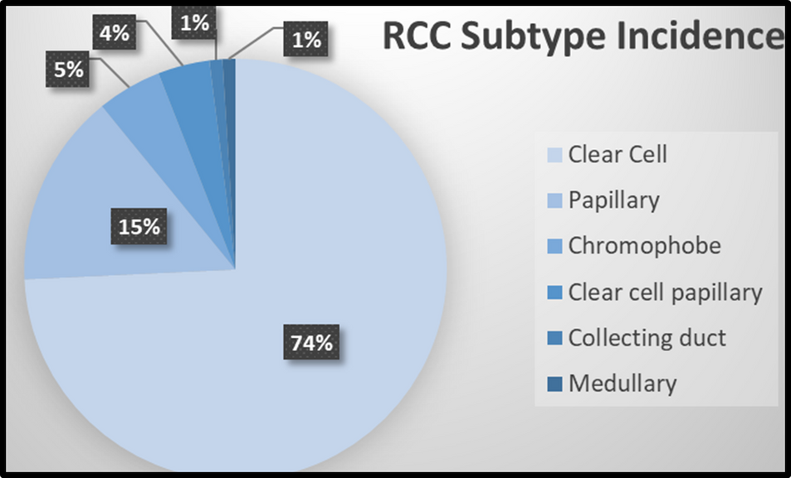
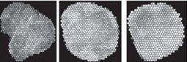
Introduction
Renal Cell Carcinoma
The most common renal tumor in adults.
2% of world cancer diagnosis'
4% of U.S. cancer cases for 2021.
~ 5.1 billion spent in the U.S. on treatment.
Subtypes of Renal Masses
Benign: 30% of diagnosis'
oncocytomas
fat-poor angiomyolipoma
Malignant: 70% of diagnosis'
Computer Aided Diagnosis
Uses CE-CT scans and differences in contrast enhancement for diagnosis
Texture analysis extracts several quantitative features from scans
Machine learning classifiers use features to distinguish between subtypes
Clear cell
Papillary
Clear cell papillary
Collecting duct
Chromophobe
Medullary
(a) AML (b) ccRCC (c) nccRCC

Slide 4
Motivations
Diagnosis is most commonly done through needle biopsy, which can be:
Painful
Unnecessary
Costly
Computer aided diagnostics are useful for physicians in that they eliminate the invasive risk biopsy poses
Staging and subtyping is significant to the patients treatment plan, and patient outcome.
Once the tumor has spread, survival
rates drop.

Slide 5
Materials
Cohort
Scans taken in Egypt
Imaging on multi-phase CT
scanner included:
pre-contrast
portal-venous
delayed-contrast phase.
Age 15-87 years
72 males and 68 Females
Subtypes
Of 140 Patients included
needle biopsy found:
70 Malignant tumors
40 ccRCC
30 nccRCC
70 Benign masses

Slide 6
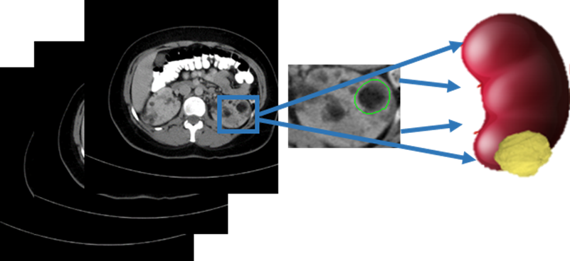
Methods
Renal cancer computer-assisted diagnosis (RC-CAD) system
Renal tumor preprocessing (segmentation):
The 2D scans were manually segmented containing only the ROI, and then stacked together to form a 3D model of the tumor

Slide 7
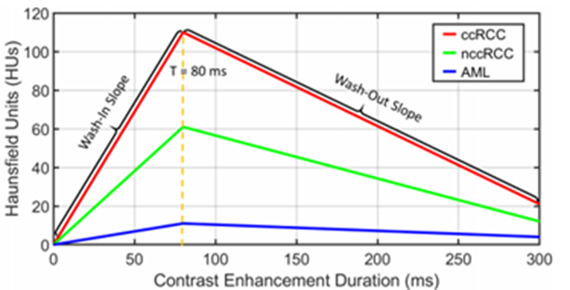
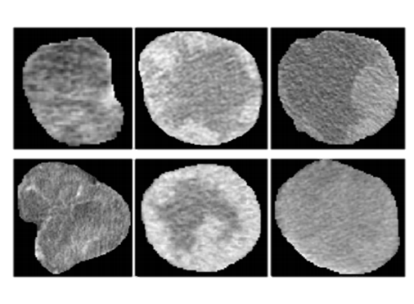
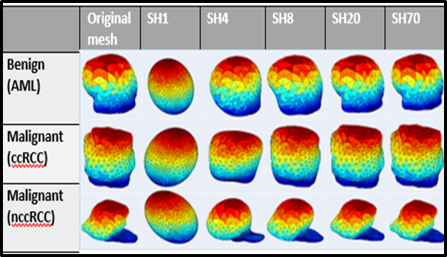
Methods
Renal cancer computer-assisted diagnosis (RC-CAD) system
Feature extraction:
The 3D models were used for the quantification of morphological, textural, and functional features.
Benign Malignant Malignant
AML ccRCC nccRCC

Slide 8
Methods
Renal cancer computer-assisted diagnosis (RC-CAD) system
Artificial neural network:
A multilayer perception ANN was used in the final two step classification system.

Slide 9
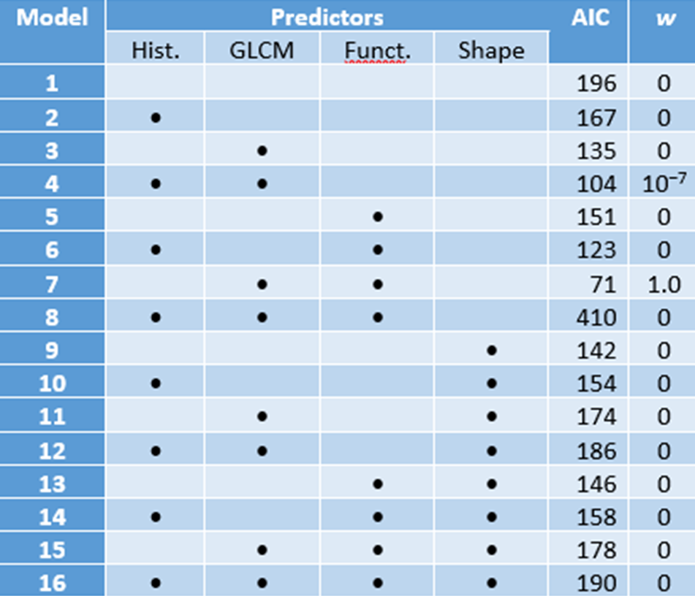
Results
First Stage Classification: Malignant vs. Benign
Akaike’s information criterion (AIC) was used to compare the efficacy of each feature category. Sixteen models were created for both classification steps.
Table 1. Candidate models for predicting RCC based on features derived from imaging data. Bullets indicate feature sets that are included in the model

Slide 10
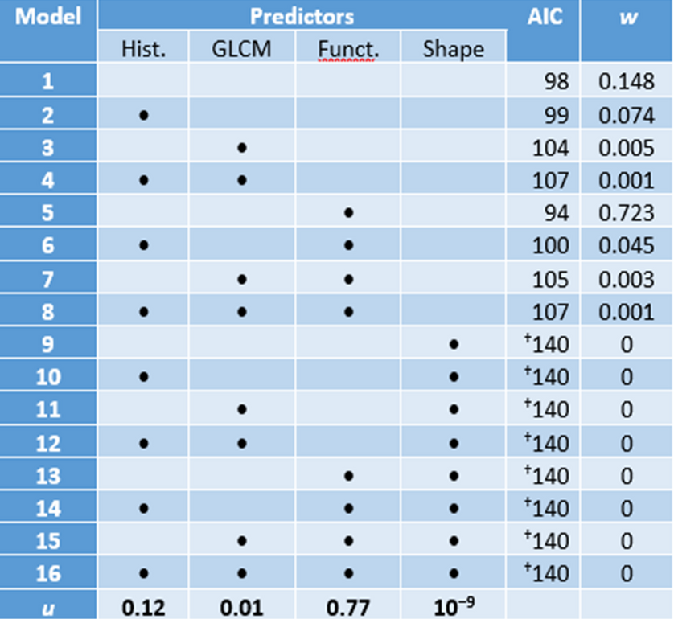
Results
Second Stage Classification: ccRCC vs nccRCC
Table 2. Candidate models for discriminating ccRCC from PRCC and ChRCC based on features derived from imaging data. Bullets indicate feature sets that are included in the model

Slide 11
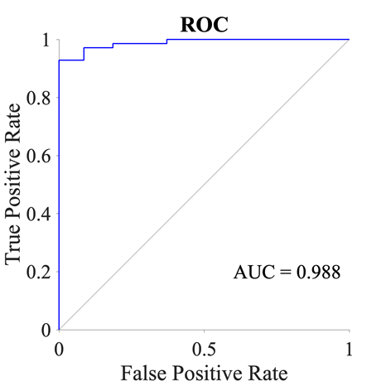
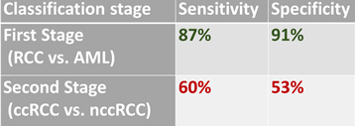
Results
Table 1. Comparison of sensitivity and specificity of the best predictive AIC models of first and second stage classification
Figure 1. ROC of the best predictive model for the first stage of classification, model 7, which includes GLCM and functional features.

Slide 12
Discussion
The first stage classification system performed efficiently in differentiating between malignant and benign masses. The best predictive AIC model, model 7, included GLCM and functional features with an AIC weight of 1.0.
Second stage classification was found to have a lower classification for differentiating between subtypes.
AIC weights showed functional features as the most useful feature in this model.
For future studies, we hope a larger cohort of patients will lead to an accurate differential diagnosis in the second step of classification.

Slide 13
References
Coy, H., Young, J. R., Douek, M. L., Brown, M. S., Sayre, J., & Raman, S. S. (2017). Quantitative computer-aided diagnostic algorithm for automated detection of peak lesion attenuation in differentiating clear cell from papillary and chromophobe renal cell carcinoma, oncocytoma, and fat-poor angiomyolipoma on multiphasic multidetector computed tomography. Abdominal Radiology, 42(7), 1919–1928. https://doi.org/10.1007/s00261-017-1095-6
Shehata, M., Alksas, A., Abouelkheir, R. T., Elmahdy, A., Shaffie, A., Soliman, A., Ghazal, M., Khalifeh, H. A., Razek, A. A., & El-Baz, A. (2021). A New Computer-Aided Diagnostic (Cad) System For Precise Identification Of Renal Tumors. 2021 IEEE 18th International Symposium on Biomedical Imaging (ISBI). Published. https://doi.org/10.1109/isbi48211.2021.9433865
UCLA. (2014). Types of Kidney Cancer - UCLA Urology, Los Angeles, California (CA). UCLA Urology. https://www.uclahealth.org/urology/types-of-kidney-cancer
Warren, A. Y., & Harrison, D. (2018). WHO/ISUP classification, grading and pathological staging of renal cell carcinoma: standards and controversies. World Journal of Urology, 36(12), 1913–1926. https://doi.org/10.1007/s00345-018-2447-8

