Slide 1
Is Dialectical Behavioral Therapy (DBT) an Effective Treatment for Suicidality?
By: Jarrod Mask & Hunter Bowling
Notes:
Introduce both of ourselves, what we are doing, and why we are interested in this.

Slide 2
Suicide Statistics
According to the Center of Disease Control and Prevention (CDC), in 2019 Suicide was the tenth leading cause of death overall in the United States
Globally, it is roughly 800,000 people who die by taking their own life.
Importance: DBT was originally developed for treatment of Borderline Personality Disorder

Slide 3
What is DBT?
DBT stands for Dialectical Behavioral Therapy
DBT defined as “Dialectical behavior therapy (DBT) is a modified type of cognitive behavioral therapy (CBT). Its main goals are to teach people how to live in the moment, develop healthy ways to cope with stress, regulate their emotions, and improve their relationships with others” (Schimelpfening, 2021).

Slide 4
What we wanted to know
Is Dialectical Behavioral Therapy (DBT) an Effective Treatment for Suicidality?

Slide 5
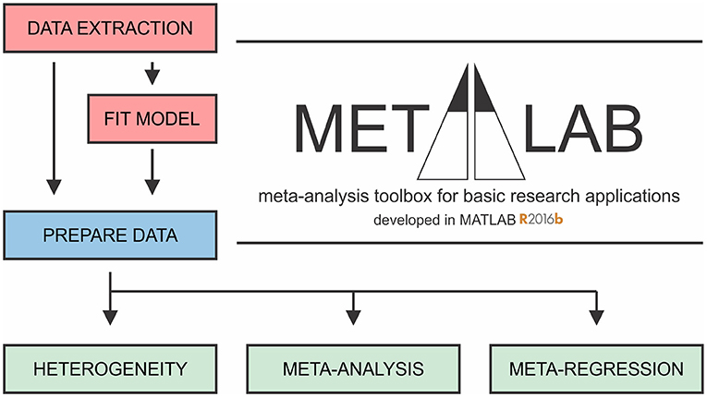
Method
First, it was important to research our topic to see if their were similar studies out there
Second, we reviewed the data and compiled it from all of the articles we chose. Then, we completed meta-analyses to get completed results that we were able to draw conclusions from

Slide 6
Method Continued
We included 13 studies that compared effectiveness in treatments (DBT, CBT, and CAMS)
Although our meta analysis did show the effectiveness between DBT compared to the other studies, this was not our primary interest.

Slide 7
A different approach to data collection?
Not much available data
Was the data we used the most appropriate for exploring our hypothesis?

Slide 8
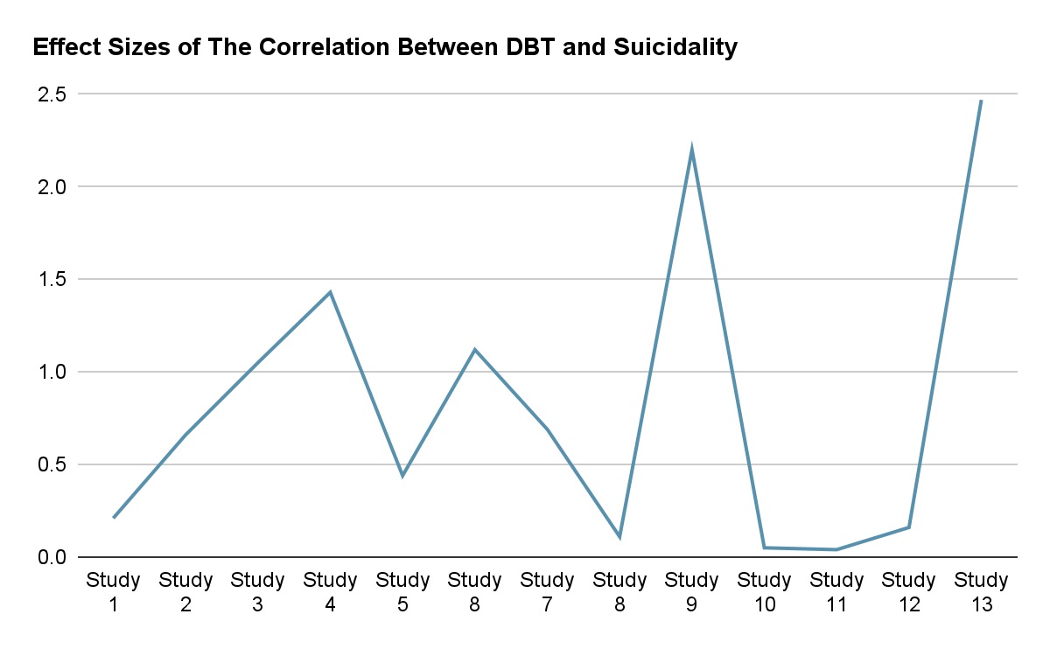
Results
Final Result:
Cohen’s d= 0.83
Strong Effect Size
Cohen’s d Effect Sizes:
Strong 0.80
Mod. 0.50
Weak 0.20

Slide 9
Implications
DBT is effective in treating suicidality!
The treatment of suicidality stands to be improved significantly.
Not any one person is the same- it is important to have as many treatment modalities as possible

