Slide 1
¹⁷O Natural Abundance Solid-State Nuclear Magnetic Resonance Spectroscopy Signal Enhancement
Valeria M. Bellido Campos
Dr. Jay H. Baltisberger
Berea College
Chemistry Department

Slide 2
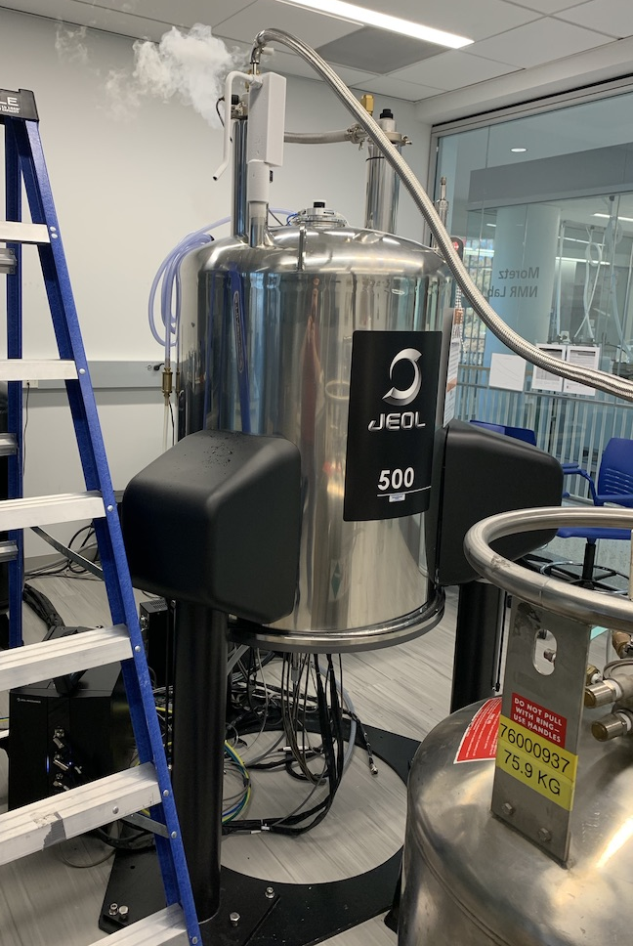
Background
Traditionally, Nuclear Magnetic Resonance (NMR) spectroscopy has been used to determine structure in both organic and inorganic compounds in both solution and solid-state.

Slide 3
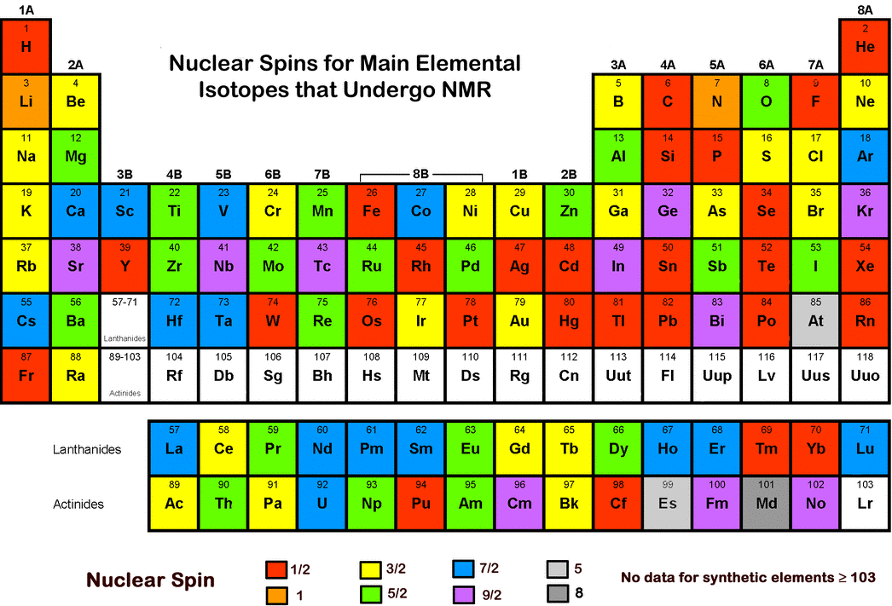
Background
Most research focuses on NMR active nuclei that are high abundance (¹H, ¹⁹F, ²³Na, ⁸⁷Rb, or ²⁷Al) or that can be introduced synthetically into compounds (mostly proteins, ¹³C or ¹⁵N)
A challenge exists when we attempt to collect NMR data from low abundance/sensitivity nuclei (such as ²⁹Si, ³³S, ¹⁷O, or ⁶⁷Zn)

Slide 4
Why is it hard to study ¹⁷O?
Oxygen is in EVERYTHING and it has two stable isotopes (¹⁶O and ¹⁷O)
¹⁷O is only about 0.037%, hence it is not often studied
The cost and difficulty of increasing this abundance to 100% is too high ($$$$) because it is hard to put in samples
O2

Slide 5
Why do we care about ¹⁷O?
We use NMR on H, C, and N already, why do we need O too?
It provides a different piece of information that is complementary
We do not need to do expensive ($$$$) modifications to the sample
Our method might also work for C and N in these sample samples without modification ($)
Finally, our methods allow us to use conventional NMR to boost sensitivity back into the realm of HOUR of acquisition time instead of YEARS

Slide 6
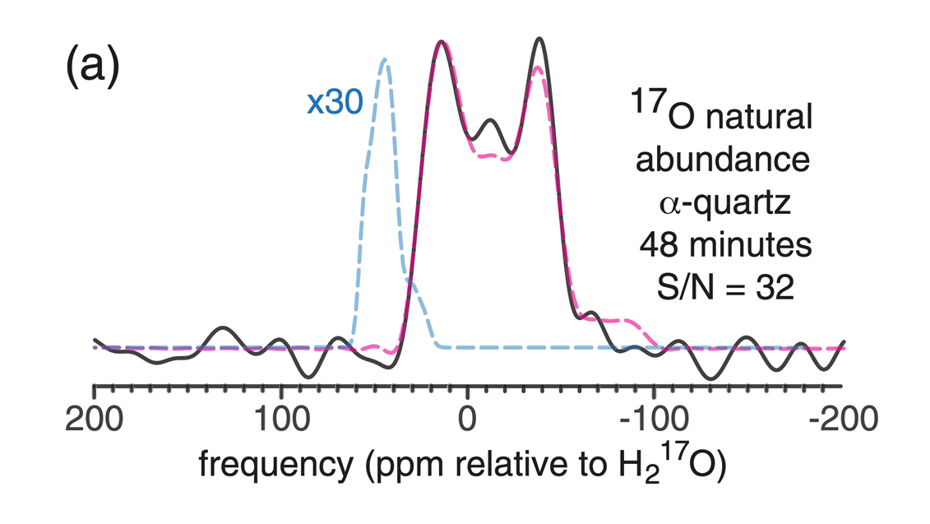
Introduction
Our group continued research that was started at The Ohio State University by Professor Baltisberger working with Professor Grandinetti
They used shaped refocusing pulses along with CPMG acquisition to acquire signal enhancement comparable to other much more expensive techniques (such as DNP)
High purity Quartz (SiO₂ MINERAL) with no special ¹⁷O added
S/N of 32 after 48 minutes
If we did this with conventional approach, would have needed 3000 days

Slide 7
Introduction
We developed the pulse sequences needed (see poster by Kambarami for more details) to achieve these sensitivity gains and attempted to implement them on a variety of samples.
Our goal is to be able to have ¹⁷O natural abundance MQMAS data like the ²⁷Al MQMAS data we acquired on Kyanite.

Slide 8
Signal to Noise (S/N)
What is LOW signal to noise?
For something like HYDROGEN, there are two populations the atom can exist
The relative population might be 1,000,000,001 in one state and 999,999,999 in the other.
This means the population DIFFERENCE is 2 out of 2 BILLION
For OXYGEN atoms it is like ”Where is Waldo” since the ones we can study are only 0.037 % of the total population
This means the population difference is Waldo vs everyone else

Slide 9
Low S/N example: Coesite (SiO₂ mineral)
Professor Baltisberger studied Coesite in 1994
Data took 40 days of 40% labeled 17O ($$$$$)
Similar data would take (40/0.037)² x 40 days = 128,000 years
Our technique reduces it to a week or two on a natural abundance sample ($)

Slide 10
How to improve s/n
Isotopically Label the sample ($$$)
High number of scans
time consuming
one option, reduce T₁
High Polarization
optical pumping – special case
DNP – expensive
RAPT – factor of 2 or 3
Large number of echoes
CPMG – factor of 50 with 7000 echoes

Slide 11
Rotor Assisted Polarization Transfer
Apply a series of satellite selective saturation pulses before acquisition
Increase population difference
Collect echoes (like when you yell from one mountain and hear your voice come back) with a CPMG experiment

Slide 12
RAPT Benefits
How much benefit do we get from RAPT?
Factor of 3 in S/N
How much benefit do we get from one echo?
Factor of 1.3 in S/N
How many echoes do we need?
We collect about 15,000 to 150,000 echoes
When we collect data with this many echoes and RAPT, we gain about 300 S/N
This means that the 100 S/N Hydrogen experiment in 2 minutes takes about 160 minutes for Oxygen
Notes:
160 minutes is reasonable for an O17 expt

Slide 13
RAPT example: Rb₂SO₃ MAS S/N
No RAPT, S/N = 38:1
RAPT, S/N = 68:1
Theoretical Maximum is 2x S/N increase for I = 3/2 (⁸⁷Rb)
For I = 5/2 (¹⁷O) we can get 3x

Slide 14
Echo Train Acquisition
A series of Gaussian shaped refocusing 180˚ pulses are used to collect signal from the same initial magnetization
A lot like bouncing your voice off a distant mountain tens or even thousands of times
The less decay/loss of signal per echo, the greater the enhancement

Slide 15
Molecules we studied:
Kyanite (Al₂SiO₅)
Rb₂SO₃, Rb₂S₂O₈, Rb₂NO₃SO₃
Al(NO₃)₃, AlK(SO₄)₂•12H₂O, Al₂(SO₄)₃
Clinoenstatite (MgSiO₃)
These molecules are useful as they help us figure out the experimental parameters that will work for Oxygen

Slide 16
²⁹Si CPMG MAS on Clinoenstatite (Mg₂Si₂O₆)
The data on the left is a single spin echo from one experiment
The data on the right is the sum of 512 echoes added properly
Clearly the two sites are plainly visible (and at the correct position compared to literature) in the CPMG data

Slide 17
¹⁷O CPMG MAS on Quartz (SiO₂)
The data on the left is a single spin echo from one experiment
The data on the right is the sum of 1000s of echoes added properly
There was a problem with the hardware preventing us from acquiring the 50,000 needed to get really good S/N

Slide 18
Conclusion and Future Work
Pulse sequences are mostly working
Some of the data suggests we have achieved partial optimization of various parameters
If you don’t have signal, it is very hard to optimize
Move to ⁶⁷Zn in ZnSO₄ for future work since this is more favorable abundance than ³³S and ¹⁷O
Work with JEOL to determine why large number of echoes fails
Move back to ¹⁷O once we have some issues above fixed
Begin to catalog possible samples of biological and geological interest since ¹⁷O has so few datasets in the literature

Slide 19
Acknowledgements
Previous Research
Foundational research by Waugh, Hahn, & others in NMR Spectroscopy
Dr. Phil Grandinetti lab at The Ohio State University
Dr. Jay Baltisberger doing sabbatical work at OSU
Funding sources
NSF at OSU
URCPP at Berea College

Slide 20
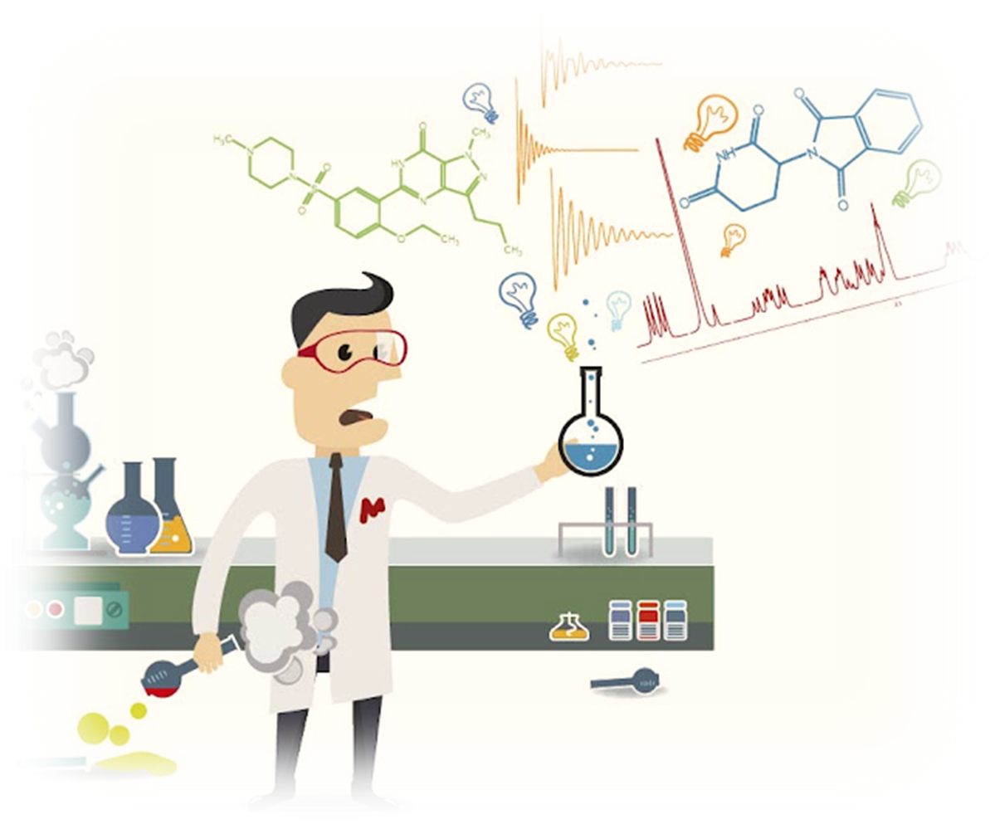
Thank you Do you have any questions?

