Slide 1
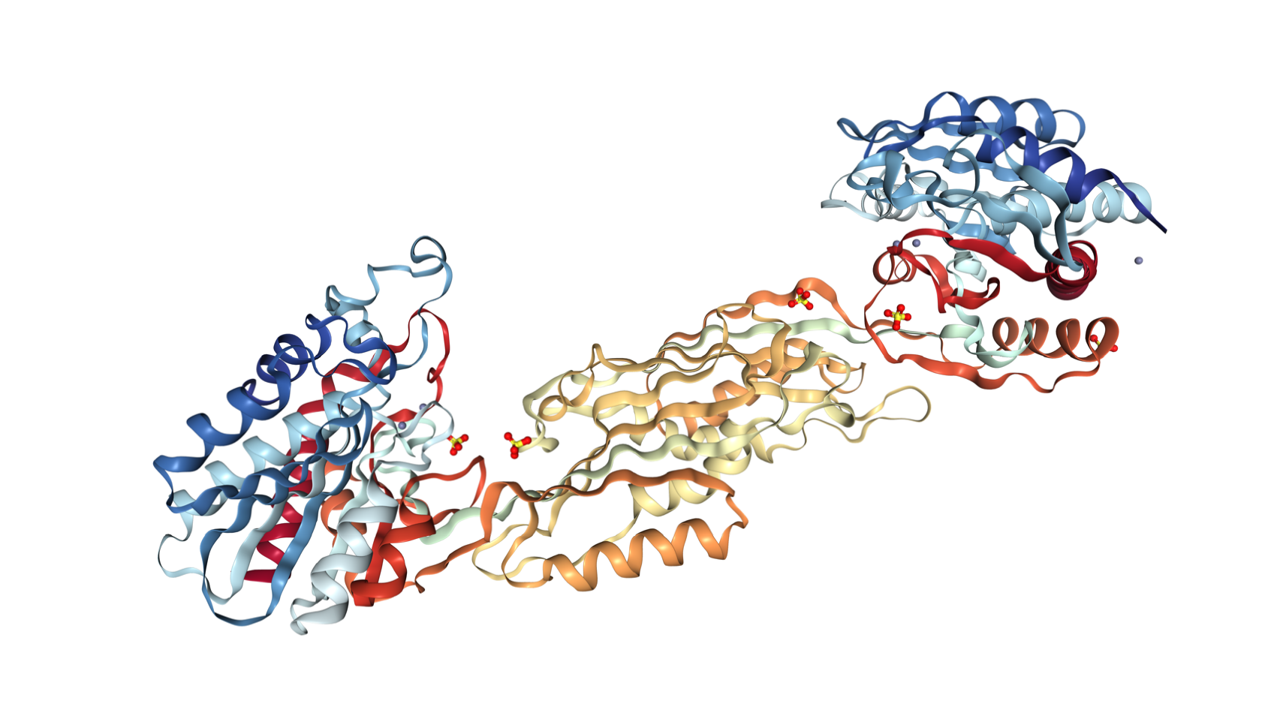
Inhibition of DapE-Encoded N-Succinyl-L,L-Diaminopimelic Acid Desuccinylase (DapE) through Acyclic Sulfonamide Derivatives
By: Channing Baker

Slide 2
Introduction: Bacterial Infection and Antibiotic Resistance
Antibiotic resistance leads to research on novel antibacterial compounds.
“Currently, at least 700,000 people die each year due to drug-resistant diseases, including 230,000 people who die from multidrug-resistant tuberculosis” (WHO).
More than 70% of pathogenic bacteria are resistant (FDA).
Methicillin-resistant Staphylococcus aureus (MRSA) is resistant to methicillin and related antibiotics, such as penicillin, vancomycin, and oxacillin (CDC).

Slide 3
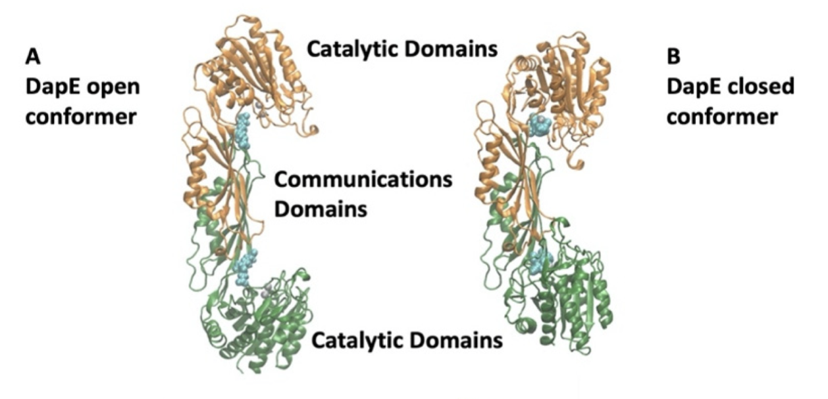
Big Question
How do we overcome the widespread problem of antibiotic resistance?
We are looking for agents that use different cellular mechanisms.
Biochemistry, 60(12), 908–917. 2021.

Slide 4
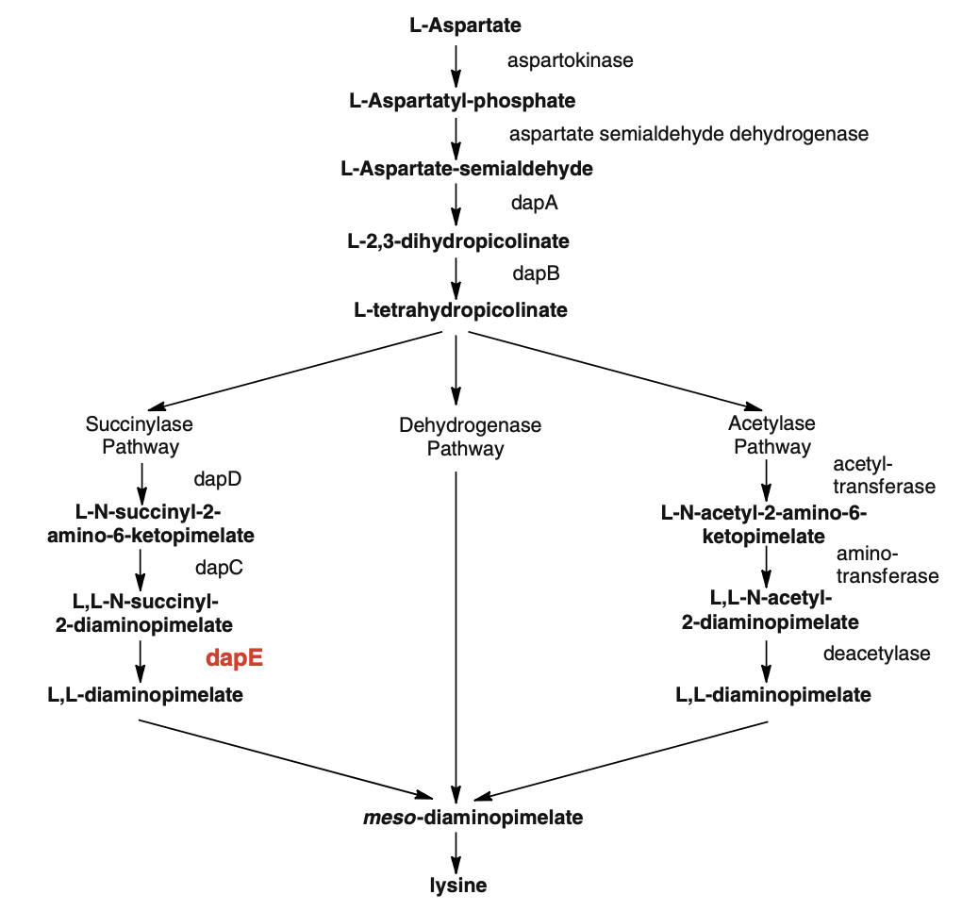
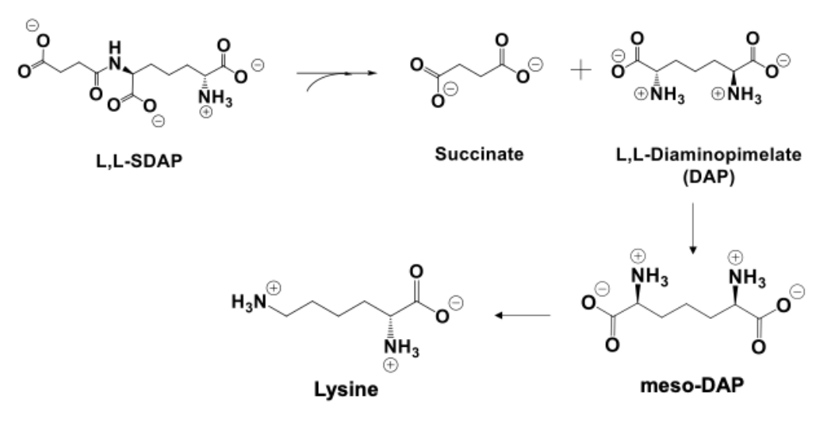
Background
DapE is a crucial enzyme in the production of lysine and meso-diaminopimelate (m-Dap).
Considering that there is no similar DapE pathway in mammals, the target of the DapE will only be destructive to bacterial function.
Antibiotics, 9(595), 595. 2020.

Slide 5
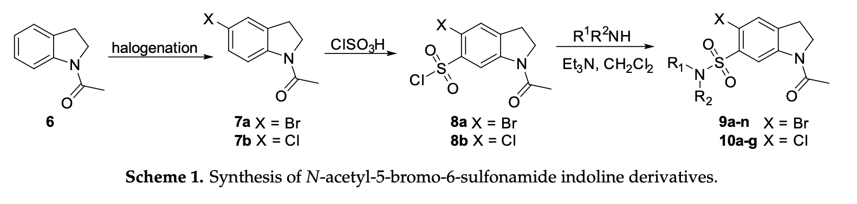
Previous Research
Antibiotics, 9(595), 595. 2020.

Slide 6
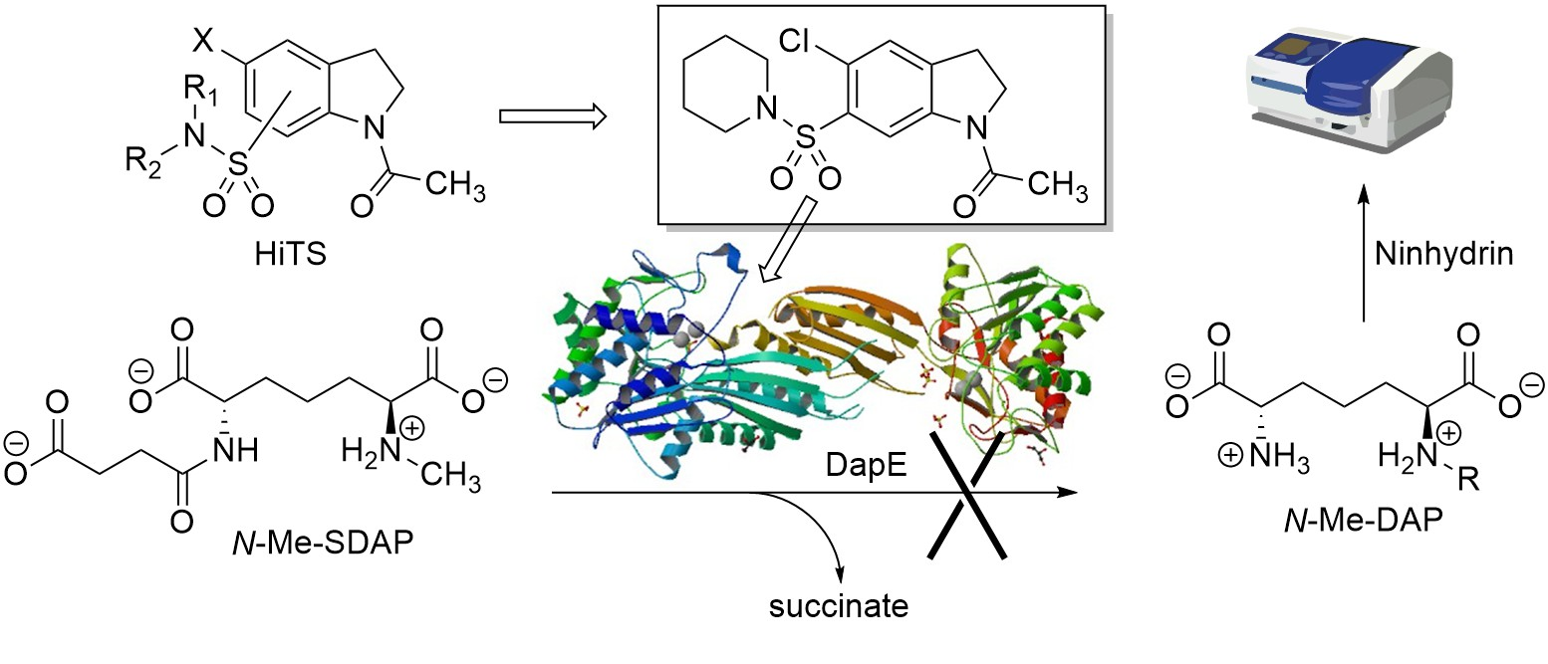
Schematic of Inhibition
Antibiotics, 9(595), 595. 2020.

Slide 7
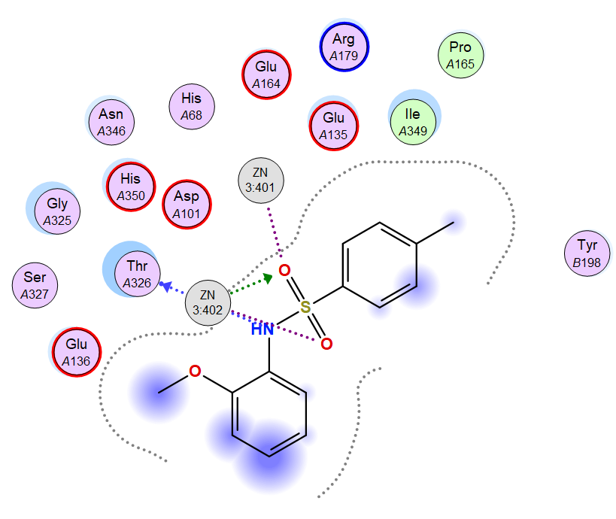
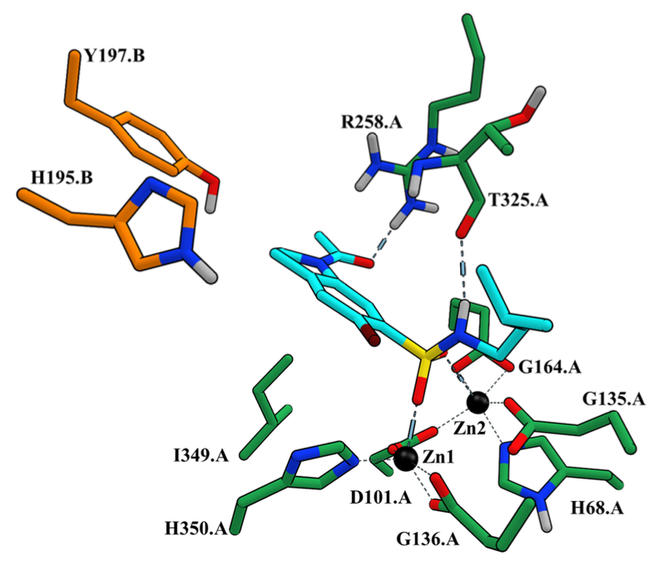
Molecular Docking Showing DapE Interactions
Antibiotics, 9(595), 595. 2020.

Slide 8
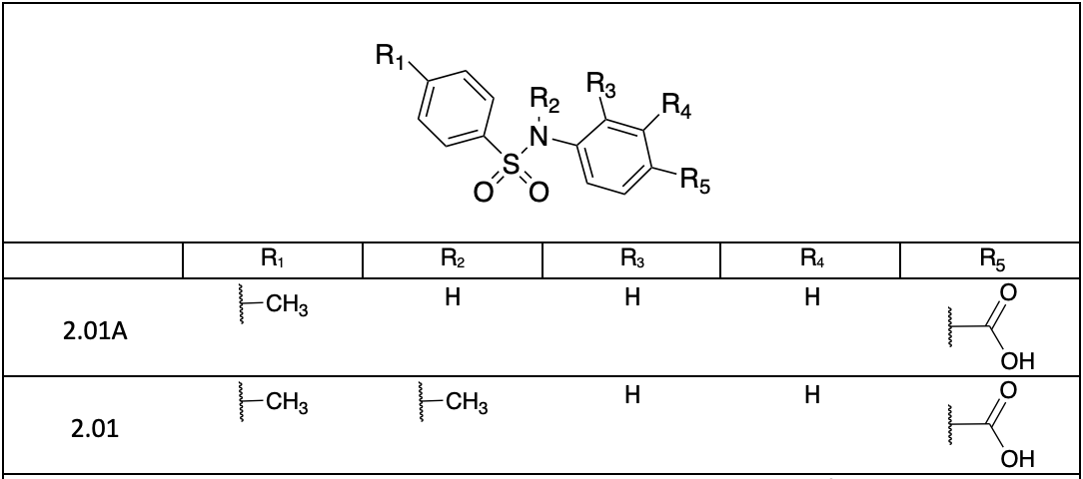
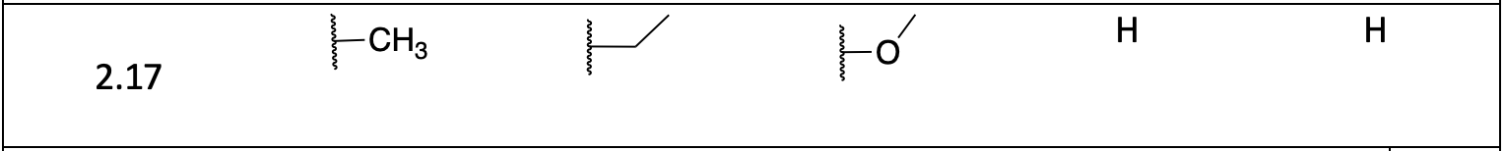
Synthesis Scheme

Slide 9
4-((4-methylphenyl) sulfonamido) benzoic acid

Slide 10
4-{[(4-methylphenyl) sulfonyl] amino} benzoic acid

Slide 11
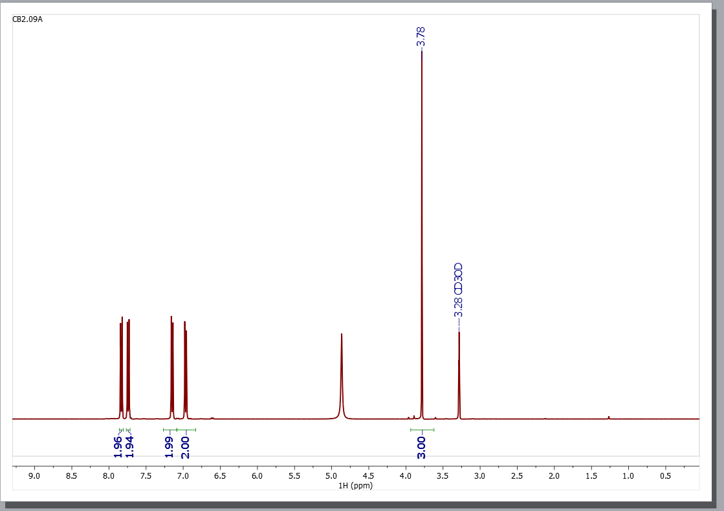
4-[[(4-methoxyphenyl) sulfonyl] amino] benzoic acid

Slide 12
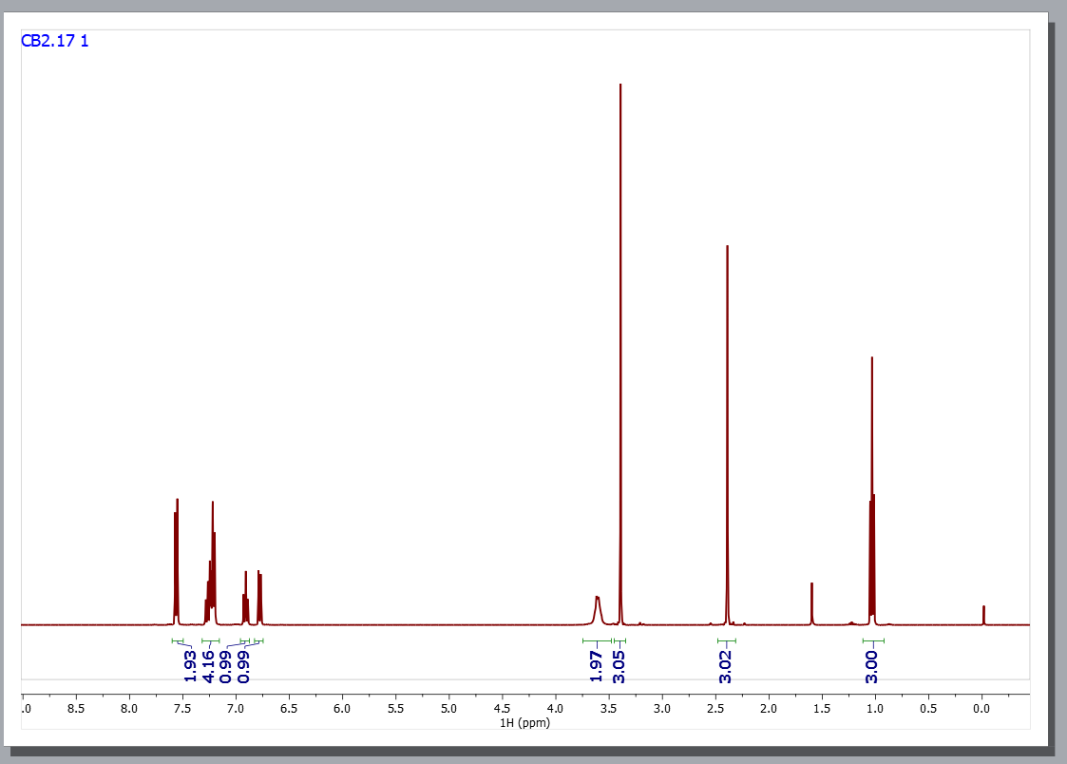
N-ethyl-N-(2-methoxyphenyl)-4-methylbenzenesulfonamide

Slide 13
Conclusion
Small acyclic sulfonamide derivatives were produced.
The characterization of these molecules, through purification processes, exhibit purity for future IC₅₀ assays.
The production of these derivatives provides a promising path for the inhibition of antibacterial resistant pathways.

Slide 14
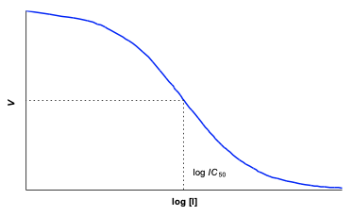
Future Work
Decrease enzymatic function by 50%.
Indicates competition between the synthesized molecule and the natural substrate.
Clinical trials.

Slide 15


Acknowledgements
Dr. Innocent Demshemino
Dr. Daniel Becker
Oliwia Ozog

