Slide 1
Analysis of Proline 137 within Subunit a of E.Coli ATP Synthase​
Student Researcher: Yessica Lopez Valdez
Principal investigator: Rashmi Shrestha
Department of Chemistry, Berea College, Berea, KY 40404​

Slide 2
Tackling a Global Heath Challenge
Antimicrobial resistance (AMR)
When bacteria, fungi, virus and parasite changes over time and no longer respond to medicines
2 million illnesses in the USA
Bacteria is always adapting
If no action is taken AMR is predicted to be the #1 cause of death by 2050
Figure 1. World Health Organization: Causes of antibiotic resistance.

Slide 3
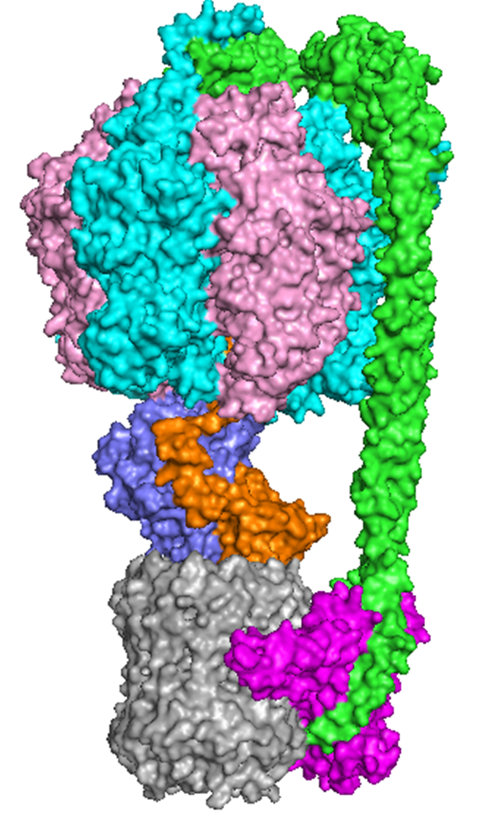
ATP Synthase
δ
Made up of two nanomotors: F₁ and F₀
3 subunits in F₀ : a, b, and c
5 subunits in F₁: α, β, γ, δ, ε
ATP Synthase is a key molecule in ATP synthesis and hydrolysis.
α
β
F₁ motor (αβγδε)
b
γ
ε
cytoplasm
membrane
a
F₀ motor (ab₂c₁₀)
c
periplasm
Figure 2. ATP Synthase molecule generated by Pymol.

Slide 4
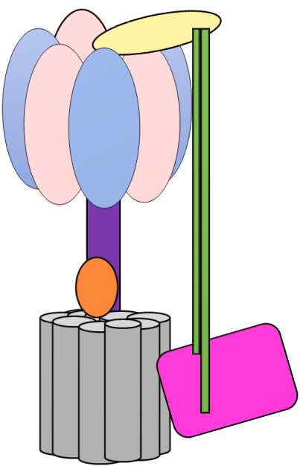
How does ATP Synthase Work?
δ
α
F₁ motor (αβγδε)
β
α
β
b
γ
cytoplasm
ε
F₀ motor (ab₂c₁₀)
membrane
c
c
c
a
c
c
periplasm
Figure 3. ATP Synthase molecule simplified.
Figure 4. Visualization of protons entering ATP Synthase and conversion of energy.

Slide 5
ATP Synthase: An Attractive Molecular Target
*
ATP synthase from Escherichia coli
Focus: periplasmic loop of subunit a called the Transmembrane 2-3 loop (TM 2-3 Loop)
Sequence and composition of the loop region is different across species
Question: How short can this loop be in E. coli so that ATP synthase activity is not affected?
Present: antibiotics that target different locations* in ATP synthase molecules of different bacterial organisms
Goal: To study the effects of a mutation within the loop on ATP synthase activity.
δ
*
α
*
β
b
γ
*
ε
*
*
c
a
Figure 5. Locations of present targets of antibiotics.
Figure 6. TM 2-3 Loop sequences in various organisms.

Slide 6
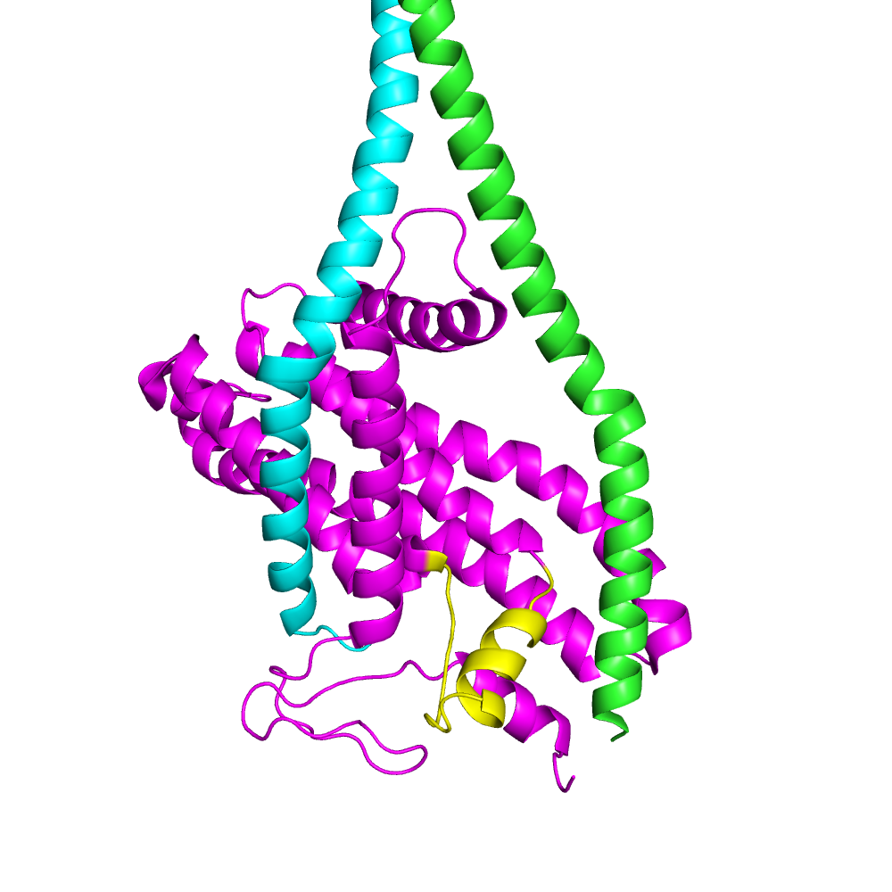
TM- 2,3 Loop Mutation
TM 2-3 Loop is near subunit b.
Past research on loop focused on doing structural studies vs. our focus was on functional studies to determine the function of the loop.
Entire deletion of the loop told us the loop is important for ATP synthase activity through various assays.
b₁
b₂
a
TM 2-3 Loop: YELLOW
Figure 7. ATP synthase zoomed in to show TM 2-3 Loop location.

Slide 7
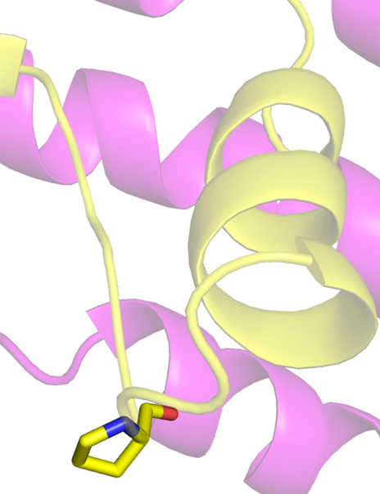
P137C Mutation
Question: How short can we make the loop and still have a fully functional ATP Synthase molecule?
Picking a location
P137C mutation Proline (nonpolar- hydrophobic) Cysteine (polar- hydrophilic)
P137
Figure 8. Primary structure of P137 within TM 2-3 Loop.

Slide 8
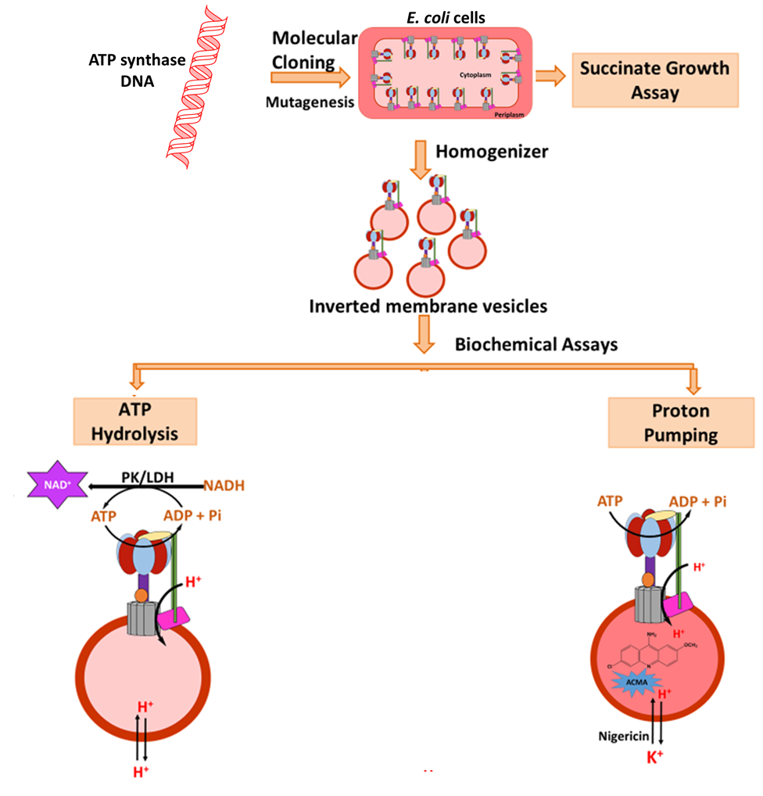
Experimental Process
Samples analyzed 1.) Wild type 2.) Negative control 3.) P137C 4.) TM 2-3 Loop deletion
Analyzing function in ATP synthesis direction
Growth of E. coli in succinate medium
Analyzing function in ATP hydrolysis direction
PK/LDH assay (ATP regenerating assay)
Proton pumping assay
Figure 9. Summary and flow chart of the experimental process done.

Slide 9
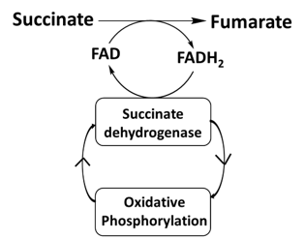
Succinate Growth Assay
Grow E. coli cultures with mutants
Plate samples on succinate plate
Results
ATP synthase produces ATP= growth of colonies “positive”
ATP Synthase defective= no growth “negative”
Mechanism
Results
Cell Type​​​ | Growth​​​ | Colony Size ​​​
Wild Type​​​ | Positive​​​ | 2 mm​​​
Negative Control​​​ | Negative​​​ | N/A​​​
P137C​​​ | Positive​​​ | 2 mm​​​
TM 2,3 Loop Del | Positive | 1.5 mm
Figure10. Mechanism of conversion from succinate to fumarate for colony growth.
Table 1. Results of the succinate growth assay.

Slide 10
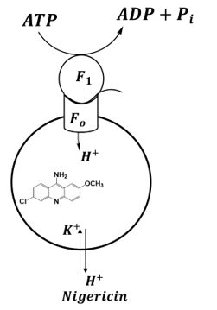
Proton Pumping
Addition of 9-Amino-6-Chloro-2-Methoxyacridine (ACMA), at 20 sec. ATP, and at 100 sec. Nigericin
Results
Fluorescence quenching occurs when ATP synthase is functional
P137C and WT versus TM 2-3 Loop Deletion and Neg. Ctrl.
ACMA
ATP
Nigericin
Figure11. Mechanism of the proton pumping experiment.
Figure 12. Results of the proton pumping assay using a fluorometer.

Slide 11
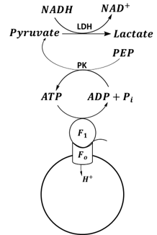
ATP Hydrolysis Assay
ATP is added to get hydrolyzed by ATP synthase> Pyruvate Kinase catalyzes reaction of Phosphoenolpyruvate to pyruvate using ADP +Pi.
Next, Lactic Dehydrogenase catalyzes conversion of Pyruvate to lactate reducing NADH to NAD+.
NADH reduced= ATP hydrolysis occurred
Data was inconsistent
Figure 13. Mechanism of ATP regenerating assay.
Figure 14. Results of the ATP regenerating assay using a UV spectrometer looking at the rate of ATP hydrolysis.

Slide 12
Conclusions and Future Directions
Main takeaway
TM 2,3 Loop in general is important for ATP synthase to be fully functional, as deleting it completely showed no activity in the proton pumping assay and showed smaller colony size compared to WT.
P137C mutation showed similar activity as WT; however, further analysis and optimization of the technique is required
Directions:
Actively working to optimize the ATP regenerating assay with PK/LDH enzymes
Researching new assays to analyze mutants in the ATP Synthesis direction
Future goals:
To identify residues within the loop that is specifically important for interactions with subunit b of ATP synthase and design a drug that would interrupt the interactions
As biochemists, we need to find that sweet spot to prove there is a new way to kill off existing and new antibiotic resistant bacteria.

Slide 13
Acknowledgements
Undergraduate Research and Creative Projects Program, Berea College
Department of Chemistry and Geology at Berea College
Dr. David Rodgers, University of Kentucky
Lauren Braswell, Kingsley Basoah, and Marlene Michel (Summer 2021 Research group)
Advisor: Dr. Rashmi Shrestha

Slide 14
References
Angevine C.M., Herold K.A.G., Vincent O.D. & Fillingame R.H. Aqueous Access Pathways in ATP Synthase Subunit a Reactivity of Cysteine Substituted into Transmembrane Helices 1, 3 and 5. J. Biol. Chem. 282, 9001-9007 (2006). ​
Antimicrobial resistance (AMR) and its impact on cancer care https://www.uicc.org/what-we-do/thematic-areas-work/antimicrobial-resistance-and-its-impact-cancer-care (accessed Oct 6, 2021).
Ishmukhametov, R. R., DeLeon-Rangel, J., Zhu, S. & Vik, S. B. Analysis of an N-terminal deletion in subunit a of the Escherichia coli ATP synthase. J Bioenerg Biomembr 49, 171-181 (2017).​
Guo, H., Suzuki, T. & Rubinstein, J. L. Structure of a bacterial ATP synthase. Elife 8 (2019).​
Sobti, M., Walshe, J.L., Wu, D. et al. Cryo-EM structures provide insight into how E. coli F1Fo ATP synthase accommodates symmetry mismatch. Nat Commun 11, 2615 (2020). ​
Steed, P. R., Kraft, K. A. & Fillingame, R. H. Interacting cytoplasmic loops of subunits a and c of Escherichia coli F1F0 ATP synthase gate H+ transport to the cytoplasm. Proc Natl Acad Sci U S A 111, 16730-16735 (2014).​

