Slide 1
Human Perceptions on Nature, Wildlife, and Conservation in Rural Appalachia
Lindsey R. Milleson and Stephen Sumithran
Department of Biological Sciences
Eastern Kentucky University, Richmond, KY 40475

Slide 2
Introduction
Human dimensions are a critical part of wildlife management
Understanding the public’s attitudes towards the environment helps create and fund management plans, increases knowledge, and encourages successful coexistence between humans and wildlife
To the best of our knowledge, no human perceptions studies on the environment have been conducted in eastern Kentucky.

Slide 3
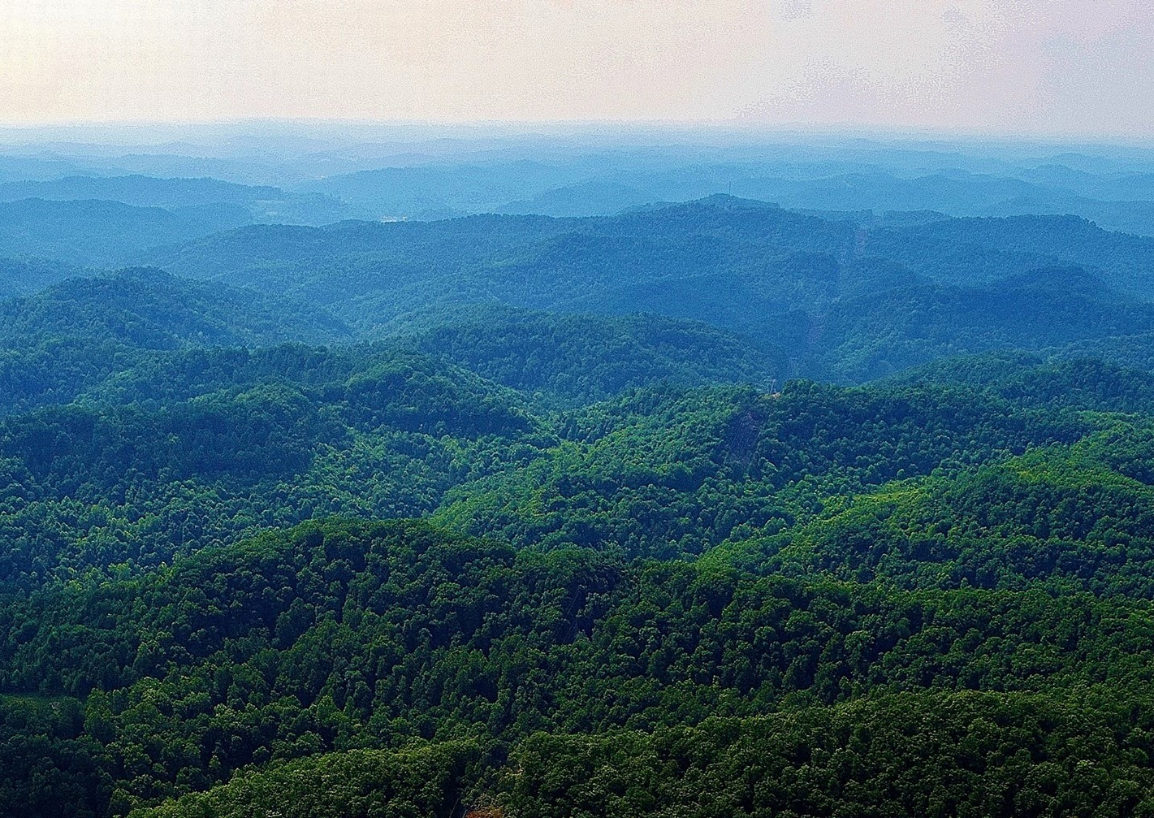
Study Area
Conducted in far eastern Kentucky
Primary focus was Martin County
Martin County’s population was 11,195 in 2019 with 34.4% in poverty

Slide 4
Methods
Questionnaire – Paper and Online format
Distributed at grocery stores, gas stations, and other businesses
EKU Institutional Review Board Protocol Approval #4022

Slide 5
Methods – Contd.
For data analysis, we focused on question 5 which contains 12 perception statements such as “it is important to conserve nature for our children and generations to come”
Participants responded on a 5-point Likert scale
We calculated the mean, standard error, chi-square, and p-value for each statement

Slide 6
Results
119 Respondents
73% of Respondents from Martin County
7% of Respondents from Floyd County
6% of Respondents from Lawrence County

Slide 7
Results – Contd.
36% of Respondents were between 20-29 years old
22% of Respondents were between 50-59 years old
14% of Respondents were between 40-49 years old

Slide 8
Statement 1. It is important to conserve nature for our children and generations to come
χ² = 103.49
p < 0.00001

Slide 9
Statement 2: Natural resources like coal must be developed even if the loss of wilderness results in much smaller wildlife populations
χ2 = 20.48
p = 0.0004

Slide 10
Statement 3: Wildlife populations should not be managed by humans
χ² = 20.96
p = 0.00032

Slide 11
Statement 4: Trophy hunting is inhumane
χ² = 8.47
p = 0.07

Slide 12
Statement 5: Wildlife do not have the ability to feel emotions (i.e. fear, sadness, happiness)
χ² = 45.03
p < 0.00001

Slide 13
Statement 6: Humans have the right to use animals as we see fit
χ² = 22.94
p = 0.00013

Slide 14
Statement 7: Ecotourism activities such as educational nature hikes would be beneficial to my community
χ² = 59.36
p < 0.00001

Slide 15
Statement 8: Forests in my area are in good condition
χ² = 30.62
p < 0.00001

Slide 16
Statement 9: Ecotourism is key to developing the local economy
χ² = 45.99
p < 0.00001

Slide 17
Statement 10: Coal mining is key to developing the local economy
χ² = 15.40
p = 0.0039

Slide 18
Statement 11: Protection of wildlife is a good thing
χ² = 74.49
p < 0.00001

Slide 19
Statement 12: I benefit from wildlife
χ² = 64.22
p < 0.00001

Slide 20
Discussion
Overall, the respondents showed a strong desire to conserve and protect the local environment
The respondents had strong support for ecotourism
One limitation of this study is that attitudes and behaviors do not always align (Nilsson et al. 2019).
One of the main problems in conservation is altering human behavior such as poaching and overexploitation

Slide 21
Conclusion
These results can be beneficial in Appalachia for implementing ecotourism, involving the public in management decisions, and knowing what conservation ideas will gain public support.

