Slide 1
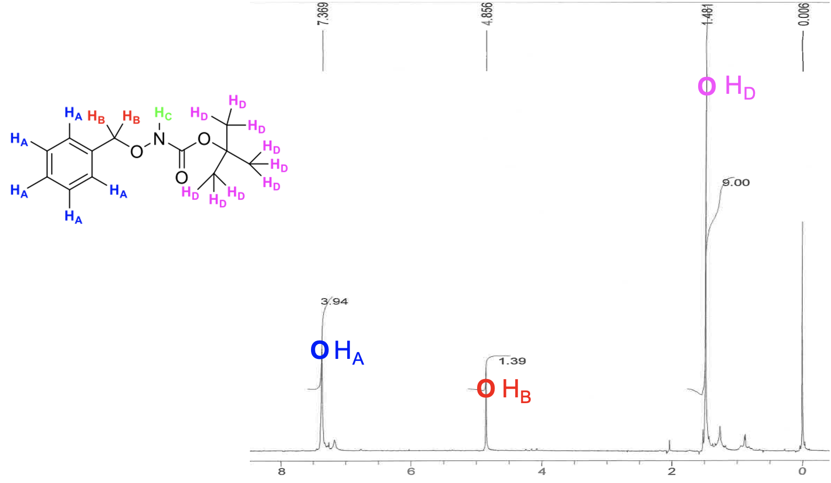
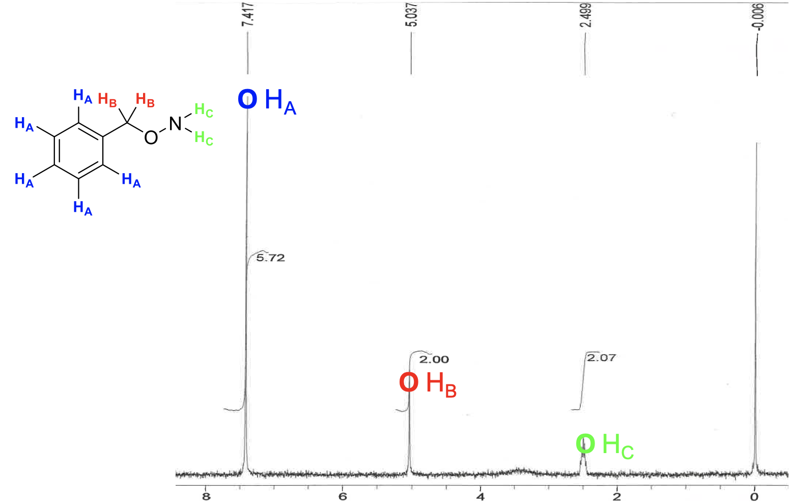
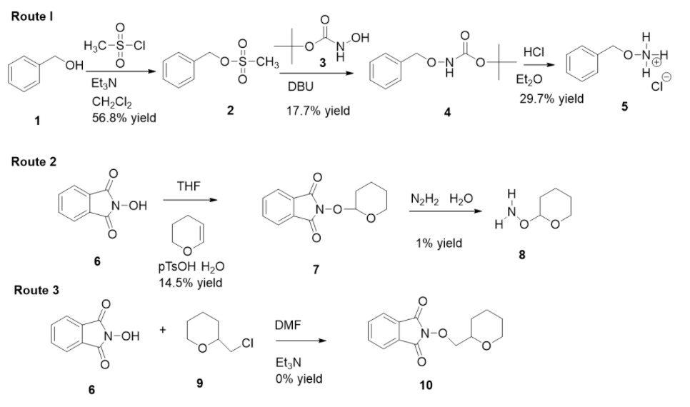
Development of Anti-Cancer Small Molecules to Inhibit The Base Excision Repair (BER) Pathway By Binding Apyrimidinic/Apurinic (AP) Sites In DNA
Ellen S. Ledford, Robert M. Tackett and Dr. Elizabeth M. Thomas,
Department of Biology and Chemistry, Morehead State Univeristy, Morehead, KY 40351
Introduction
Method
Results
Two of the main treatments available to patients with cancer are radiation and chemotherapy which both rely on the ability to induce DNA damage [1]. One reason cancer deaths perpetrate is due to cancer resistance towards current cancer therapies [1]. The Base Excision Repair (BER) pathway is involved in therapeutic resistance by utilizing DNA glycosylases that recognize and remove the damaged DNA base to leave the aldehyde in Figure 1 [2]. Apyrimidinic/Apurinic (AP) enzyme 1, APE1, then recognizes the aldehyde to trigger DNA repair. Alkoxyamines function to competitively covalently bind the aldehyde generated from the AP site. Once the aldehyde is covalently bonded with the alkoxyamine, APE1 can no longer perform BER [3]. Therefore, providing patients with alkoxyamine drug compounds, such as methoxyamine, CH₃ONH₂, current cancer therapies better survive cancer resistance [3]. This is known as a combinatorial cancer therapy strategy. Currently, methoxyamine, TRC102, is being investigated in Phase I/II clinical trials for binding AP sites in DNA to inhibit the BER pathway [4]. The focus of this research is to synthesize alkoxyamines and evaluate them as APE1 inhibitors (Figure 2). In particular, this work presented is focused on finding a synthetic route to generate alkoxyamines to potentiate current cancer therapies (Scheme 1).
4
5
Figure 2
A structure activity relationship (SAR) shows several target alkoxyamines to synthesize. These target structures include alkyl halides, acetal, alkyne, and benzyl functional groups.
Figure 3
4) ¹H NMR (90MHz, CDCl₃): 𝛿 7.370 (m, 5H), 4.854 (s, 2H), 1.480 (s,9H)
5) ¹H NMR (90MHz, CDCl₃): 𝛿 7.417 (m, 5H), 5.037 (s, 2H), 2.499 (m, 2H)
Discussion
The objective of this project was to find a synthetic route to alkoxyamines that could be performed within our laboratory. Route 1 proved to be the most successful synthetic route, affording compound 5 in 29.7% yield. Our plans are to optimize this yield and apply this route towards the synthesis of other compounds, such that are found in Figure 2.
Acknowledgements
We would like to thank Dr. Elizabeth Thomas for her passion and determination to help us with this creative research project. We would also like to thank Morehead State University for funding and support of our intellectual curiosity.
Scheme 1
Scheme 1 shows Route 1, the synthesis of alkoxy amine (5) from benzyl alcohol (1) by converting the alcohol to a benzyloxymesylate (2) before coupling to the hydroxamic acid (3) to produce tert-butyl-N-(phenylmethyloxy) carbamate (4) which was purified by column chromatography (4:1 Hex:EtOAc) before adding hydrochloric acid to synthesize O-(2-benzyl)hydroxylamine hydrochloride (5) in 29.7% yield. Route 2 shows the synthesis of tetrahydropyran-2-ylhydroxylamine (8) from N-hydroxyphthalamide (6) by making a tetrahydropyran (7) followed by hydrazinolysis produce alkoxyamine (8) in 1% yield. Route 3 shows the synthesis of methyltetrahydropyranyl phthalimide (10) from N-hydroxyphthalamide (6) coupled to 2-chloromethyl- tetrahydropyran (9).
Literature Cited
1. Damia G, D’Incalci M; Kluwer Academic Publishers.1998, 62, 165-173
2. Gordon M, Rosen L, Mendelson D; et al. Invest New Drugs.2013, 31(3): 714-723
3. Kim, Y, Wilson D, Curr Mol Pharmacol.2012, 5(1): 3-13
4. Longley D, Johnston P; J Pathol.2005,205: 275- 292
5. Mansoori B, Mohammadi A, Davudian S, Shirjang S, Baradaran B; Advanced Pharmaceutical Bulletin.2017, 7(3), 339-348
6. Wilson D, Simeonov A; Cell Mol Life Sci.2010, 67 (21), 3621-3631
Figure 1
Figure 1 illustrates the BER pathway where a DNA glycosylase removes the damaged DNA base to generate an AP site. Upon binding methoxyamine to the AP site blocks APE1 from repairing the DNA.

