Slide 1
Molecular Mechanisms of Histone H2B Variants in Arsenic-Mediated Carcinogenesis
Harrison Booher, Wesley Saintilnord, & Yvonne Fondufe-Mittendorf

Slide 2
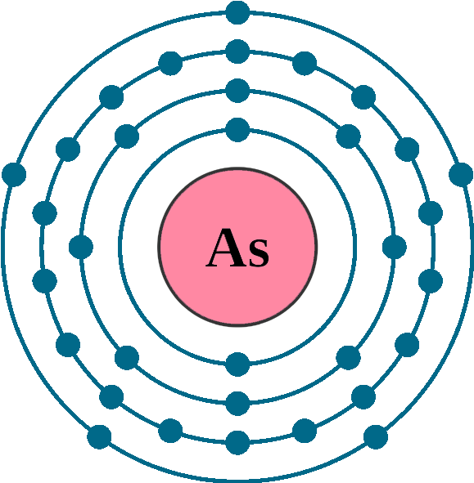
Environmental Arsenic Exposure is a Threat to our Health
Environmental Arsenic Exposure has been linked to:
Cardiovascular Disease
Diabetes
Cancers (Bladder, Prostate, Colorectal, Skin, Lung)
Notes:
Arsenic is one of the most common environmental pollutants, with human exposure occurring mainly through contaminated drinking water. In some regions of the world, especially coal mining regions, inorganic arsenic (iAs) levels in drinking water can exceed those recommended by the World Health Organization. Long-term exposure to iAs is associated with the etiology of several diseases including coronary heart disease, hypertension, arteriosclerosis and multiple cancers [3-5]. Although arsenic is a recognized human carcinogen, the mechanism(s) by which it causes cancer remains elusive.

Slide 3
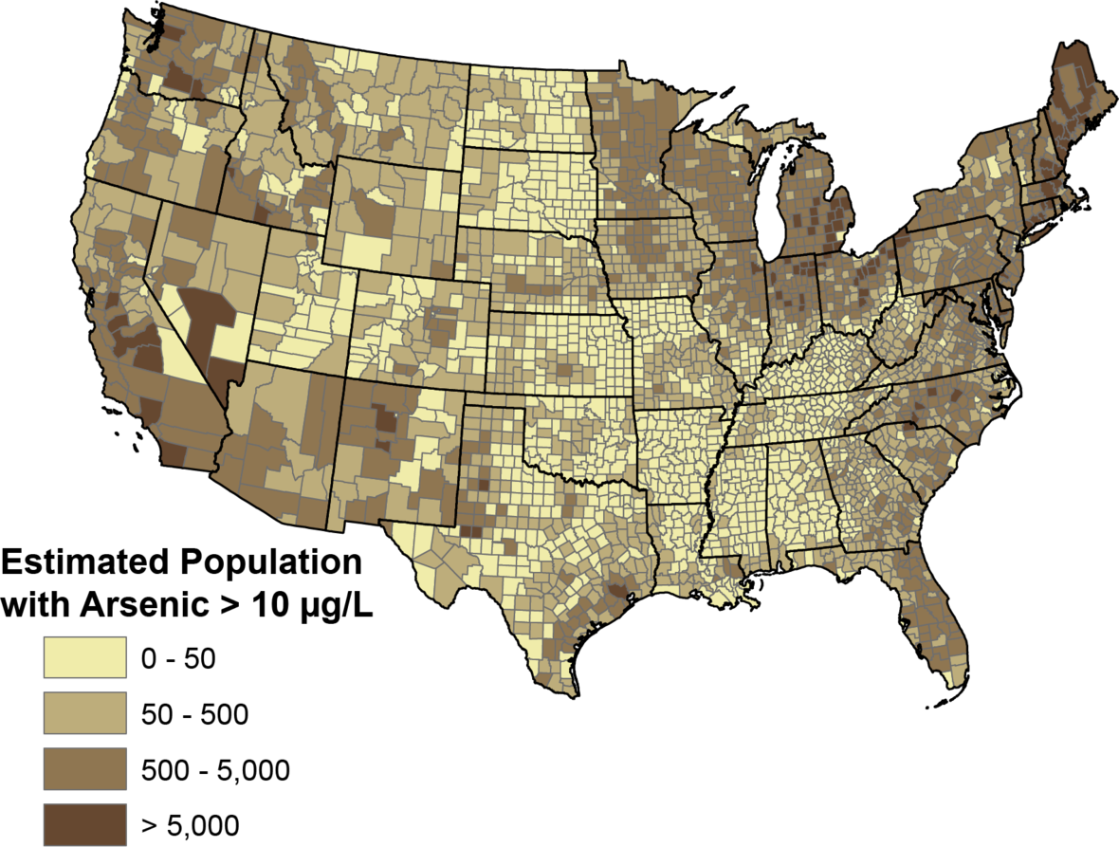
Low Dose Inorganic Arsenic (iAs) Exposure is a Concern Across the United States
Study Estimates about 2.1 Million People using Wells High in Arsenic
Study conducted by USGS and CDC

Slide 4
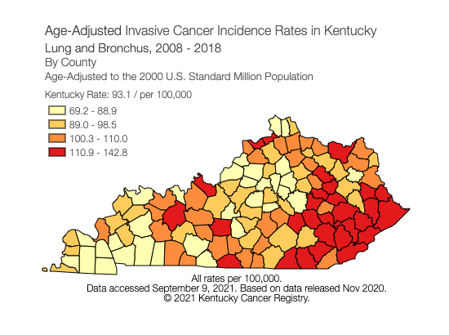
Cancer and Arsenic in Kentucky
High incidence of cancer in KY
Cancer rates highest in Eastern Appalachian Region

Slide 5
How Does Arsenic Cause Cancer?

Slide 6
What are the Molecular Mechanisms of Histone H2B Variants that lead to Arsenic-Mediated Cancer?

Slide 7
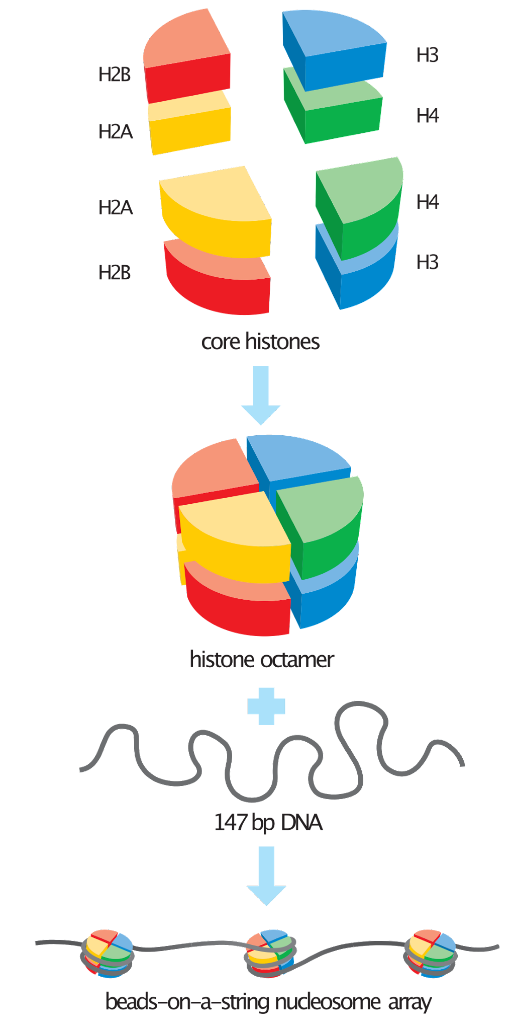
Chromatin, Nucleosomes, and Histones

Slide 8
Histone H2B Variants Have Small, Single Amino Acid Changes

Slide 9
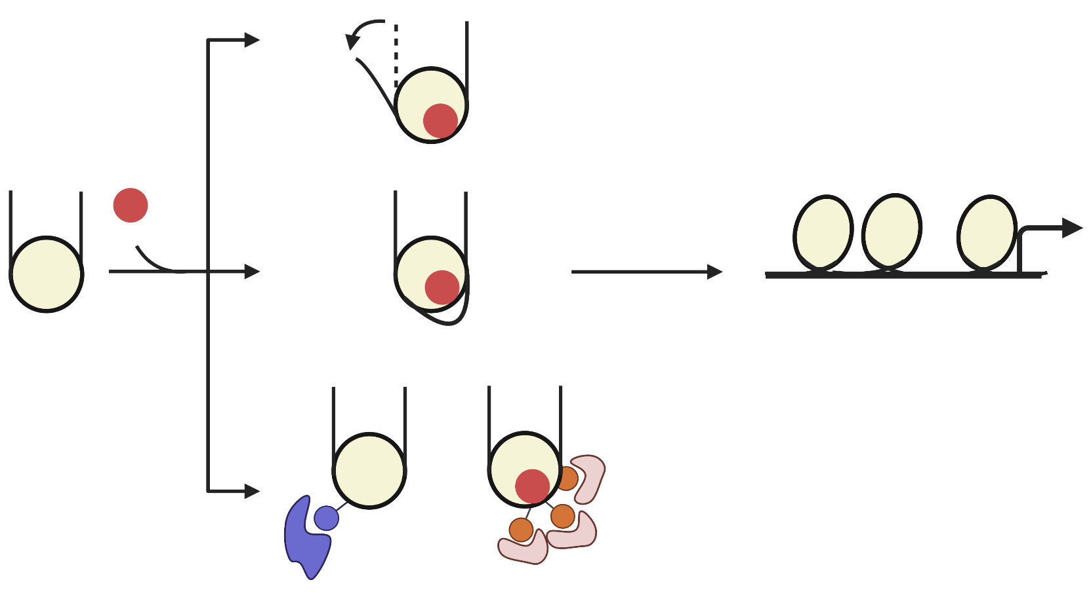
H2B Histone Variants
H2B
Variant
Histone
Octamer

Slide 10
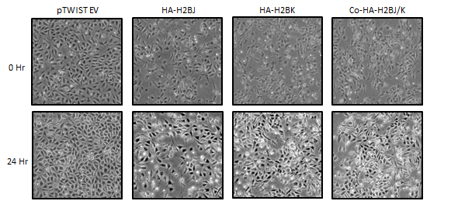
Overexpression of variants J and K induce morphological changes

Slide 11
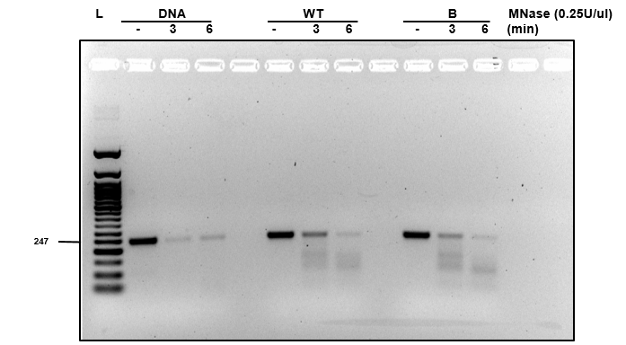
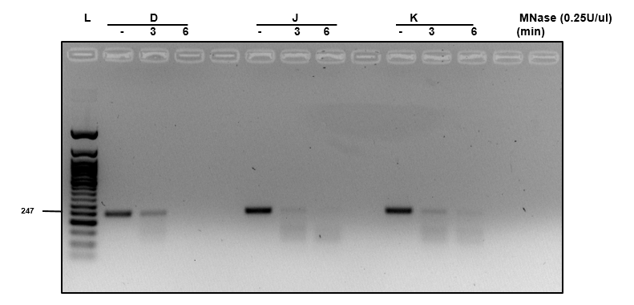
Digested Purified Nucleosomes Reveal Differential Stability

Slide 12
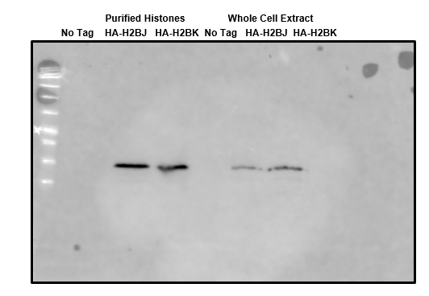
Overexpression of Histone Variants

Slide 13
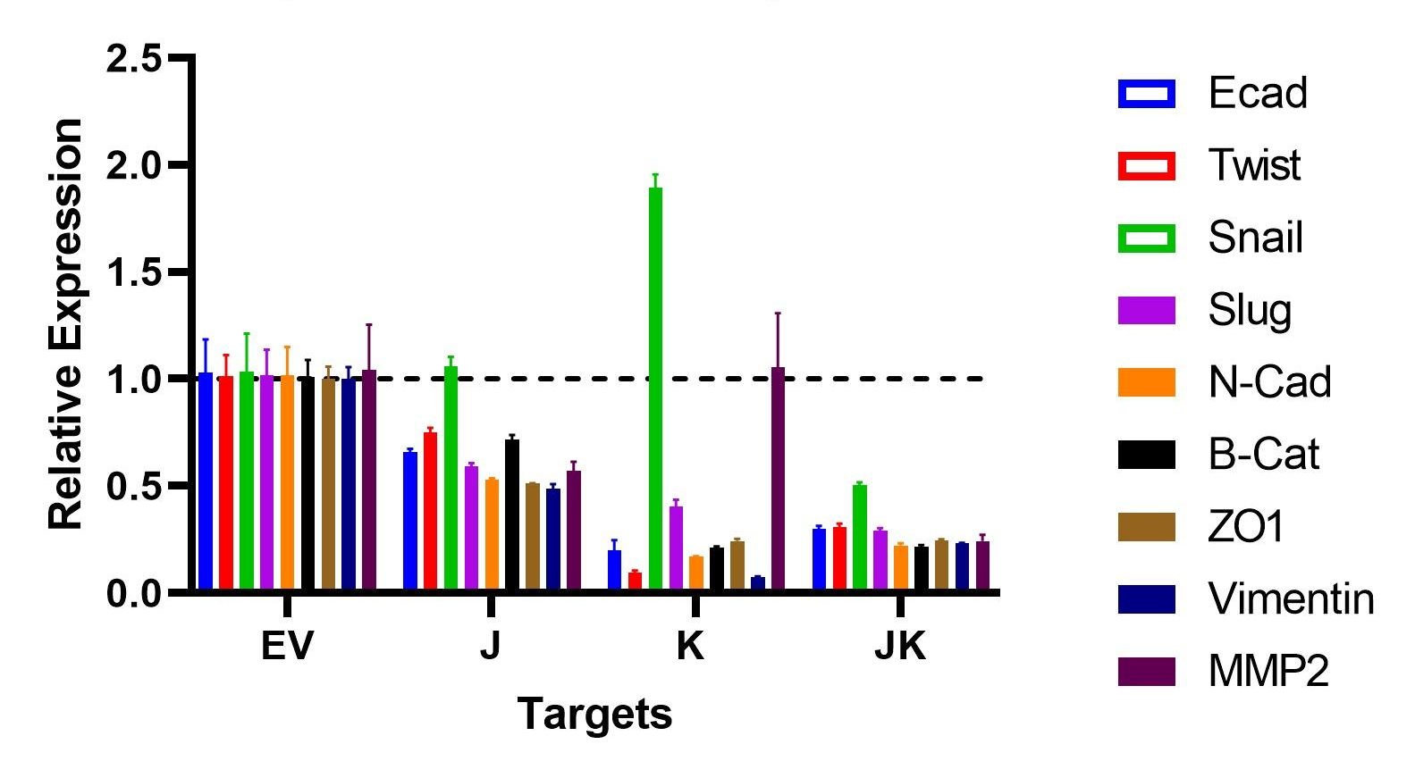
Variants Overexpression

Slide 14
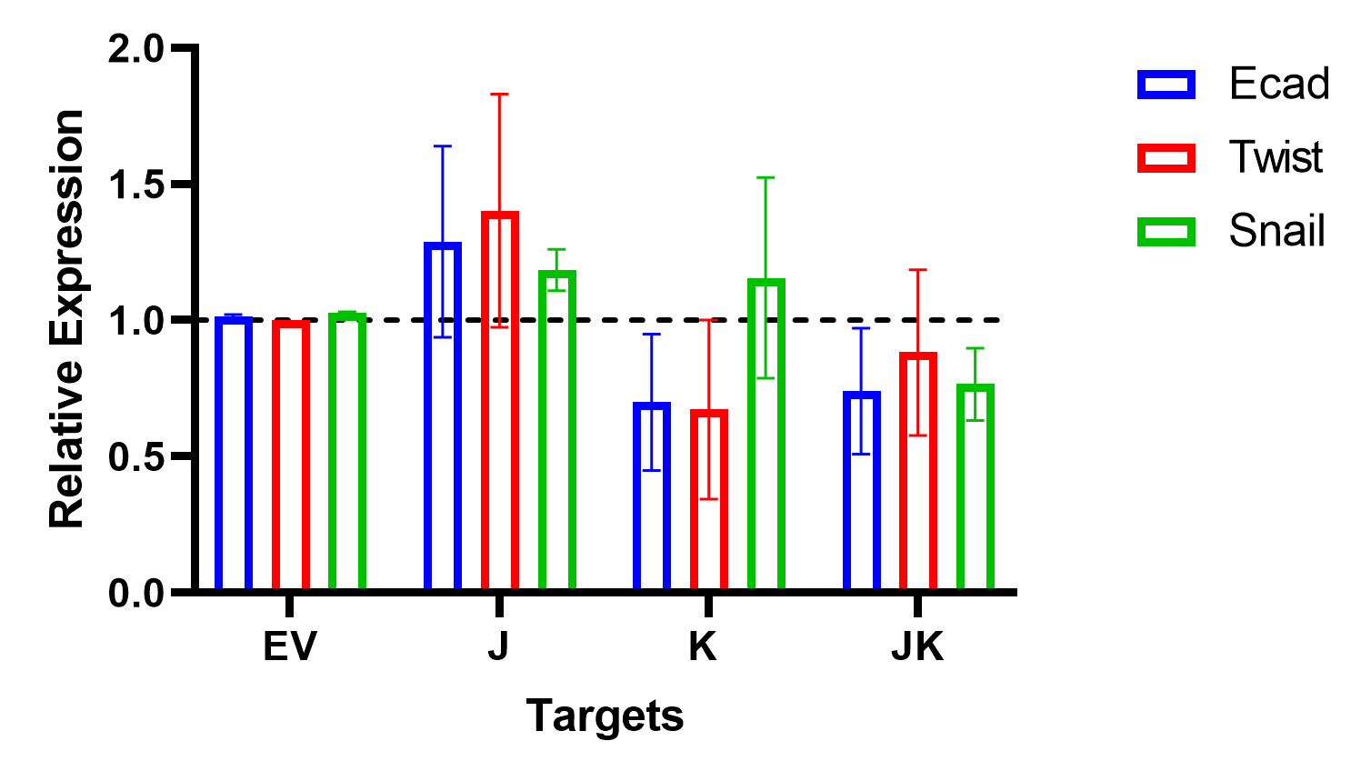
Variants Overexpression

Slide 15
Summary of Findings
Overexpressed variants H2BJ and H2BK induce morphological changes in BEAS-2B cells, recapitulating their overexpression in arsenic-induced cells.
These variant overexpressing cells also showed expression changes in key EMT markers.
These variants were less resistant to micrococcal nuclease digestion (MNase) suggesting that, when incorporated into the nucleosome, they render it less stable.
Together, these results suggest that arsenic exposure affects nucleosome stability leading to gene expression changes and carcinogenesis.

Slide 16
Acknowledgements

