Slide 1
A Meta-analysis on the Effectiveness of Cognitive Behavioral Therapy on Anxiety Symptoms in the Hispanic and Latinx Population
Yadira Diaz Romero and Mia Mattingly

Slide 2
Background
18.5% of the U.S. population identified as Latinx or Hispanic
14.4% of the adult U.S. Hispanic population experience anxiety symptoms
What is Anxiety?
What are the risks?
Notes:
Intense, excessive, and persistent worry and fear about everyday situation and can cause psychosomatic symptoms such as fast heart rate, rapid breathing, and sweating
Anxiety can lead to other mental or physical health issues and can worsen problems that are already present. Things like insomnia, social isolation, headaches are all complications of living a life with untreated anxiety. But there's hope!

Slide 3
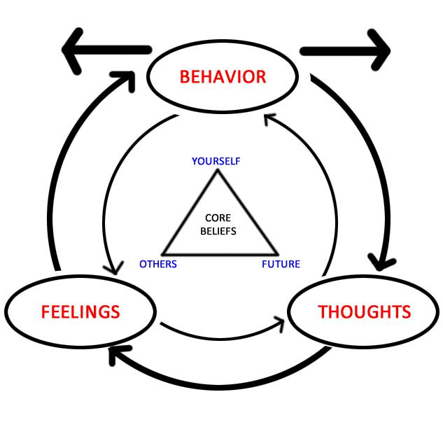
Cognitive Behavioral Therapy (CBT)
Notes:
CBT is a therapy model which examines the connection between thoughts, feelings and behavior and challenges negative cognitions to respond to them in a more effective manner
CBT is an evidence based practice that is proven to be effective for treating anxiety.
An important aspect of treatment is ensuring culturally competent treatment, or providing care that overcomes the cultural barriers between therapist and client and ensuring that the treatment modality being used is proven effective for the population you’re working with. We wanted to look at how effective CBT appears to be in treating anxiety in the Latinx/Hispanic population.

Slide 4
Tribute to Aaron Beck
1921-2021
Notes:
Aaron Beck was an American Psychiatrist was a professor in the department of psychiatry at the University of Pennsylvania. He is considered the father of cognitive behavioral therapy.

Slide 5
Method
Utilized PsychInfo
Key Terms:
Lantix or Latino or Hispanics or Latinas
anxiety or anxiety symptoms
Cognitive Behavioral Therapy or CBT
We sourced our data from a meta-analysis
When determining the effect size of our data we utilized the statistical formula of Cohen’s d
Notes:
database provided by Eastern Kentucky University to search peer-reviewed journals
We sourced our data from a meta-analysis that looked at mental health treatment for the Latinx population → excluded the data that did not meet key terms listed above
When determining the effect size of our data we utilized the statistical formula of Cohen’s d; which is appropriate to use when comparing two means

Slide 6
Results
d= 0. 96 for the Hispanic and Latinx population
Very strong relationship
d =0.39 for White samples
Notes:
We can talk about

Slide 7
Implications
CBT is VERY effective in treating anxiety for the Latinx population
Further support for CBT as an effective treatment model
These results can guide practitioners who seek to provide culturally competent care

Slide 8
Future Research
How effective is CBT with other mental illnesses in the Latinx population?
Further analysis into how country of origin and immigration status correlates with CBT effectiveness
What aspects of CBT are most useful?
Do specific alterations need to be made to CBT to provide culturally competent care?

Slide 9
Questions?

