Slide 1

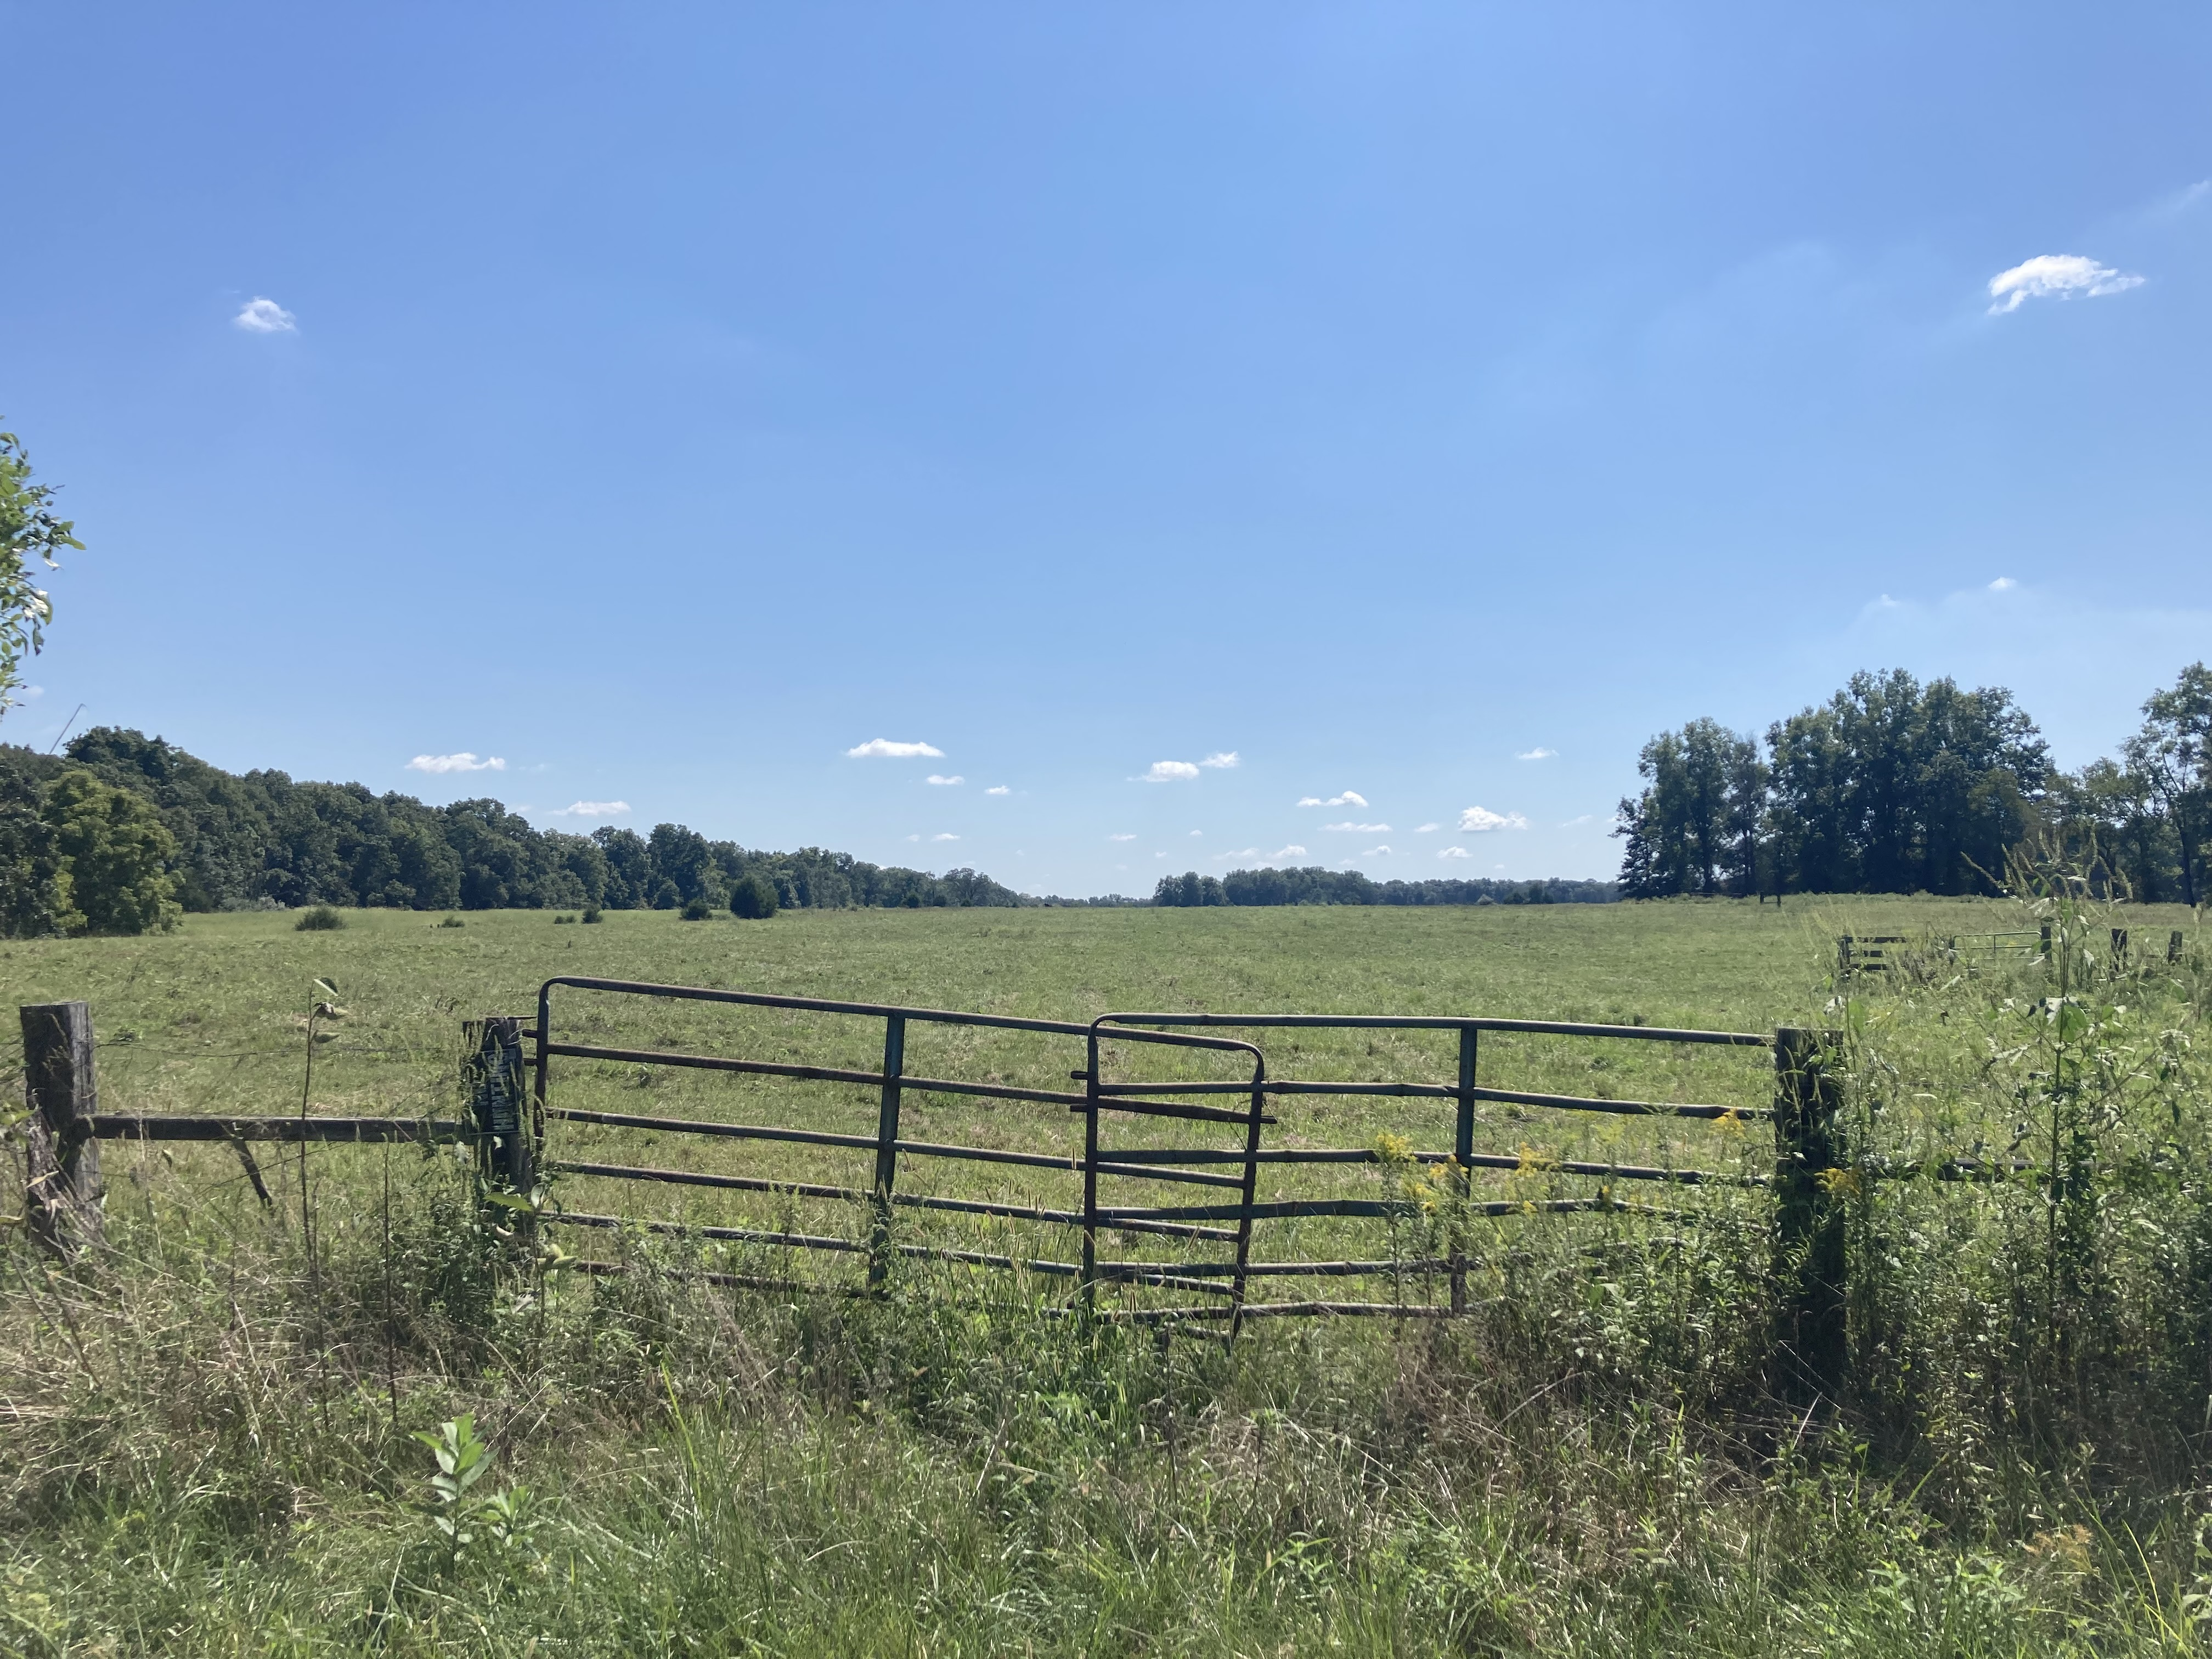
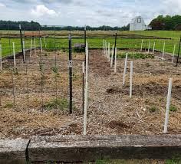
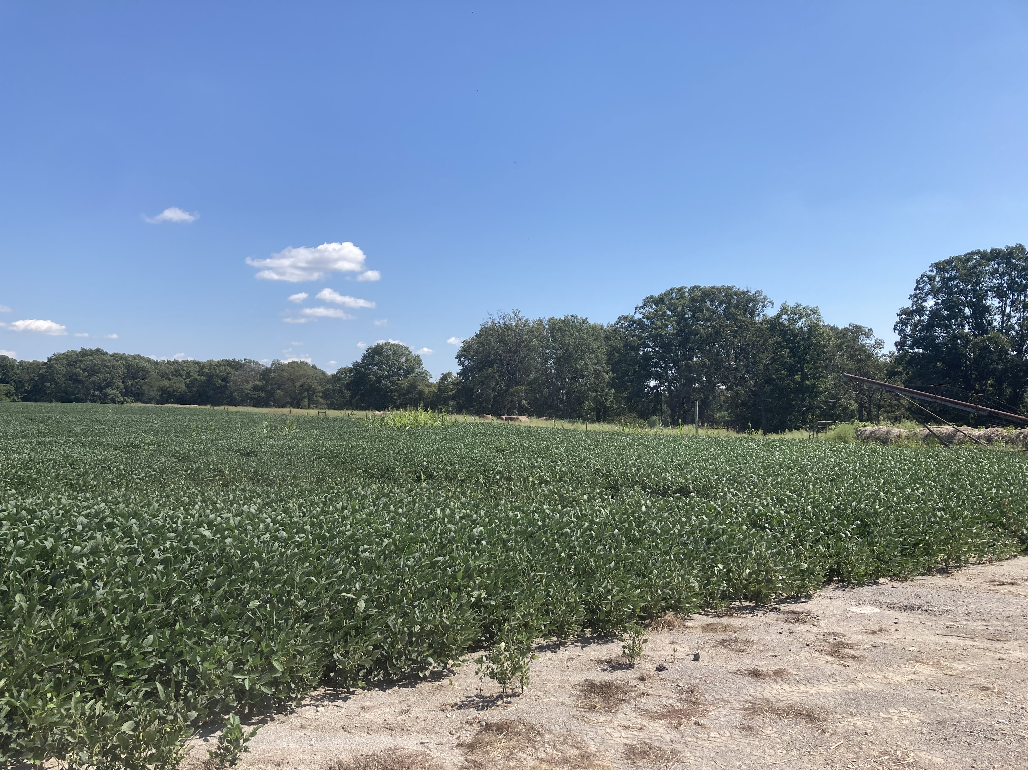
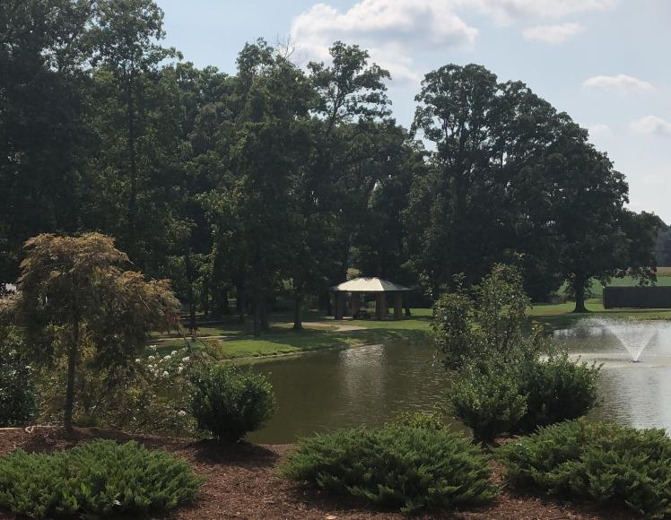
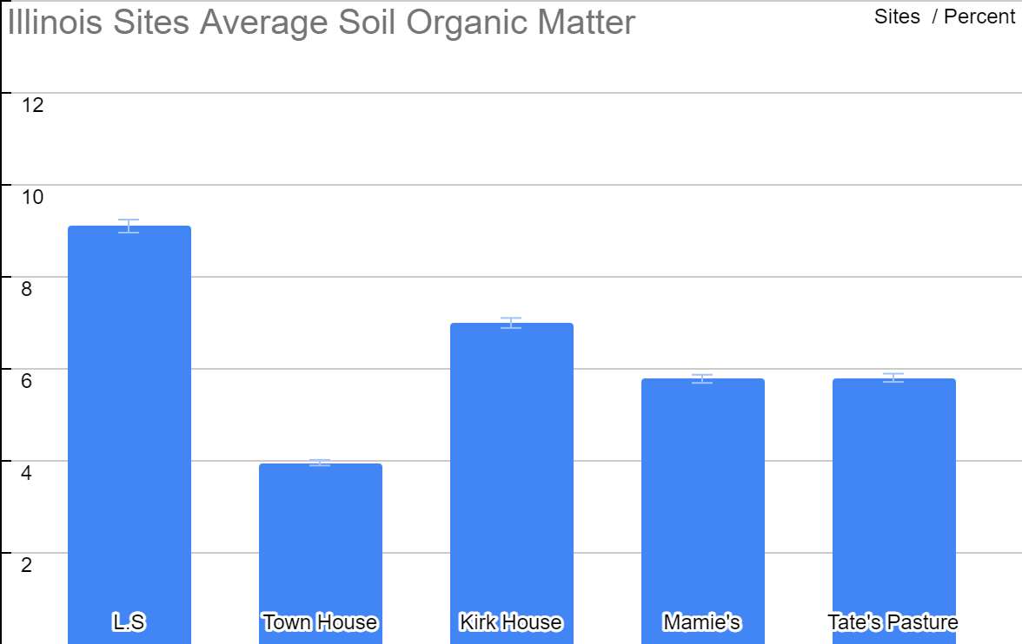
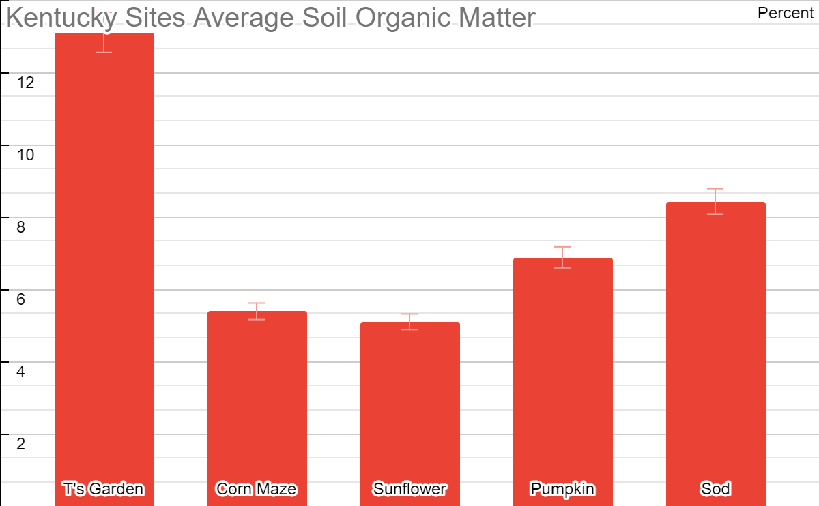
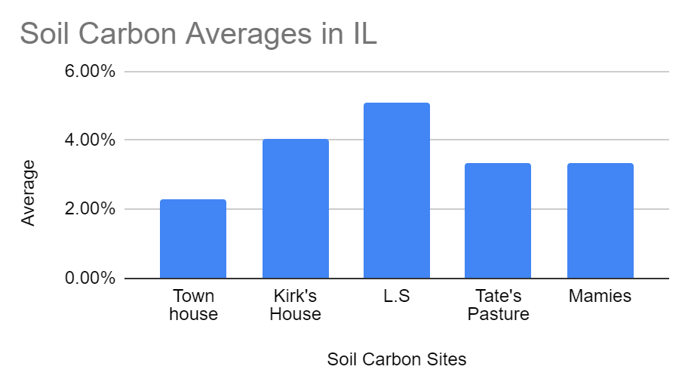
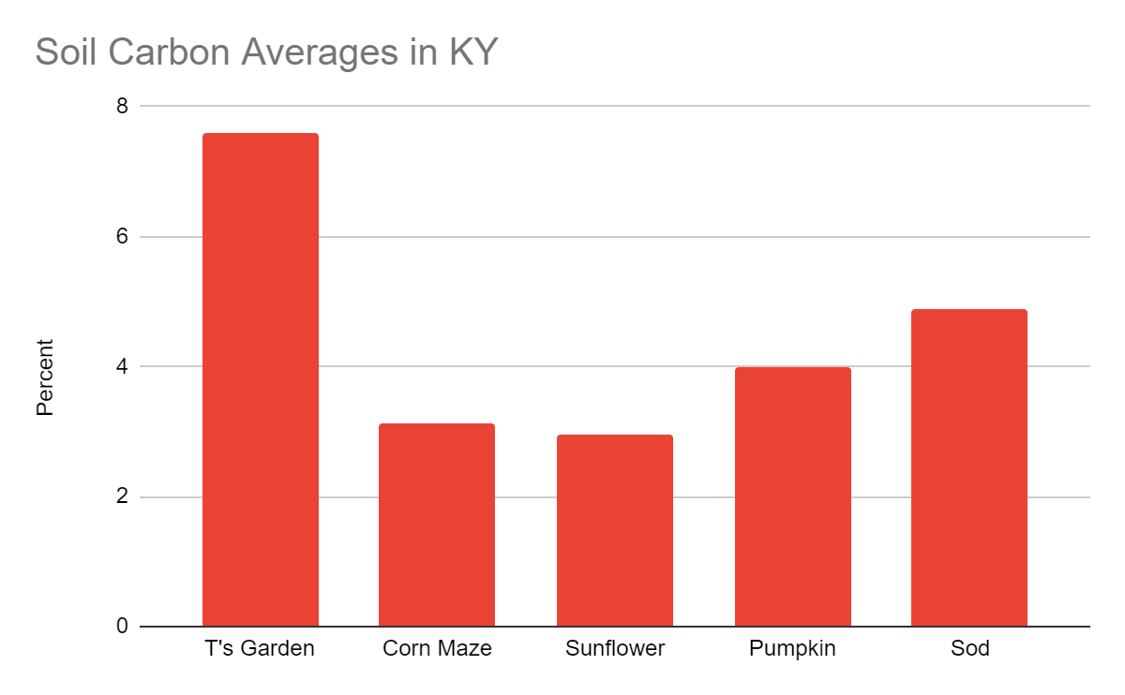
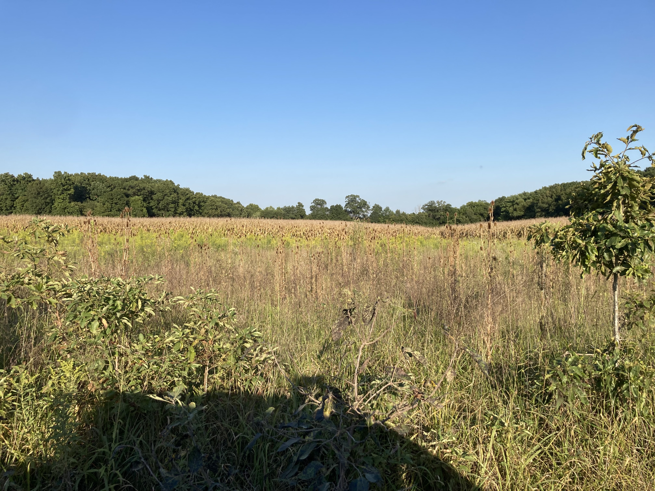
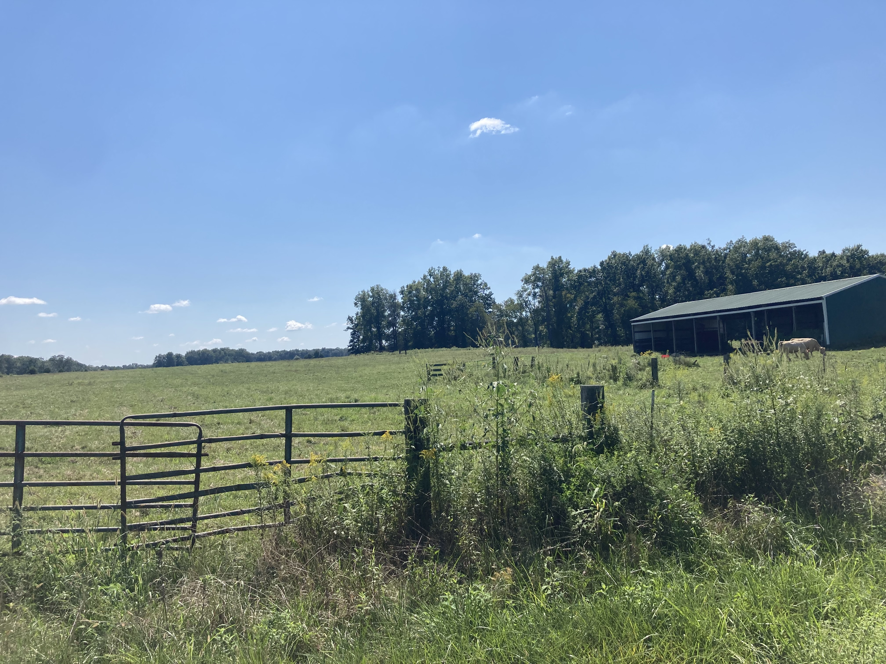
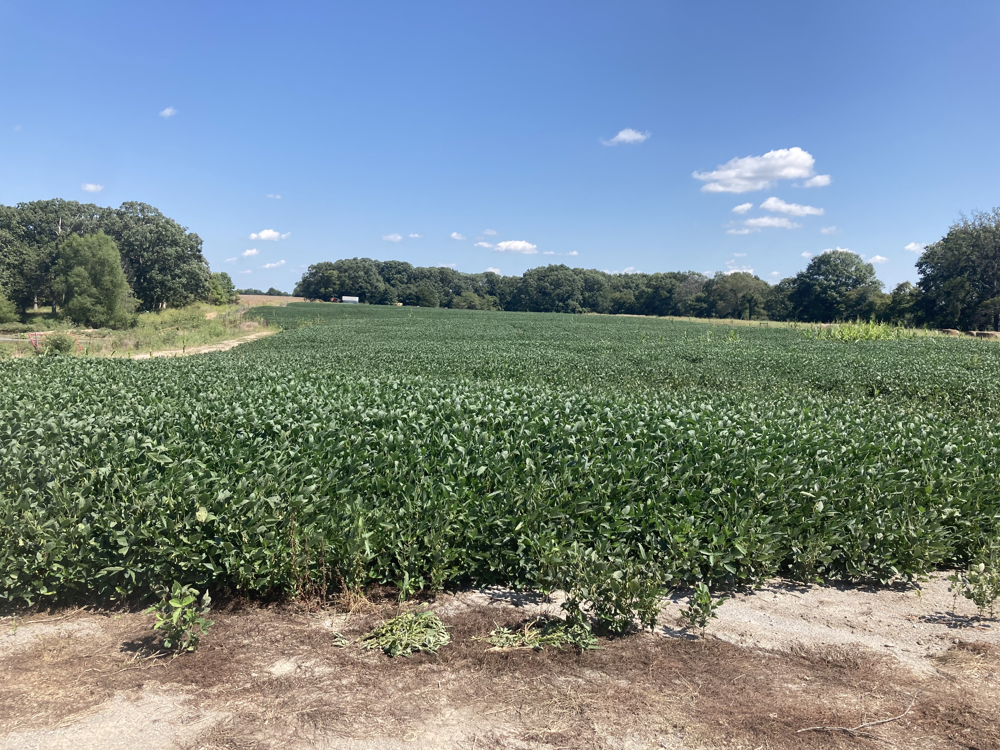
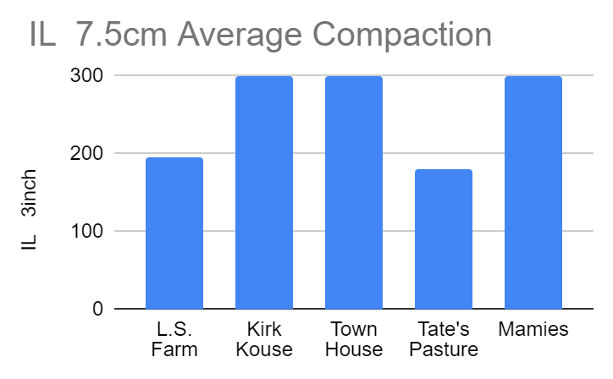
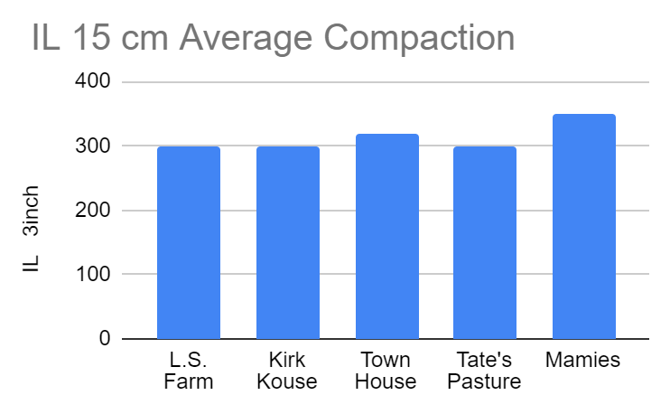
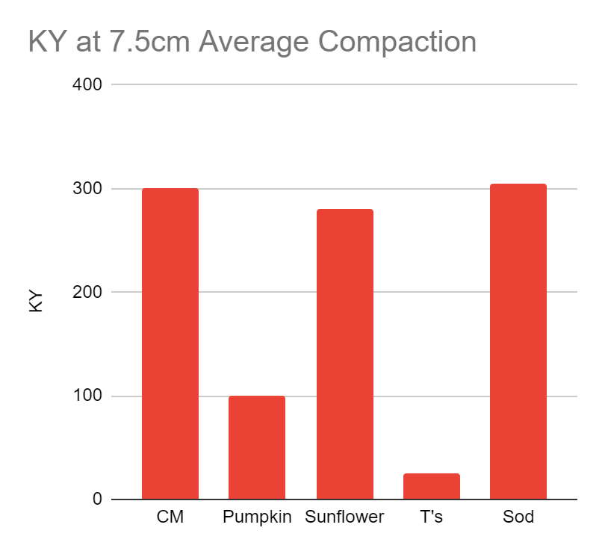
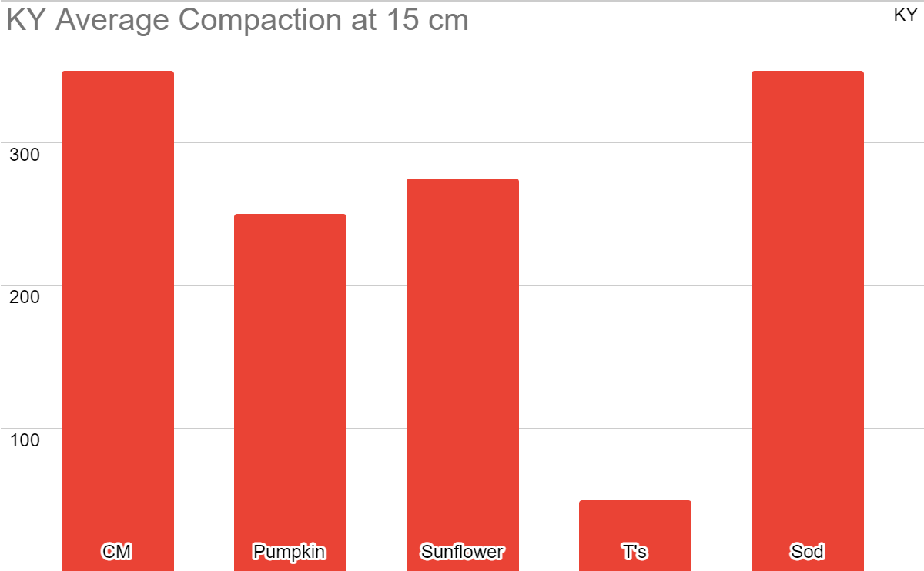
Evaluating Soil Carbon Sequestration and Compaction Levels
in Various Agricultural Fields
Dakota C. Tate, I.P Handayani & N. Musunuru, M. Taylor
Hutson School of Agriculture, Murray State University, Murray, KY, USA
Introduction
Soil Organic Matter is available in most every Agricultural Field that is in a production or fallow event. It is tied to the very essence of Agriculture as (Weil and Ray, 2004) shows it has a vital link to fertility and carbon sequestration levels in the soil profile. The tillage and cropping practices also influence C Levels. Intense management such as conventional tillage or ripping can limit the carbon pool by losing the gain from the prior crop year through emission into the atmosphere. Crop selection is also important in determining the over-all potential for sequestration in a crop cycle. Grasslands can potentially yield higher carbon sequestration under intensive grazing management than cropland (Schlesinger and Amundson, 2018), However, the ability of croplands to sequester carbon is not understated. The health and growth of the crop do affect the amount of carbon in the soil. The relationship between soil health, plant health and soil carbon level is symbiotic and mutually beneficial to the entire growth process and can vary from farm to farm. Compaction can be a detrimental factor in plant and soil health in our various soils.
Soils can become compacted through various circumstances such as rainfall and traffic. Other circumstances such as tillage practices can affect the natural profile of the soil. Compaction can affect soil fertility and plant health dramatically in cropland environments.
(AN Shah, M Tanveer, B Shahzad, 2017) Compaction can be prevented through certain cropping and tillage practices.
Results
Conclusions,
Carbon Levels
Soil Organic Matter IL
Soil Organic Matter KY
Overall, the no-till systems in the IL sites ( Mamies, L.S) showed a higher SOM and soil carbon levels.
The Tate Pasture (IL) showed a lesser rate of SOM and C level than its Sod (KY) counterpart by 2%.
The more aggressive tillage system (Town House) showed less SOM and less carbon.
The Rye cover crop used on “Town House” and “Kirk’s House” was not significant enough to overcome the tillage difference.
The former CRP grounds ( L.S, Mamies) showed the advantages of what having fallow years accompanied with minor management can do for your Soil Organic Matter and C level.
The advantage that intensive management has, (T’s Garden), shows the possibility on a small scale of how much Carbon can be up taken and kept in the soil.
The samples in the Kentucky site “Pumpkin” also continue to show the advantage that grassland has over cropland if managed correctly.
Compaction
The compaction levels in the IL sites show that the non-crop sample shows a lower 7.5 cm compaction level yet has a near equal 15 cm compaction level with the crop production acres.
The compaction levels also show a correlation between higher surface compaction and lower C levels in the sites of “Town House, Kirk’s House, and Mamies”
The deeper compaction levels are minorly different at 15cm and showed no correlation with Organic Matter or Carbon levels.
The L.S had a significantly lower surface compaction and a high C level.
The Kentucky sites showed the same results as the “Corn Maze and Sunflower” sites had high surface compaction and a lower Soil Carbon level.
The “Pumpkin” site shows the effect that continued sod can do for compaction in the surface and deep in the soil profile.
Study Site
The study sites were in Southern IL and Western Kentucky. The IL sites are located in Jefferson County, IL (38°18′N 88°55′W) and the KY sites are in Calloway County, KY (36.6403° N, 88.2850° W). Research was conducted on 5 localized sites in Illinois. These sites include soils such as Zanesville Silt Loams, Bluford Silt Loams , Hickory Clay Loams and Ava silt loams. The sites in Illinois are named L.S, Townhouse, Kirk House, Tate Pasture, and Mamie. The 5 localized Kentucky sites included Grenada Silt Loam, Calloway silt loams, Calloway-Kurk Complex. The Kentucky sites named are T’s Garden, Corn Maze, Sunflowers, Pumpkins, and Sod. These sites are farmed in a variety of ways with different crops on each, such as, no-till soybeans, conventional soybeans, and corn. The fields also include former CRP grounds and cattle pasture.
Soil Carbon Content in IL and KY
Conclusions
Soil Compaction at 0 - 7.5 cm
Soil Compaction at 7.5 - 15 cm
Methods
Acknowledgements
The fields were examined and divided into three sections (North, Center, South or East, Central, West). These labels were used to better readily identify the fields if they were elongated in shape or square. These sites contributed 5 random samples for C measures in each zone. After labeling and bagging these samples in each of the zones, 5 random compaction samples were taken at two depths of 7.5 cm and 15 cm to measure the compaction at these depths. The different depths were pulled to examine the tillage and crop rotations affect on the soil profile in the root zone of various crops. The randomization also allows for a broad look at compaction across the many different areas in these zones in each field. The carbon samples were pulled in the same fashion to allow a broader look on how the cropping system of the field and its respective tillage practice’s impact on C levels in the different zones.
This research was made possible by the support and funding of the Murray State Agronomy Dept. I want to thank Justin and Luke Smith of Smith Farms and Cord and Kirk of Hails Farms for allowing me to use their land in my Illinois portion. I want to thank Murray State University for letting me the Pullen Farm in my Kentucky portion of my study.
References
Changes in soil carbon stocks in Brazil due to land use: paired site comparisons and a regional pasture soil survey
E. D. Assad¹, H. S. Pinto², S. C. Martins¹, J. D. Groppo¹, P. R. Salgado³, B. Evangelista⁴, E. Vasconcellos¹, E. E. Sano⁴, E. Pavão¹, R. Luna¹, P. B. Camargo⁵, and L. A. Martinelli⁵
Managing for soil carbon sequestration: Let’s get realistic
William H. Schlesinger,Ronald Amundson
First published: 28 November 2018
Soil compaction effects on soil health and crop productivity: an overview Adnan Noor Shah1 & Mohsin Tanveer2 & Babar Shahzad3 & Guozheng Yang1 & Shah Fahad4 & Saif Ali1 & Muhammad Adnan Bukhari5 & Shahbaz Atta Tung1 & Abdul Hafeez 1 & Biangkham Souliyanonh1 Received: 23 October 2016 /Accepted: 5 January 2017

