Slide 1
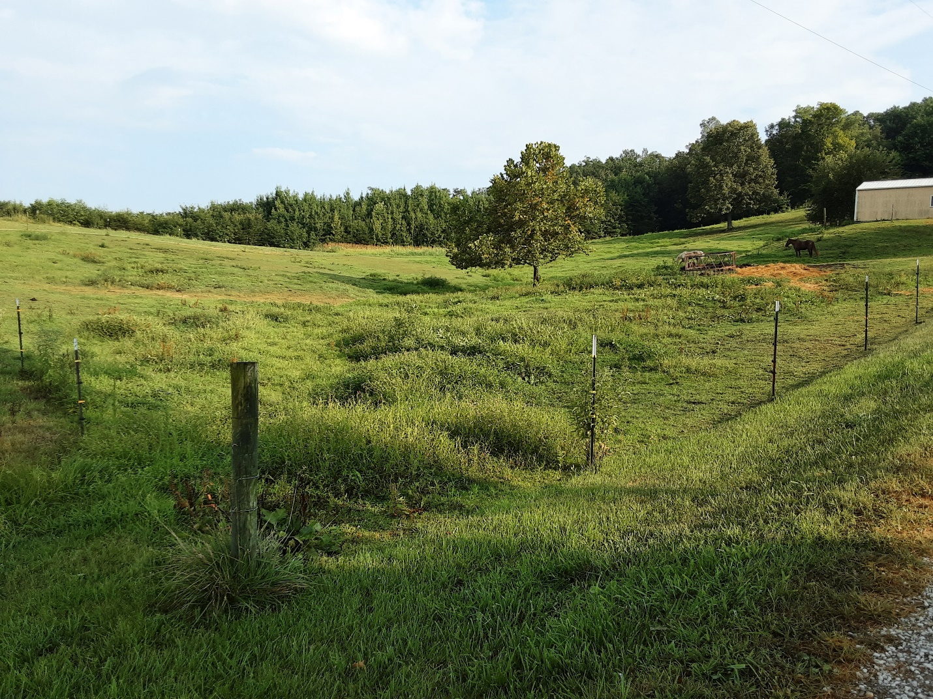
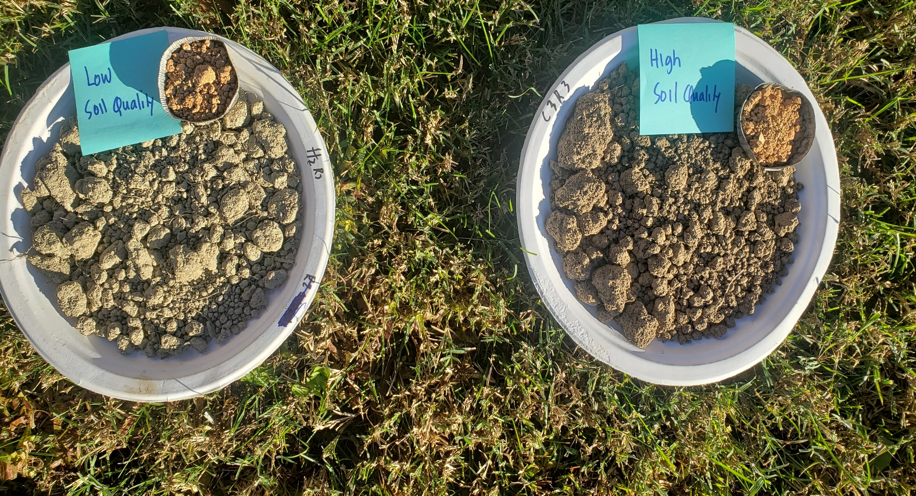
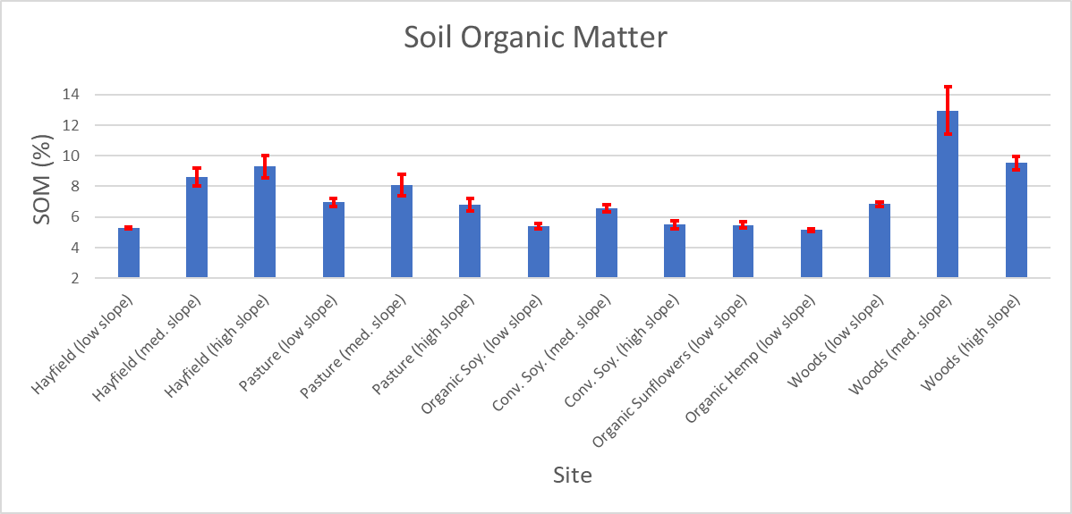
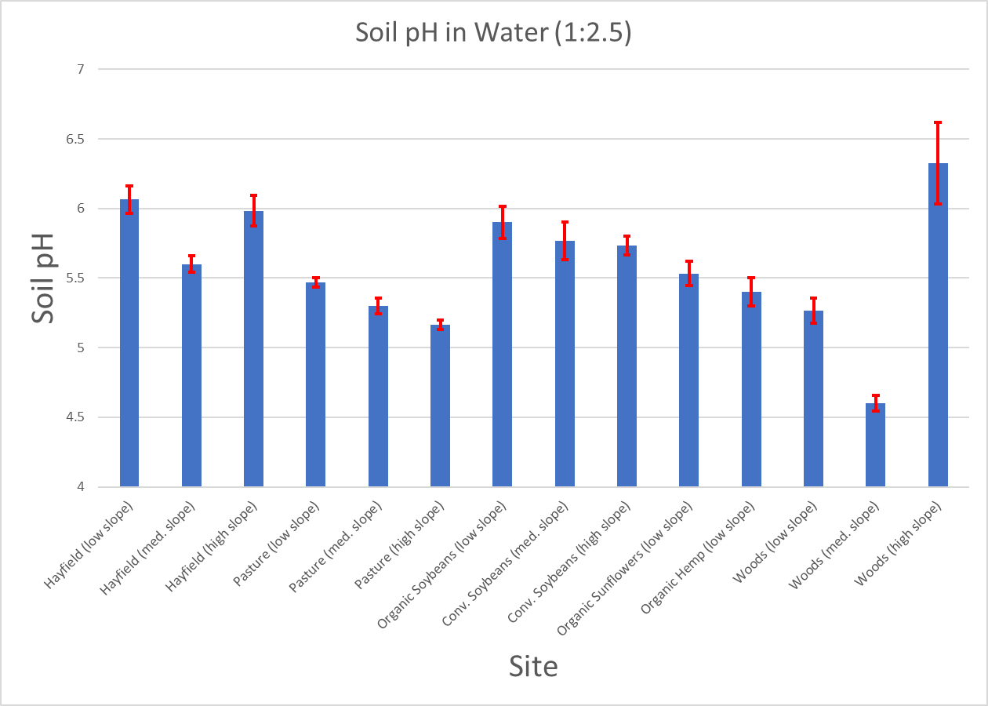
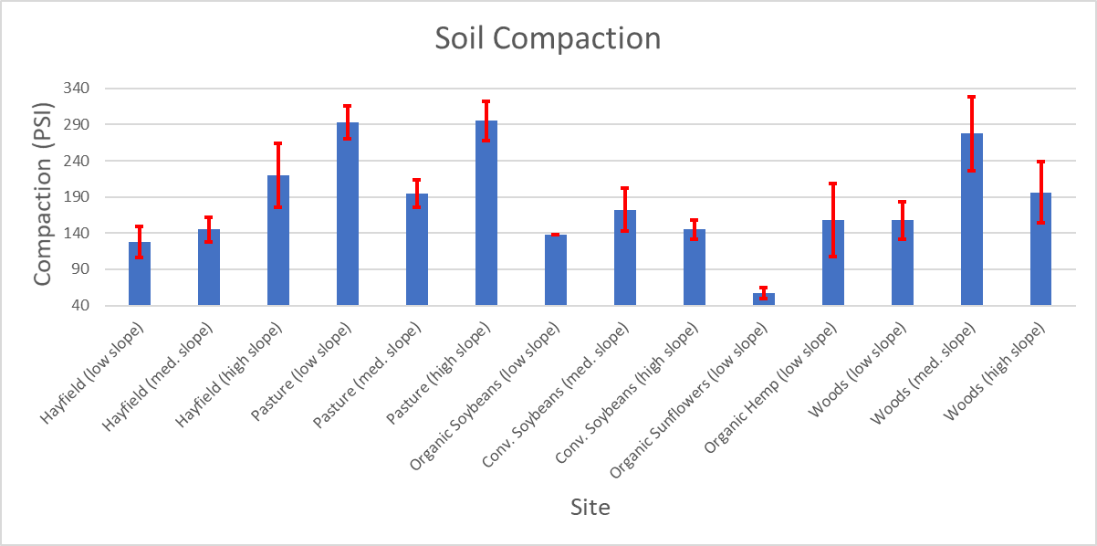
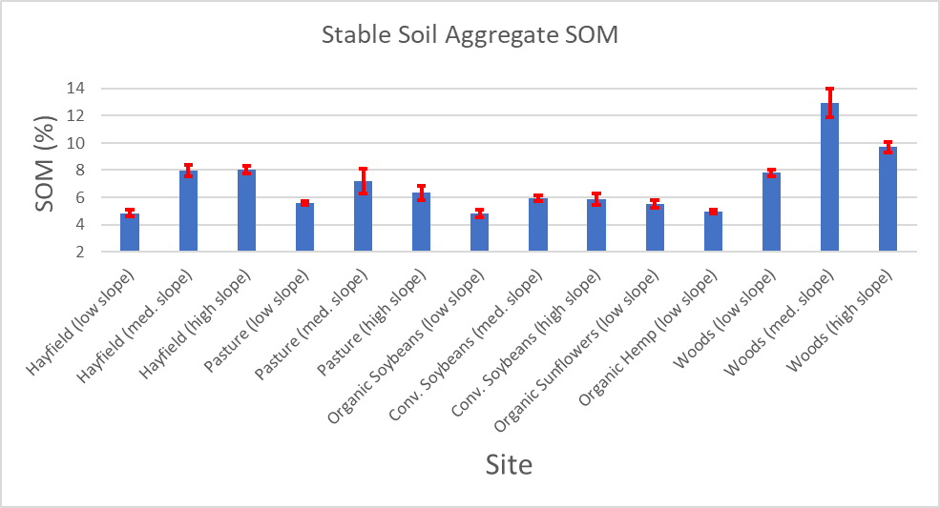
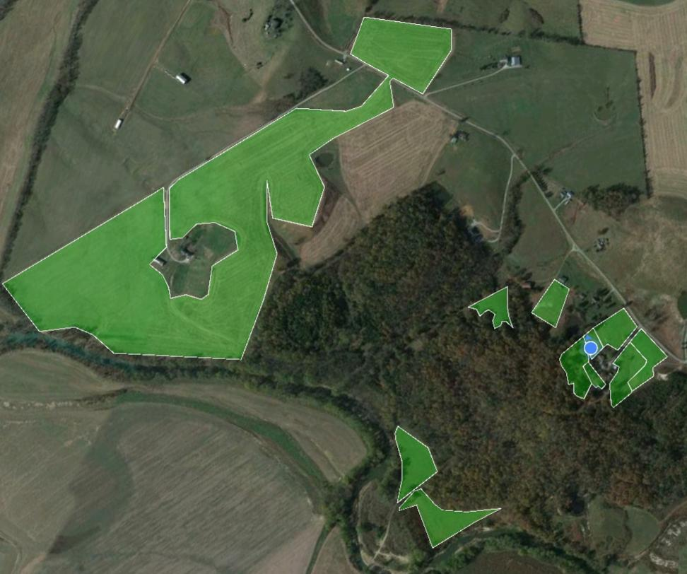
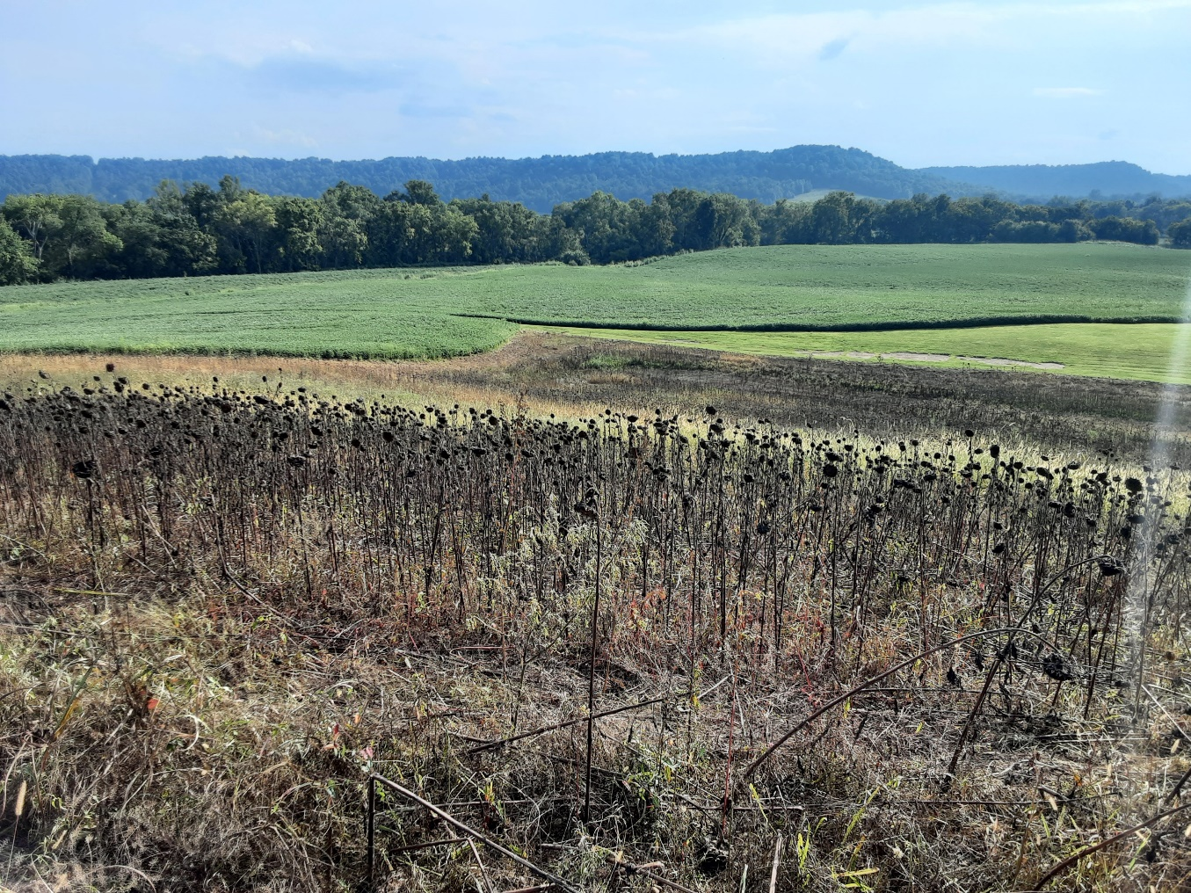
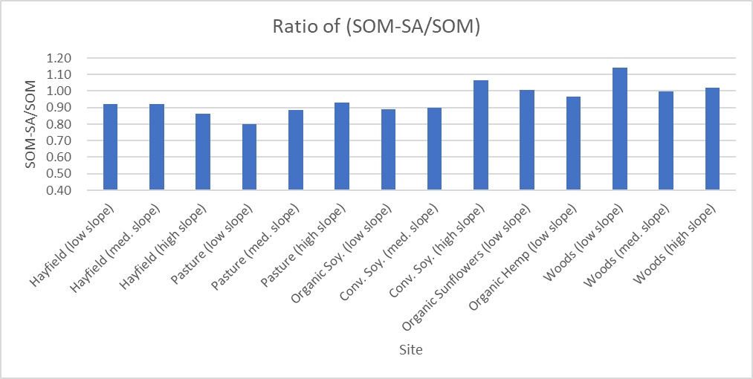
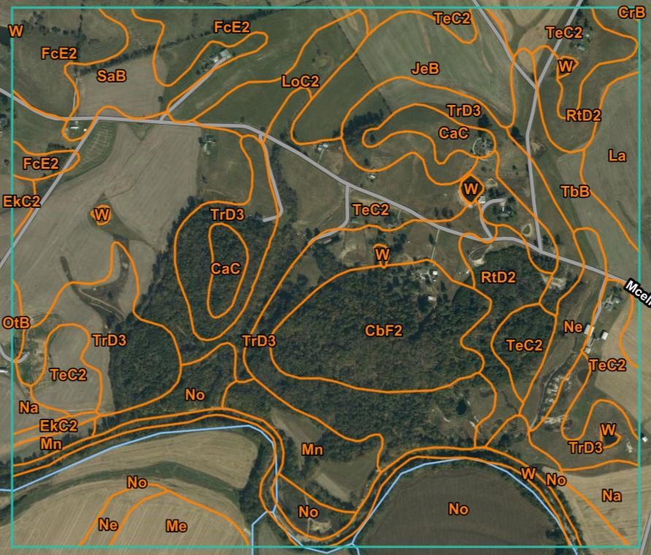
DYNAMICS OF SOIL PROPERTIES RELATED TO TOPOGRAPHY IN CENTRAL KENTUCKY
Matthew Fowler & Iin Handayani
Hutson School of Agriculture, Murray State University, Murray, Kentucky, USA
Introduction
Results
Topography has a significant influence on soil chemical, physical, and biological properties (Florinsky, 2012). Water plays a significant role with topography to influence these properties. An increase in slope leads to more runoff, moving soil particles to the bottom of the slope. This generally means that slopes will be less fertile than soils at the bottom of the slope (Florinksy, 2012). The influence of slope and water on soil properties and formation have been well understood for a long time. This association influences the accumulation and depletion of nutrients and soil organic matter in different topographic areas (Mellinger, 2015). Soil aggregate stability can be used as an indicator to soil resistance to soil erosion (Barthès & Benali, 2002). The more stabile the soil aggregates, the more resistant they are to erosion. This would affect the distribution of soil nutrients in a particular landscape in accordance with topography.
Land use can also alter soil properties by increasing erosion, mixing soil layers, and altering soil biological functions (Biro et al., 2013). Agricultural land use can especially influence soil properties. Soil organic matter often is lower in cultivated areas than in areas that are undisturbed by agriculture, such as wooded areas. Additionally, soil pH is affected by different land uses. A study in Sudan found soil pH levels to be higher in cultivated fields than nearby wooded areas (Biro et al., 2013). It was noted that soil organic matter had dropped from the wooded areas (at 1.13%) to the cultivated areas (at .93%). Soil pH had increased from the wooded areas (7.23) to the cultivated areas (7.33). The objective of this study was to determine the contribution of land uses and topography to change the following soil properties: soil organic matter (SOM), soil compaction, soil color, soil pH, and SOM in stable aggregates (SOM-SA).
Conclusions
The highest soil organic matter (SOM) was found in the medium slope wooded area (12.96%).
The lowest SOM was observed at the conventional till, low slope organic hemp field (5.14%).
The highest SOM among topographic features was in the medium slope areas (9.1%), followed by the high slope areas (7.8%), and then the low slope areas (5.9%).
The mean SOM across all fields was 7.32%.
The highest SOM among the land uses was shown to be in the wooded areas (9.8%) followed by the hayfields (7.7%), the pastures (7.3%), and the cultivated fields (5.3%).
Soil pH was highest in the high slope wooded area (6.3) and was statistically higher than all other areas, except the low slope hayfield (6.1) and the high slope hayfield (6.0).
The lowest pH was at the medium slope wooded area (4.6), and it was statistically lower than any other field.
The data showed that the highest soil pH was in the hayfields (5.9), followed by the cultivated fields (5.7), the wooded areas (5.4), and finally the pastures (5.3).
The highest pH among topographic features was seen in the high slope areas (5.8), followed by the low slope areas (5.6), and the medium slope areas (5.3).
The mean soil pH for all fields was 5.6.
The highest soil compaction was found in the high slope pasture (295 PSI), but was not statistically higher than the low slope pasture (293 PSI) or the high slope hayfield (220 PSI).
The lowest soil compaction was in the low slope organic sunflowers (58 PSI), likely because it was conventionally tilled and testing was done only at 0-7.5cm.
Among topographic features, the low slope areas had the lowest mean compaction (155 PSI) followed by the medium slopes (198 PSI), and the high slopes (214 PSI).
Between different land uses, the highest soil compaction was in the pasture fields (261 PSI), then the wooded areas (210), the hayfields (164 PSI), and finally the cultivated areas (134 PSI).
Study Site
There are a total of 14 fields with three hayfields, three pasture fields, five cultivated fields, and three wooded areas. Each of the three fields from the four land uses (hayfields, pasture fields, cultivated fields, and wooded areas) represent a high slope (20-45%), medium slope (6-19%), and low slope (flat to 2-3%). However, there are 5 cultivated fields (3 soybean fields with high, medium, and low slopes were sampled along with an organic hemp and organic sunflower field that are on low slopes). The study was primarily located in central Kentucky in Marion County with the 3 organic fields (soybeans, sunflowers, and hemp) being located in Boyle County, Kentucky. All of the cultivated fields in the study were managed as no-till, except for the organic sunflower and organic hemp fields.
Methods
Disturbed soil samples were collected in three replications from each field in the study. Samples were taken at a depth of 0-7.5cm. These samples were used to determine soil organic matter content, soil wet aggregate stability, and soil pH. Additionally, a penetrometer was used to determine soil compaction, with 10 replications taken per field at a depth of 0-7.5cm.
Soil wet aggregate stability was determined by placing soil in tea strainers, and submerging the soil in water for 10 minutes each. The difference in weight between the air dry samples before the test and after the test was calculated. This was used to determine the percentage of the soil still in the sample. The less soil that was loss in the test, the higher the aggregate stability.
Soil pH was calculated by using a pH meter in a 1:2.5 ratio. 10g of air-dry soil (that was previously sieved to .5mm) was mixed with 25ml of distilled water for 3 min. The samples were then allowed to sit for 30 minutes. After 30 min., the pH meter was used to determine soil pH.
Soil organic matter was determined using the loss on ignition method (LOI).
Acknowledgements
This research was made possible by the support and funding of the McNair Scholar Program, the use of the Soil Science Laboratory of the Hutson School of Agriculture at Murray State University, and Peterson Farms in Loretto, KY.
References
Asadi, H., Raeisvandi, A., Rabiei, B. and Ghadiri, H. (2012). Effect of land use and topography on soil properties and agronomic productivity on calcareous soils of a semiarid region, Iran. Land Degrad. Dev. 23: 496-504. https://doi.org/10.1002/ldr.1081
Barthès, B. & Benali, Issam. (2002). Aggregate stability as an indicator of soil susceptibility to runoff and erosion : validation at several levels. CATENA. 47. 133-149. 10.1016/S0341-8162(01)00180-1.
Biro, K., Pradhan, B., Buchroithner, M. and Makeschin, F. (2013). Land Use/Land Cover Change Analysis and its Impact on Soil Properties in the Northern Part of Gadarif Region, Sudan. Land Degradation & Development. 24(1), 90-102. doi:10.1002/ldr.1116
Florinsky, Igor. (2012). Influence of Topography on Soil Properties. doi:10.1016/B978-0-12-385036-2.00008-0.
Guo, Xinxin, Qiang Fu, Yanhong Hang, He Lu, Fengjie Gao, and Jingbo Si. (2020). Spatial Variability of Soil Moisture in Relation to Land Use Types and Topographic Features on Hillslopes in the Black Soil (Mollisols) Area of Northeast China. Sustainability 12(9). https://doi.org/10.3390/su12093552
Mellinger, A. 2015. The effect of conservation tillage and topographic position on soil properties in central Illinois. Master Thesis. Southern Illinois University, Carbondale IL
Zhang, Yun-Yi, Wei Wu, & Liu, H. (2019). Factors affecting variations of soil pH in different horizons in hilly regions. PLoS ONE. 14 (6).

