Slide 1
Analysis of Purified Extracts from Antibiotic-Producing Bacterial Isolates
Austin Minton and Dr. Rachel Pritchard
Photo retrieved from https://tinyearth.wisc.edu.
Photo retrieved from https://www.lanereport.com/120814/2020/01/kentucky-wesleyan-college-recognized-for-having-one-of-the-nations-best-online-bachelor-degree-programs/.

Slide 2
Overview
Introduction
What is Antibiotic Resistance?
Research Goals
Methodology and Results
Streaking for Isolation and ESKAPE Testing
Biochemical Testing and 16S rRNA Gene PCR
Organic Extraction
Antibiotic Activity Assay of Extract
Conclusion
Discussion
Future Experimentation
Acknowledgements
References
Questions

Slide 3
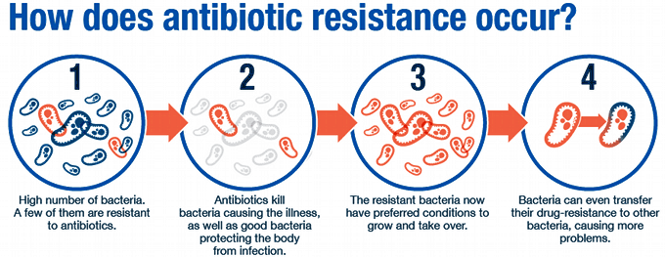
What is Antibiotic Resistance?
Antibiotics are efficient in killing off bacteria, but most aren’t very selective of the bacteria they kill (Hamilton et al., 2013).
2 million infections are caused by antibiotic-resistant bacteria, resulting in 23,000 deaths each year (Mainous et al., 2011).
These numbers are only going to increase, as pharmaceutical companies aren’t deriving enough new drugs to combat this (Piddock, 2012).
Photo retrieved from http://modmedmicro.nsms.ox.ac.uk/learn-more-about-antibiotic-resistance/
Notes:
Bacteria become resistant when they develop the ability to defeat the drugs that are designed to kill them.
A common misconception is that your body is becoming resistant to antibiotics. It is, actually, the bacteria that is becoming resistant.
Overall, antibiotic resistance can affect people of any age. This is a big risk for those receiving joint replacements, organ transplants, cancer therapy, etc.

Slide 4
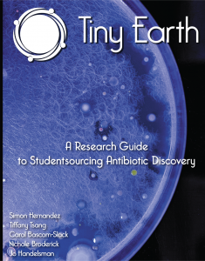
Research Goals
The goal of the Tiny Earth Project is the discovery of novel antibiotics from the soil and steering more science trainees in the direction of antibiotic research (Hernandez et al., 2018).
The goal of this research is to utilize the Tiny Earth protocol to characterize, and extract the purified product of antibiotic-producing bacterial isolates from a past class. Further experimentation will allow for examination of the medical efficacy of these particular isolates.
Photo retrieved from https://tinyearth.wisc.
edu/the-tiny-earth-manuals-are-ready/.
Notes:
Focus more on my project rather than Tiny Earth itself. Still briefly discuss TE, though.
Discover novel antibiotics from soil samples collected by a past class.

Slide 5
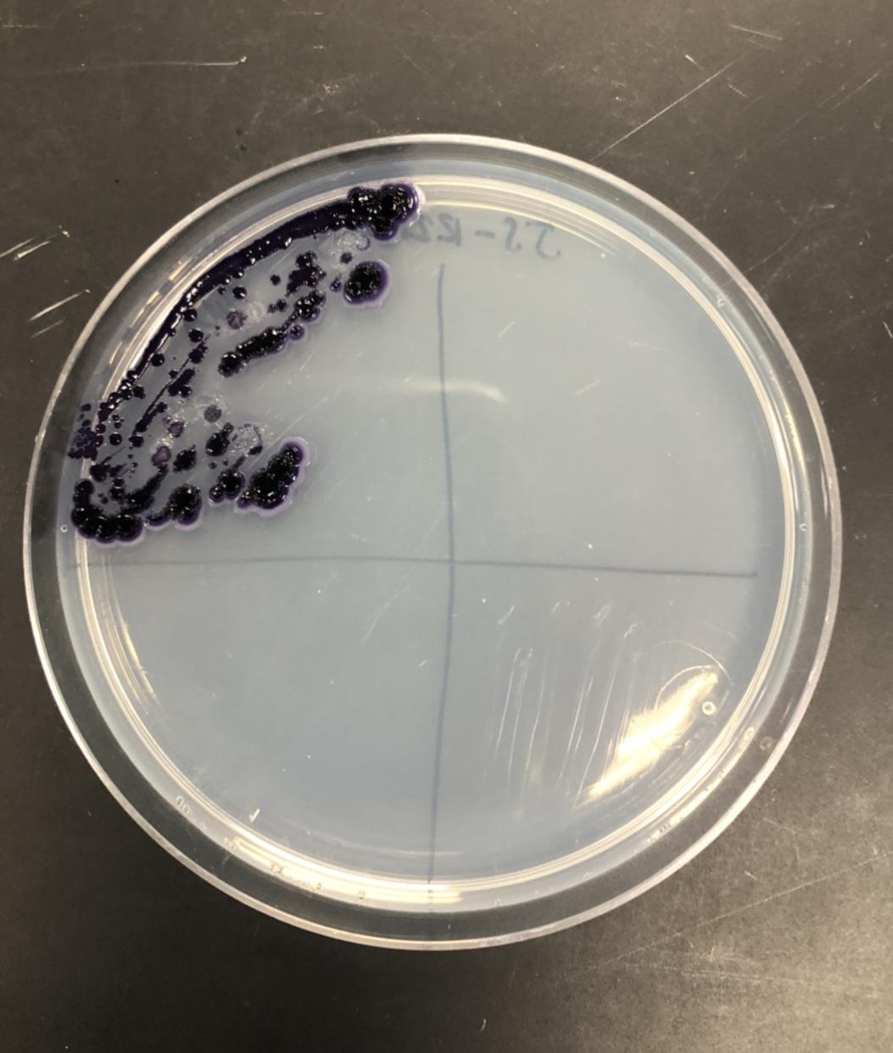
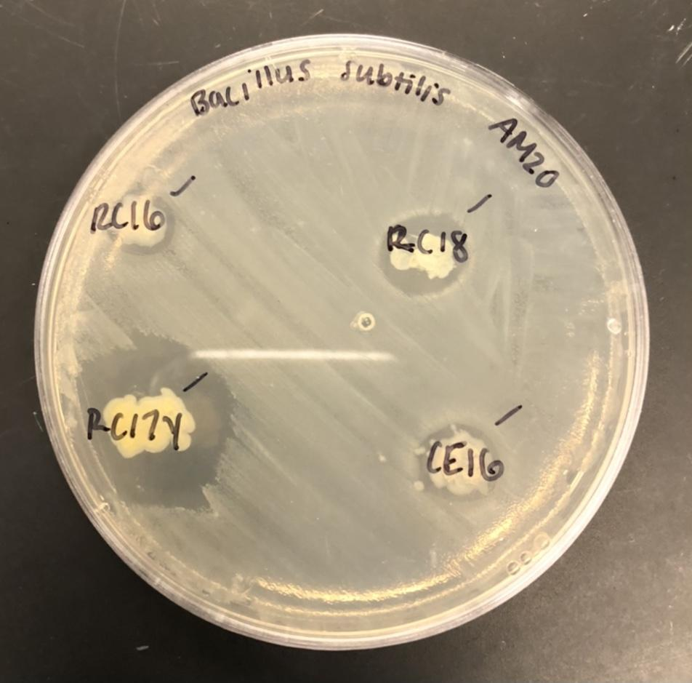
Methodology: Streaking for Isolation & ESKAPE Testing
Freezer stocks of 21 bacterial isolates were plated on their predetermined growth medium (PDA, R2A, or BHI) utilizing the method of streaking for isolation.
9 ESKAPE pathogen relatives were plated on LB Agar utilizing the method of streaking for isolation.
ESKAPE testing for each isolate was executed by utilizing the method of spread-patch plating.
Hernandez et al., 2018
Notes:
Information from notebooks included past location of retrieval of the original soil sample, antibiotic-production testing results, etc.
Determined type of agar by looking at name of isolate (INITIALS-TYPE OF AGAR-ID...JS-R2A-5)\
Discuss streaking for isolation
Discuss patch plating…LB agar broth of ESKAPEs

Slide 6
Results: ESKAPE Testing
Isolate ID | Bacillus subtilis | Enterococcus raffinosus | Staphylococcus epidermidis | Mycobacterium smegmatis | Escherichia coli | Enterobacter aerogenes | Erwinia carotovora | Acinetobacter baylyi | Pseudomonas putida
Isolate ID | Bacillus subtilis | Enterococcus raffinosus | Staphylococcus epidermidis | Mycobacterium smegmatis | Escherichia coli | Enterobacter aerogenes | Erwinia carotovora | Acinetobacter baylyi | Pseudomonas putida
HL-18B | + | - | + | + | - | - | - | - | -
HL-5a.a.2 | - | - | + | + | - | - | - | - | -
HL-5a.b. | + | - | + | + | - | - | - | - | -
JS-AD | - | - | - | + | - | - | - | - | -
JS-12 | - | - | + | - | - | - | - | - | -
JS-5 | - | - | + | + | - | - | - | - | -
JS-5A | + | - | + | + | + | - | - | - | -
JS-1A | - | - | + | - | - | - | - | - | -
JS-30Y | - | - | - | + | - | - | - | - | -
RC-16 | + | - | + | - | + | - | + | + | -
RC-17Y | + | + | + | + | - | - | + | + | -
RC-18 | + | + | + | - | + | - | + | + | -
CE-16 | + | - | + | - | + | - | + | + | -
Notes:
B. subt: G+
E. raff: G+
S. epi: G+
E. coli: G-
E. aero: G-
E. caro: G-
A. bayl: G-
P. puti: G-
M. smeg: G+

Slide 7
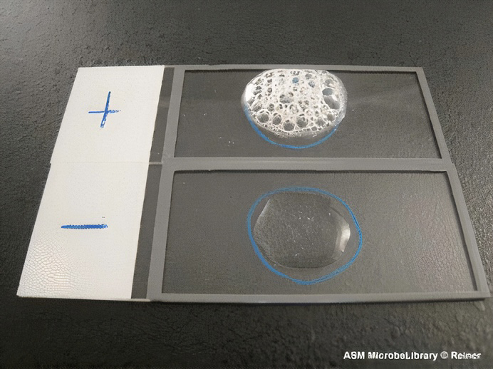
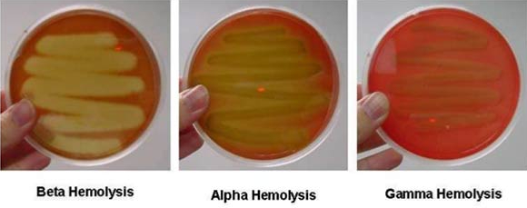
Methodology: Biochemical Testing
Bacterial isolates deemed antibiotic producers were subjected to biochemical testing, and all results were recorded.
Lactose Fermentation
Amylase Synthesis
Hemolysin Synthesis
Catalase Synthesis
Oxidase Synthesis
Photo retrieved from https://microbeonline.com/catalase-test-principle-uses-procedure-results/.
Photo retrieved from https://microbenotes.com/hemolysis-of-streptococci/
Hernandez et al., 2018
Notes:
13 of the 21 original bacterial isolates were deemed producers.
PCR stands for “ “…you create a solution containing the isolate and specific primers in a microcentrifuge tube, put it in a thermocycler (just called PCR machine), and allow it to run for the cycle. Its purpose is to amplify a particular portion of DNA. This type amplifies the 16s rRNA gene.
Gel electrophoresis…

Slide 8
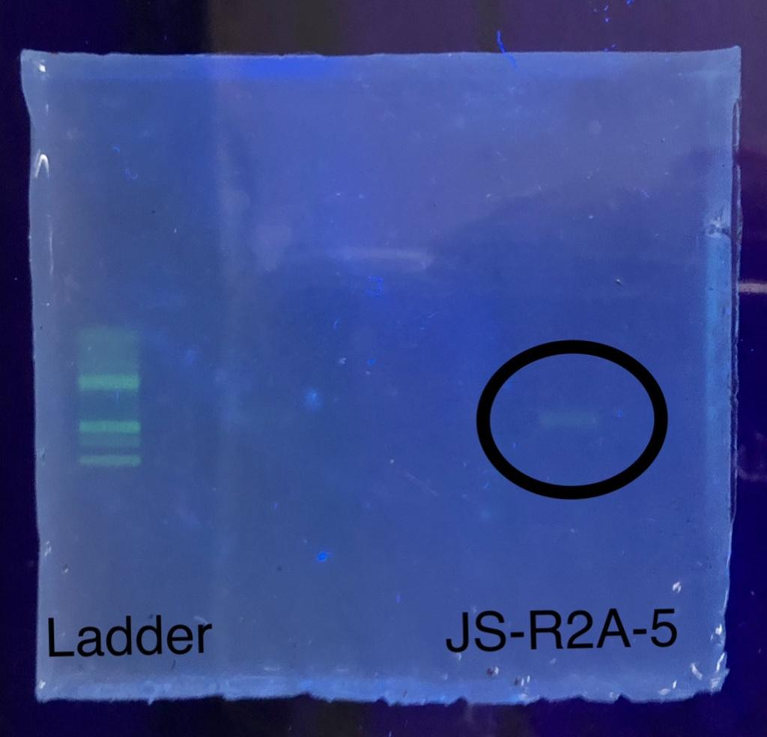
Methodology: 16S rRNA Gene PCR
PCR was performed on the 16s rRNA gene and confirmed using agarose gel electrophoresis.
PCR samples were used for Sanger sequencing, and the derived sequences were used to determine the likely identity of each isolate.
Hernandez et al., 2018
Notes:
13 of the 21 original bacterial isolates were deemed producers.
PCR stands for “ “…you create a solution containing the isolate and specific primers in a microcentrifuge tube, put it in a thermocycler (just called PCR machine), and allow it to run for the cycle. Its purpose is to amplify a particular portion of DNA. This type amplifies the 16s rRNA gene.
Gel electrophoresis…

Slide 9
Results: Biochemical Testing and BLAST Top Genus Match
Isolate ID | MacConkey | Starch | Blood | Catalase | Oxidase | Top Genus Match
Isolate ID | MacConkey | Starch | Blood | Catalase | Oxidase | Top Genus Match
HL-18B | - | - | G | + | - | Pseudomonas
HL-5a.a.2 | - | - | G | + | + | Pseudomonas
HL-5a.b. | - | - | G | + | - | Pseudomonas
JS-AD | - | - | G | + | - | Pseudomonas
JS-12 | - | + | G | + | - | Pseudomonas
JS-5 | - | - | G | + | + | Janthinobacterium
JS-5A | - | - | G | + | - | Pseudomonas
JS-1A | - | - | G | + | - | Arthrobacter
JS-30Y | - | + | A | - | - | Flavobacterium
RC-16 | - | - | B | + | - | Pseudomonas
RC-17Y | - | - | G | + | - | Pseudomonas
RC-18 | - | - | G | + | + | Pseudomonas
CE-16 | - | - | B | + | + | Pseudomonas
RC-17Y | - | - | G | + | - | Pseudomonas
RC-18 | - | - | G | + | + | Pseudomonas
CE-16 | - | - | B | + | + | Pseudomonas
Notes:
We execute biochemical testing for an extra level of characterization.
Found results for all 13 producers.
Look into JS-R2A-5.

Slide 10
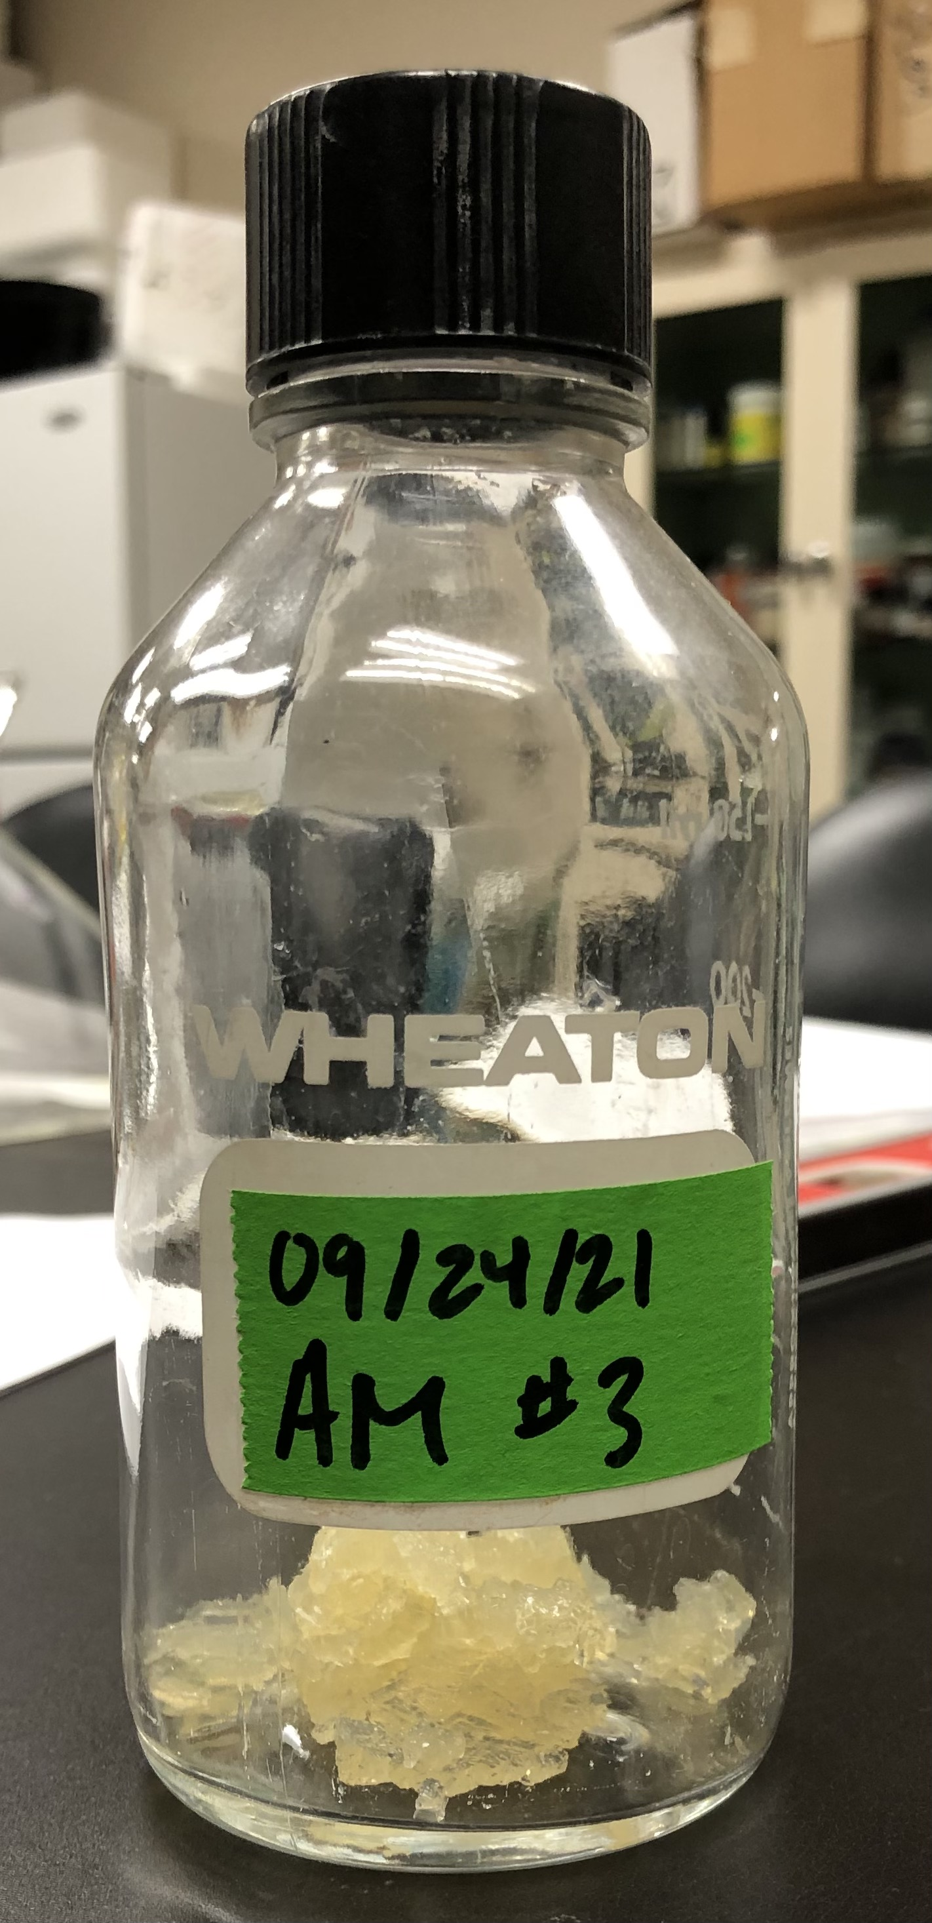
Methodology: Organic Extraction
Freezer stock of RC-17Y was used to make a spread plate on its predetermined growth medium.
Spring 2021
1-week
Fall 2021
1-week
Agar was cut up into 1 cm pieces, transferred into a capped bottle, and placed in the -80ºC freezer.
Capped bottle was placed on the shaker following the addition of ethyl acetate.
Hernandez et al., 2018

Slide 11
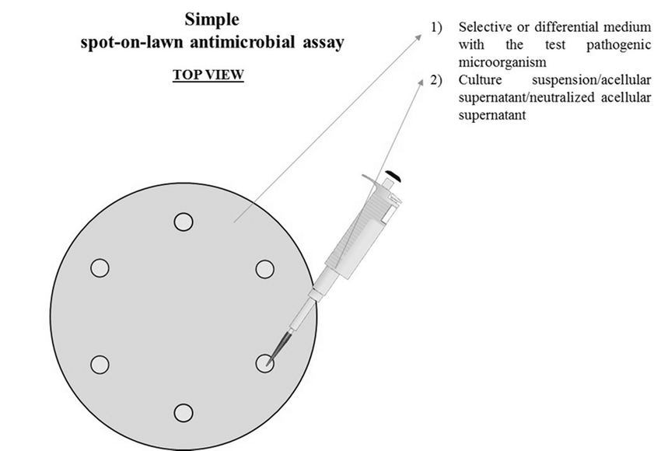
Methodology: Assay Extract for Antibiotic Activity
4 spread plates of A. baylyi and S. epidermidis (2 for each ESKAPE pathogen relative) were made from overnight liquid cultures.
Dried extracts were resuspended in methanol at a concentration of 10 μg/μL.
5 concentrations of extract (100 μg/μL, 50 μg/μL, 25 μg/μL, 10 μg/μL, and 5 μg/μL) were created utilizing the method of serial dilution.
Spread-Spot method was executed with 10 μL of each dilution.
Photo retrieved from https://www.researchgate.net/figure/Simple-spot-on-lawn-antimicrobial-assay_fig1_334535091
Hernandez et al., 2018

Slide 12
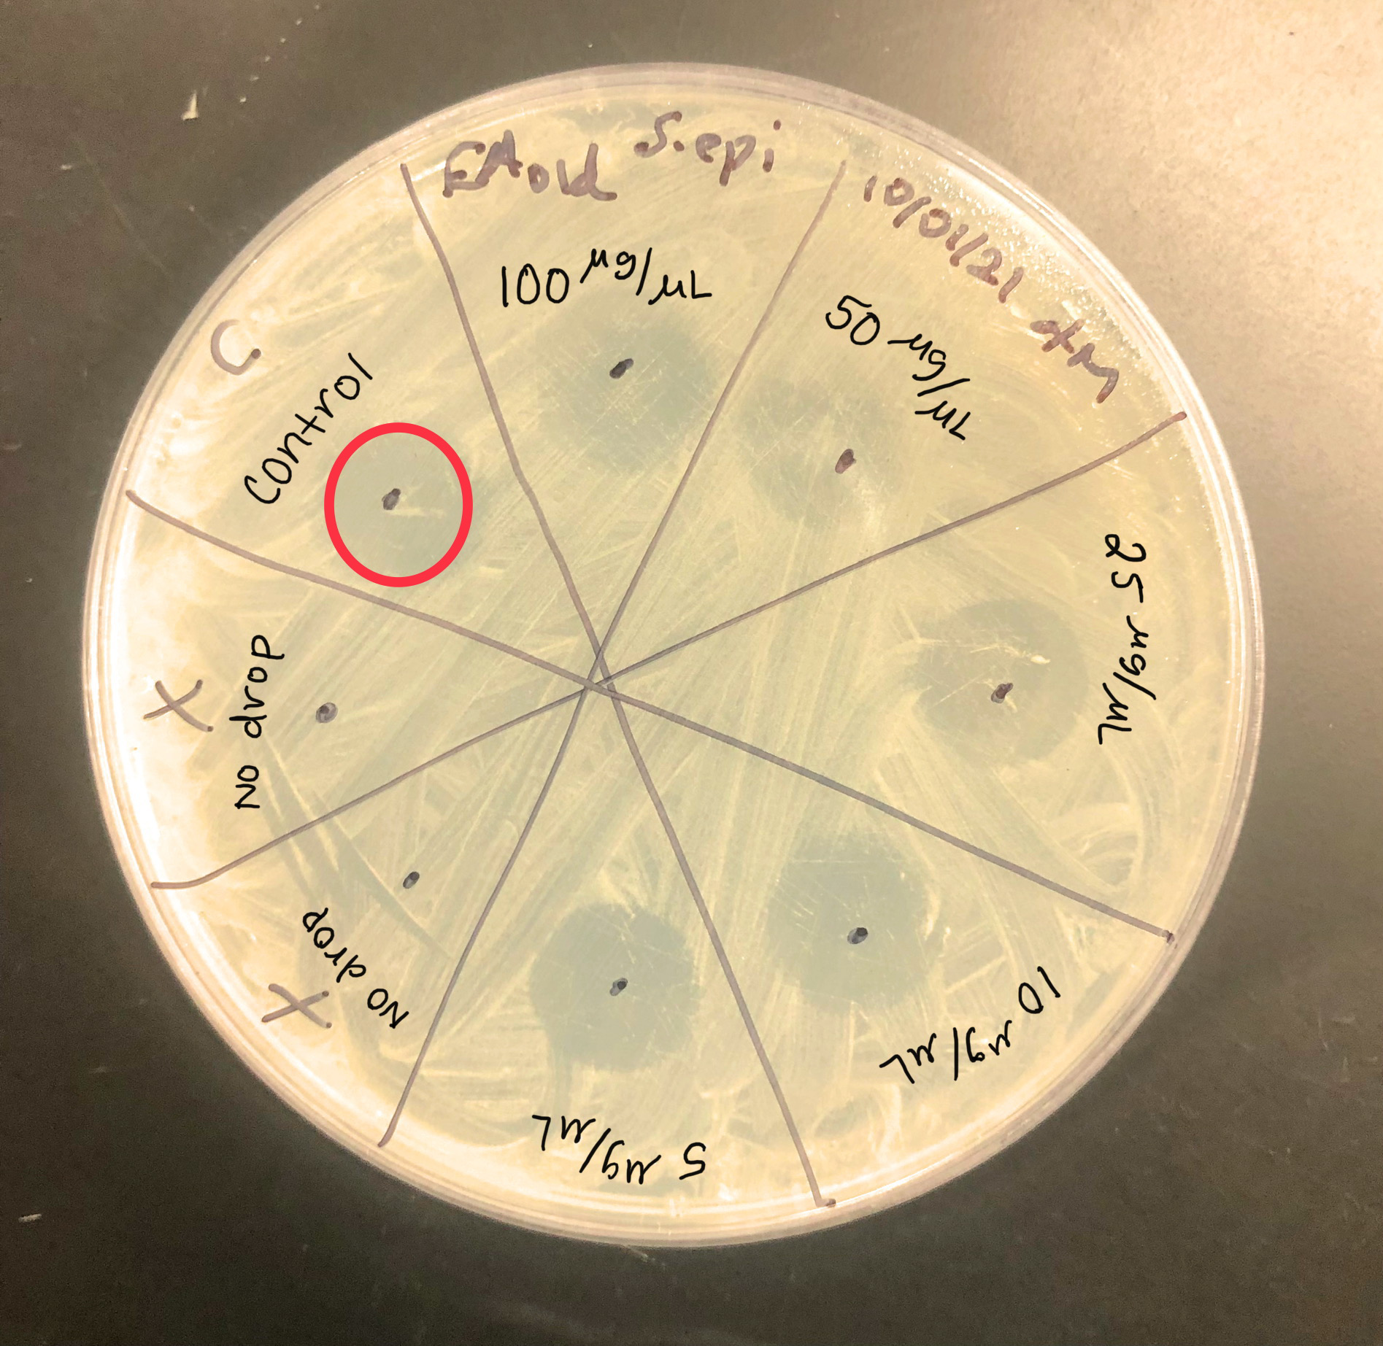
Results: Zones of Inhibition
All 4 plates were deemed inconclusive due to negative control displaying a zone of inhibition.
Notes:
This is a representative image…it displayed the clearest zones of inhibition (including the methanol control).

Slide 13
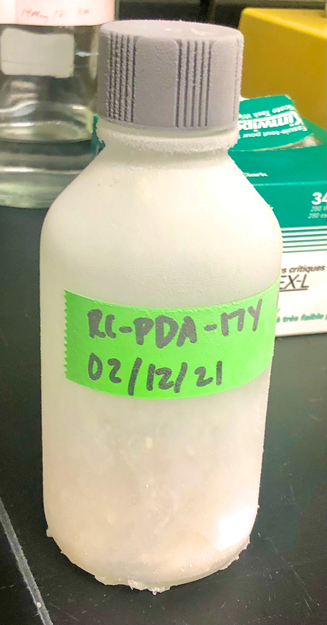
Discussion
All 21 bacterial isolates were deemed antibiotic producers by a past class, but only 13 displayed this characteristic.
5 bacterial isolates produced broad-spectrum antibiotics (Solomon et al., 2001)
Diverse biochemical testing results were derived for the 13 bacterial isolates.
10 of the 13 bacterial isolates derived likely genus as Pseudomonas.
Isolate RC-17Y was subjected to the extraction protocol due to its ability to produce antibiotics against the most ESKAPE pathogen relatives.
Zones of inhibition were observed for all concentrations and negative control, causing those results to be considered inconclusive (Braun & Stolp, 1985).

Slide 14
Future Experimentation
Enter Results into Tiny Earth Database
Send Bacterial Isolate Samples to the Tiny Earth Chem Hub
Improve Organic Extraction Methods
Bacterial Inhibition Testing with Purified Chemicals
Host Toxicity Testing with Eukaryotic Cells
Structural Characterization with Chemical Analysis
Notes:
I started chemical extraction last semester but was halted because school closure due to COVID-19.

Slide 15
Acknowledgements
Dr. Rachel Pritchard
Michael Vacik
Dr. Krystal Hamorsky
Division of Natural Sciences and Mathematics
University of Kentucky HealthCare Genomics Core Laboratory
Work Study Students
Notes:
Dr. Rachel Pritchard for training of Tiny Earth Protocol and mentorship.
Mike for training of Tiny Earth Protocol and basic lab procedures.
Dr. Krystal Hamorsky for her wise guidance.
Division of Natural Sciences and Mathematics for providing the necessary workspace and funding.
Work Study Students for media preparation and instrument sterilization.

Slide 16
References
2019. The tiny Earth manuals are ready! Tiny Earth.
2020. About antibiotic resistance. Centers for Disease Control and Prevention. Centers for Disease Control and Prevention.
Braun M, Stolp H. 1985. Degradation of methanol by a sulfate reducing bacterium. Archives of Microbiology 142:77–80.
Denkova R, Goranov B, Teneva D, Denkova Z. 2017. Antimicrobial activity of probiotic microorganisms: mechanisms of interaction and methods of examination 201–212.
Hamilton SM, Bayer CR, Stevens DL, Bryant AE. 2013. Effects of selective and nonselective nonsteroidal anti-inflammatory drugs on antibiotic efficacy of experimental group a streptococcal Myonecrosis. Journal of Infectious Diseases 209:1429–1435.
Jernigan JA, Hatfield KM, Wolford H, Nelson RE, Olubajo B, Reddy SC, McCarthy N, Paul P, McDonald LC, Kallen A, Fiore A, Craig M, Baggs J. 2020. Multidrug-resistant bacterial infections in U.S. hospitalized patients, 2012–2017. New England Journal of Medicine 382:1309–1319.
Kratzenberg J. 2020. Kentucky Wesleyan College recognized for having one of the nation's best online bachelor degree programs. Lane Report | Kentucky Business & Economic News.
Mainous AG, Diaz VA, Matheson EM, Gregorie SH, Hueston WJ. 2011. Trends in hospitalizations with antibiotic-resistant infections: U.S., 1997–2006. Public Health Reports 126:354–360.
Piddock LJV. 2012. The crisis of no new antibiotics—what is the way forward? The Lancet Infectious Diseases 12:249–253.
Solomon DH, Van Houten L, Glynn RJ, Baden L, Curtis K, Schrager H, Avorn J. 2001. Academic detailing to improve use of broad-spectrum antibiotics at an academic medical center. Archives of Internal Medicine 161:1897.

Slide 17
Questions?

