Slide 1


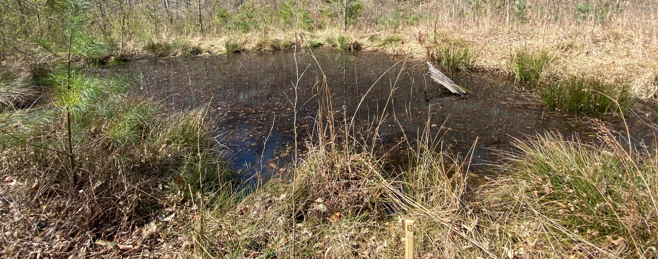
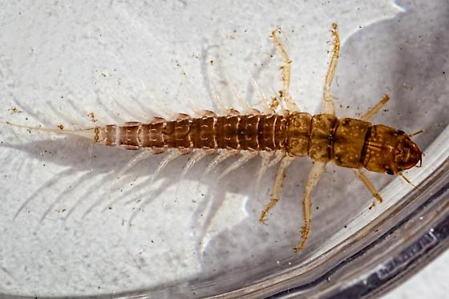
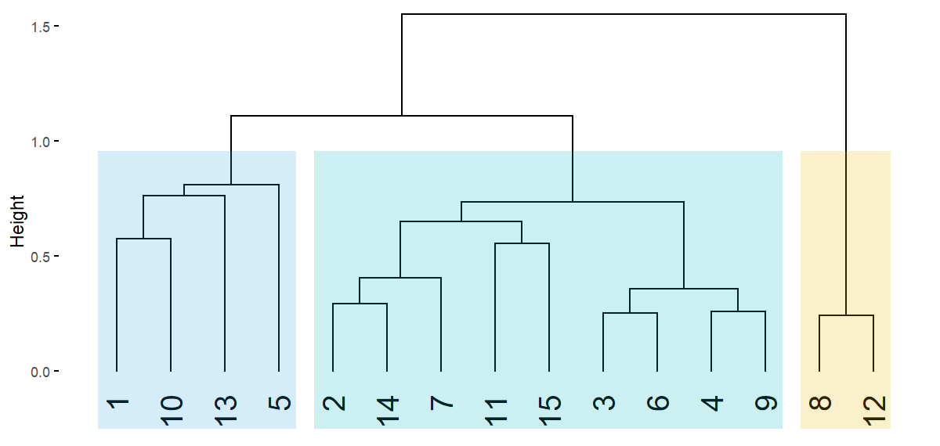
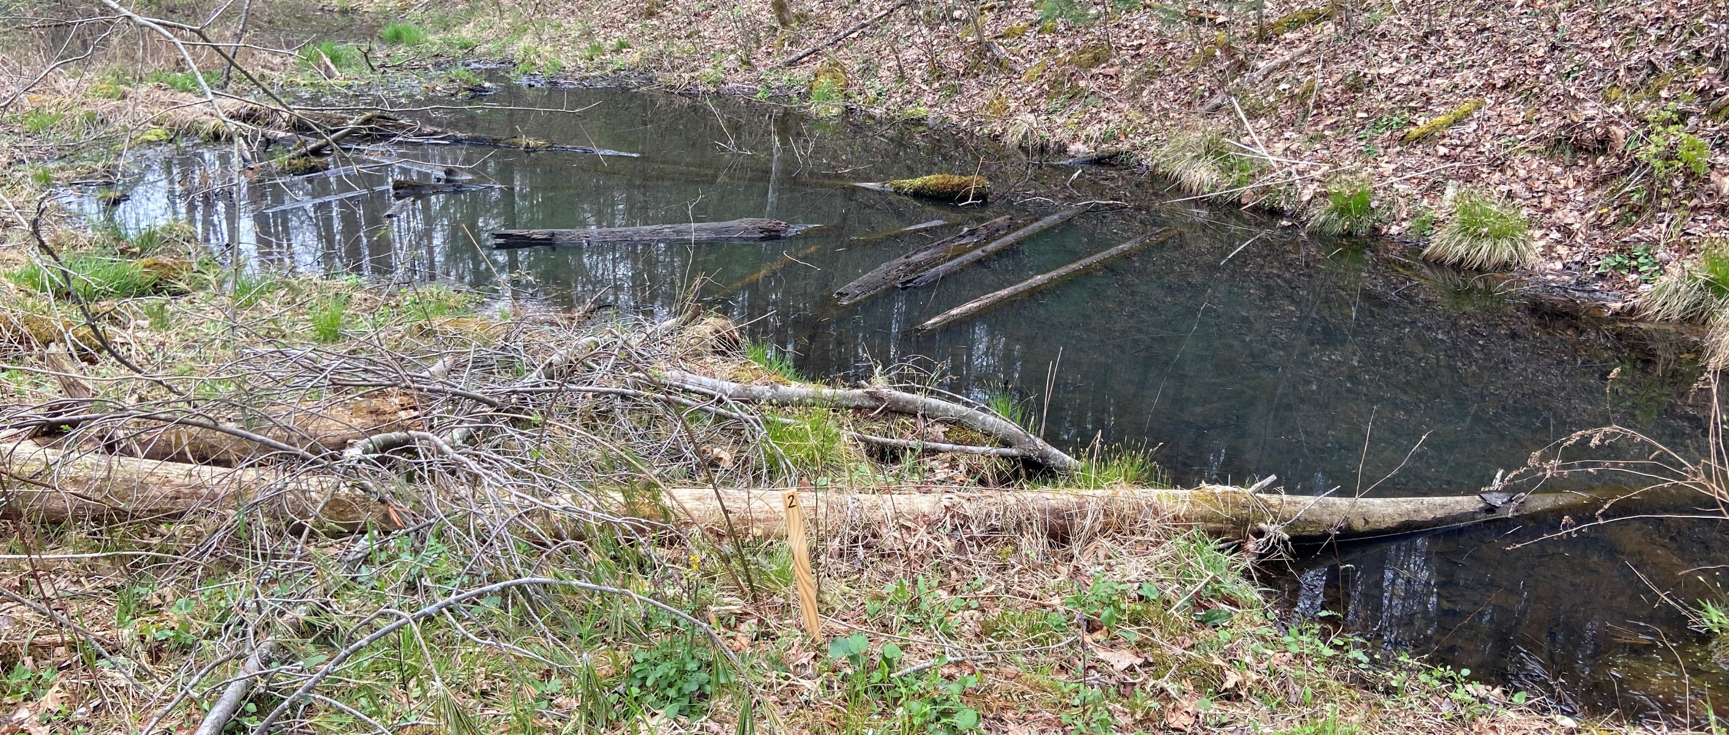
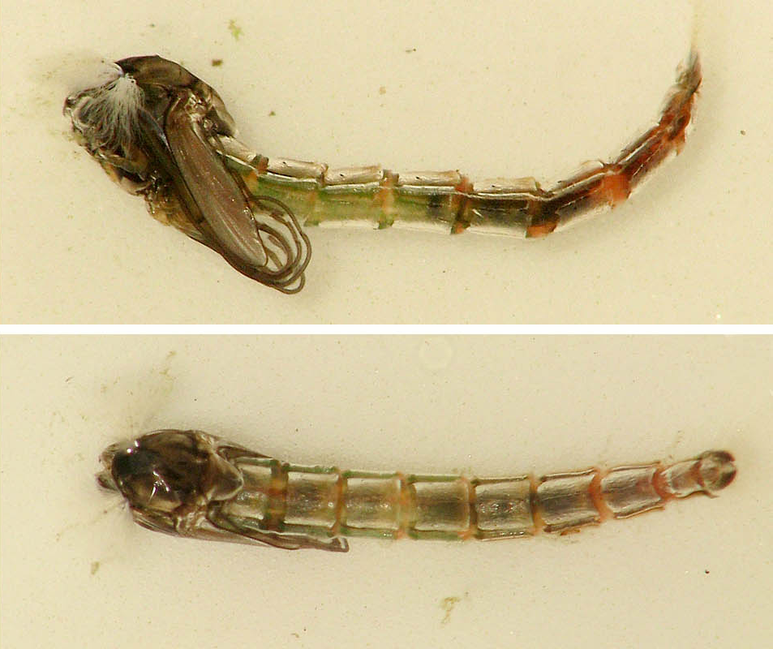
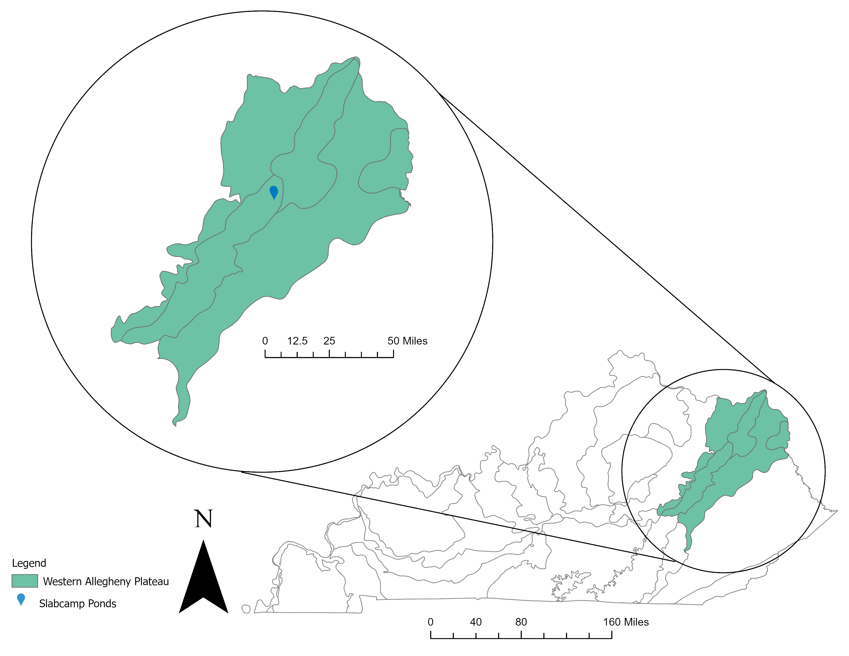
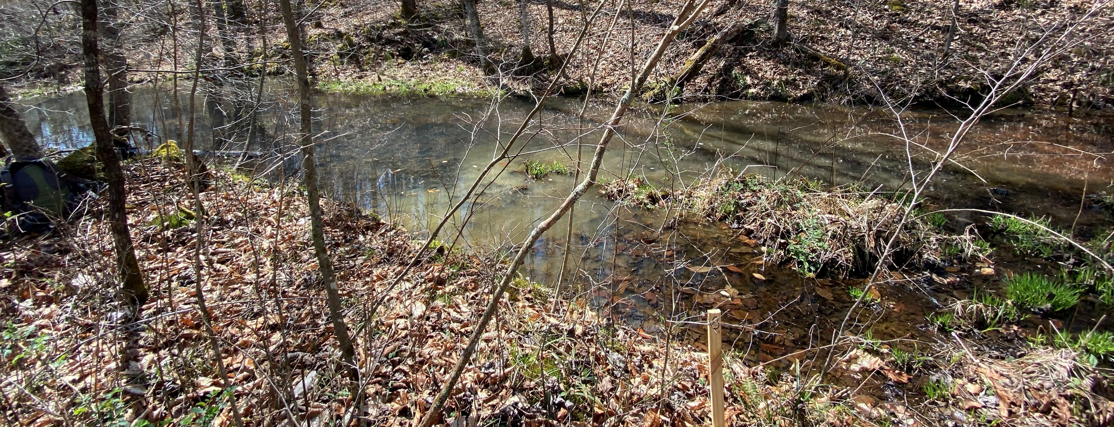
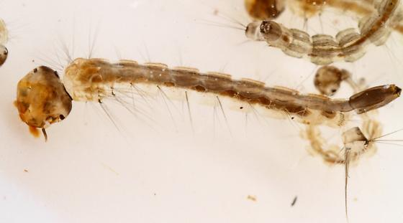
Invertebrate assemblage structure within floodplain depressional ponds of a restored headwater valley in Southern Appalachia
Katie Cody*¹, Amy Braccia ¹, Jesse Robinson², Michael Croasdaile², and Arthur Parola²
Introduction:
Stream and wetland restoration and mitigation efforts have increased in the last 40 years
There is a limited understanding of the ecological structure and function of newly restored, mitigated, or created wetlands because of few follow-up studies
The headwater valley of Slabcamp Creek in Southern Appalachia is an example of a restored stream-wetland complex with unique, understudied habitats such as floodplain depressional ponds (FDPs)
Objective: To describe the wetland invertebrate assemblage structure within the FDPs of Slabcamp Creek’s restored headwater valley
Statistical Analyses:
To define groups, a Bray-Curtis dissimilarity matrix was ran on relative abundance data in R Studio followed by an agglomerative hierarchical cluster analysis. An indicator species analysis was ran to identify potential indicators for each group. Packages used for these analyses were Vegan, Cluster, and indicspecies.
Results:
Photo credit: bugguide.net
Richness: 10-13; Abundance: 26-200
Cluster Dendrogram with Pond Groupings
Figure 3. Pond 13 (Group 1), a representative of the indicator taxa, family Sialidae (bottom left), and the group richness and abundance ranges
Photo credit: diptera.info
Richness: 4-18 ; Abundance: 22-1892
Figure 2. Results of the cluster analysis using a Bray-Curtis dissimilarity matrix and flexible beta linkage. Elbow, silhouette, and gap stat methods were employed to determine the optimal number of clusters.
Figure 4. Pond 2 (Group 2), a representative of the indicator taxa, family Chironomidae (pupa) (bottom left), and the group richness and abundance ranges
Table 1. Results of indicator species analysis for each group. IndVal is the indicator value for each taxon and is a product of components A and B. Component A is the probability that a pond belongs to the group because the taxon is found there. Component B is the probability of finding the taxon in ponds belonging to the group.
Figure 1. Map showing the location of the ponds within Slabcamp Creek’s Headwater Valley
Field Methods:
Fifteen FDPs were randomly selected for invertebrate sampling in April 2021
Semi-quantitative samples were taken with a D-frame net
Qualitative samples were collected from vegetation and coarse woody debris
Invertebrates were sorted and identified to the lowest practical taxonomic level
Photo credit: bugguide.net
Richness: 5-7; Abundance: 19-42
Figure 5. Pond 8 (Group 3), a representative of the indicator taxa, genus Aedes spp. (bottom left), and the group richness and abundance ranges
Discussion:
Group 3 FDPs dried in August 2021, indicating hydroperiod may be influencing the invertebrate assemblage
Previous studies indicate mosquitos tend to dominate ephemeral ponds
Chironomidae tend to dominate perennial ponds
Going Forward:
FDPs were sampled again in July 2021 and will be sampled again in early Nov. 2021 to analyze seasonality
Several environmental variables are being measured to see if they can explain the variance in the assemblage structure of the FDPs
Contact: *katie_cody1@mymail.eku.edu; Acknowledgements: US EPA Region 4, University of Louisville Stream Institute, Dr. David Brown, Dr. Sherry Harrel, Emily Jones, Olivia Bowling, Sandra Elliott, “KC” Carter, Ted Brancheau, Dr. Cy Mott, Holly Rabnott, and Robert Pace
Notes:
The height of the dendrogram indicates the order in which the clusters were joined. Height on cluster dendrogram indicates how similar the groups are. The shorter the height of the link that joins them, the more similar. The height is equal to the distance metric between groups. The shorter, the more similar; the higher, the less similar. Since I used dissimilarity, the closer to 0 means the more similar they are and vice-versa

