Slide 1
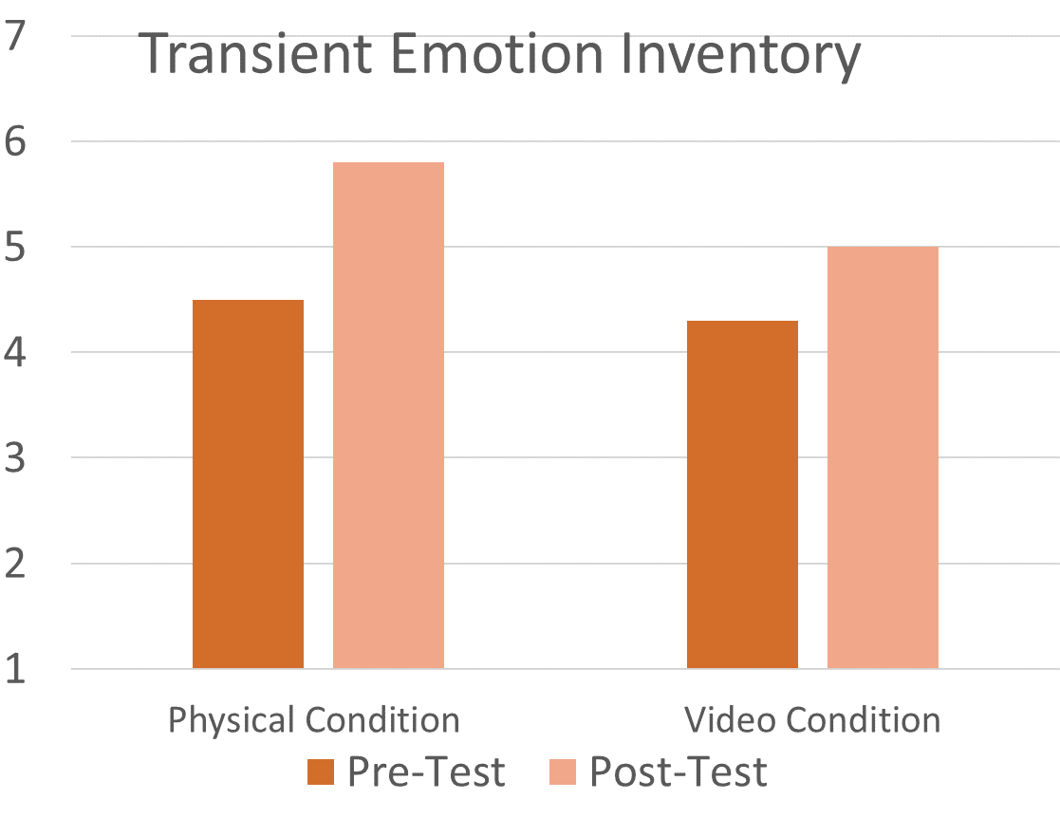
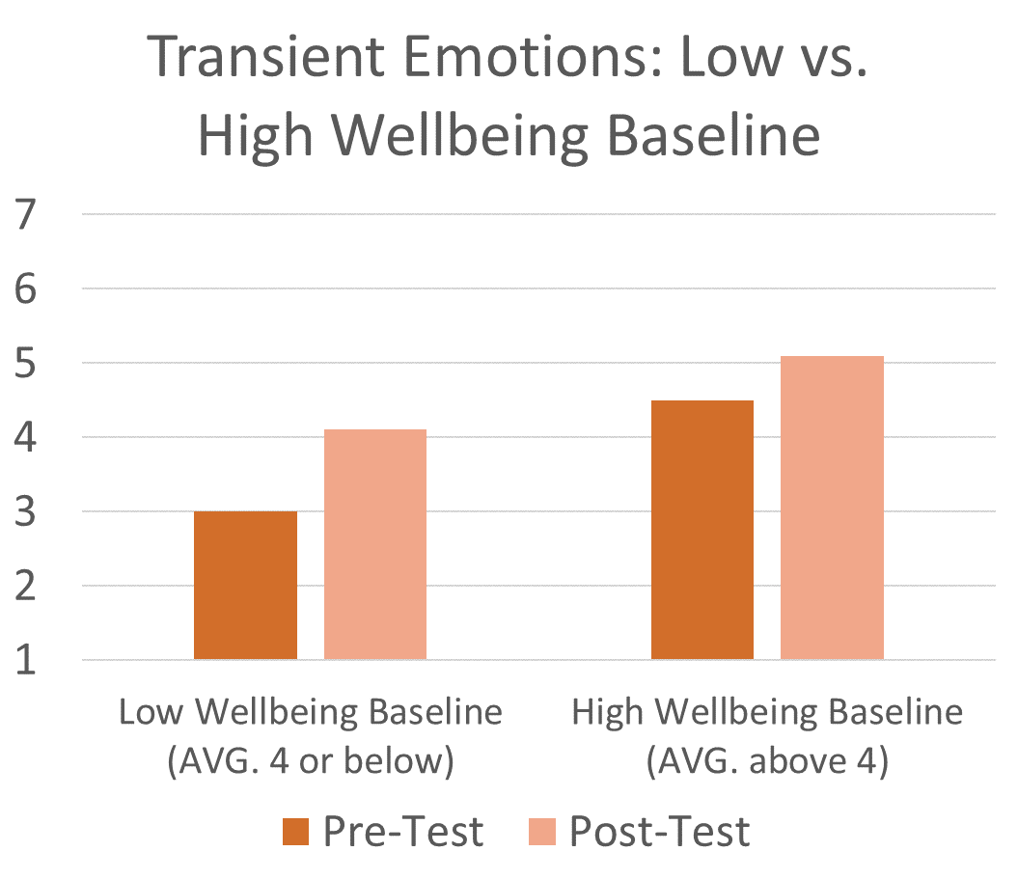
Human-Dog interactions: Effects on openness and happiness
Christian Phillips, Benjamin Meadows, Katelynn McClure, Hung-Tao M. Chen
Department of Psychology, Eastern Kentucky University
INTRODUCTION
The use of animal-assisted therapy and virtual therapy is increasing as an alternative to traditional therapy.
In a college setting, canine-assisted therapy has proven effective at helping students’ sense of openness and happiness (wellbeing).
Questions:
Is there a different effect when interacting with a dog in-person vs. watching a video?
Are these interactions more effective for individuals who report having lower baseline wellbeing?
RESULTS(hypothesized)
Both conditions saw improved transient wellbeing.
Participants with a low wellbeing baseline had a greater positive sense of transient wellbeing than those with a high wellbeing baseline after the physical condition.
Participants who watched the video experienced little change to their transient wellbeing.
Transient Emotion Rating
Transient Emotion Rating
METHOD
Design & Materials
Between groups design with two conditions
Physical interactions with dog
2) Watch a video of a human and dog interacting
Each group completed a pretest and post test survey to measure baseline and transient emotional state.
Procedure
Introduction to study
Complete pre-test emotion inventory
Interaction with dog or watch video
Complete post-test emotion inventory
Debriefing
REFERENCES
Atkinson, R. K., Mayer, R. E., & Merrill, M. M. (2005). Fostering social agency in multimedia learning: Examining the impact of an animated agent’s voice. Contemporary Educational Psychology, 30(1), 117–139. https://doi.org/10.1016/j.cedpsych.2004.07.001
Chen, H.-T., & Lorch, R. F., Jr. (2018). Effects of audio headings on learning. Journal of Experimental Psychology: Applied, 24(2), 207–221. https://doi.org/10.1037/xap0000143
Craig, S. D., & Schroeder, N. L. (2017). Reconsidering the voice effect when learning from a virtual human. Computers & Education, 114, 193–205. https://doi.org/10.1016/j.compedu.2017
Hart, S. G. (2006). Nasa-Task Load Index (NASA-TLX); 20 Years Later. Proceedings of the Human Factors and Ergonomics Society Annual Meeting, 50(9), 904–908. https://doi.org/10.1177/154193120605000909
Lorch, R. F., Jr., Chen, H.-T., & Lemarié, J. (2012). Communicating headings and preview sentences in text and speech. Journal of Experimental Psychology: Applied, 18(3), 265–276. https://doi.org/10.1037/a0029547
Mayer, R. E., Sobko, K., & Mautone, P. D. (2003). Social cues in multimedia learning: Role of speaker’s voice. Journal of Educational Psychology, 95(2), 419–425. https://doi.org/10.1037/0022-0663.95.2.419
Mayer, R. E. (2017). Using multimedia for e-learning. Journal of Computer Assisted Learning, 33(5), 403–423. https://doi.org/10.1111/jcal.12197
Salomon, G. (1984). Television is “easy” and print is “tough”: The differential investment of mental effort in learning as a function of perceptions and attributions. Journal of Educational Psychology, 76(4), 647–658. https://doi.org/10.1037/0022-0663.76.4.647
Sweller, J., van Merriënboer, J.J.G. & Paas, F. (2019). Cognitive Architecture and Instructional Design: 20 Years Later. Educational Psychology Review, 31, 261–292. https://doi.org/10.1007/s10648-019-09465-5

Slide 2
Human-Dog interactions: Effects on openness and happiness
Christian Phillips, Benjamin Meadows, Katelynn McClure, Hung-Tao M. Chen
Department of Psychology, Eastern Kentucky University
INTRODUCTION
The use of animal-assisted therapy and virtual therapy is increasing as an alternative to traditional therapy
In a college setting, canine-assisted therapy has proven effective at helping students’ sense of openness and happiness (wellbeing).
Questions:
Is there a different effect when interacting with a dog in-person vs. watching a video?
Are these interactions more effective for individuals who report having lower baseline wellbeing?

Slide 3
Human-Dog interactions: Effects on openness and happiness
Christian Phillips, Benjamin Meadows, Katelynn McClure, Hung-Tao M. Chen
Department of Psychology, Eastern Kentucky University
METHOD
Design & Materials
Between groups design with two conditions
1) Physical interactions with dog
2) Watch a video of a human and dog interacting
Each group completed a pretest and post test survey to measure baseline and transient emotional state.
Procedure
Introduction to study
Complete baseline & transient pre-test emotion inventory
Interaction with dog or watch video
Complete transient post-test emotion inventory
Debriefing

Slide 4
Human-Dog interactions: Effects on openness and happiness
Christian Phillips, Benjamin Meadows, Katelynn McClure, Hung-Tao M. Chen
Department of Psychology, Eastern Kentucky University
Transient Emotion Rating

Slide 5
Human-Dog interactions: Effects on openness and happiness
Christian Phillips, Benjamin Meadows, Katelynn McClure, Hung-Tao M. Chen
Department of Psychology, Eastern Kentucky University
Transient Emotion Rating

Slide 6
Human-Dog interactions: Effects on openness and happiness
Christian Phillips, Benjamin Meadows, Katelynn McClure, Hung-Tao M. Chen
Department of Psychology, Eastern Kentucky University
RESULTS
Both conditions saw improved transient wellbeing.
Participants with a low wellbeing baseline had a greater positive sense of transient wellbeing than those with a high wellbeing baseline after the physical condition.
Participants who watched the video experienced little change to their transient wellbeing.

Slide 7
Human-Dog interactions: Effects on openness and happiness
Christian Phillips, Benjamin Meadows, Katelynn McClure, Hung-Tao M. Chen
Department of Psychology, Eastern Kentucky University
Questions/Feedback
Christian_phillip38@mymail.eku.edu

Slide 8
Human-Dog interactions: Effects on openness and happiness
Christian Phillips, Benjamin Meadows, Katelynn McClure, Hung-Tao M. Chen
Department of Psychology, Eastern Kentucky University
Binfet, J.-T., Green, F. L., & Draper, Z. A. (2021). The importance of client–canine contact in canine-assisted interventions: A randomized controlled trial. Anthrozoös, 1–22. https://doi.org/10.1080/08927936.2021.1944558
Bolton, D., & Bhugra, D. (2020). Changes in society and Young People’s Mental health1. International Review of Psychiatry, 33(1-2), 154–161. https://doi.org/10.1080/09540261.2020.1753968
Gee, N. R., Friedmann, E., Coglitore, V., Fisk, A., & Stendahl, M. (2015). Does physical contact with a dog or person affect performance of a working memory task? Anthrozoös, 28(3), 483–500. https://doi.org/10.1080/08927936.2015.1052282
Goldberg, L. R. (1993). The structure of phenotypic personality traits. American Psychologist, 48(1), 26–34. https://doi.org/10.1037/0003066x.48.1.26
Hills, P., & Argyle, M. (2002). The Oxford Happiness Questionnaire: A compact scale for the measurement of psychological well-being. Personality and Individual Differences, 33(7), 1073–1082. https://doi.org/10.1016/s0191-8869(01)00213-6
Owenby, B. E. (2016). The potential of animal-assisted therapy within the Supervisory Alliance. Journal of Creativity in Mental Health, 12(1), 146–159. https://doi.org/10.1080/15401383.2016.1184113
Pręgowski, M. P. (2015). Your dog is your teacher: Contemporary dog training beyond radical behaviorism. Society & Animals, 23(6), 525–543. https://doi.org/10.1163/15685306-12341383
Torous, J. B., Chan, S. R., Gipson, S. Y.-M., Kim, J. W., Nguyen, T.-Q., Luo, J., & Wang, P. (2018). A hierarchical framework for evaluation and informed decision making regarding smartphone apps for clinical care. Psychiatric Services, 69(5), 498–500. https://doi.org/10.1176/appi.ps.201700423
Trammell, J. P. (2019). Therapy dogs improve student affect but not memory. Anthrozoös, 32(5), 691–699. https://doi.org/10.1080/08927936.2019.1645514

