Slide 1
One-pot reaction of pyruvate carboxylase and phosphoenolpyruvate carboxykinase for the production of deuterated phosphoenolpyruvate
Liat Ungar¹ and Catherine L. Shelton²
¹Department of Biological Sciences, Northern Kentucky University, Highland Heights, KY
²Department of Chemistry & Biochemistry, Northern Kentucky University, Highland Heights, KY

Slide 2
Introduction
Current rise in antibiotic resistant bacteria and decrease in new antibiotic synthesis
Shelton lab targeting menaquinone, siderophore, tryptophan (MST) enzymes for antibiotic production
Uncertainty of lyase mechanism of MST enzymes
  Evidence for general acid-general base and pericyclic
  Lack of all-inclusive testing
Using isotopically labelled chorismate for kinetic isotope effect experiments
MbtI
Irp9
Chorismate
Salicylate
General acid-general base mechanism
Pericyclic mechanism

Slide 3
Synthesis of Isotopically Labelled Chorismate
Low yield in organic synthesis, therefore reconstituting Shikimate pathway in vitro
Requires labelled phosphoenolpyruvate (PEP) to incorporate deuterium in chorismate
Synthesizing labelled PEP with bacterial enzymes pyruvate carboxylase (PycA) and PEP carboxykinase (PckA) and labelled pyruvate
AroG, AroB, AroD, AroE, AroK, AroA, AroC
Erythrose-4-phosphate
Phosphoenolpyruvate (PEP)
Chorismate
Mg²⁺
Pyruvate Carboxylase
Pyruvate
Bicarbonate
Oxaloacetate
PEP Carboxykinase
Phosphoenolpyruvate (PEP)
Carbon dioxide
Oxaloacetate

Slide 4
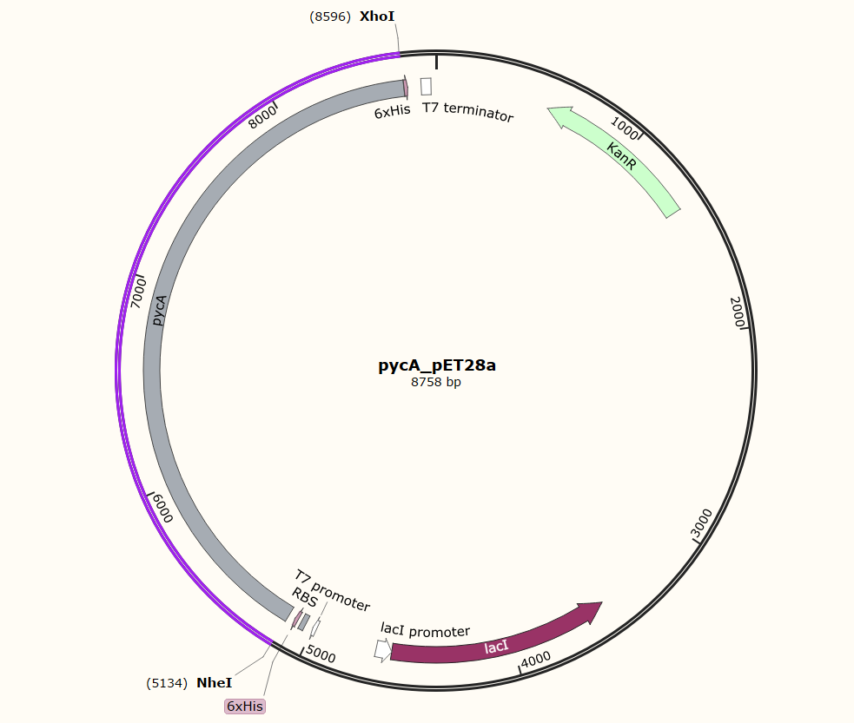
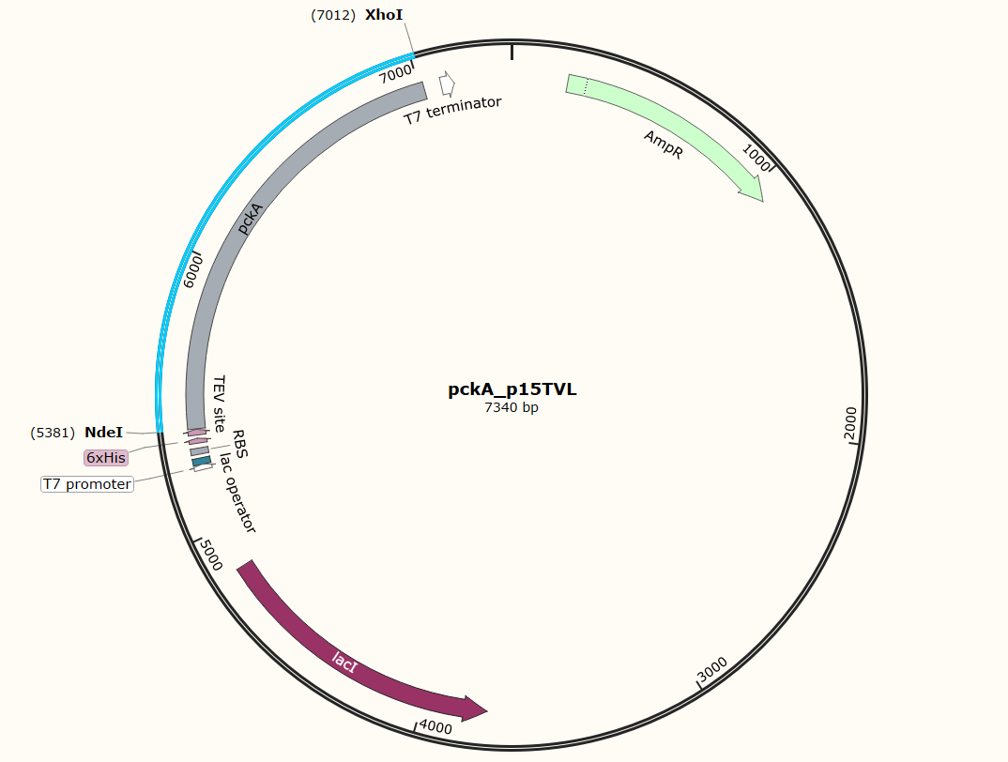
Overexpression Constructs of PycA and PckA

Slide 5
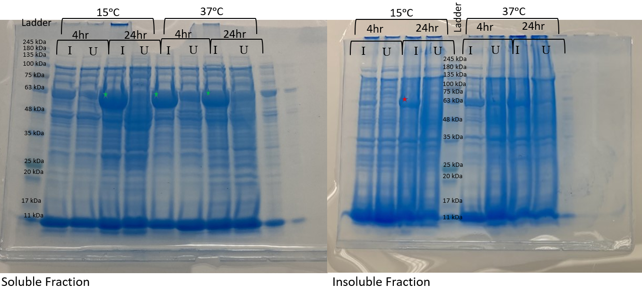
Determining Ideal Expression Conditions for PckA
PEP Carboxykinase
pckA p15 TV-L was transformed in BL21(DE3) cells. Protein expression was induced at 15ᵒC and at 37ᵒC for 4hr and 24hr. The ideal condition was at 15ᵒC for 24hr with induced expression.

Slide 6
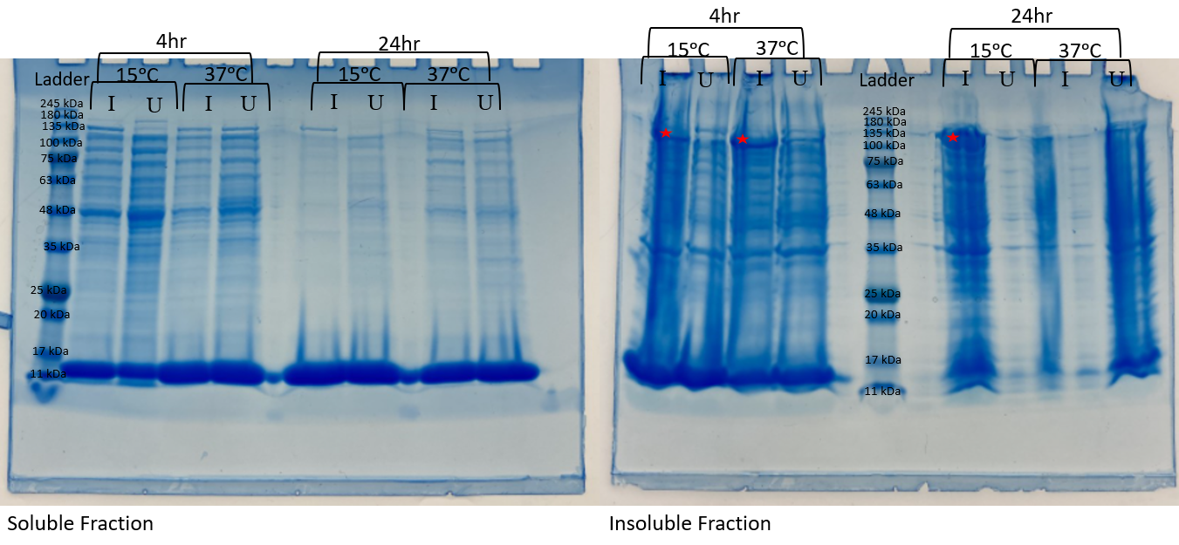
Determining Ideal Expression Conditions for PycA
Mg²⁺
Pyruvate Carboxylase
BL21(DE3)

Slide 7
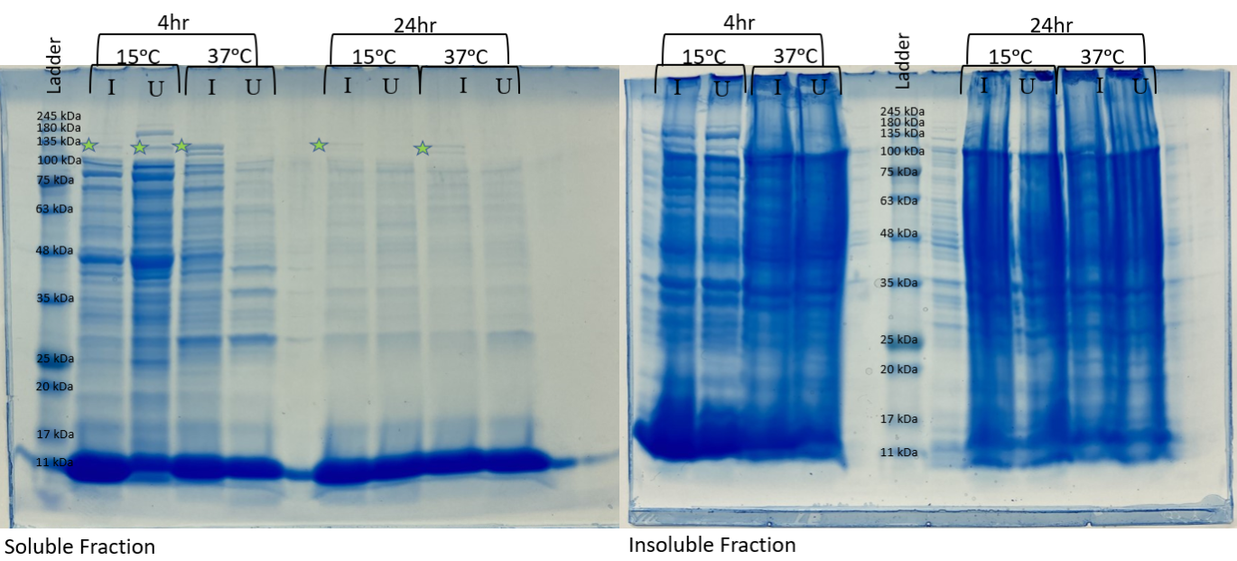
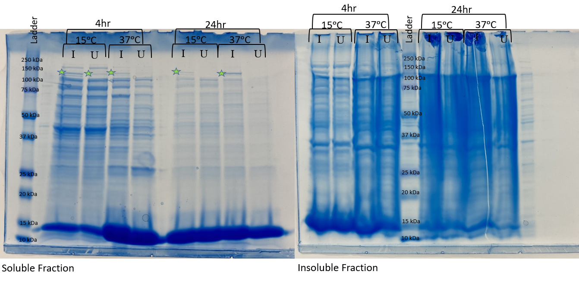
Determining Ideal Expression Conditions for PycA Continued
Mg²⁺
Pyruvate Carboxylase
C43(DE3)
C41(DE3)

Slide 8
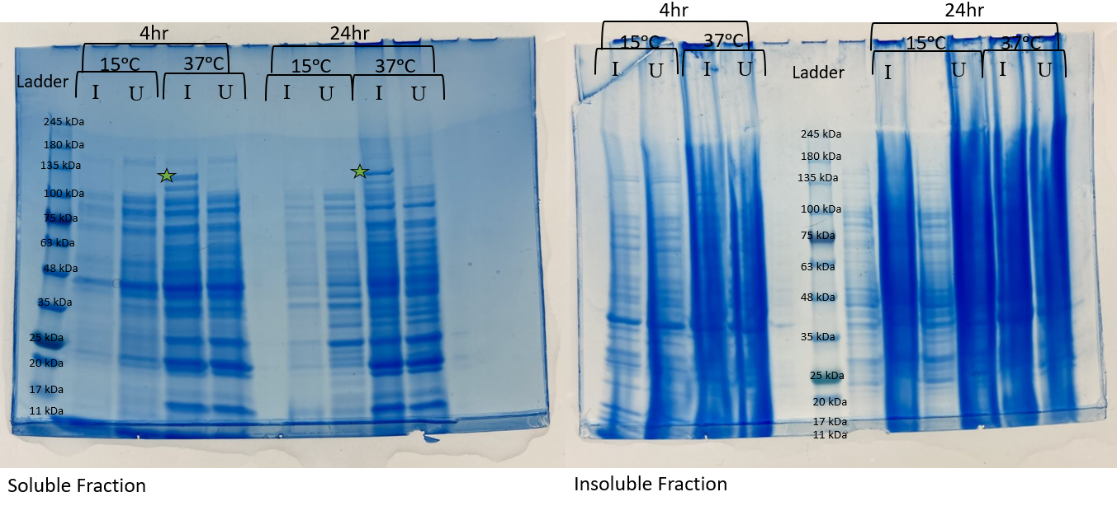
Determining Ideal Expression Conditions for PycA Continued
Mg²⁺
Pyruvate Carboxylase
C43(DE3) pLysS

Slide 9
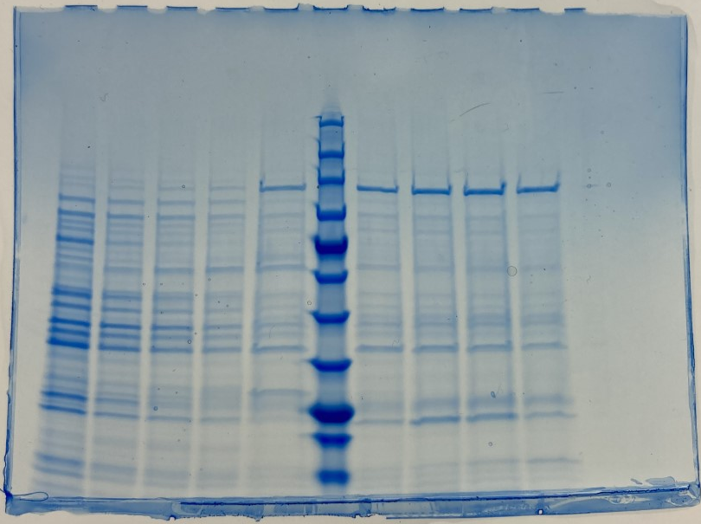
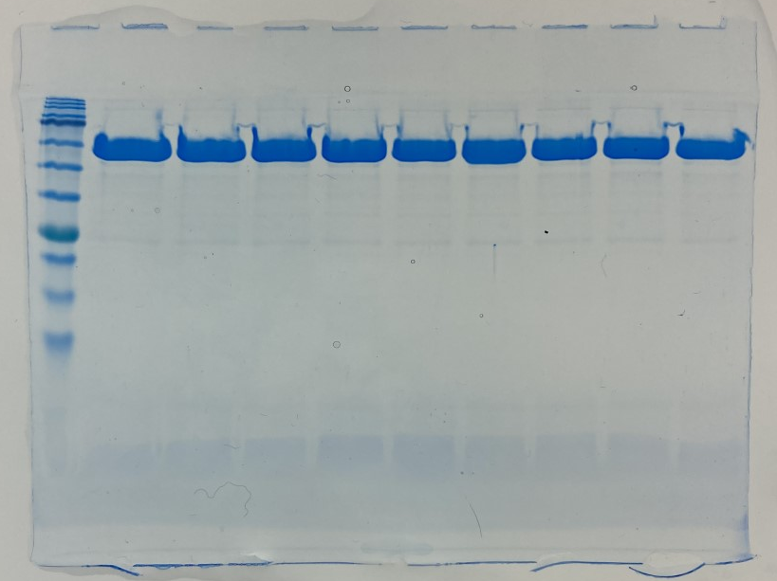
Protein Purification
PckA expressed in BL21(DE3) at 15ᵒC, 24hr, with IPTG
PycA expressed in C43(DE3) pLysS at 37ᵒC, 24hr, with IPTG
Both extracted from cells via French press and purified via FPLC
245 kDa
63 kDa
180 kDa
48 kDa
135 kDa
35 kDa
100 kDa
25 kDa
75 kDa
20 kDa
63 kDa
17 kDa
48 kDa
11 kDa
35 kDa
25 kDa
20 kDa
17 kDa
11 kDa
PycA
PckA

Slide 10
Future Directions
Pyruvate carboxylase
Express PycA with BirA
Assay function of PckA and PycA
One-pot reaction
  Confirm production of labelled PEP with NMR
Pyruvate
Oxaloacetate
Malate dehydrogenase
Oxaloacetate
Malate
PEP carboxykinase
Pyruvate Kinase
Lactate Dehydrogenase
Oxaloacetate
Phosphoenolpyruvate (PEP)
Pyruvate
Lactate

Slide 11
References
1. Sebbane, F.; Lemaître, N. Antibiotic Therapy of Plague: A Review. Biomolecules. [Online] 2021, 11, 724. https://pubmed.ncbi.nlm.nih.gov/34065940/ (Accessed Jul 7, 2021).
2. Ditchburn, J.; Hodgkins, R. Yersinia pestis, a Problem of the Past and a Re-emerging Threat. Biosafety and Health. [Online] 2019, 1, 65-70. https://www.sciencedirect.com/science/article/pii/S2590053619300230 (Accessed Jul 7, 2021).
3. Miethke, M.; Marahiel M.A. Siderophore-Based Iron Acquisition and Pathogen Control. Microbiology and Molecular Biology Reviews. [Online] 2007, 71, 413-451. https://www.ncbi.nlm.nih.gov/pmc/articles/PMC2168645/pdf/0012-07.pdf (Accessed Jul 7, 2021).
4. Culbertson, J.E.; Chung, D.; Ziebart, K.T.; Espiritu, E.; Toney, M.D. Conversion of Aminodeoxychorismate Synthase into Anthranilate Synthase with Janus Mutations: Mechanism of Pyruvate EliminationCatalyzed by Chorismate Enzymes. Biochemistry. [Online] 2015, 54, 2372-2384. https://pubmed.ncbi.nlm.nih.gov/25710100/ (Accessed Jul 7, 2021).
5. Miroux, B.; Walker, J.E. Over-production of Proteins in Escherichia coli: Mutant Hosts that allow Synthesis of some Membrane Proteins and Globular Proteins at High Levels. Journal of Molecular Biology. [Online] 1996, 260, 289-298. https://pubmed.ncbi.nlm.nih.gov/8757792/ (Accessed Jul 26, 2021).
6. Wagner, S.; Klepsch, M.M.; Schlegel, S.; Appel, A.; Draheim, R.; Tarry, M.; Hogbom, M.; van Wijk, K.J.; Slotboom, D.J.; Persson, J.O.; de Gier, J.W. Tuning Escherichia coli for Membrane Protein Overexpression. Proceedings of the National Academy of Sciences of the United States of America. [Online] 2008, 105, 14371-14376. https://www.ncbi.nlm.nih.gov/pmc/articles/PMC2567230/pdf/zpq14371.pdf (Accessed Jul 26, 2021).
7. Krebs, A.; Bridger, W.A. The Kinetic Properties of Phosphoenolpyruvate Carboxykinase of Escherichia coli. Can. J. Biochem. 1980, 58, 309-318.

Slide 12
Thank you! Questions?

