Slide 1
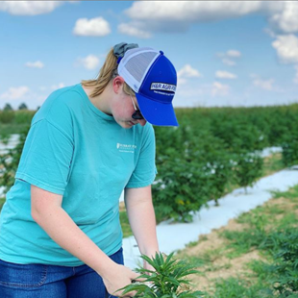
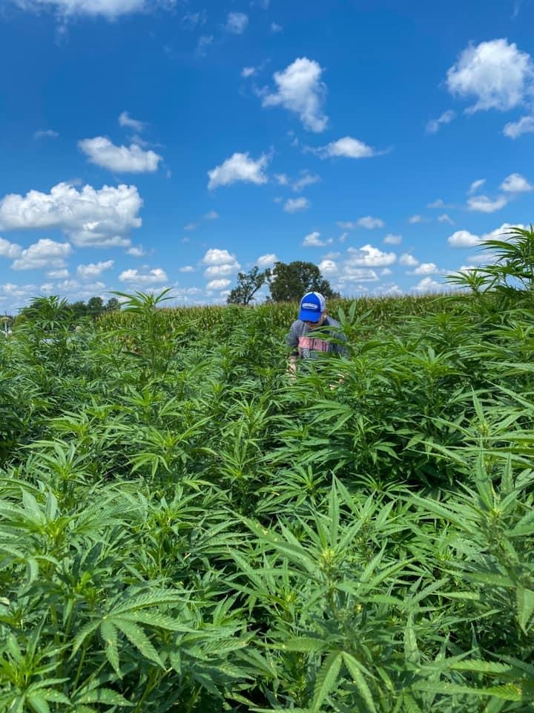
Evaluating the Impact of Rhizomicrobia Application
on Soil and CBD: First Year Study
Alexandria Riddle, Mallorie Snider, Brian Parr, and Iin Handayani
Hutson School of Agriculture, Murray State University, Murray, KY, USA
Introduction
Results
In recent years, an interest has developed in the rising hemp commodity. This rise in interest has in turn, led to an increase in the demand of hemp. One way to improve hemp production is by applying soil amendments such as rhizomicrobia (SoilCare). The objective of this study was to determine the impacts of different rates of rhizomicrobia solution on hemp growth parameters, hemp yield, and soil properties This research is pertinent to improving soil quality as well as developing a method to produce higher levels of CBD that can be used in medicinal and research facilities.
Treatments | Cation Exchange Capacity (meq/100g) | Soil pH | Organic Matter
Control | 8.3 | 5.1 | 1.93
Treatment 1 | 9.2 | 5.1 | 1.83
Treatment 2 | 7.9 | 5.1 | 1.92
Treatment 3 | 8.4 | 5.1 | 2.06
Study Site
The experiment was conducted on West Farm, owned by Murray State University in western Kentucky using CBD hemp, planted in June 2020. Established in 2001, West Farm has been the site of numerous research studies involving corn, soybeans, and even tobacco. West Farm is also the home of the University’s angus beef herd.
Conclusion
There is not a significant difference between the control and the treatments.
Treatment three (0.25 gal/ac) seemed to result in the highest chlorophyll levels, highest CBD %, produce the highest yield, as well as possess the highest amount of organic matter.
Soil pH does not seem to be affected by applied rhizomicrobia solution.
Treatment one (1 gal/ac) had the highest Cation Exchange Capacity.
Methods
In order to complete this experiment, we applied three different solutions of the microbe treatment as well as a control to different plots of soil before hemp was planted. Microbes were applied via backpack sprayer to each of the plots. Hemp was divided into the different treatment plots and replicated four times for each treatment. The hemp was monitored weekly, and the following measurements were taken: weekly average height, overall average height, yield per treatment, chlorophyll levels, true leaf count, and average percent of CBD per treatment.
Acknowledgements
This research was made possible by the support and funding of Wind River Microbes. We also thank Murray State University ORCA for providing the funding to travel here today.

