Slide 1
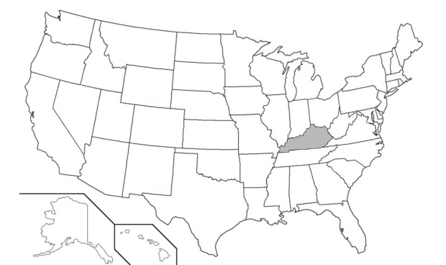
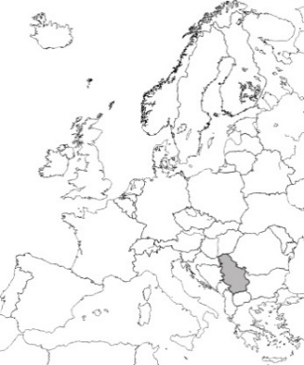
Center for Human-GeoEnvironmental Studies (CHNGES)
Western Kentucky University
United States of America
Deptartment of
Ecological Engineering
University of Belgrade
Republic of Serbia
Natural attenuation processes for petroleum releases in karst aquifers (Bowling Green, Kentucky)
Nenad MARIĆ, Jason POLK, James SHELLEY, James TROXELL, Zoran NIKIĆ
2021 Annual Meeting - Kentucky Academy of Science
11/06/2021
Notes:
Hello, I am Nenad Maric, Assistant Professor at the University of Belgrade and Visiting Scholar at the WKU.
This collaboration between CHNGES as the Center of Excellence from the WKU and University of Belgrade has been supported by Fulbright Commission.
This is an ongoing natural attenuation study in Bowling Green. Its focus are petroleum hydrocarbons as the most common groundwater contaminants.

Slide 2
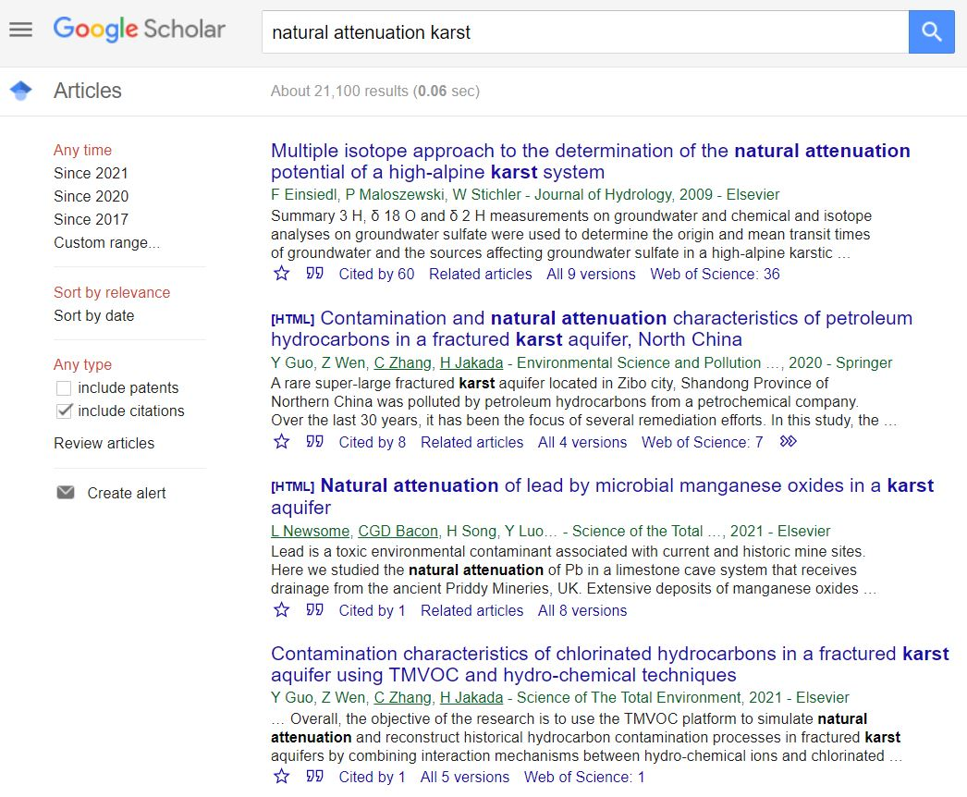
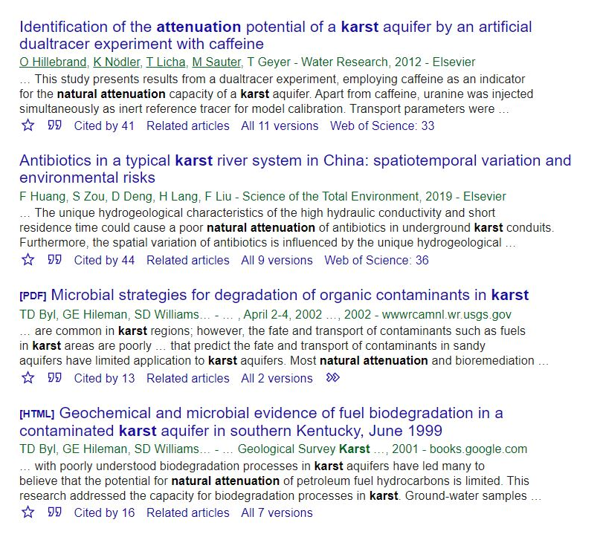
Karst aquifers and natural attenuation studies
Karst landscapes are formed by the dissolution of carbonate rocks (e.g. Mammoth Cave)
20–25% of the global population depends largely or entirely on groundwater from karst aquifers [e.g., San Antonio and Miami (US), Vienna (Austria), Rome (Italy)]
Karst groundwater systems are prone to contamination due to poor filtration and rapid infiltration from the surface
Natural attenuation processes in karst
are understudied
Notes:
As a researcher from Europe, I am honored to talk about karst here in Kentucky.
Globally karst is covering about 15% of the Earth’s surface.
Karst aquifers are important sources of drinking water for many regions of the world. These aquifers provide significant water supplies in 15 states in the US, and are a primary water sources for several cities with populations >1 million [e.g., San Antonio and Miami (United States), Vienna (Austria), Rome (Italy), and Damascus (Syria)]
On the other hand, natural attenuation processes of petroleum hydrocarbons in karst aquifers are understudied.
By using Google Scholar as a publication search platform, there are a few studies even on the first page.
Thus, this type of research is novel in karst. Thus lets talk about results of similar studies in from non-karst aquifers.

Slide 3
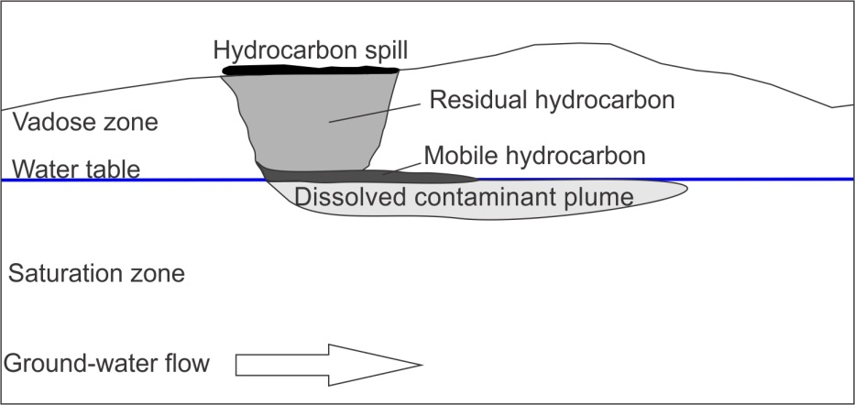
Groundwater contaminants in non-karst hydrogeologic settings: petroleum hydrocarbons
Sources
Groundwater contamination in the United States (NRC, 1994, 1997):
Leaking underground storage tanks (450,000)
Municipal solids and hazardous waste landfills (93,000)
Hazardous waste management sites (18,000)
Unlined pits, ponds, and lagoons (180,000)
Household septic systems (20 million)
Surface spills
Most petroleum hydrocarbon plumes are under 200 ft long
Reductions can occur,
even without remediation
Subsurface distribution of LNAPL spill
(Fetter, 1999)
Limit of migration of petroleum hydrocarbon plumes, based on combined reuslts from 604 sites (Newell and Conor, 1998)
Notes:
Petroleum hydrocarbons are among the most common groundwater contaminants, due to their widespread use.
Underground Storage Tanks are among the most common sources of contamination. During last three decades numerous studies were conducted at sites hydrocarbon-contaminated sites.
Here we can see a typical distribution of contamination in an unconfined aquifer. The dissolved plume is the primary focus in studying natural attenuation processes.
Data from more than 600 contaminated sites indicate that about 75% of the hydrocarbon plumes are less than 200 feet long!
This type of contamination undergoes significant interaction with subsurface media.

Slide 4
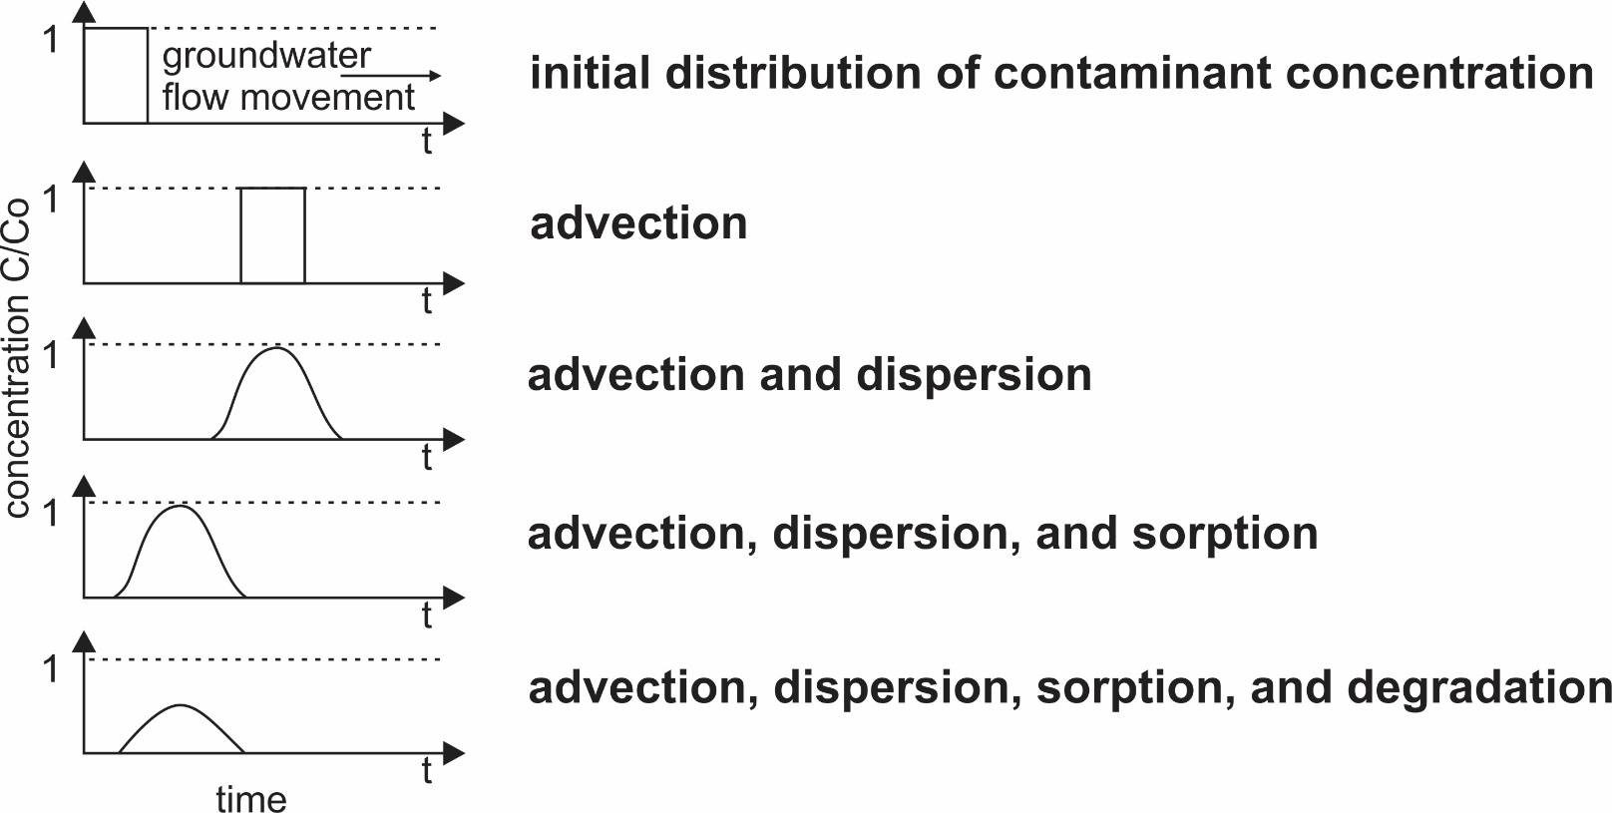
Key natural attenuation processes of petroleum hydrocarbons in non-karst aquifers
Natural attenuation of petroleum hydrocarbons in sediments and groundwater include: biodegradation, dispersion, sorption, advection, dilution, volatilization (Rifai et al., 1995);
Processes
Biodegradation: process where microorganisms are capable of utilizing petroleum hydrocarbons as a metabolic carbon source
Notes:
Different subsurface processes contribute to the reduction of groundwater contamination in non-karst environments.
It should be emphasized that biodegradation is the only process which leads to the destruction of the contamination. Other processes primarily affect the distribution of contaminants in the aquifer.
Advection will cause the plume to be displaced in the direction of groundwater flow movement. Dispersion leads to the plume shrinking. Sorption leads to the retardation of the plume movement. The destructive impact of biodegradation on petroleum hydrocarbons is obvious!
This is a consequence of the fact that naturally present microbes in the subsurface are using hydrocarbons as a metabolic source of carbon!

Slide 5
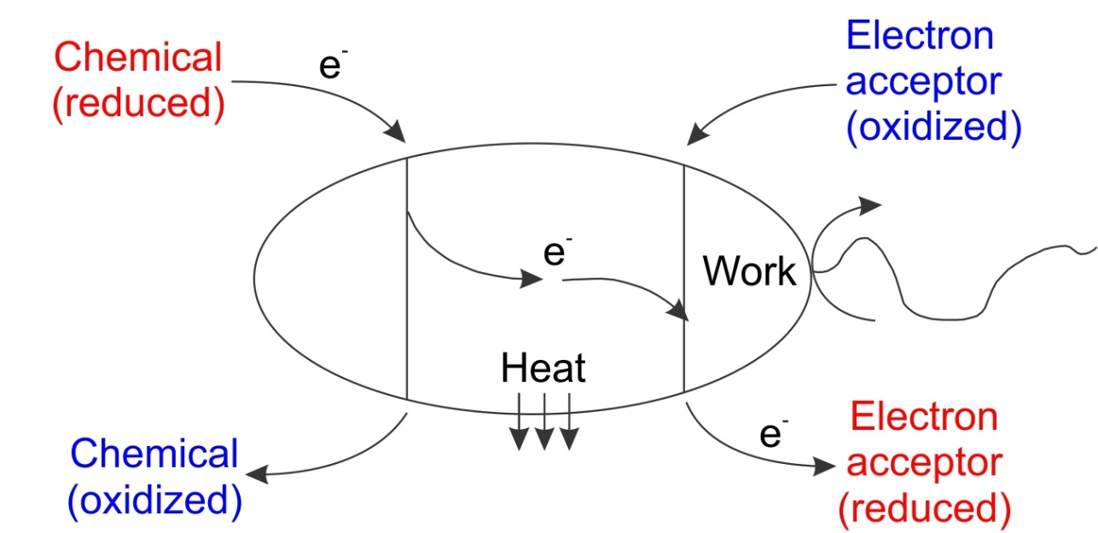
Biodegradation as natural attenuation mechanism
Generalized biodegradation equation (Wiedermeier et al. 1999):
microorganisms
+
electron donor
+
electron acceptor
+
nutrients
fuel molecule
(electron donor)
1
metabolic by-products
+
energy
+
microorganisms
electron acceptor
(O₂, NO₃⁻, Mn⁴⁺,
Fe³⁺, SO₄ ²⁻, HCO₃⁻)
3
2
fuel molecule oxidation coupled with reduction of electron accpetor
Bacterial oxidation of fuel molecules (Alvarez and Illman, 2006)
Notes:
As you can see, for the biodegradation occurrence – the presence of microbes, electron donors, electron acceptors, and nutrients is required. As a result of biodegradation, metabolic products, energy and new microbes are produced.
In the classical case, hydrocarbons represent an electron donor, while acceptors represent inorganic compounds which receive electrons.
Thus, microbes couple the oxidation of the contaminant with the reduction of electron acceptors, to use hydrocarbons as a source of energy.
As a consequence of electron transfer in this reaction, oxidation of the hydrocarbon occurs, while electron acceptors become reduced.

Slide 6
Fingerprints of hydrocarbon biodegradation in non-karst aquifers
1
Thermodynamic sequence of electron acceptor utilization (Alvarez and Illman, 2006):
→
→
O₂ NO₃⁻ Mn⁴⁺ Fe³⁺ SO₄ ²⁻ HCO₃-
→
→
→
2
Sequence of biodegradradation mechanisms occurence in groundwater:
aerobic
respiration
Mn (IV)
reduction
Fe (III)
reduction
sulfate
reduction
→
denitrification
→
→
→
→
methanogenesis
Oxic
groundwater redox conditions
Anoxic
3
Biodegradation mechanism | Reaction | Effect
aerobic respiration |  | O₂
denitrification |  | NO₃⁻
reduction of manganese (IV) |  | Mn
reduction of iron (III) |  | Fe
sulfate reduction |  | SO₄²⁻
Expected impact
Main biodegradation mechanisms and their expected impact on groundwater hydrochemistry
Notes:
A classic sequence of electron acceptor reduction is following: dissolved oxygen, nitrate, manganese (IV), iron (III), sulfate, and bicarbonate. This sequence of utilization is a consequence of the energy which microbes gain using these electron acceptors.
Dissolved oxygen is a primary electron acceptor, since microbes gain the highest amount of energy by its reduction– this process is called aerobic respiration.
After the reduction of dissolved oxygen, the next most-favorable available electron acceptor are nitrates. After the reduction of nitrate, manganese (IV) will be reduced.
Thus, mechanisms of biodegradation occur in the following sequence: aerobic respiration, to methanogenesis.
Here are expected fingerprints in hydrochemistry of groundwater contaminated by hydrocarbons. Oxygen concentrations are expected to decrease, due to oxygen reduction during aerobic respiration. A similar trend can be expected for nitrate and sulfate, a decrease in their concentration due to the reduction. On the other hand, manganese and iron concentrations are expected to increase due to their reduction from insoluble manganese (IV) and iron (III) to soluble forms in groundwater.

Slide 7
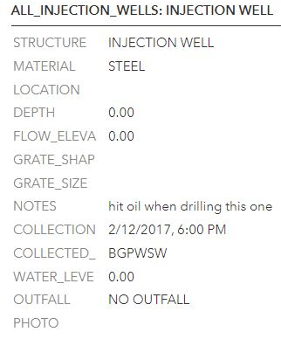
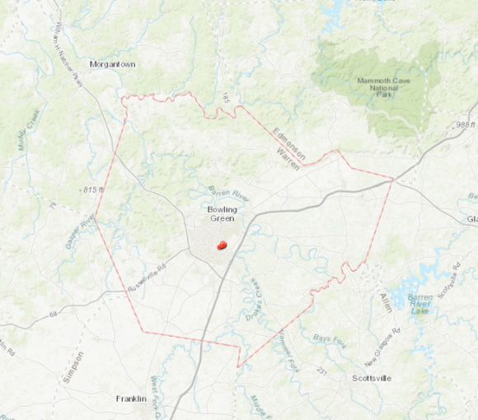
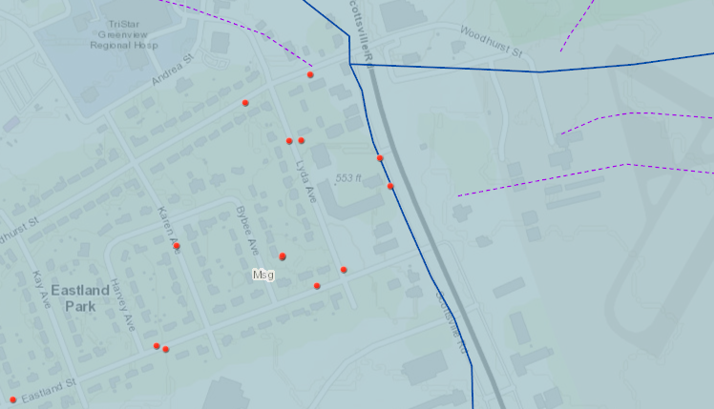
Study area: Lyda Well-1
Results
Natural seep
of hydrocarbons
Base water level
depth around 50 feet
Lyda Well-1
Notes:
The Lyda Well site is located in Warren County, Bowling Green. According to the available reports, this injection well hit the natural hydrocarbon seep during the drilling.
During the study we can confirm that there is a constant source of hydrocarbons in the well. Some 12 wells are located in the same drainage basin. Water flow directions determined by dye tracing are shown in purple.
Surface of the study site is made of Upper Mississippian St. Genevieve limestones. The depth of water level in baseflow conditions in around 50 ft.
The overall well depth is unknown, it is highly likely that it reaches St. Louis limestones.
So let get a closer look at this well!

Slide 8
Lyda Well-1: closer look
Under BGKY Injection Well Series
Ep: Lyda Avenue Well
Captured by James Troxell
uncased well in limestone
permeable carbonate rocks with chert layers
Notes:
So lets enjoy this subsurface tour! We have seen this is an uncased well in permeable limestones with some occurrence of chert.

Slide 9
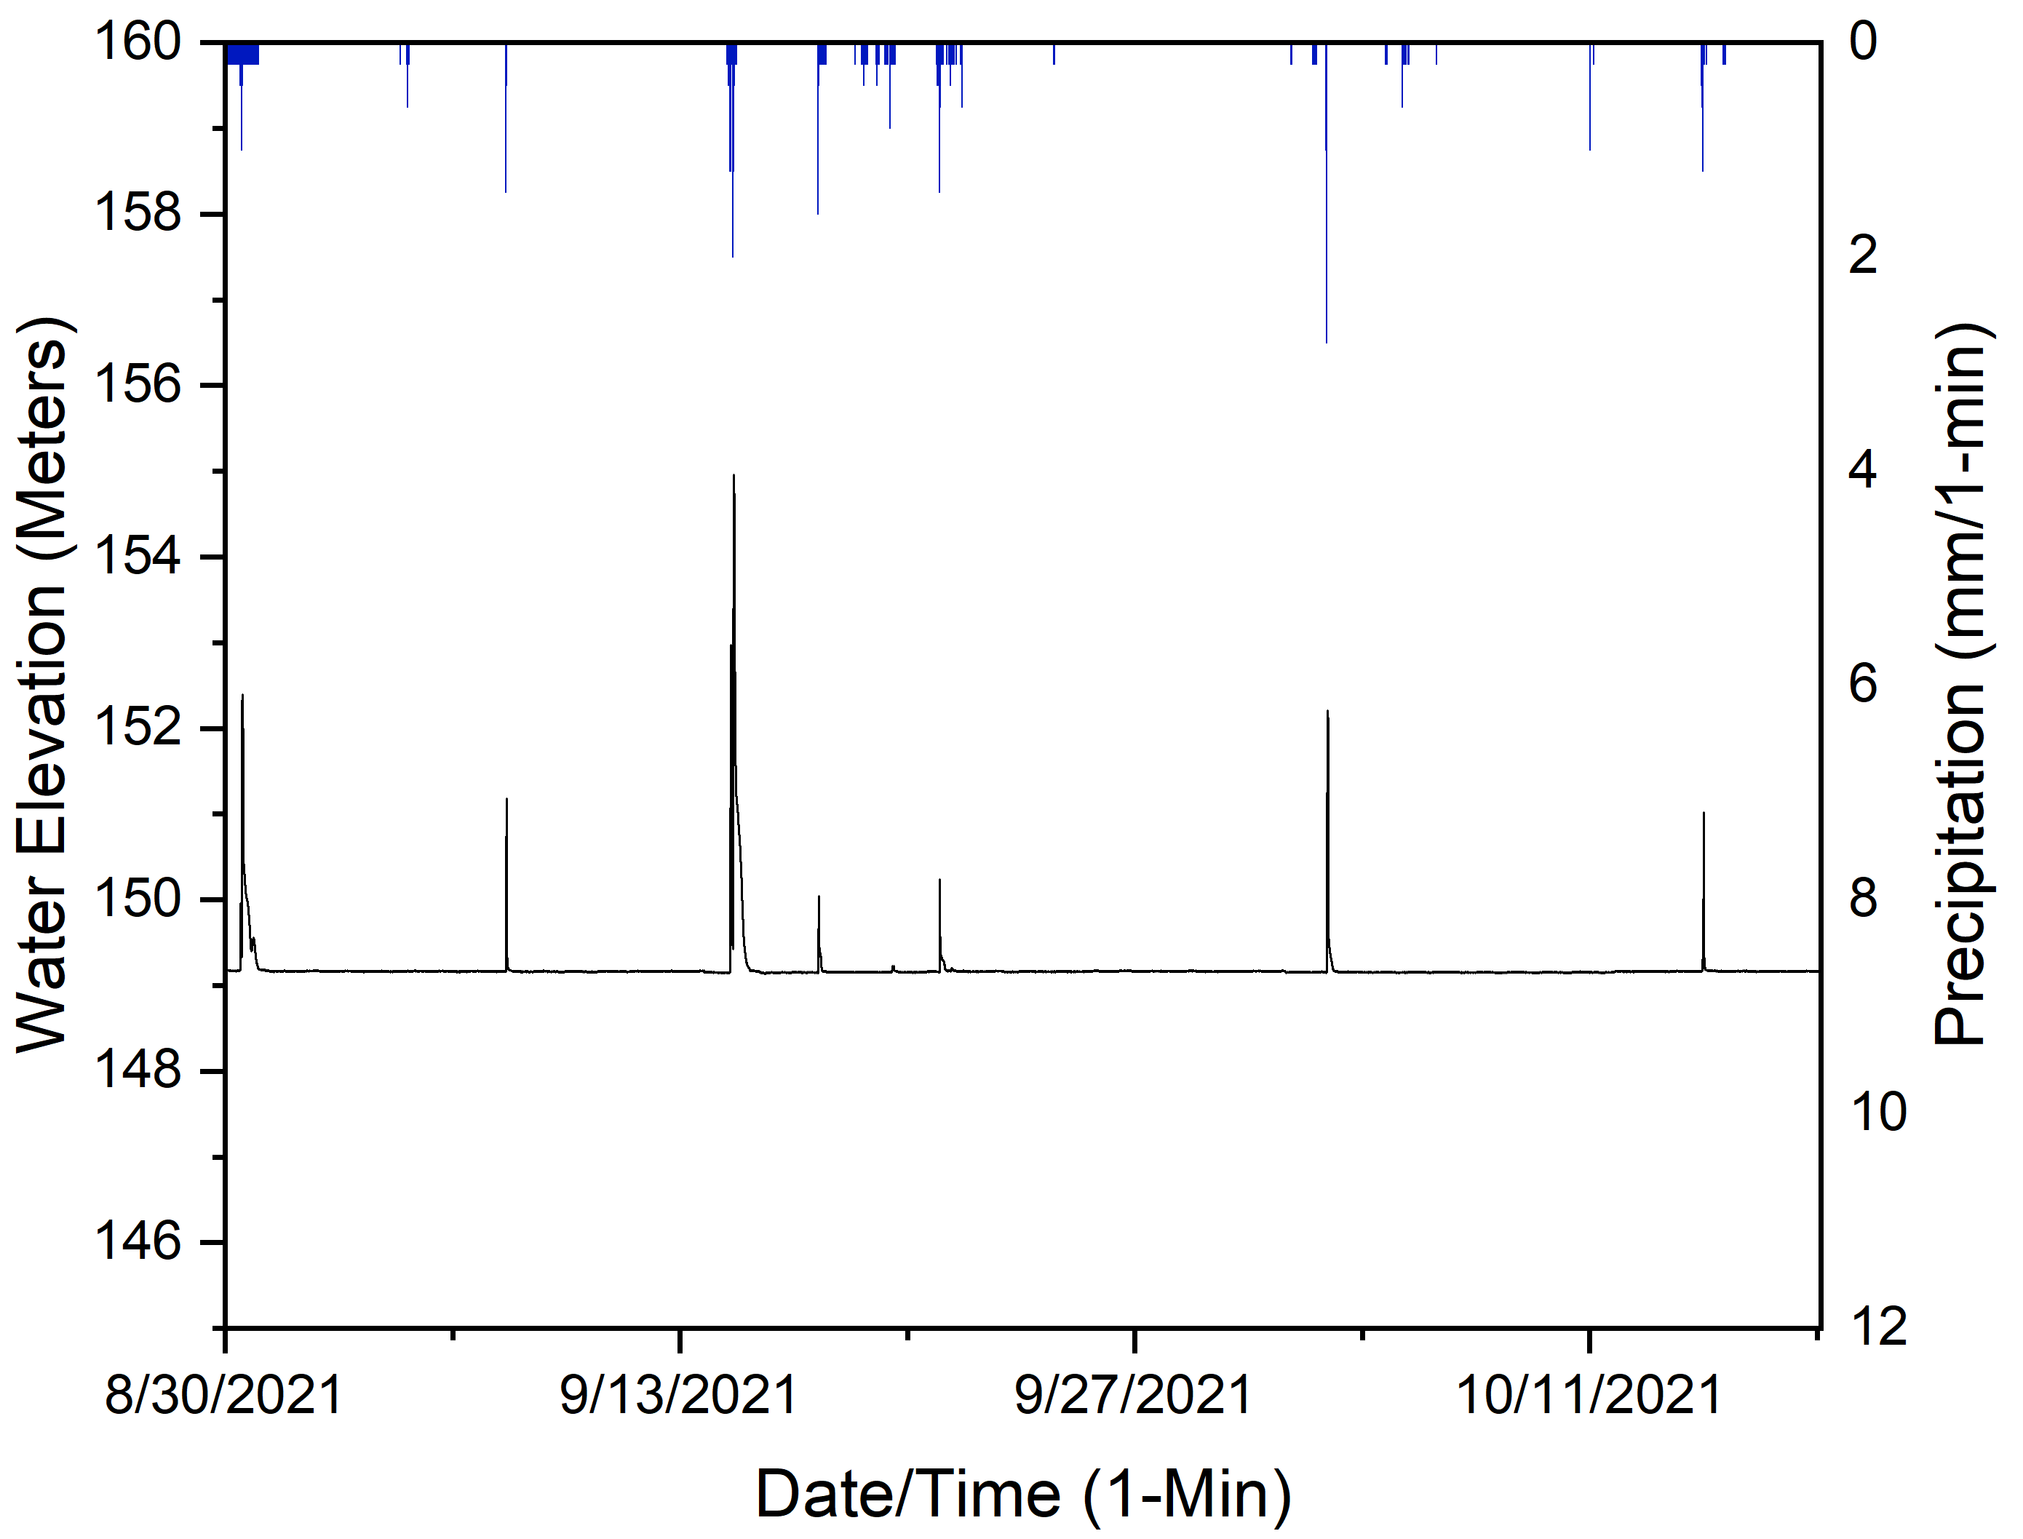
Hydrology of Lyda Well-1
Analysis
continuous monitoring of water levels/precipitation (1 min resolution)
quick response of the system on recharge events
Notes:
Before making any conclusions about the groundwater quality, we need to get some insight into the hydrology of this system.
Continuous monitoring of water level elevations and precipitation has been conducted at 1 min resolution.
Without doubt, that this is an active flowing system, which quickly responds to the recharge events.
Precipitation events are followed by almost immediate rise of water level in the well.
Thus, this is an active karst system, and observed changes in chemistry can be analyzed in that context.

Slide 10
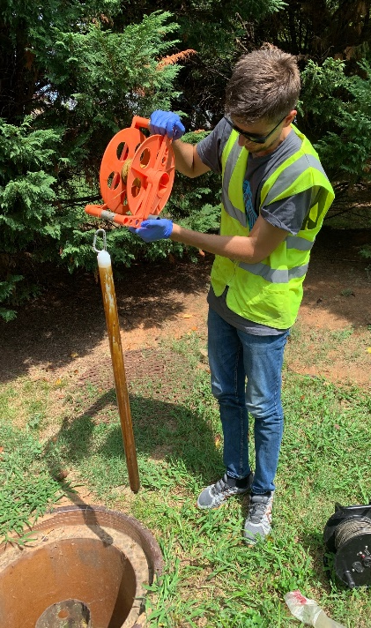
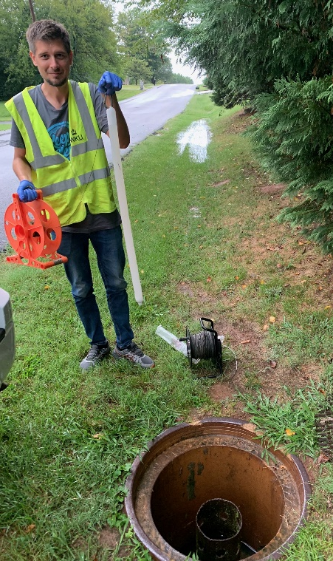
Hydrochemistry of groundwater from Lyda Well-1
freshwater recharge
occurrence of flushing
shift towards the uncontaminated conditions
changes of biodegradation-sensitive parameters
Analysis
Notes:
Two sampling campaigns were conducted before and after rainfall event on August 14. (17 mm of precipitation in a less than an hour).
This rainfall event caused the flushing of the well, and concentrations of total petroleum hydrocarbons in groundwater decreased from an initial 20.4 mg/l to <1.4 mg/l after the rainfall event. The occurrence of well flushing has been confirmed both quantitatively and visually on the sampling bailer.
This recharge event caused a shift towards uncontaminated conditions provided insight into hydrochemistry of hydrocarbon-contaminated groundwater.

Slide 11
Hydrochemistry of groundwater from Lyda Well-1
Lyda Well-1 hydrochemistry before/after rainfall event
Analysis
Sampling/ Rainfall event 08/14/21 | TPH (mg/L) | O₂ (mg/L) | NO₃ (mg/L) | Mn (mg/L) | Fe (mg/L) | SO₄ (mg/L)
Before | 20.4 | 3.14 | 1.19 | 0.35 | 2.6 | 7.42
After | <1.4 | 5.02 | 4.45 | 0.12 | 0.88 | 7.23
Main biodegradation mechanisms and their expected impact on groundwater hydrochemistry in non-karst settings
Biodegradation mechanism | Reaction | Effect
aerobic respiration |  | O₂
denitrification |  | NO₃⁻
reduction of manganese (IV) |  | Mn
reduction of iron (III) |  | Fe
sulfate reduction |  | SO₄²⁻
decreased content of O₂ and NO₃ (electron acceptors),
increased concentrations of Mn and Fe (metabolic products of biodegradation),
SO₄ concentrations stayed stable - biodegradation didn’t reach the sulfate-reducing mechanism
Notes:
The groundwater before the rainfall event was characterized by:
decreased concentrations of O₂ which corresponds to the aerobic respiration impact in non-karst settings
decreased concentrations of NO₃ which corresponds to the denitrification impact in non-karst settings
concentrations of Mn were increased likely caused by the reduction of manganese (IV) impact to soluble forms
and increased concentrations of iron due to their reduction from insoluble iron (III) to soluble forms
It seems reasonable to assume that biodegradation didn’t reach sulfate reduction, since sulfate concentrations stayed were similar before and after of freshwater recharge

Slide 12
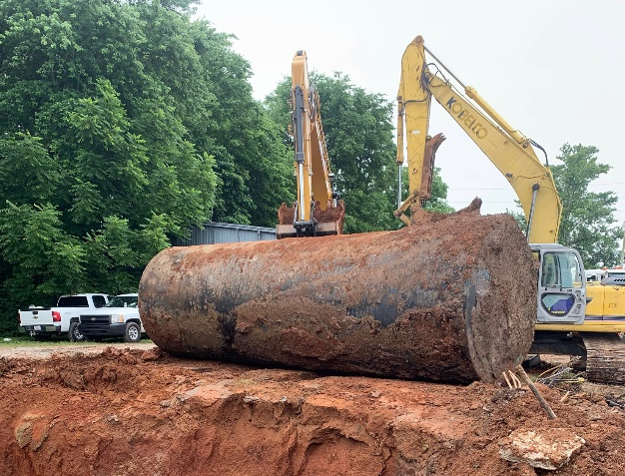
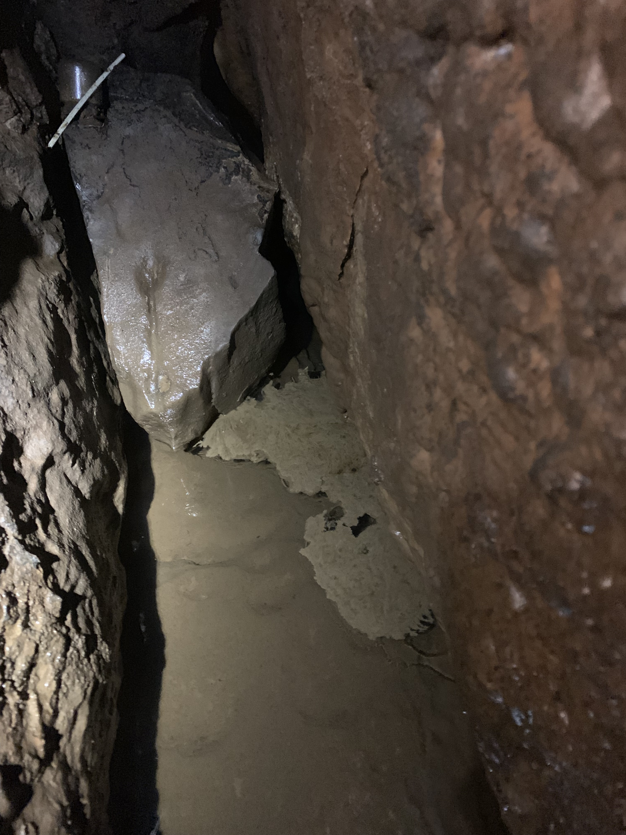
Similar observations about natural attenuation in karst
2019 Gasoline Fumes at Lost Rive Cave System
2
1
Bulk Plant reservoir removal
2021 Pit Stop Cave – recovered from contamination
Pit Stop Cave
3
Pit Stop Cave
“Slightly weather gasoline”
based on EPA analysis
Pit Stop Cave
Notes:
Similar observations were made on a larger scale in the Lost River Cave System, which was contaminated in 2019.
The highest concentrations of dissolved hydrocarbons, along with free phase product were discovered at the Pit Stop Cave. The potential source of contamination in the vicinity of the this cave has been removed in 2019.
In May 2021, the results of groundwater/soil sampling confirmed that cave completely recovered from the contamination. Traces of hydrocarbons in three analyzed samples were bellow detection limit.
Considering the impact of flushing on the Lyda Well, these results from Pit Stop somehow reflect similar concept, occurrence of natural attenuation.

Slide 13
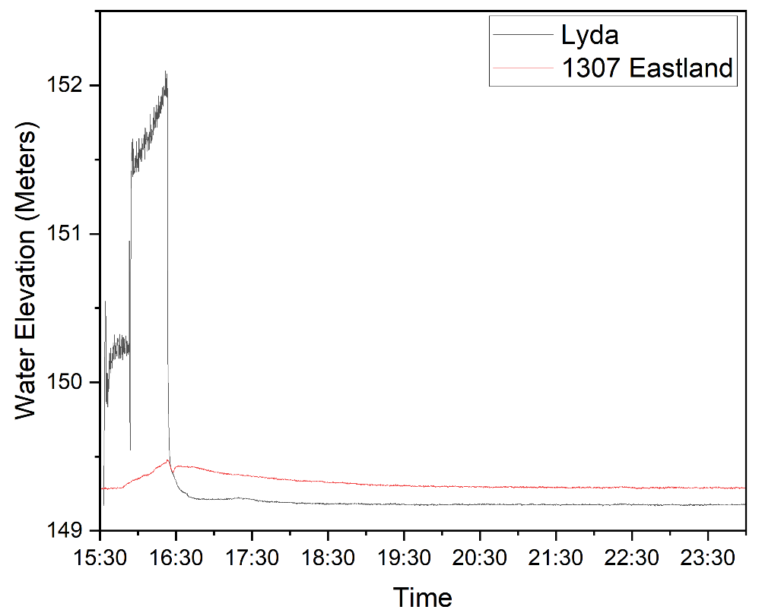
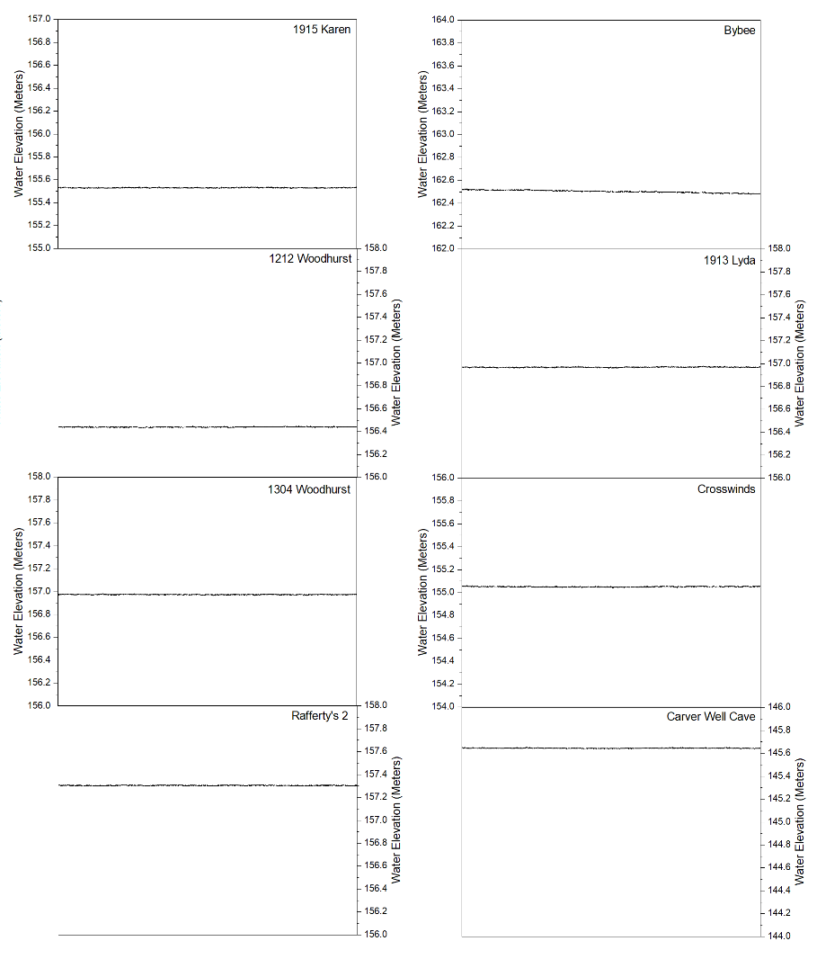
Further research activities
Hydrologic test conducted on 10/21/2021:
8000 gal/hour injected at Lyda Well-1
water table response monitored at 13 wells
direct response – connection confirmed at 1 well (1307 Eastland)
Expanding the research activities -3 well natural attenuation study:
Microbiology analysis
Biochemical analysis
Isotopic analysis
Notes:
This is an ongoing study, and 2 weeks ago hydrologic test has been conducted aiming to determine which wells are connected to the hydrocarbon-contaminated well.
About 8 thousands gallons of water were injected in 1 hour in this well, causing almost 10 feet of water table rise. Water table responses were monitored at 1 min resolution at the 12 other injection wells within this drainage basin.
Direct response – hydrologic connection (similar trend of water table) was confirmed at the closest well (Eastland street).
Further activities include making this research a 3-well study (2 connected wells and 1 pristine well within the same limestone formation).
Besides geochemistry, microbiological, biochemical, and isotopic analysis will be conducted.

Slide 14
Acknowledgments
Thank you!
Notes:
Since this is an ongoing study, your feedback is highly appreciated.
Thank you!

